Slide 1
Visualization of Oil Displacement by Foam in Porous Media Micromodels
Charles Conn, Kun Ma, George Hirasaki, Sibani Lisa Biswal
Rice University, Chemical and Biomolecular Engineering
Rice Porous Media Consortium Meeting 2013
April 29th, 2013
Notes:
Good morning. My name is Charles Conn – I’m a PhD student working with Dr. Biswal. Today I’ll be presenting some of my research on micromodel visualization of foam displacing oil.

Slide 2
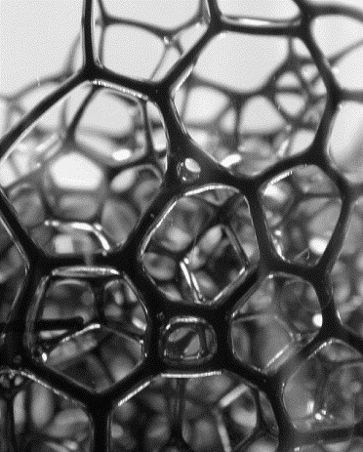
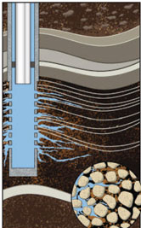
Motivation
2
Challenges in gas flooding – premature gas breakthrough, channeling through high-permeability regions, fingering due to low viscosity
Possible Solution: Foam
Applications in enhanced/improved oil recovery (EOR/IOR) and
CO₂ sequestration
Questions:
How does foam transition from a fracture to the matrix?
How does foam gas fraction and texture
(bubble size) change in porous media?
Source: Vikingstad, Skauge (2005); adapted from Hanssen, Surguchev (1995); epmag.com
Notes:
So, “Why do we care about foam?”
I use micromodels to help address some of these questions
Hanssen J.E., Surguchev L.M. (1995). A Norwegian Research Program On Improved Oil Recovery 41(5): 205-220.

Slide 3
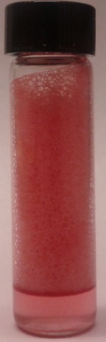
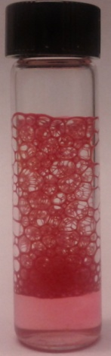
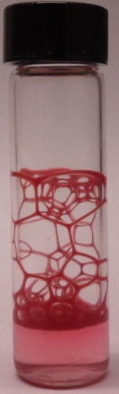

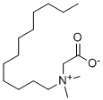
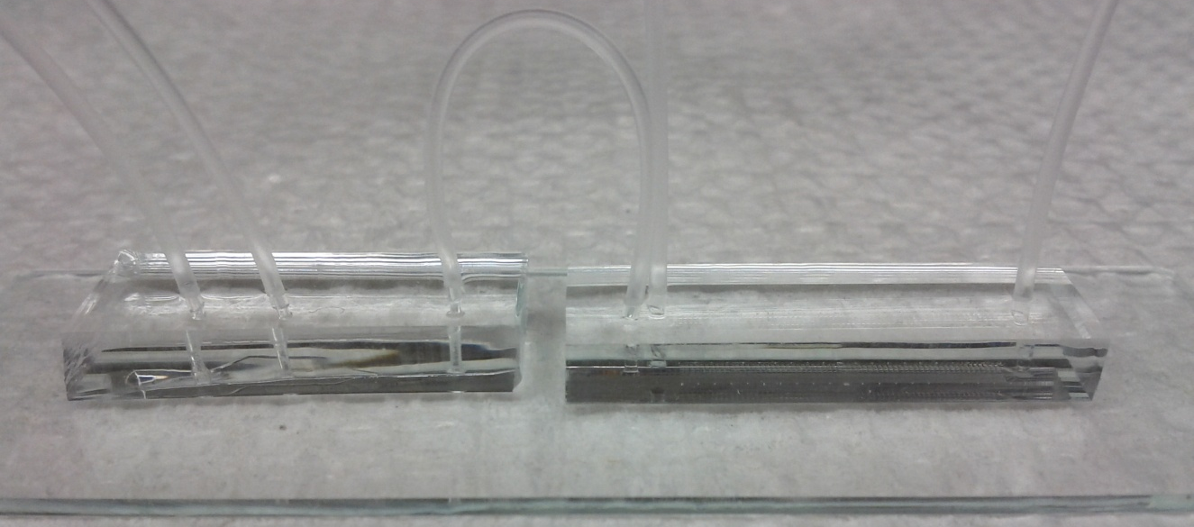
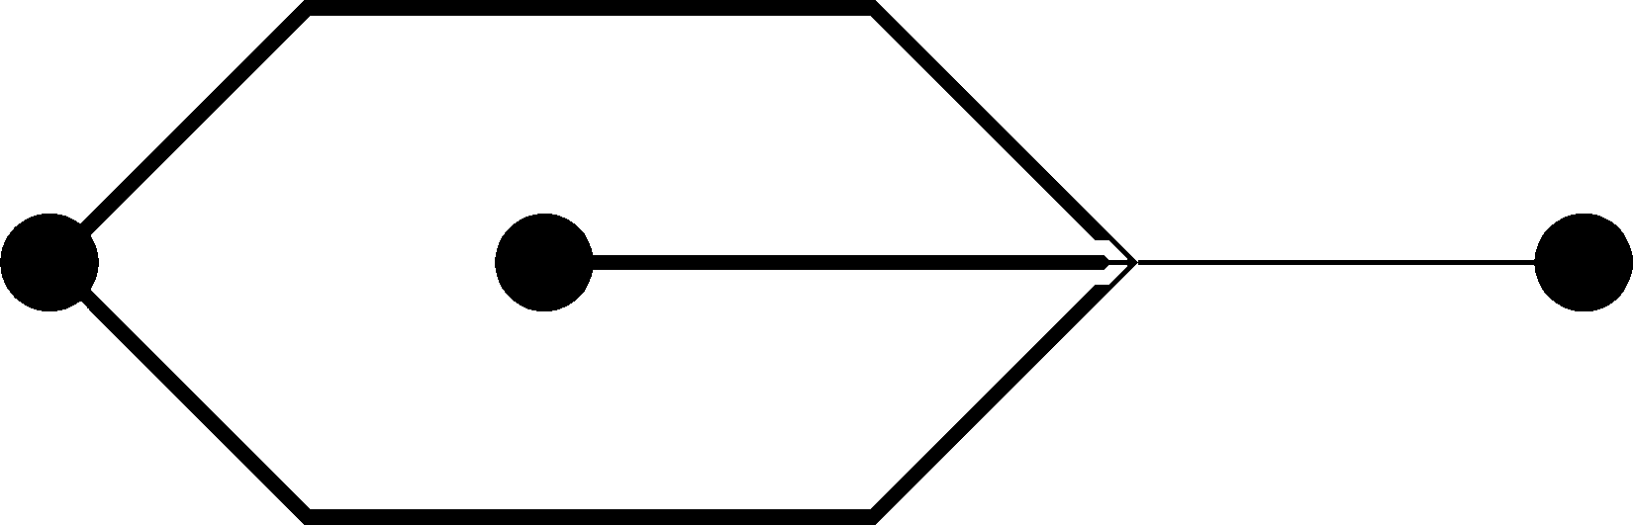
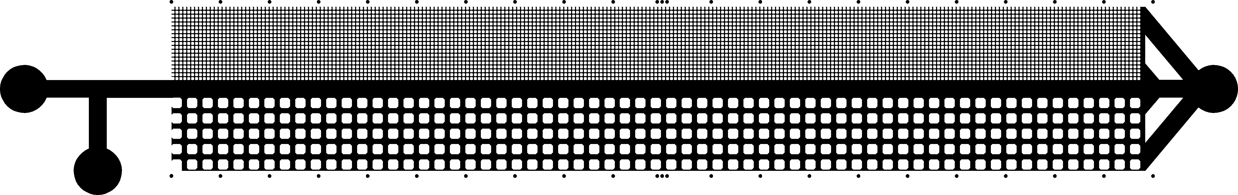
Experimental Design
3
SURFACTANT
OIL
0 hr
4 hr
22 hr
AOS 1%
AOS C14-16
NaCl 2.5%
GAS
Paraffin Oil
25 cP
MATERIALS
1:1 ratio
Air
LB 1%
lauryl betaine
NaCl 2.5%
Oil Red O
foams w/oil
PDMS (water-wet)
PDMS (oil-wet)
FOAM GENERATOR POROUS MICROMODEL
PDMS-coated microscope slide
GAS & SURFACTANT
FOAM
WASTE
Source: Conn et al, in preparation
Notes:
Let me first give you some background information about my experimental setup. I’m using a moderately viscous paraffin oil that I dye red to better visualize. I use paraffin oil because PDMS micromodels will swell with short-chain alkanes or small molecule hydrocarbons. I generate a foam using air and a surfactant blend of AOS and lauryl betaine. AOS is an anionic surfactant and lauryl betaine is zwitterionic. The salinity is adjusted with sodium chloride to the same ionic strength as seawater. This blend is used because it can make a stable foam in the presence of my model oil.
Here are some pictures of a shake-test with this surfactant blend and oil (in red). You can see the foam lamellae remain intact over a long period of time. My experiments last only a few minutes so I get stable bubbles, even in the presence of oil.
The basic schematic of my experiments is shown at the bottom. I have two PDMS microfluidic devices – one generates the foam, which then flows through a connector tube to the porous media micromodel. I use two devices because the foam-generator needs to be water-wet and the micromodel in these experiments is oil-wet.
Why surfactant blend? Anionic, Zwitterionic
Why two devices? PDMS wettability
“moderately viscous” oil, non-swelling, 10:1 ratio base elatomer:cross-linker

Slide 4

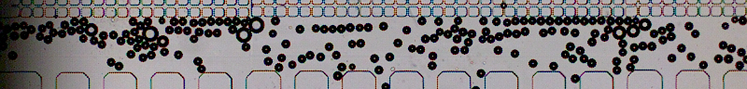

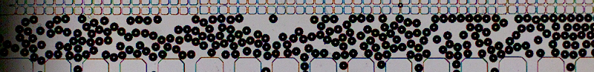


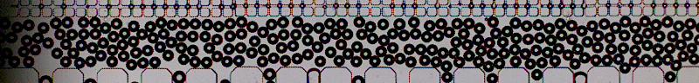
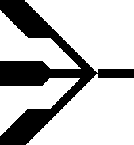

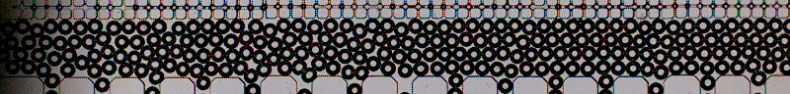
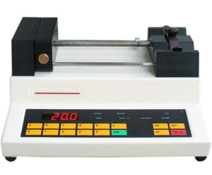


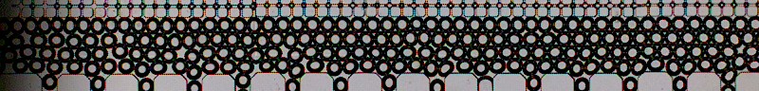

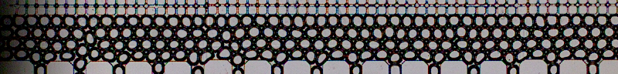



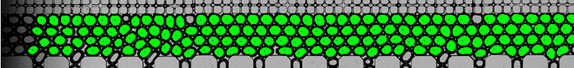


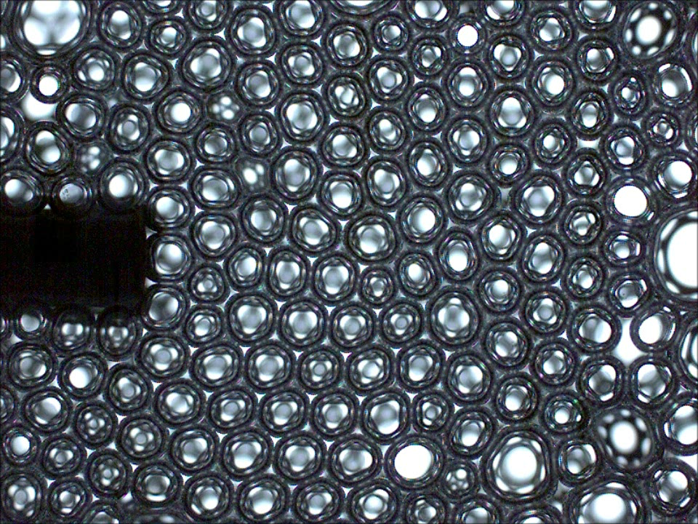
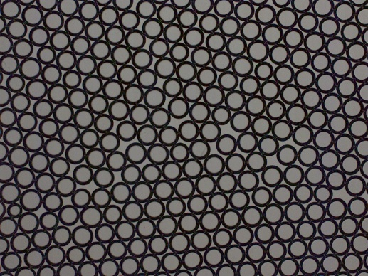
Flow-Focusing Bubble Generator
4
water-wet
GAS
SURFACTANT
syringe pump &
pressure regulator
Abundant microfluidics literature &
published work
Tunable gas fraction/foam texture by
adjusting flow rate & pressure
Highly repeatable and monodisperse
bubbles
Source: Conn et al, in preparation
Notes:
I’m using a flow-focusing design for the foam generator. In the microfluidics field, flow-focusing designs are used to make bubbles and droplets for things like drug screening, crystalization, and microreactors. The confined geometry of microfluidics devices allows for precise tuning of bubble size and gives excellent monodispersity. Flow-focusing works by squeezing the gas stream through a small orifice with surfactant solution so that bubbles pinch off the other side.
In the middle is a close-up of the flow-focusing geometry. Gas is injected using a pressure regulator and surfactant solution is supplied via a syringe pump.
At the bottom right you can see high-speed videos taken at over 8000 fps for different gas pressures.
At the top right you can see how changing the injection pressure and flow-rate can alter the foam gas fraction and bubble size. The first set shows a close-up of what happens when you decrease the liquid flow rate at a constant gas pressure. The second set shows the central fracture of my micromodel with different gas pressures at a constant flow-rate.
You can see this approach to foam generation offers a great deal of control over foam texture and gas-fraction.

Slide 5
Porous Media Micromodel
5
Sweep
oil-wet
Injection
Production
Oil pre-flood
Pre-flood drain
Camera view
1 mm
Bottom-up design of 2D porous media including fractures
“Fracture” – comparatively high permeability
Tunable wettability via PDMS
Channel Depth: 50 microns
Porosity: 0.42 (high-perm), 0.53 (low-perm)
Permeability contrast: 9.44
LOW-PERM
FRACTURE
HIGH-PERM
1 mm
Source: Conn et al, in preparation
Notes:
PDMS is nice because it allows for rapid-prototyping of microfluidic devices. You can design a pattern on the computer using AutoCAD (or even MS Paint) and have a fully-fabricated device in a few hours. If you’re smart you can make a set of redundant designs and prepare a batch of identical experiments for the next day.
We are able to design 2D porous media at the pore-scale, with resolution down to about 5-10 microns. This pattern I’m showing you today includes a central straight fracture with a low-permeable and high-permeable porous matrix on either side. I would say each porous matrix is a ‘homogeneous’ square lattice, but the entire model is heterogeneous in that it includes different regions with different permeability. The entire device is only about 3 cm long, and its width was designed to match the field-of-view of our microscope camera at 4x.
Prior to the experiment, these devices are pre-flooded with paraffin oil to make the PDMS oil-wet. Foam is later injected at the left inlet and both oil and foam flow out the drain for several minutes until the system stabilizes. Then the drain is clamped and the foam sweeps and displaced oil from left to right.

Slide 6
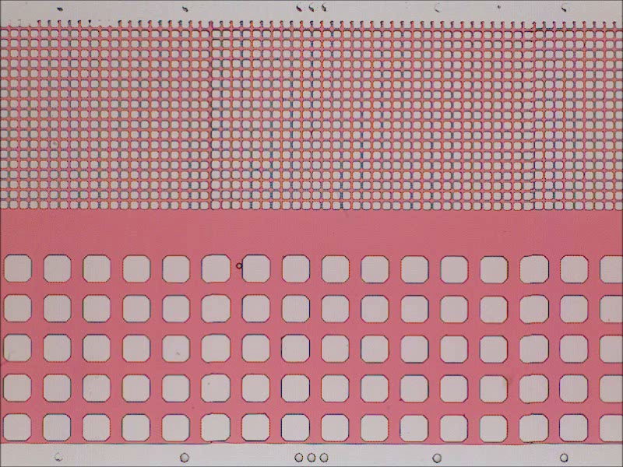
WATER FLOOD VIDEO
6
0.1 mL/hr | red = oil | white = PDMS or water
4x objective; 1 mm
Notes:
Here is an example of what you would see under the microscope. The pink areas are oil, and the white areas are PDMS posts representing solid grains in porous media.
Now as I play this video you will see water enter from the left side and sweep through the fracture. You can see it completely displaces all the oil in the fracture, but barely enters the high-perm region and doesn’t enter the low-perm region at all. Now all the water is channeling through the fracture and bypassing adjacent trapped oil.
If I were to increase the injection flow-rate you would see more water enter the high-perm region. If I increased the pressure high enough I might be able to enter the low-perm region, but it would be very difficult.

Slide 7
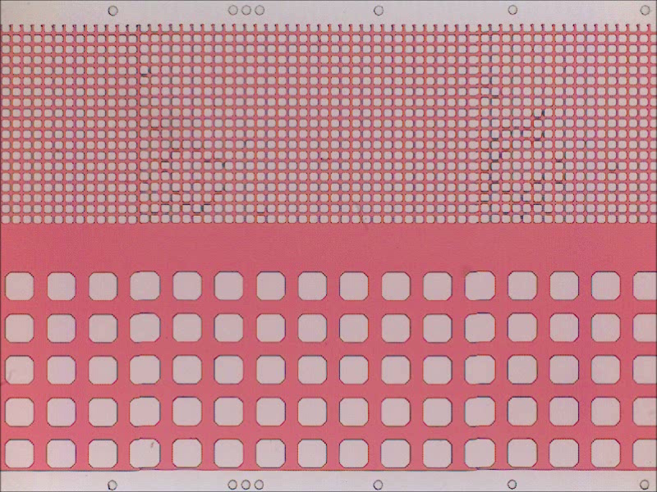
GAS FLOOD VIDEO
7
300 mbar| red = oil | white = PDMS or air
4x objective; 1 mm
Notes:
Now we have an example of a gas flood. At first you can see the gas quickly zip through the fracture. Since this gas pressure has a higher pressure-drop compared to the previous water-flood it streams through the high-perm region. However, you still see a lot of oil being bypassed as the low-viscosity oil channels through paths of least-resistance.

Slide 8
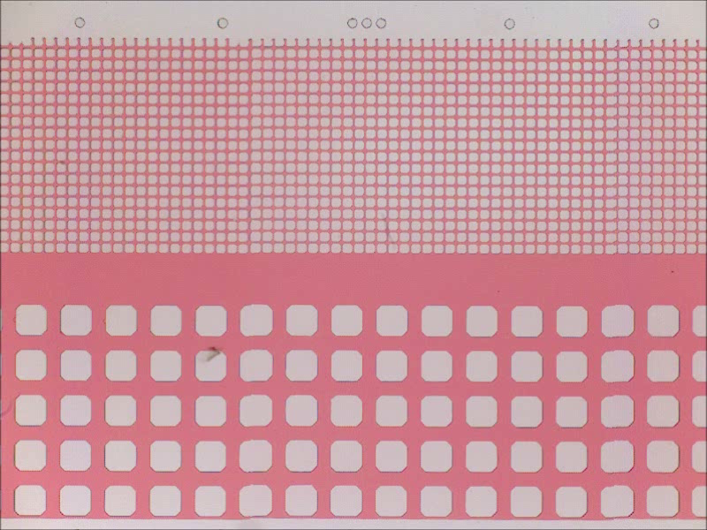
FOAM FLOOD VIDEO
8
0.1 mL/hr, 300 mbar | red = oil | white = PDMS, water, or air
4x objective; 1 mm
Notes:
Here we have a foam flood. It is a combination of the previous two injection conditions: water flow-rate and injected gas pressure. You see that the foam quickly sweeps the fracture, as in the other two cases, but even before the foam front reaches the edge of the screen you see it invading into the high-perm region. All of the oil is quickly displaced except at the bottom, here.
Since we’re looking at the middle of the micromodel, we can’t see what’s occurring off-screen, but in a second you’ll start to see surfactant solution invading the low-perm region. You can see that these bubbles are smaller than the pore throats in the high-perm region; we’re currently asking questions like, “What would happen if the bubbles were larger than the pore size? What effect would that have?”
Now you can see surfactant solution start to creep in.
If you notice, there are still some pockets of trapped oil.

Slide 9
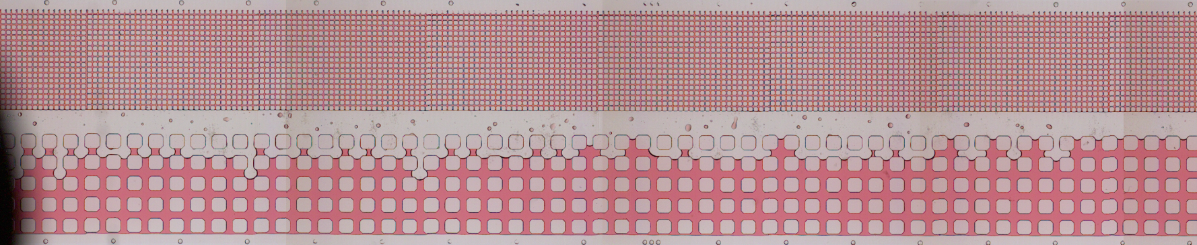
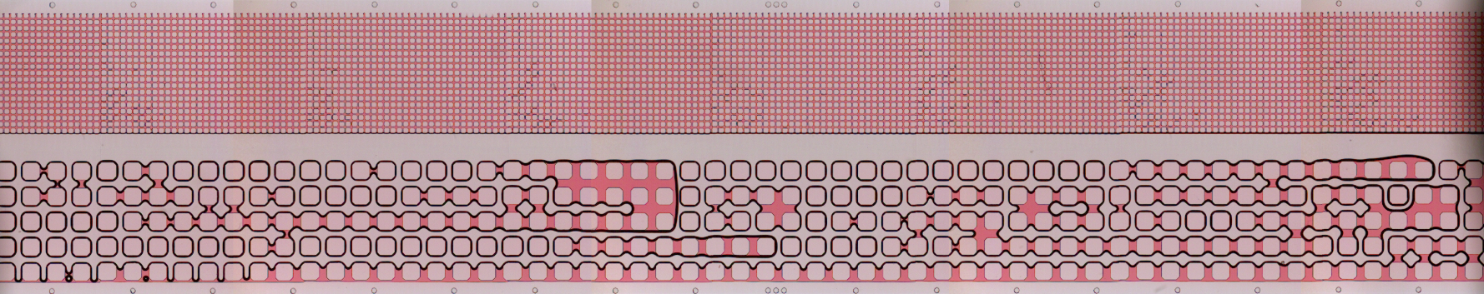
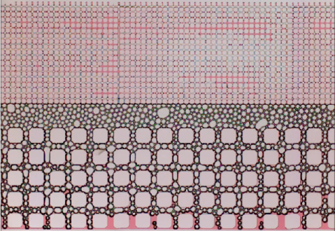
MICROMODEL OVERVIEW
9
red = oil | white = PDMS, water, or air
1 mm
WATER
FLOOD
1 mm
GAS
FLOOD
FOAM
FLOOD
Source: Conn et al, in preparation
Notes:
Now, at the end of the experiments, if we take a survey of the entire micromodel, we see that in water flood we’re basically just channeling through the fracture. In the gas flood we also channel through the fracture, but since we’re at a higher pressure we can push into the high-perm region. In neither the water-flood nor the gas-flood were we able to displace any oil from the low-perm region.
With foam, however, we were able to displace much of the oil from the low-perm matrix.

Slide 10
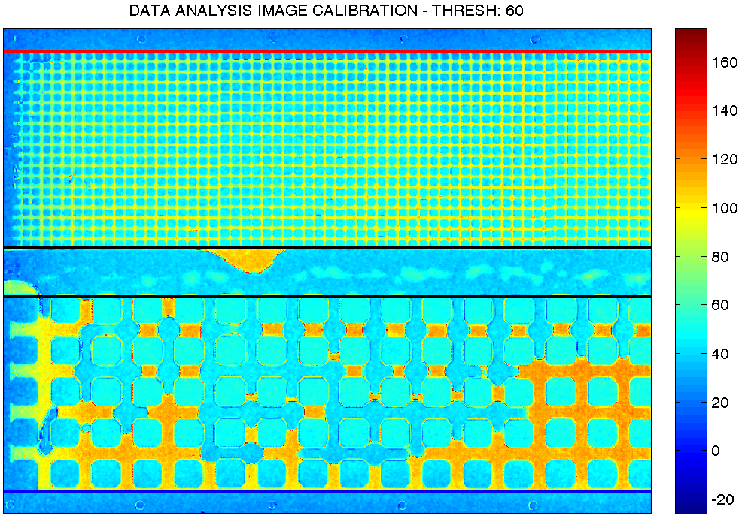
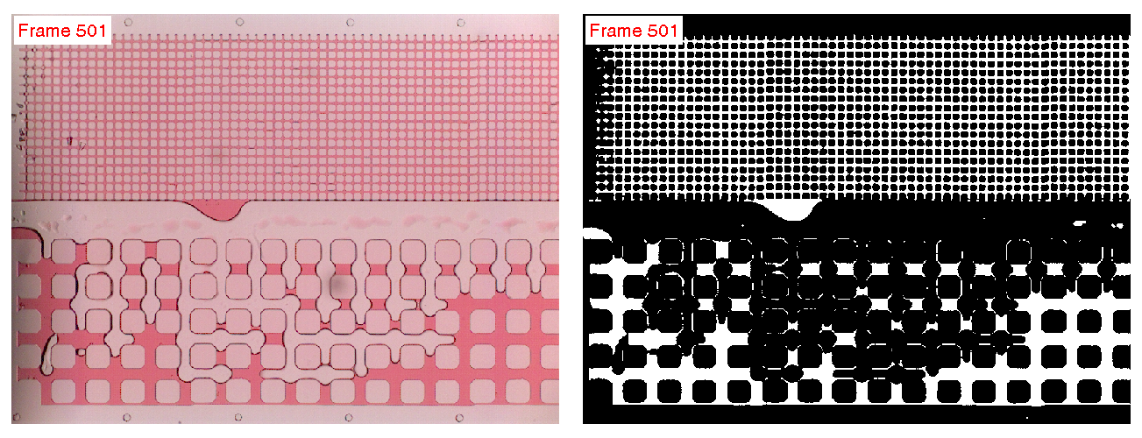
Data Processing
10
Low-perm
High-perm
Total
Fracture
Define low-perm, high-perm, and fracture regions
Identify red pixels (oil) via color threshold
Calculate oil saturation for each region
Source: Conn et al, in preparation
Notes:
So how can we analyze this data?
First of all, we record a video of the sweep. Then I take that video and run some image-processing code I wrote that defines the fracture, low-perm, and high-perm regions, and identifies the regions with oil. I run this code for each frame in the video, and if I normalize the oil saturation to the original oil-in-place, I can plot how each region is swept over time.
For example, the green line here indicates oil in the fracture is quickly swept out, while oil in the low-perm region takes longer to sweep and reach a steady saturation. Additionally, the added benefit of micromodels is that instead of just getting a total amount of recovered oil – which would be just this black line – we instead can see exactly from which region the oil was displaced.

Slide 11
Micromodel Results
11
0.1 mL/hr
300 mbar
0.1 mL/hr, 300 mbar
In all floods, oil in the fracture displaces completely
High-perm region displaces best with foam
Oil in the low-perm region only mobilizes with foam
Total oil recovery improves with displaced low-perm oil
Source: Conn et al, in preparation
Notes:
So, if we take the final end-saturations from each of these experiments, this is what we get. We see that in each case the fracture is completely displaced. The high-perm region is best-displaced with foam. However the gas flood displaced more than the water flood – “Why is that?” Well, these comparisons are for a given set of injection conditions, and in this case the gas pressure drop was higher than in the water injection.
We might also note that in these results we can see the relationship between the total oil displaced and the region from which it mobilized. Traditional experiments would tell you displaced a certain amount of oil, but it’s more difficult to say where exactly that oil came from – especially in more heterogeneous systems with fractures and a distribution of pore sizes where you have to estimate the volume of oil trapped at each pore size. This is certainly an idealized system but it’s nice to have more definitive proof that the oil was mobilized from a certain region.
Perhaps the most interesting result is that the low-perm region oil displacement is negligible in both the water flood and gas flood cases, but quite good in the foam flood.

Slide 12
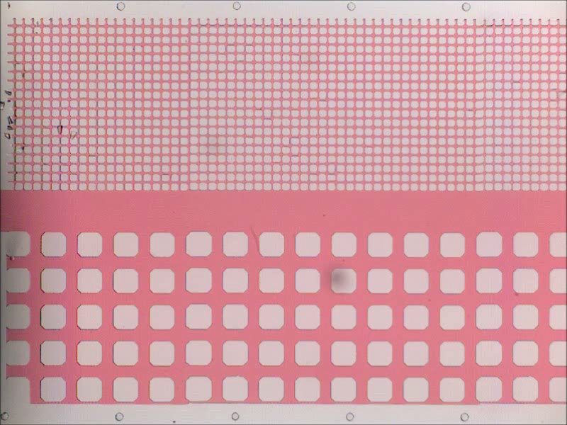
FOAM FLOOD: low-perm diversion
12
Notes:
So let’s ask the question, “How is oil mobilized from the low-perm region in these foam floods?”
Here is a video of a foam flood – like before – but instead of looking at the middle of the micromodel we’re going to look at the very beginning, where the foam first enters the system. At first you see foam enter the fracture and some of it diverts into the high-perm matrix. After a bit the bubbles jam the high-perm region and surfactant solution starts pushing into the low-perm matrix. We believe this happens because the highest pressure drop from the fracture into the matrix occurs at this point, and once the liquid enters this matrix it follows the pressure gradient downstream through the matrix itself.
So really what we see is the liquid entering the low-perm region at the beginning, then filtering through and displacing the oil through the low-perm matrix itself.

Slide 13
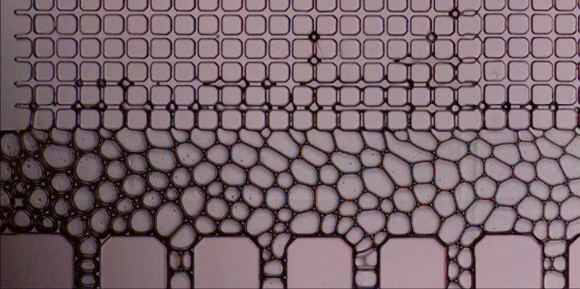
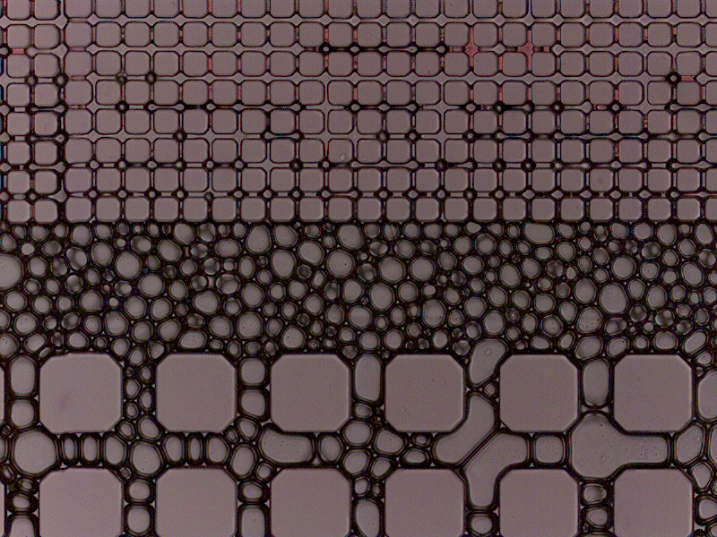
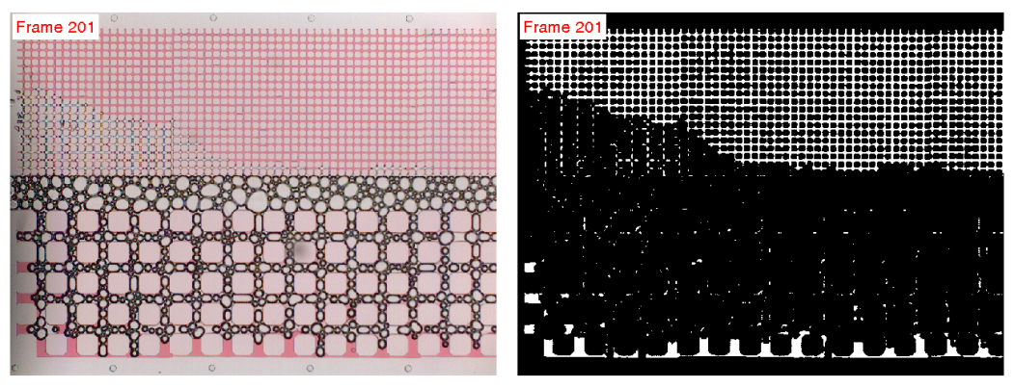
Discussion
13
Fluid selectivity
No gas in low-perm*
Oil mobilized by surfactant sol’n
in low-perm region
Capillary entry pressure
P_{ce, air} > P_{ce, aqueous}
Foam in porous media is not homogeneous in gas fraction or texture
Implications for reservoir modeling
Low-perm entry & foam drying
Liquid portion of foam diverted into low-perm
High gas pressure entry into low-perm
* Unless gas pressure is high!
Source: Conn et al, in preparation
Notes:
So what can we learn from these experiments? First of all, there’s no gas in the low-perm region, except at high pressures. The oil in the low-perm region is mobilized entirely by the liquid portion of the foam. Why does this happen?
In order to enter a pore throat a fluid must overcome the capillary entry pressure. If you imagine the curved interface in a pore throat between a displacing fluid and oil, the pressure needed to maintain that curvature is proportional to the interfacial tension, the wettability, and inversely proportional to the radius of the pore.
In this system, air has both a higher interfacial tension with oil and is less wetting – compared to the surfactant solution. This means a higher capillary pressure is needed to establish an interface in the pore throat. So, surfactant solution more easily enters the small pores compared to the gas at a given pressure gradient. It may also be the case that gas only enters small pores after surfactant solution has already invaded – because the capillary entry pressure of gas into surfactant solution is much easier than gas into oil.
Here we can see some examples of bubbles entering the low-perm region when the pressure is high enough. Also you can see the effect this fluid selectivity might have on foam quality – the liquid portion of the foam more readily enters the porous matrix, while foam in the fracture dries out. Look at the difference in lamellae at the beginning and end of this picture.
Micromodels allow us to see this effect of fluid selectivity, and show that foam in porous media is not necessarily homogeneous, and it may have implications in the modeling of foam floods in reservoir simulators.
Think: σ comparable or larger with gas, cos(θ) larger with gas if oil-wetting (water will wet surface more than gas)

Slide 14
Discussion
14
Direction of transport
Fluid enters low-perm at the beginning; biggest ΔP into matrix
Oil displaces through the porous matrix (not into fracture) by the liquid portion of the foam
This may be because the fracture is parallel to the pressure gradient across the micromodel
● surfactant solution
Notes:
Some people like to think of foam first invading the fracture, then pushing out into the surrounding matrix, but in my experiments this wasn’t the case.
Fluid enters into the porous matrix at the beginning of the fracture, where there’s the biggest pressure drop from the fracture into the matrix, and then percolates through the matrix itself.
Now, this might be because in this case the fracture in parallel to the pressure gradient, so downstream all the pressure gradients in the matrix are parallel to the fracture. In future experiments we might change the orientation of the fracture and see what effect that has on fluid transport.

Slide 15
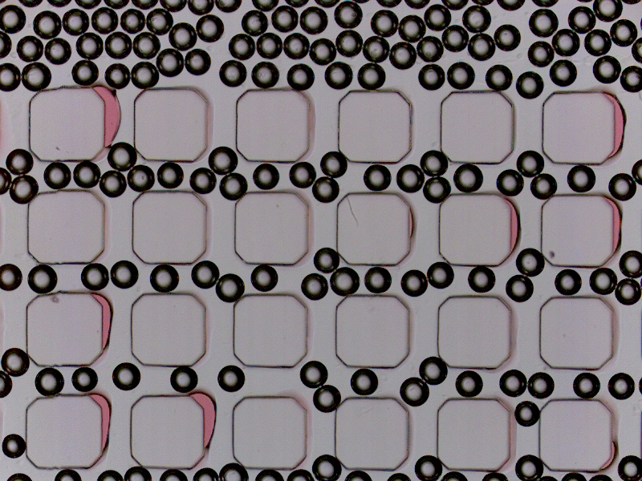
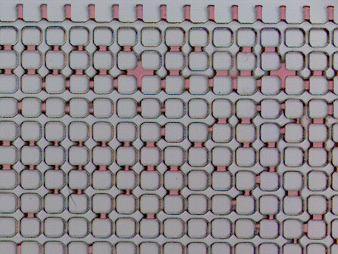
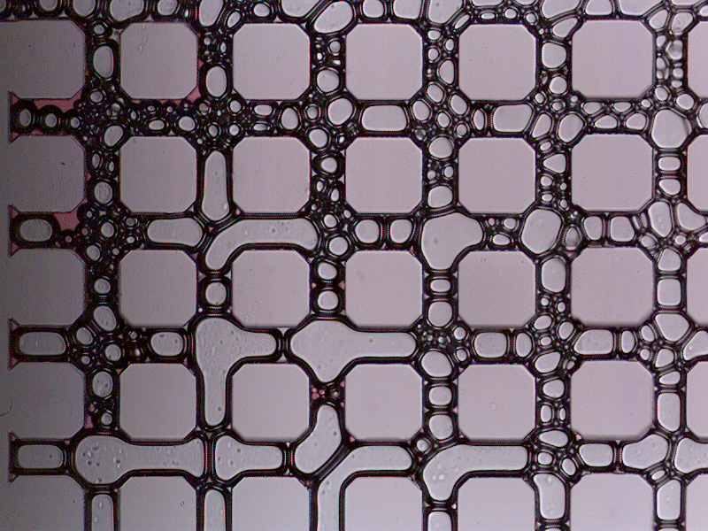
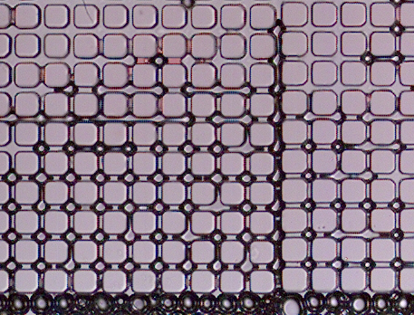
Pore-scale Observations
15
High-Perm
Low-Perm
Trapped oil on walls
Wet foam
small bubbles
Trapped oil in pore throats
Leave-behind oil lamellae
High gas pressure
Bubbles entering
low-perm
Bubble Blocking
Note: high- and low-perm images at different magnifications
Source: Conn et al, in preparation
Notes:
Here we have some close-up pore-scale observations. The top-left shows oil trapped on the surface of the grains, since the micromodel is oil-wet. We also see that the bubbles are smaller than the pore throats and it is a very wet foam, so they easily flow through. On the bottom-left we see bigger bubbles that tend to jam flow paths and force fluid to divert around them. If you watch videos of this you see bubble trains flowing through one path, then a bubble gets stuck and the bubble train goes in a different direction.
At the top-right we see oil trapped in the pore-throats between grains, and also leave-behind oil lamellae as the surfactant solution pushed through. I also have videos of oil lamellae rearranging so that they show leave-behind in the direction of the pressure gradient over time. At the bottom-right you can see the visual difference between gas, surfactant solution, and oil in the low-perm region. Here the injected pressure is higher so we can get bubbles to enter.

Slide 16
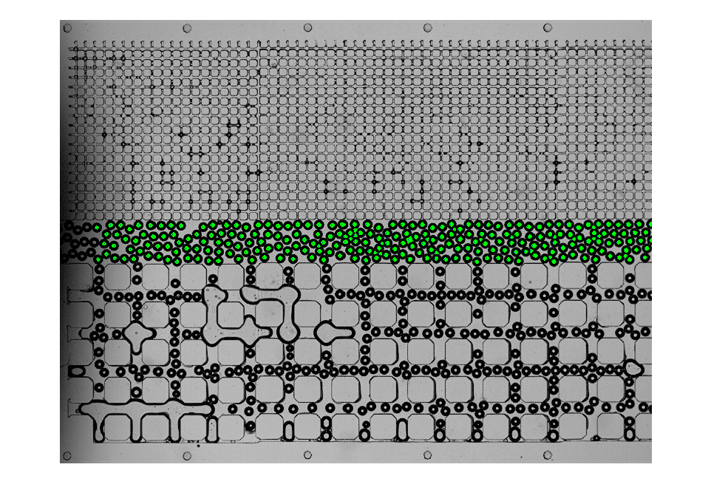

Future Work
16
Bubble Size & Foam Texture
Effect on fluid transport
Critical bubble size for
mobility (vs. pore size)
In-situ foam generation strategies with low ΔP
Fracture Effects
Multiple fractures, varying widths, fracture networks
Orientation relative to pressure drop
Wettability
Compare displacement of oil-wet & water-wet systems
Surfactant Screening
Understand foam destabilization in the presence of oil
Source: Conn et al, in preparation
Notes:
For future work, we want to investigate the role of bubble size on fluid transport. “Is there a critical bubble size compared to the pore size in which a bubble won’t mobilize through?” And, “How can we generate a strong foam even at low pressure drops?”
We also want to look at the role of fractures, since they are much easier to set-up and study in micromodels you can design yourself. We plan to compare fractures with varying dimensions, look at networks of fractures, and see how their orientation relative to flow changes things.
We can look at wettability – comparing oil-wet and water-wet systems, and use micromodels to better understand how foam destabilizes in the presence of oil – and what makes some surfactant formulations better than others.

Slide 17



Acknowledgements
17
U.S. Department of Energy (DOE) (DE-FE0005902)
Abu Dhabi National Oil Company (ADNOC)/Petroleum Institute
Rice University Porous Media Consortium
Special thanks to:
Dr. Jose Lopez-Salinas (Rice)
Dr. Maura Puerto (Rice)
Notes:
I am funded by the US Department of Energy, and I would like to thank ADNOC and the Rice University Porous Media Consortium. I’d also like to that Jose Lopez-Salinas and Maura Puerto in the Hirasaki group for surfactant advice and helpful discussions.

