Slide 1
CO₂ Foam Mobility Control and Adsorption
with Nonionic Surfactant
Michael Guoqing Jian,
Leyu Cui, Lisa Biswal, George Hirasaki
04/22/2015
Notes:
Hello everyone, I am Michael. Today I will give a presentation of CO2 Foam Mobility Control and Adsorption with Noninic surfactant.

Slide 2
Core Flood at
Reservoir Conditions
Composition of brine of East Seminole reservoir (TDS=34,180 ppm)
Na₂SO₄ (mg/l) | KCl (mg/l) | CaCl₂⋅2 H₂O (mg/l) | MgCl₂⋅6H₂O (mg/l) | NaCl (mg/l)
5,236 | 458 | 5,825 | 2,760 | 22,796
Surfactant
Linear alcohol ethoxylates SURFONIC®L24-22
m=11~13;
n=22
SURFONIC®L24-22, Huntsman Corporation
Notes:
This project is designed for CO2 foam mobility control for East Seminole Oil field which is locate din West Texas. The TDS of the reservoir brine is with TDS=34,180 ppm. The detailed composition is shown in the table.
The surfactant we use is provided by huntsman and it is a linear alcohol ethexylates surfactant. Which is a class of nonionic surfactant.

Slide 3
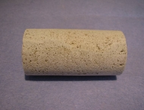
Core Flood at
Reservoir Conditions
Core
Diameter: 1.50 inch
Length: 2.97 inch
Pore volume: 14.4 cm³
Lithology: Silurian dolomite core from Kocurek Industries
Porosity=16.7%
Permeability=91 mD
Notes:
The core used here is a representative silurium dolomite with 1.50 inches diameter and with a length of 2.97 inches.
The pore volume is about 14.4 cm3.
The porosity is about 16.7% and the water permeability is about 91 mD.

Slide 4
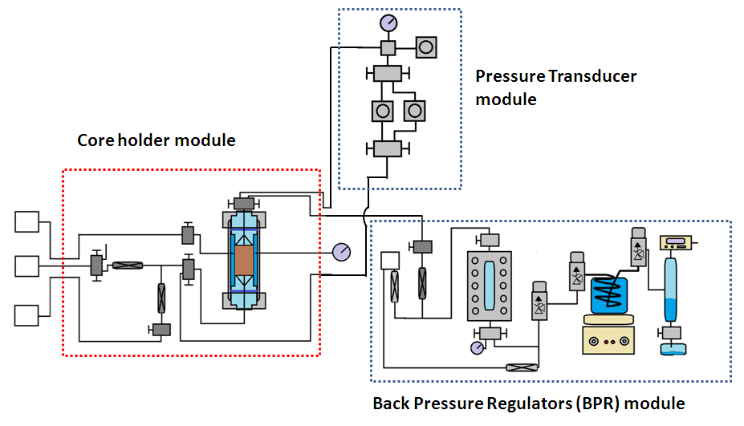
Diagram of the High Temperature and High Pressure Core Flooding Setup
Specially designed heating coil, core holder and back pressure regulator system.
Harsh Conditions: 2,600 psi, T=110 °F, moderate salinity and low pH (≈ 4)
Hastelloy alloy for wetting materials
Pumps
System
Notes:
the special designed HTHP core flooding was used for this foam flooding process. It has specilly designed heating coil, core hold and the back pressure whichi allows it operate at harsh reservoir conditions. The experiment was conducted under harsh conditions with 2600 psi, 110degF and moderate salinity and low pH which is around 4. The wetting materials are made of Hastelloy alloy.

Slide 5
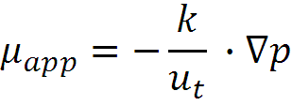



Core flooding:
Apparent Viscosity
Apparent viscosity is used to describe the foam strength, which is calculated by Darcy’s law:
where is foam apparent viscosity, is core permeability, is the total superficial velocity and is the pressure gradient.
Notes:
We use apparent viscosity to describe the foam strength, which is calculated by Darcy’s law. Where miu_app is the foam apparent viscosity, k is the core permeability. U_t is the total superficial velocity and delta p is the pressure gradient.

Slide 6
Core flooding
80% foam quality, Injection rate=4 ft/day,
T=110 °F(43.3 °C), Injection pressure=2600 psi.
23 cp
1% L24_22 in ES brine
Equilibrium average apparent viscosity by co-injection of surfactant and CO₂ is 23 cp
Notes:
This is this result of the core flooding process. The foam quality is 80% and the injection rate is 4 ft/day. The blue dots shows the apparent viscosity of co-injection of brine and CO2 co-injection. The apparent viscosity is about some value between 0-5 cp. However, when we switch to the foam flooding , the apparent viscosity of CO2 foam under reservoir conditions is about 23 cp which is much higher than the coinjection of CO2 and brine coinjection as the blue dots shows.

Slide 7
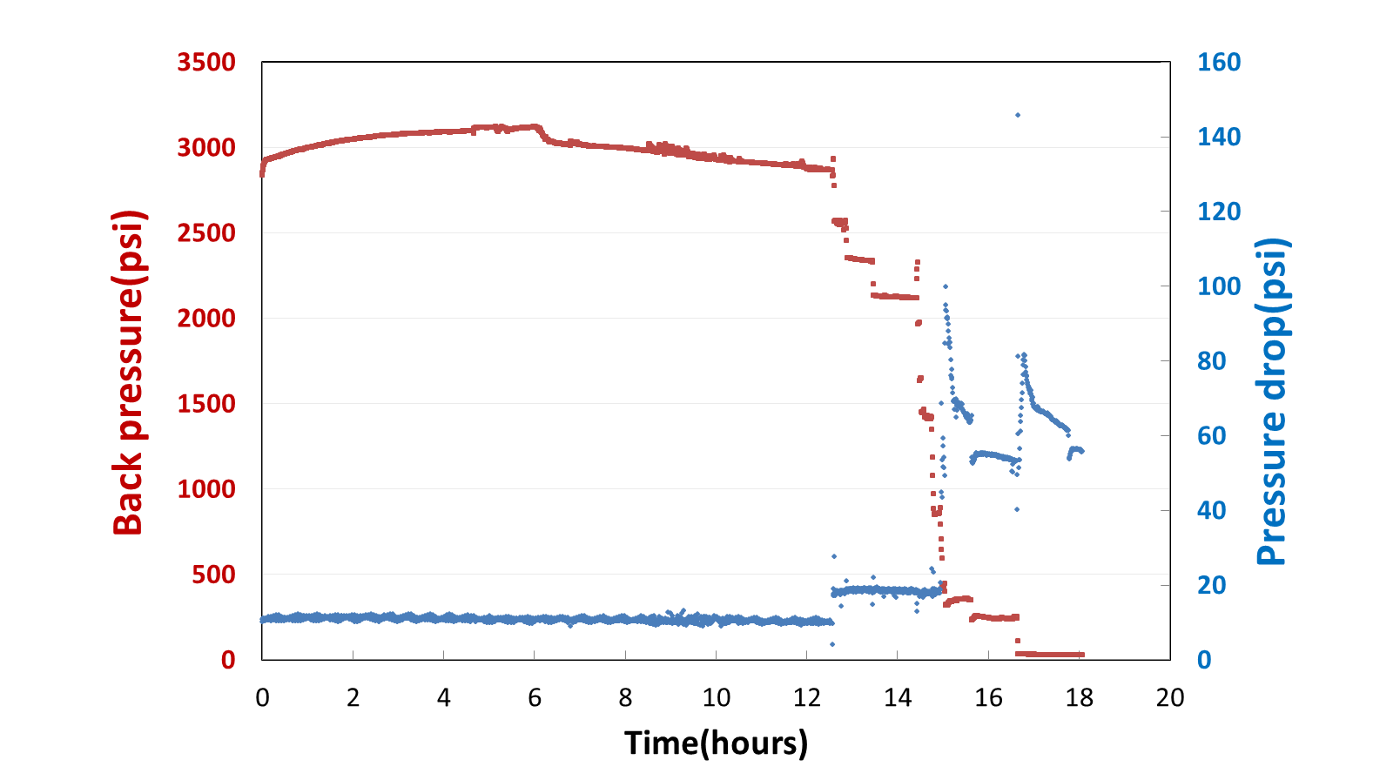
Depressurization
depressurization
Flush core with ES brine
1 ml/min@20 °C
Plug
Depressurization from 1500 psi to 800 psi and then to 200 psi(at 20 °C), we saw a sudden increase of pressure drop(from 20 psi to 60 psi)
Does the pressure drop indicate core plug?
Notes:
The most interesting thing is that after doing the experiment, we depressurize the system to atmosphere condition. Howevre, when we depressurize it to some value, we see there exsits a sudden pressure drop accorss the core. So why this happens? So design a serous experiment and silulation to explain this.

Slide 8

Assumption: Plug of Core
Before core flooding
flow in
flow out
91 mD
After core flooding and depressurization
Surface plug
flow in
flow out
8 mD
Permeability decreased from 91 mD to 8 mD
Core was plugged
Notes:
First, we test the peameability of the core again after core fooding process. We found that the peameability is decreased from 91mD to 8mD which indicate the core has been plugged.

Slide 9
Confirm Plug of Core
Original surface plug
flow in
flow out
8 mD
Experiment 2
flow out
flow in
57 mD
Reverse the core
Experiment 3
Reduced surface plug
flow in
flow out
47 mD
Reverse the core again
Plug has been partially flushed away which can be reflected from the permeability change
Notes:
And by reversing the core the peameability of the core has increased from 8mD to 57 mD. Which indicate that some plug has been flushed away from the surface of the core. After that we test the peameability of the core again, and found that the permeability is about 47 mD which indicate that the plug has been partially flushed away.

Slide 10
Interpretation of Core Plug
Saturated Index* of anhydrite and gypsum was simulated by PHREEQC Software
Negative Saturated index(SI) means under saturated and positive SI means oversaturated
Oversaturated zone@20°C, SI>0
Under saturated zone@20°C, SI<0
Anhydrite is under saturated from 14.7 psi to 3000 psi
Gypsum is over saturated from 14.7 psi to 2800 psi, which indicates that depressurization is favorable for gypsum formation
*Lopez-Salinas, Jose Luis, George J. Hirasaki, and Clarence A. Miller. SPE141420
Notes:
SO we use the PHREEQC to simulate the depressurization of this process.
the brine saturated index, which is the vertica axias, Negative vaue means under saturated and positive value means oversaturated.
The simulated results shows that
Anhydrate is under saturated from 14.7 psi to 3000 psi
Gypsum is over saturated from 14.7 psi to 2800 psi, which indicates that depressurization is favorable for gypsum formation

Slide 11
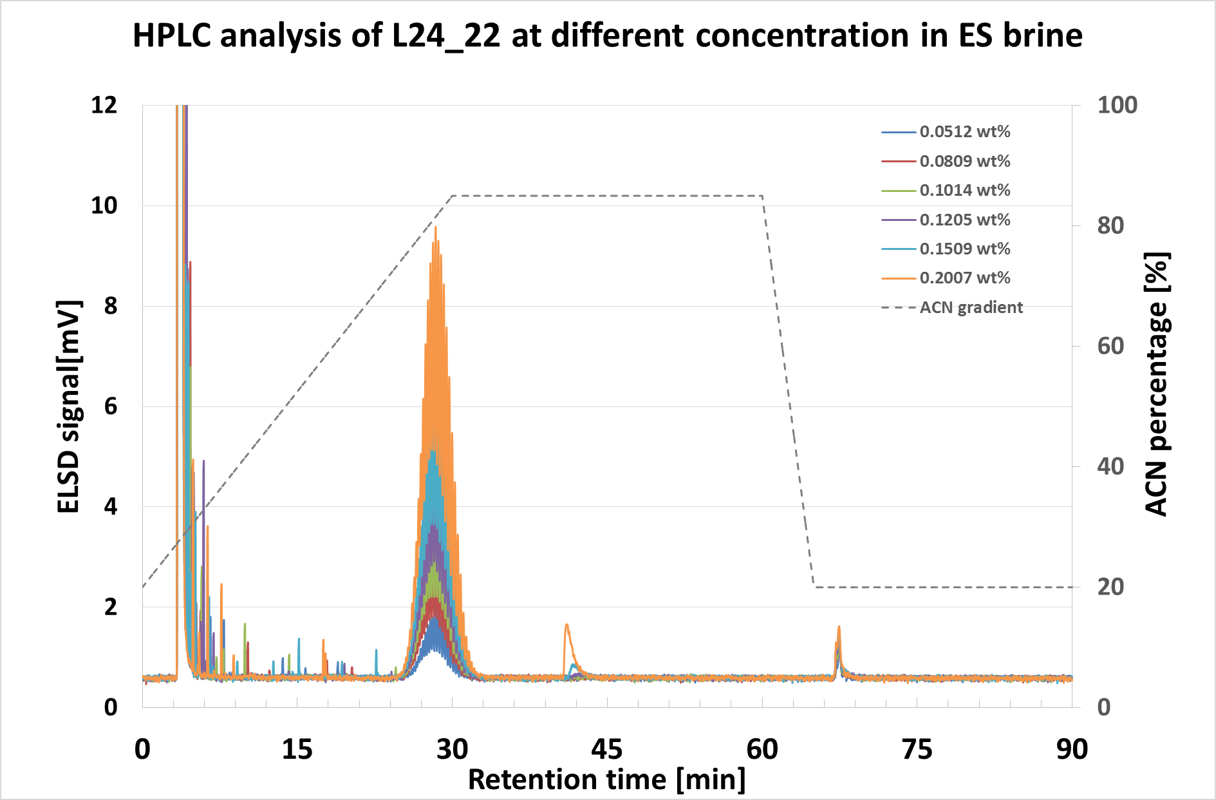
HPLC_ELSD Signal of Surfactant
The peaks with different heights correspond to different surfactant concentrations
Notes:
The last part is about the surfactant adsorption, the surfactant work pretty well under East Seminole reservoir conditions. But, how much is the adsorption amount, we need know that. We use HPLC and ELSD detetacor to determine the adsortion amount. Here is the surfactant in East seminole brine conditions. This is the surfactant peaks, By intergrating the area under the peaks, we can get the calibration curve for adsorption test. The different color of curves means different surfactant concentrations.

Slide 12
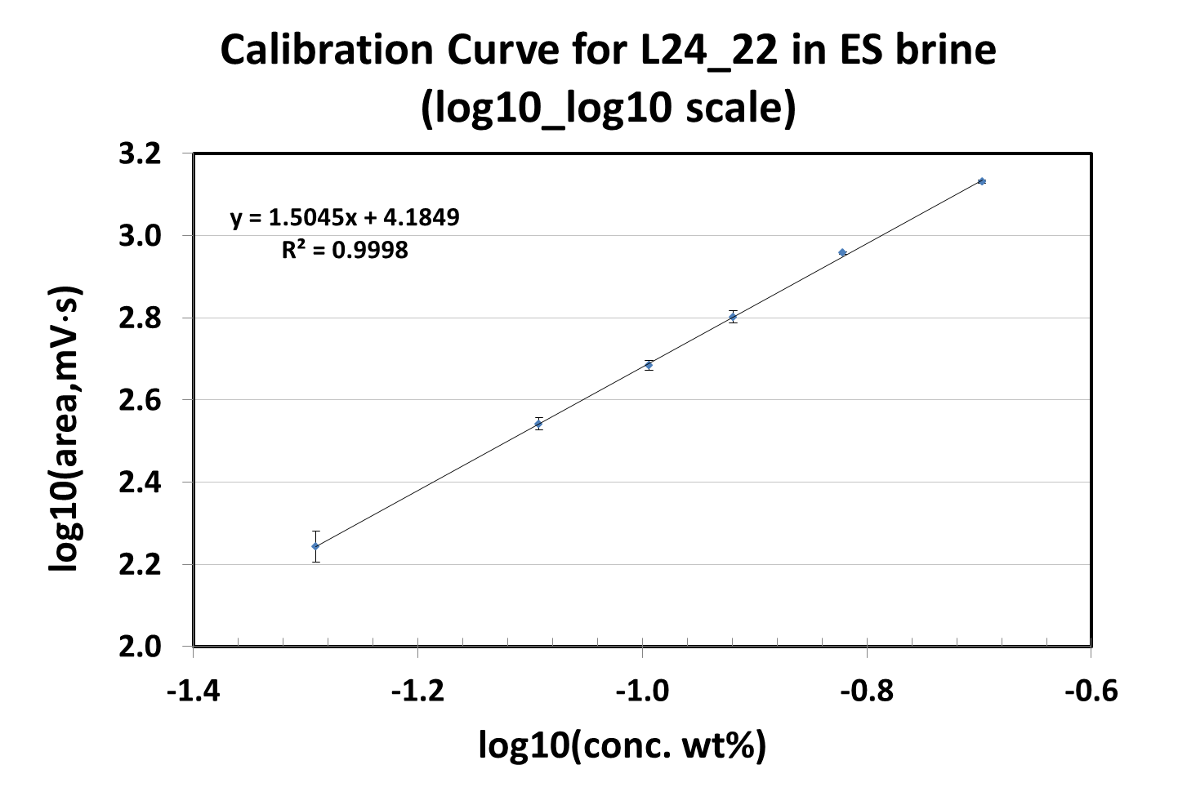
Power Law
Calibration Curve
Calibration curve could be used for determine surfactant concentration in
adsorption test
Notes:
This is the calibration curve of the sufactant at different concentrations. It is very good linear relationship which means that the signal response is a power law model for the surfactant concentaiuons. The the linear relationship is perfect with R2 up to 0.9998.

Slide 13
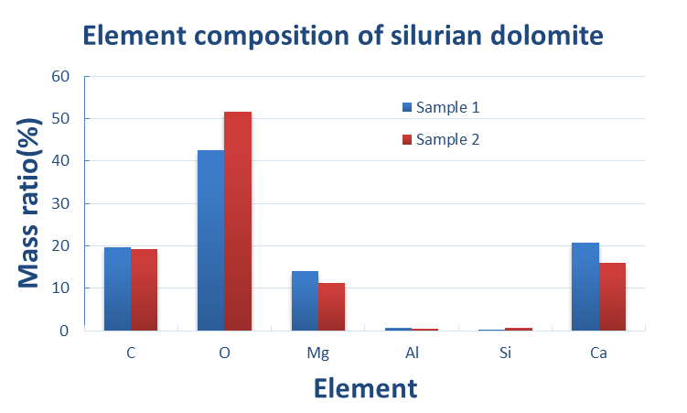
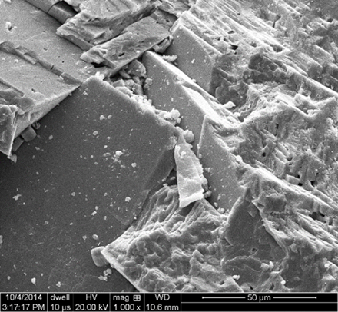
Properties of Adsorbent
1
SEM of Silurian dolomite
2
The Silurian dolomite are mainly consist of Ca, Mg; little amount of Al, Si
BET surface area is 0.95 m2/g
Notes:
After establishing the analytical method for determine surfactant concentration, Now we can do the adsorption test. We use the same rock which is silurian dolomite as we used in the core flooding process. We use EDX to determine the element compostion of the silurium dolomite. The mainly contains calsium and megnesium, andvery a little amouunt of aluminum and silica, which indicate that the rock contains little amount of clay and silica. As aluminum and silicon is main element of clay and silicon is themain element of silica. The SEM shown show the materila we use in a microscopic view. The BET area is 0.95mg/m2.

Slide 14
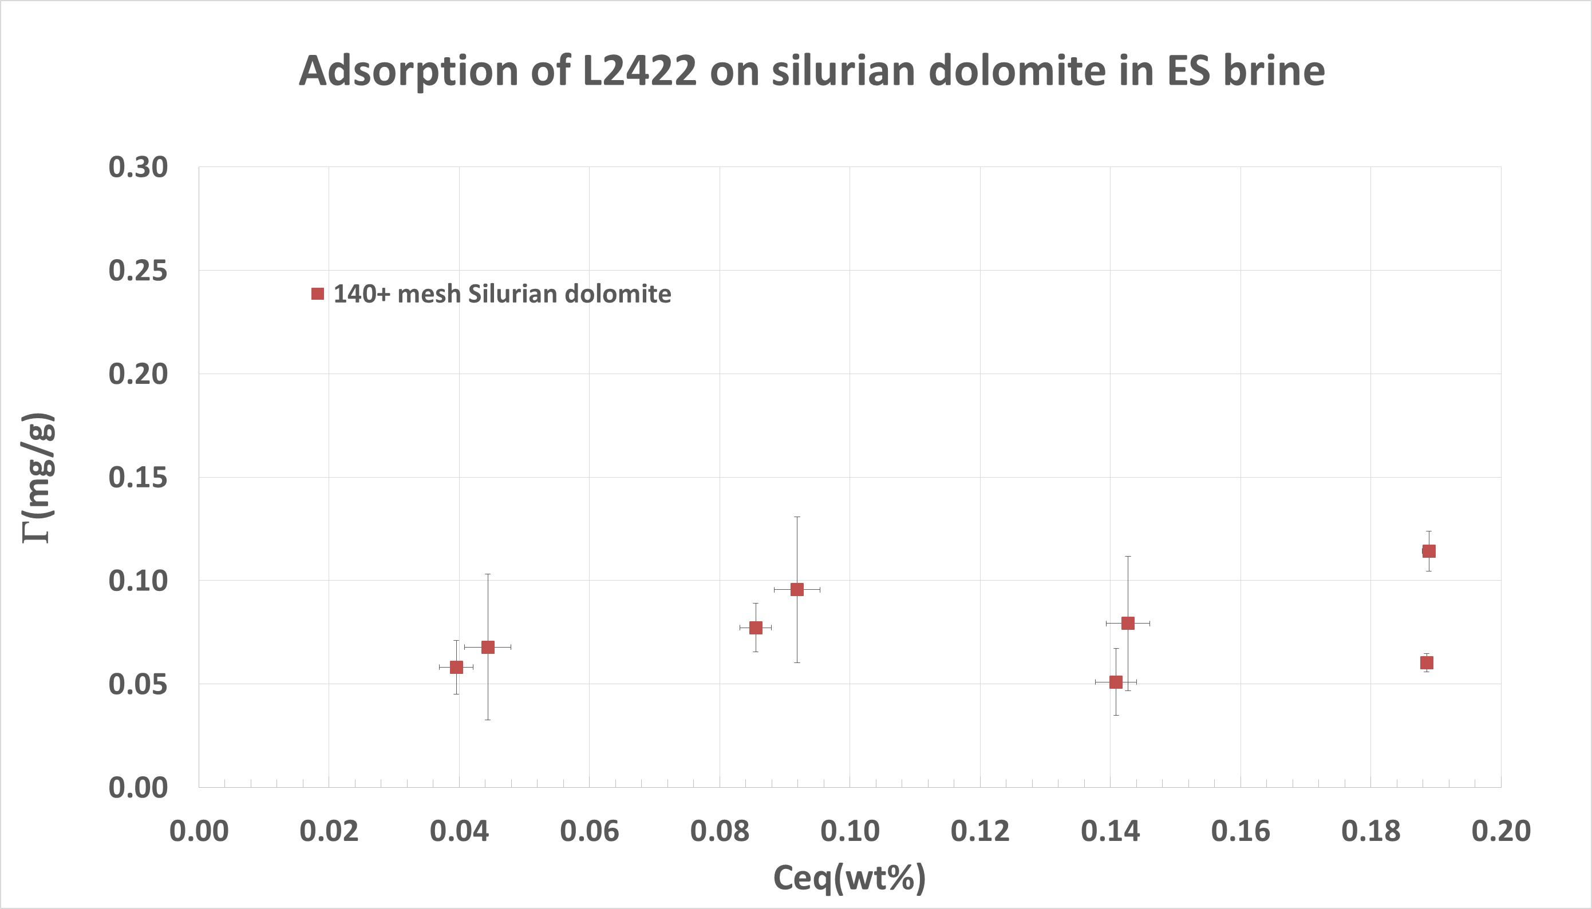
Adsorption on
Silurian Dolomite Powder
1
2
The equilibrium adsorption amount of L2422 on Silurian dolomite is ~0.08 mg/g
Notes:
This figure shows that the adsorption behavior of L2422 on silurian dolomite. The euiqlibium adsorption amount of L2422 on silurium dolomite is 0.08mg/g, which is extremely low enough for CO2 foam flooding applaication.

Slide 15
Thermal decomposition
Everything seems good till now,
foam could be generated at reservoir conditions with 23 cp apparent viscosity and adsorption on Silurian dolomite is so low which is about 0.08mg/g [0.08mg/m2] rock.
How about adsorption at higher temperatures?

Slide 16
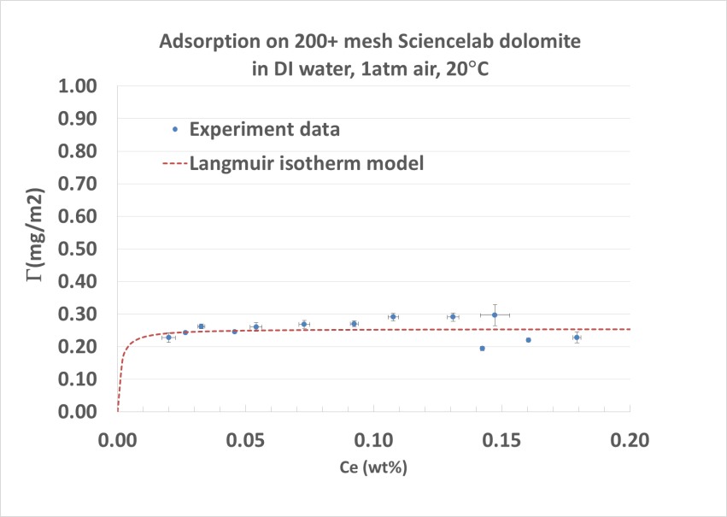
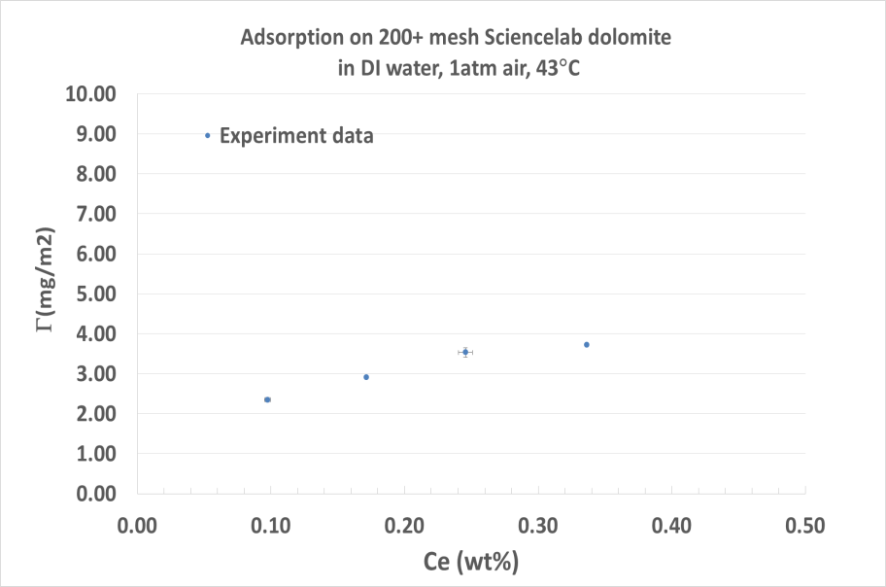
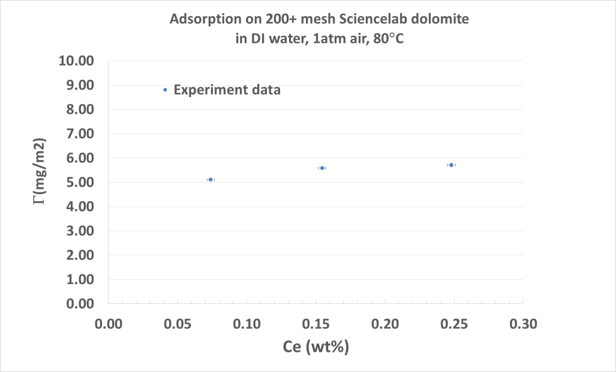
Adsorption without Na2SO3
Why is so high adsorption at high Temperature?
(on Sciencelab dolomite)

Slide 17
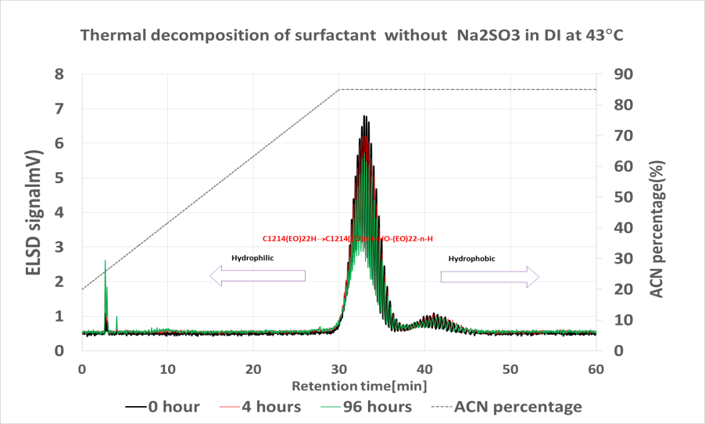
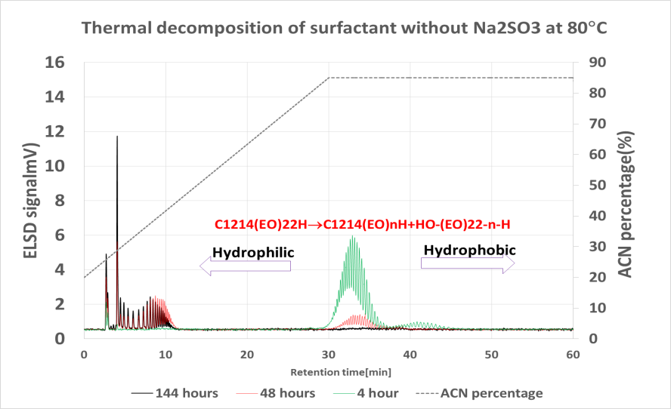
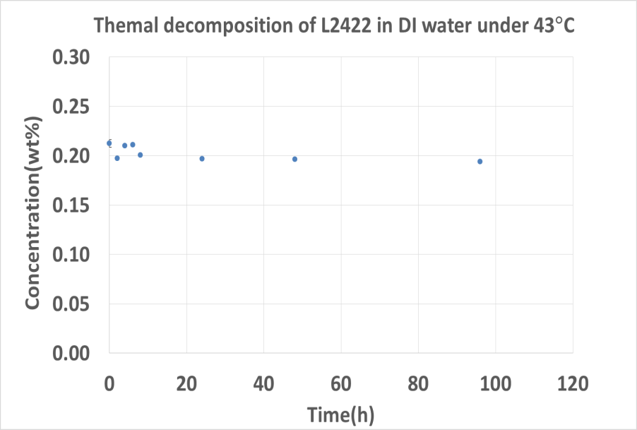
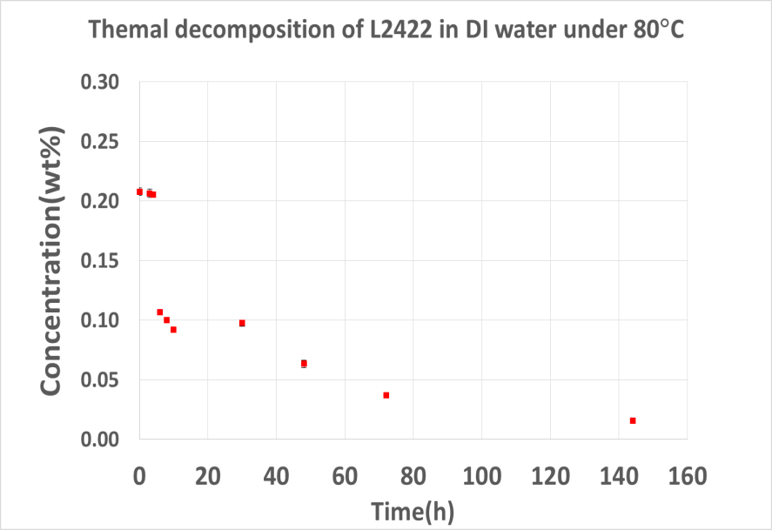
Effect of temperature
Thermal decomposition is severe at 80°C but not at 43°C

Slide 18
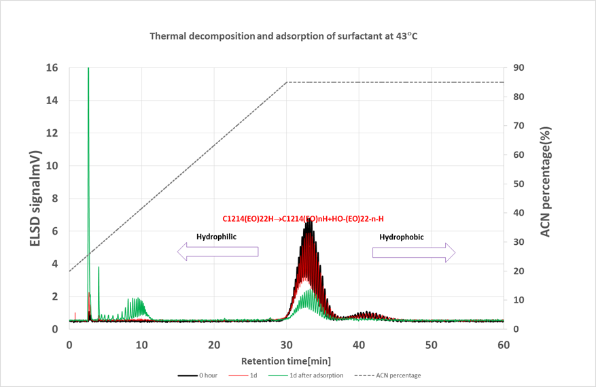
Thermal decomposition
Thermal Decomposition is also severe at 43°C, if surfactant contacts with dolomite as pH increase from pH=6.2 to pH~=9.0

Slide 19
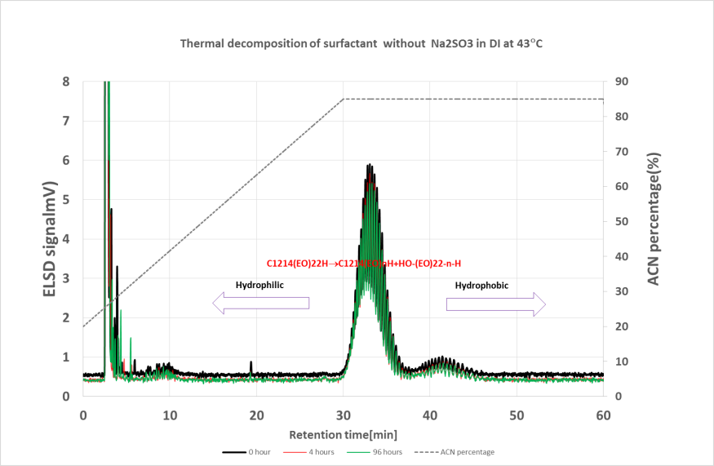
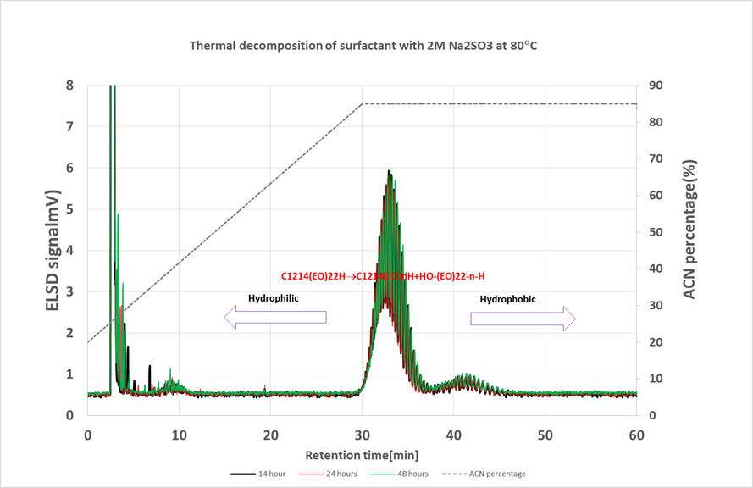
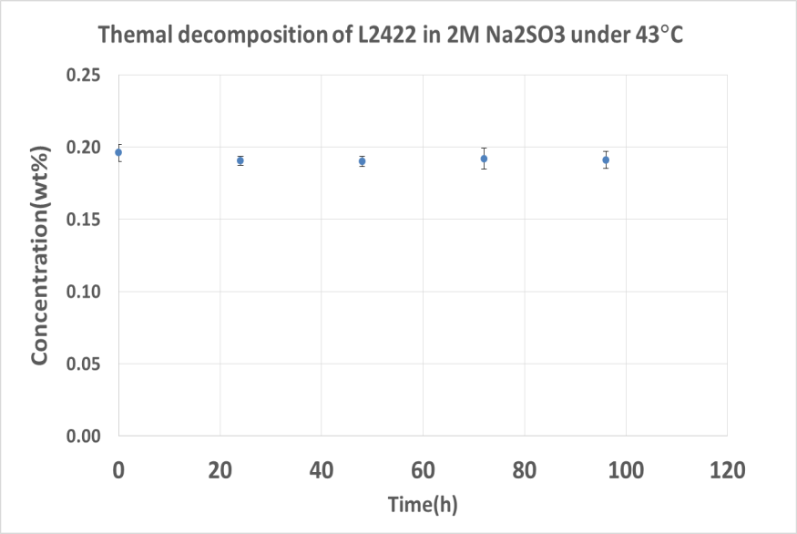
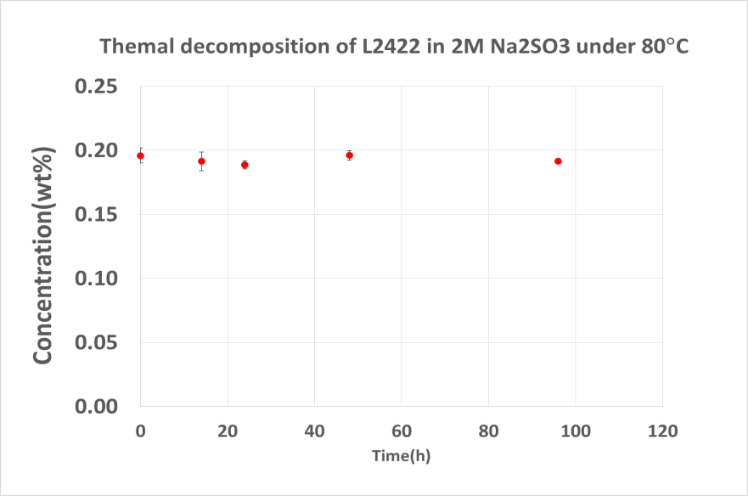
Effect of temperature with 2M Na2SO3
No decomposition was found when 2M Na2SO3 was introduced at 43°C and 80°C

Slide 20
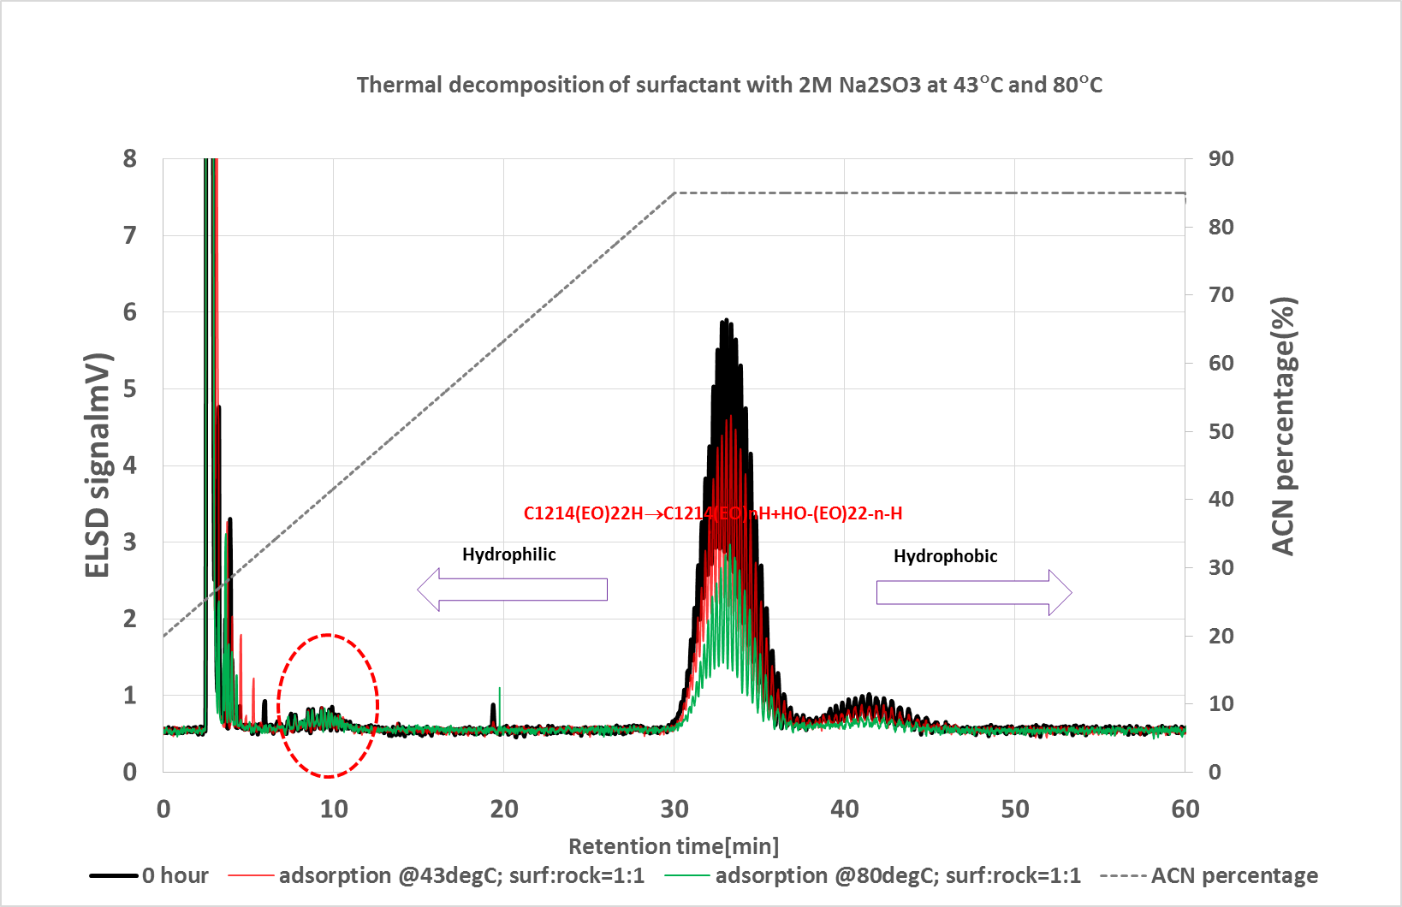
Adsorption
(with 2M Na2SO3)
For adsorption at 43°C and 80°C, the decomposition product of alcohol was not observed which indicate that decomposition was inhibited with 2M Na2SO3

Slide 21
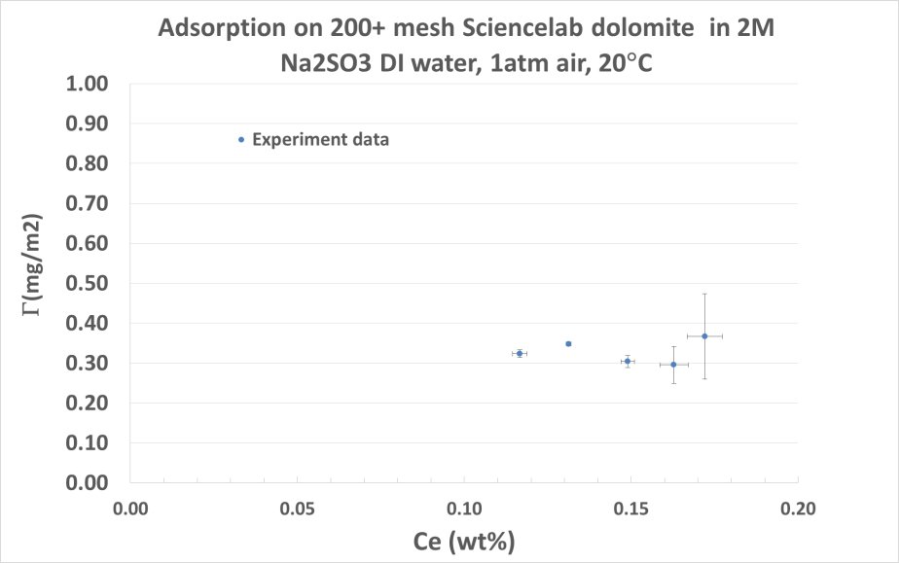
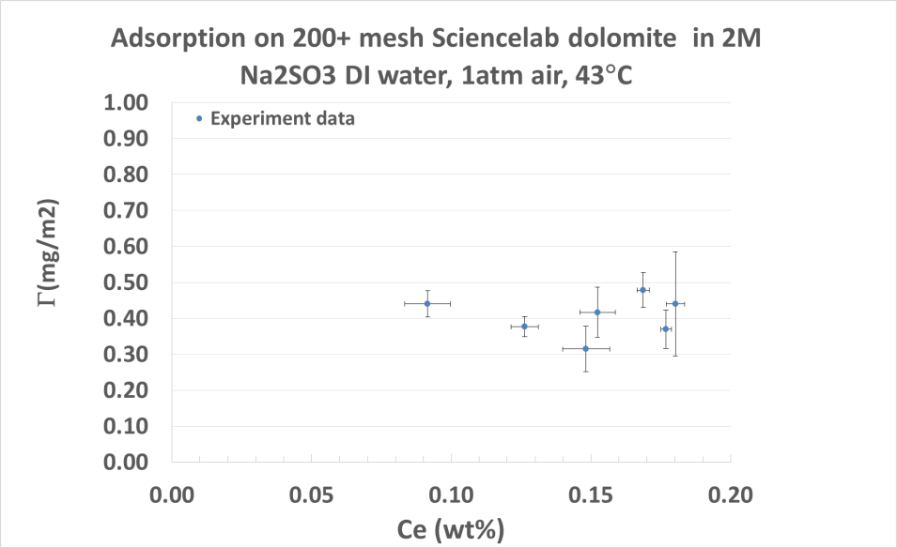
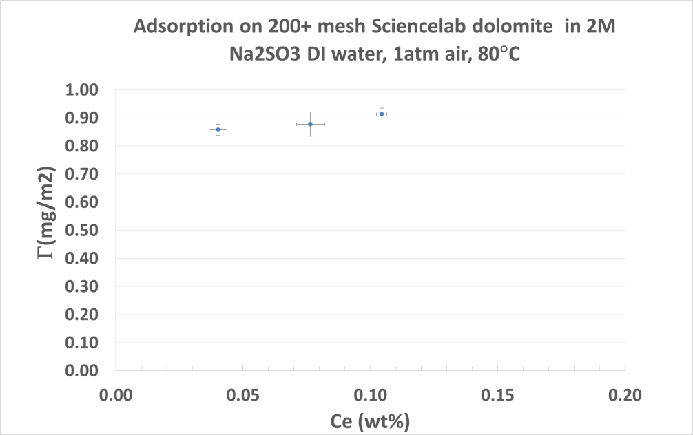
Adsorption
(with 2M Na2SO3)
Γ~=0.32mg/m2
Γ~=0.45mg/m2
Adsorption increases with temperature increase,
Γ<1mg/m2
Γ=0.90 mg/m2

Slide 22
Conclusions
Using 1wt% L24_22 nonionic surfactant, Foam with apparent viscosity of 23 cp can be generated in Silurian dolomite core(80% foam quality, 4 ft/day injection rate, 110°F(43.3°C), pressure of 2600psi, reservoir brine )
Gypsum can precipitate during depressurization at 20°C which was observed by experiment and simulation results from PHREEQC
Adsorption on Silurian dolomite is as low as 0.08 mg/g
Notes:
OK, so finally, let come to three conclusions,
first is about foam properties. the L2422 can generate viscose foam with apprent viscosity of 23 cp in a silurian olomite core. Under reservoir pressure and temperatue conditions.
Second is about brine chemistry. We found that Gypsum can precipitate during depressurization at 20°C which was observed by experiment and simulation results from PHREEQC. As the solution is supersaturaed with calsium sulfite.
Thirs is about adsortion. The adsorption is about 0.08 mg/g silurian dolomite which is very promising for field use.

Slide 23
Conclusions
L2422 gets thermal decomposition at high temperature in the presence of oxygen
Adsorption of L2422 on Sciencelab dolomite increases with temperature at reducing environment(2M Na2SO3), Γ<1mg/m2 for temperature range investigated[20°C~43°C~80°C]
Notes:
OK, so finally, let come to three conclusions,
first is about foam properties. the L2422 can generate viscose foam with apprent viscosity of 23 cp in a silurian olomite core. Under reservoir pressure and temperatue conditions.
Second is about brine chemistry. We found that Gypsum can precipitate during depressurization at 20°C which was observed by experiment and simulation results from PHREEQC. As the solution is supersaturaed with calsium sulfite.
Thirs is about adsortion. The adsorption is about 0.08 mg/g silurian dolomite which is very promising for field use.

Slide 24
Acknowledgement
This work was financially supported by Department of Energy(DOE) and Rice consortium for processes in porous media
Notes:
Finally , I will thank Department of Energy(DOE) and Rice consortium for processes in porous media for supporting me of doing this project.

Slide 25
Thank you!
Any questions?

Slide 26
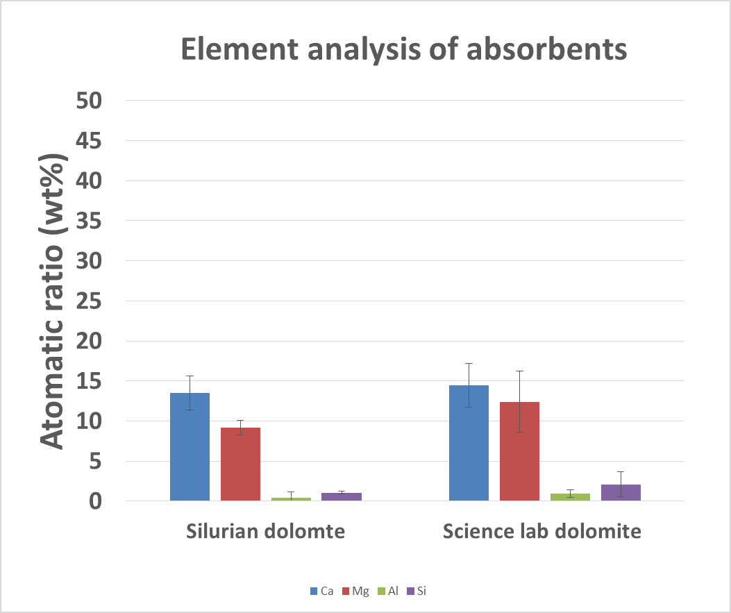
Element analysis of dolomite

Slide 27
Two dolomite
absorbent | Diameter | BET surface area(m2/g) | Source
Silurian Dolomite | ≤105 μm | 0.95 | Kocurek Industries, silurian dolomite, Ohio, USA
Sciencelab Dolomite | ≤74 μm | 0.89 | Science lab.com, Inc.(Catalog #SLD4477),USA

Slide 28
SEM of two dolomite
Silurian domomite | Sciencelab dolomite

Slide 29
BET surface area of all absorbents
Absorbent | Diameter | BET surface area(m2/g) | Source
Silurian Dolomite | ≤105 μm | 0.95 | Kocurek Industries, silurian dolomite, Ohio, USA
Sciencelab Dolomite | ≤74 μm | 0.89 | Science lab.com, Inc.(Catalog #SLD4477),USA
Calcite | 5 μm | 1.65 | Alfa Aesar(catalog#11403),USA
silica | ≤ 10 μm | 1.16 | U.S.silica Company, Pacific, MO, USA
Kaolin | 0.1-4 μm | 26.61 | Sigma-Aldrich(Catalog#K7375),USA

Slide 30
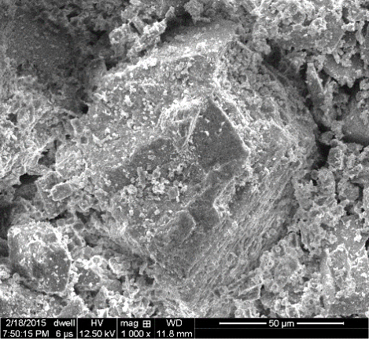
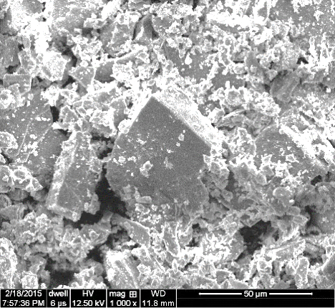
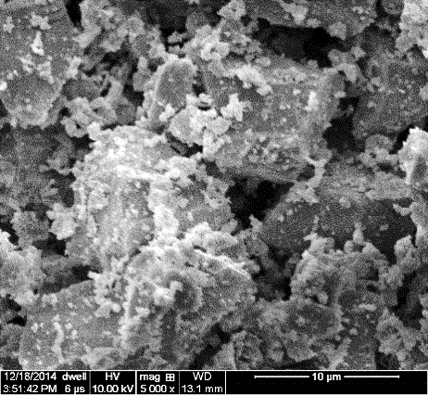
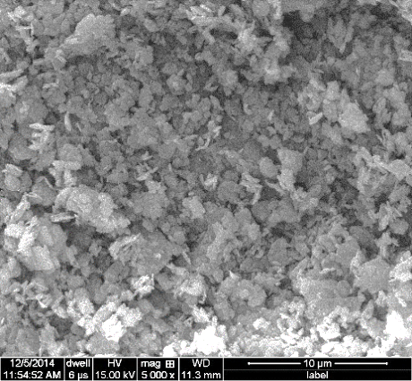
SEM Characterization of Adsorbent
1
Silurian dolomite
Sciencelab dolomite
2
Calcite
Silica
Kaolin
Notes:
This figure shows the element composition microscopic morphology of the silurium dolomite. Thanks, Abi, for helping me test samples.

Slide 31
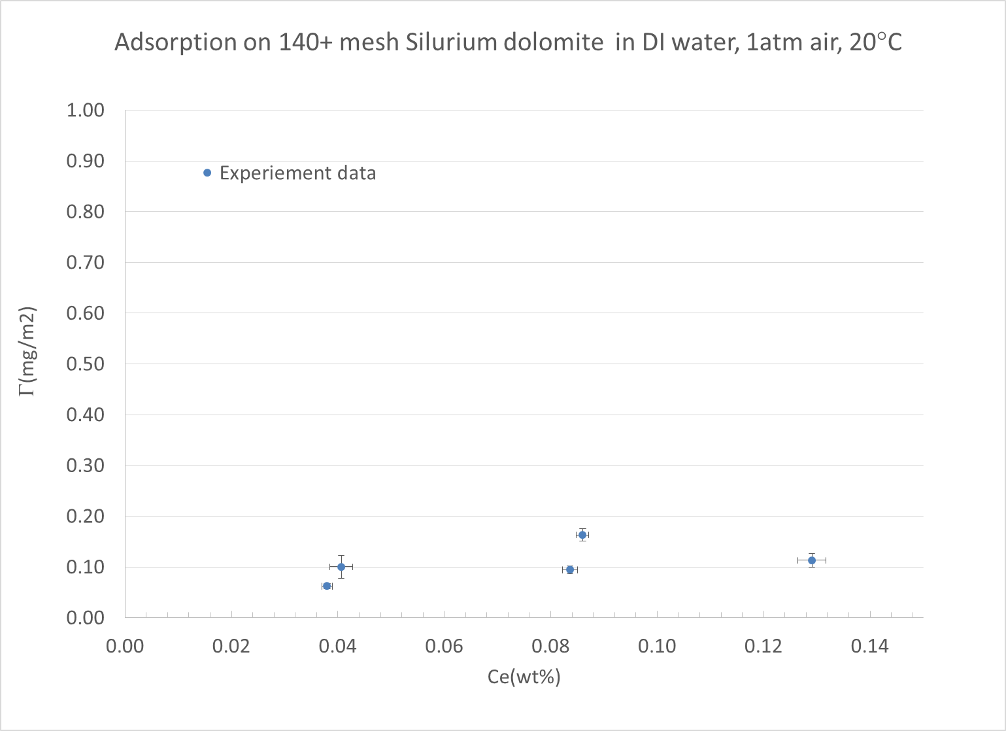
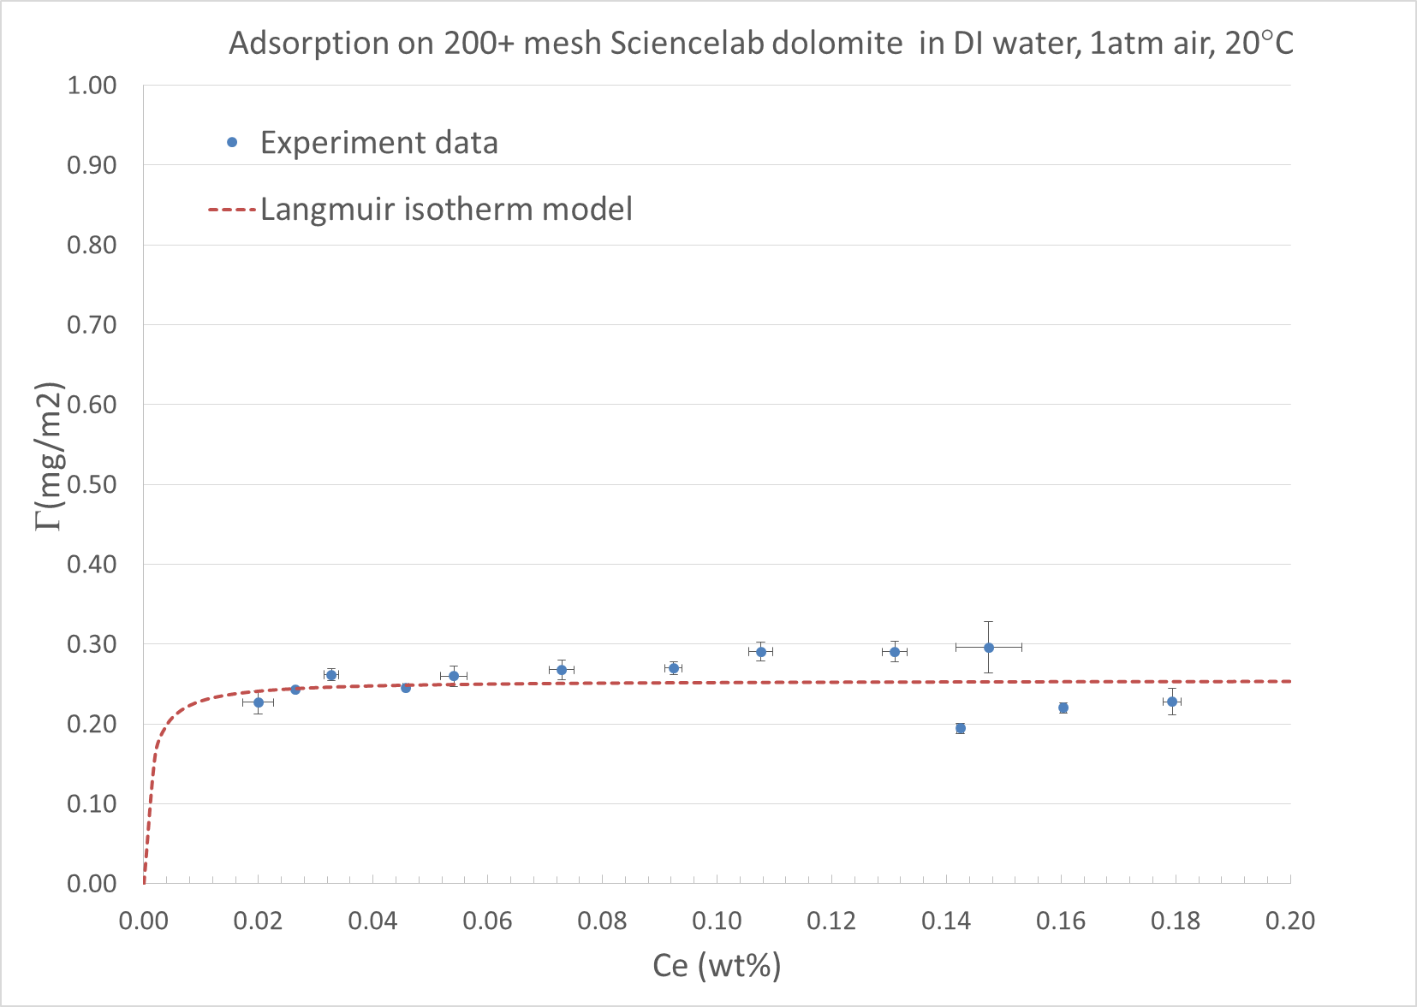
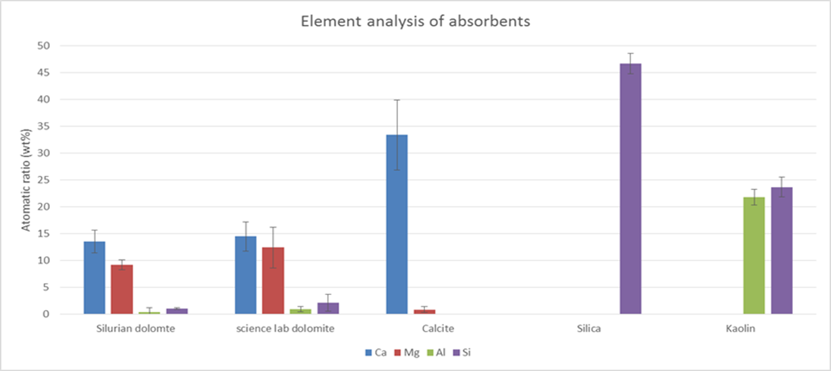
Effect of different dolomite
1
The equilibrium adsorption amount of L2422 on Silurian dolomite is 0.12 mg/m2 and 0.28 mg/m2 for sciencelab dolomite
The difference may be caused by the different amount of silica and clay on dolomite surfaces
2
Notes:
This figure shows that the adsorption behavior of two differnet dolomite materials. The first one is the dolomite from Sirium core materials which has lower content of silica and aluminum materials which indicate that low content of silica and clays. The euiqlibium adsorption amount of L2422 on silurium dolomite is 0.12 mg/m2 and 0.26mg/2 for sciencelab dolomite.

Slide 32
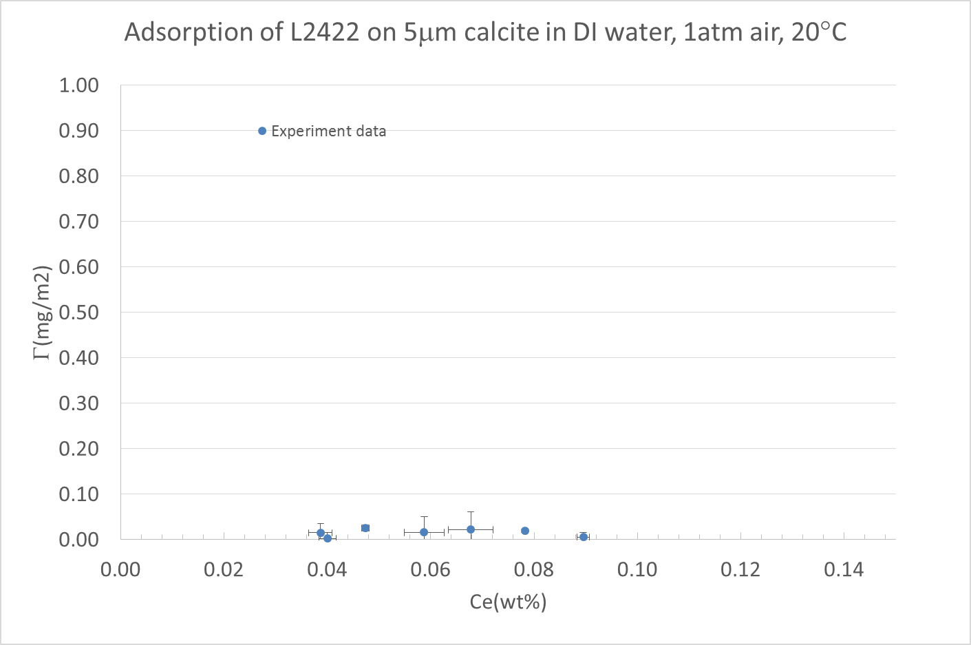
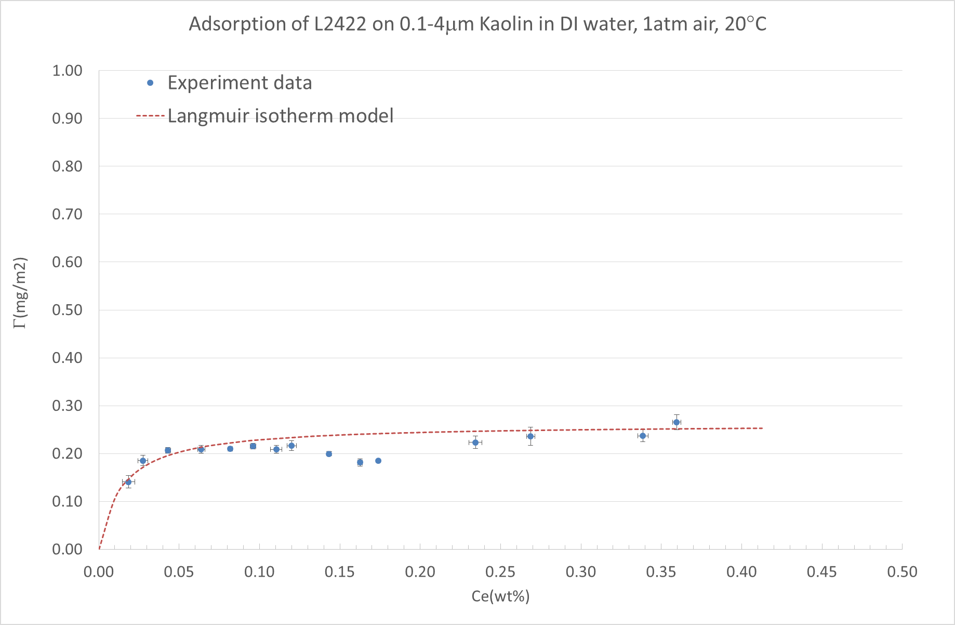
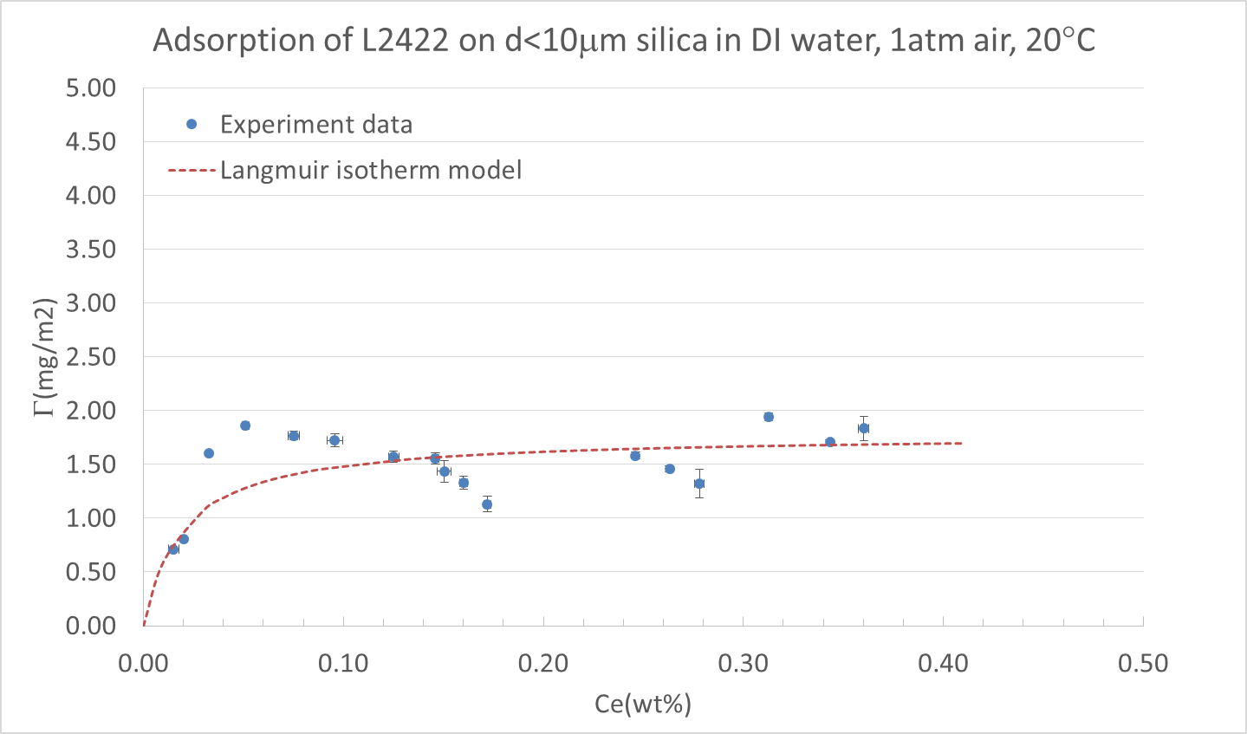
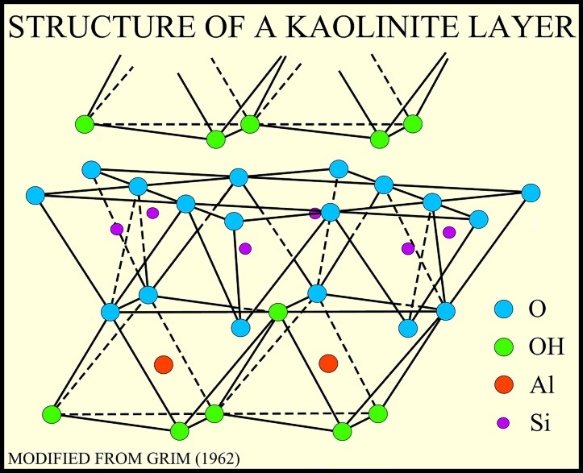
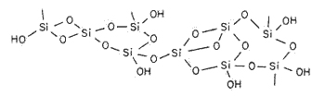
Effect of impurities in Carbonate materials
1
Hydroxyl group
2
The equilibrium adsorption amount of L2422 on silica is 1.8 mg/m2 and 0.26mg/2 for Kaolin clay, which was caused by hydrogen bond formed; Below 0.05 mg/m2 for calcite
Notes:
This figure shows that the adsorption behavior of L2422 on different pure materials, the first is the adsorption on pure carbonate, and the second is the adsorption on silica ad the third is the adsorption of L2422 on Kaolin clay.

Slide 33

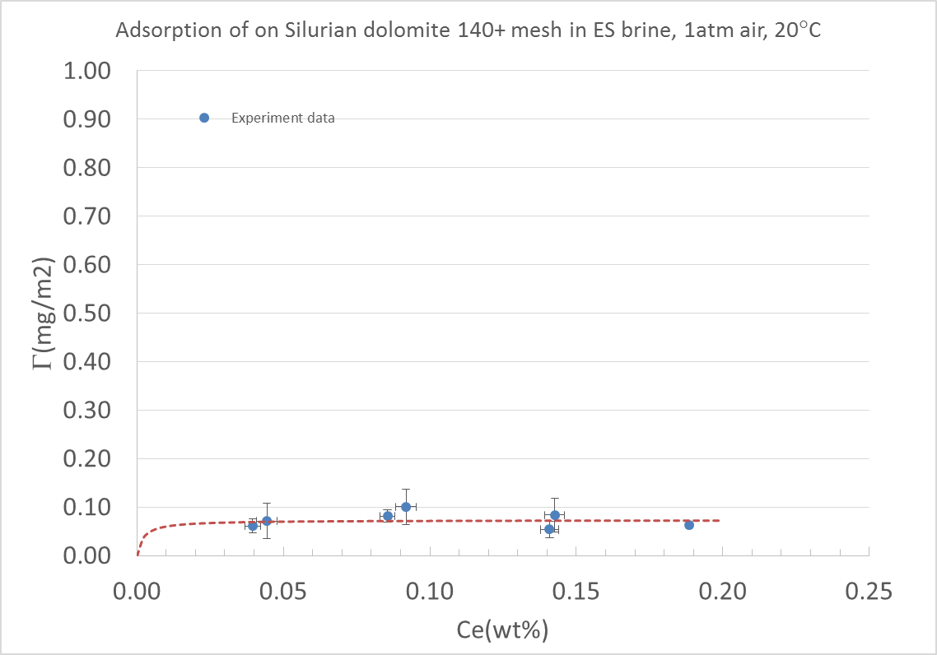
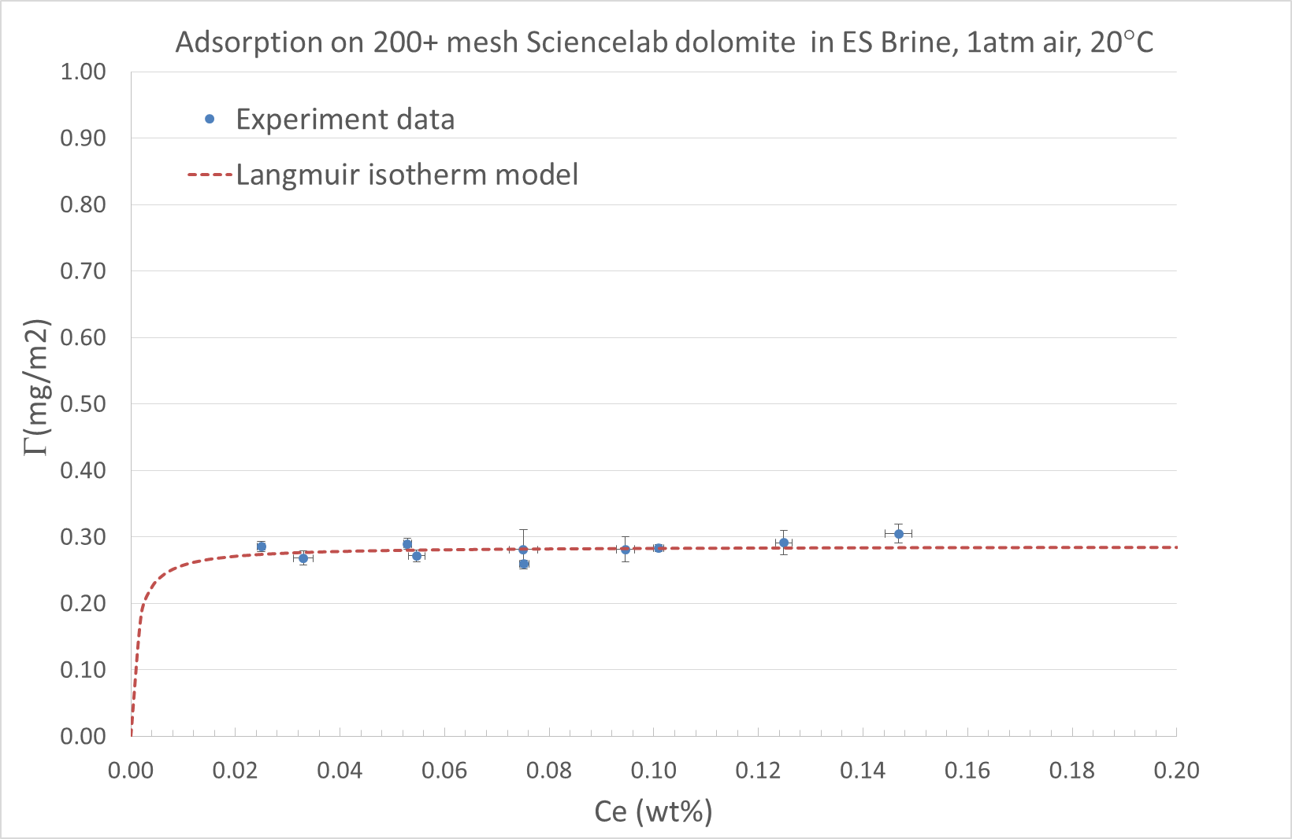
Effect of brine
Silurian dolomite
DI
Silurian dolomite Brine
Sciencelab dolomite
DI
Sciencelab dolomite
Brine
The adsorption of L2422 decreased from 0.12mg/m2 to 0.09mg/m2 for Silurian dolomite in the presence of ES brine
The equilibrium plateau of adsorption amount of L2422 on sciencelab dolomite in ES brine is around 0.28mg/m2 which is almost the same as that in DI water environment

Slide 34
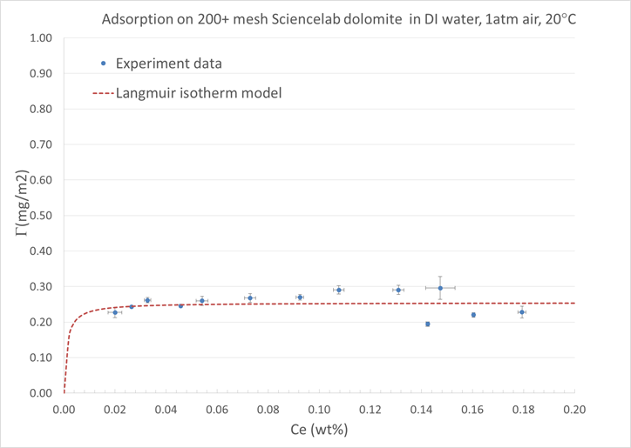
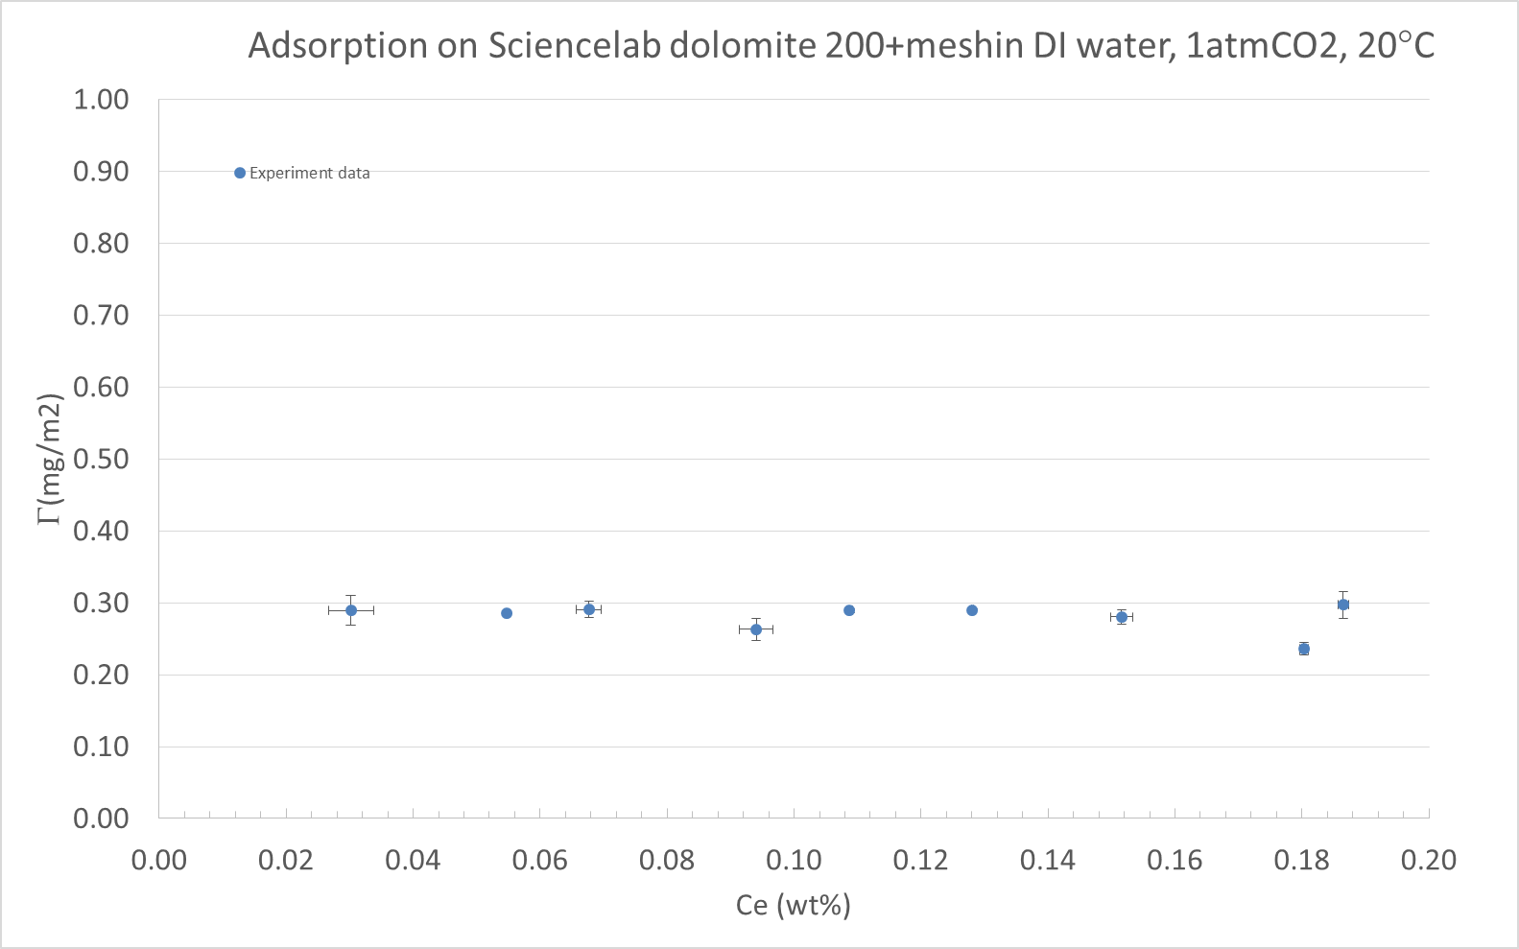
Effect of CO2
Sciencalab dolomite,
1atm air
Sciencalab dolomite,
1atm CO2
The adsorption of L2422 was almost the same under the 1atm air and 1atm CO2, both at room temperature

Slide 35
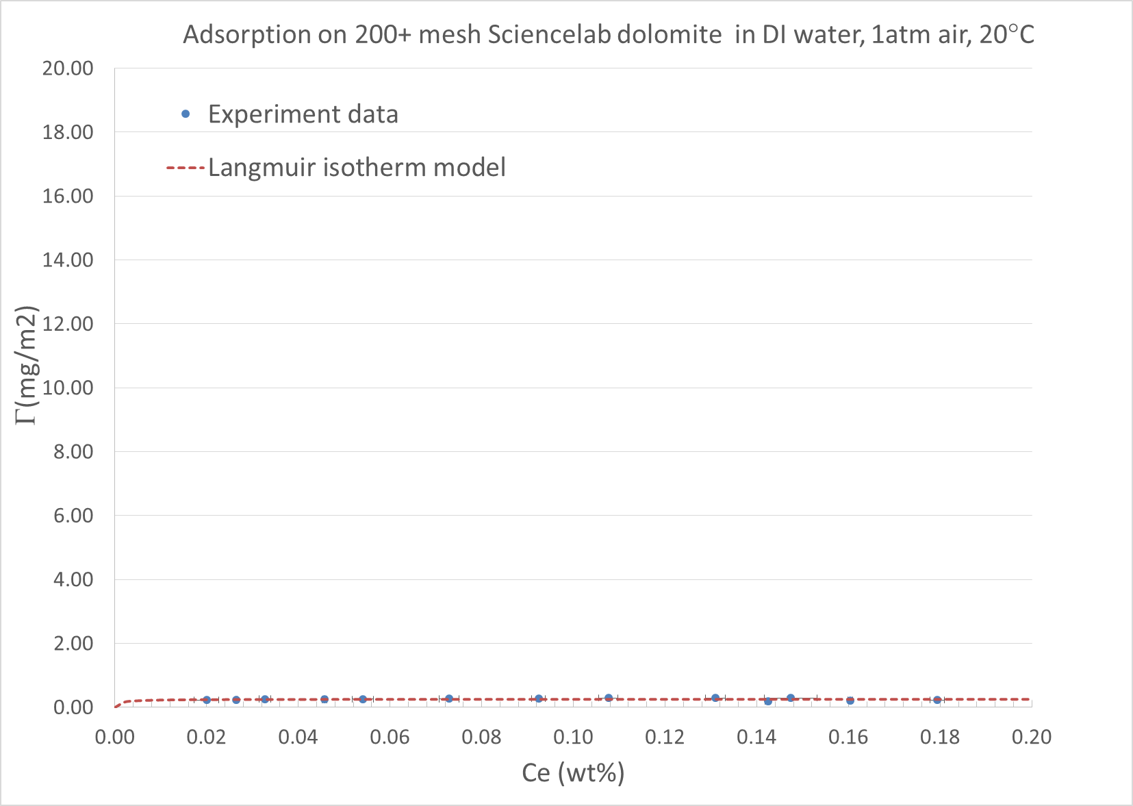

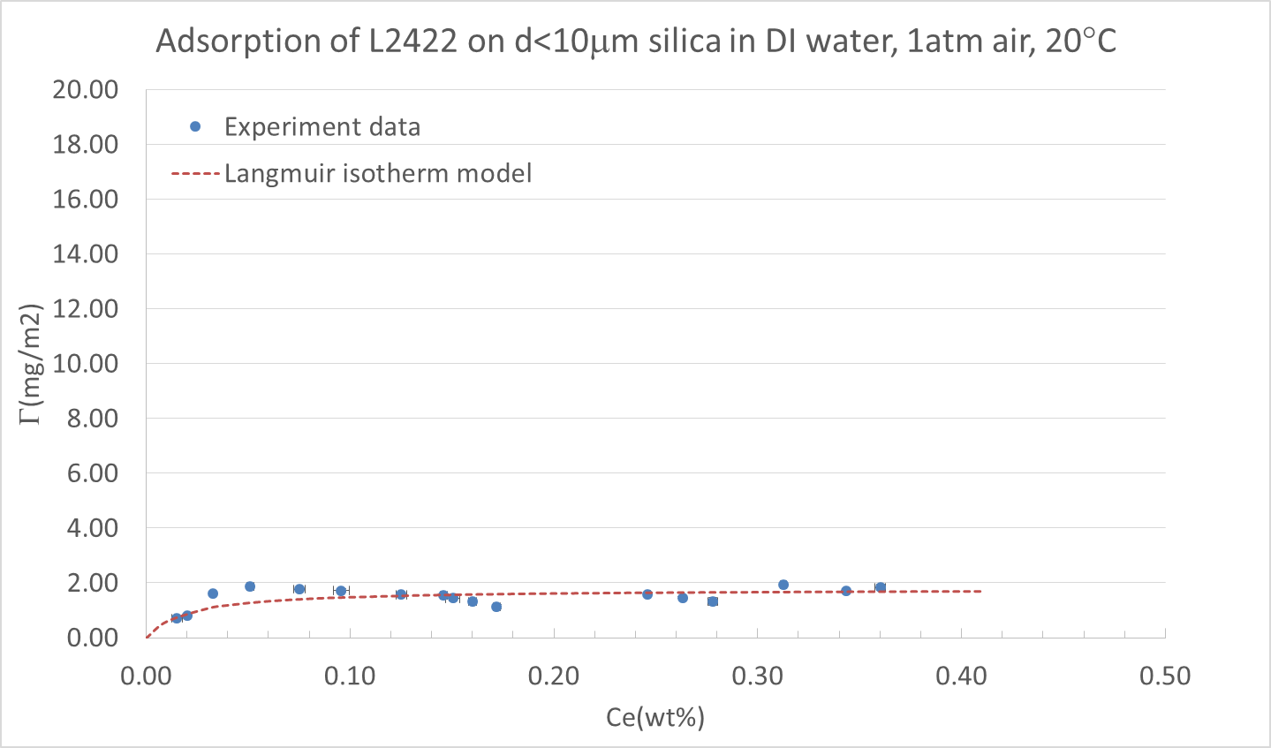
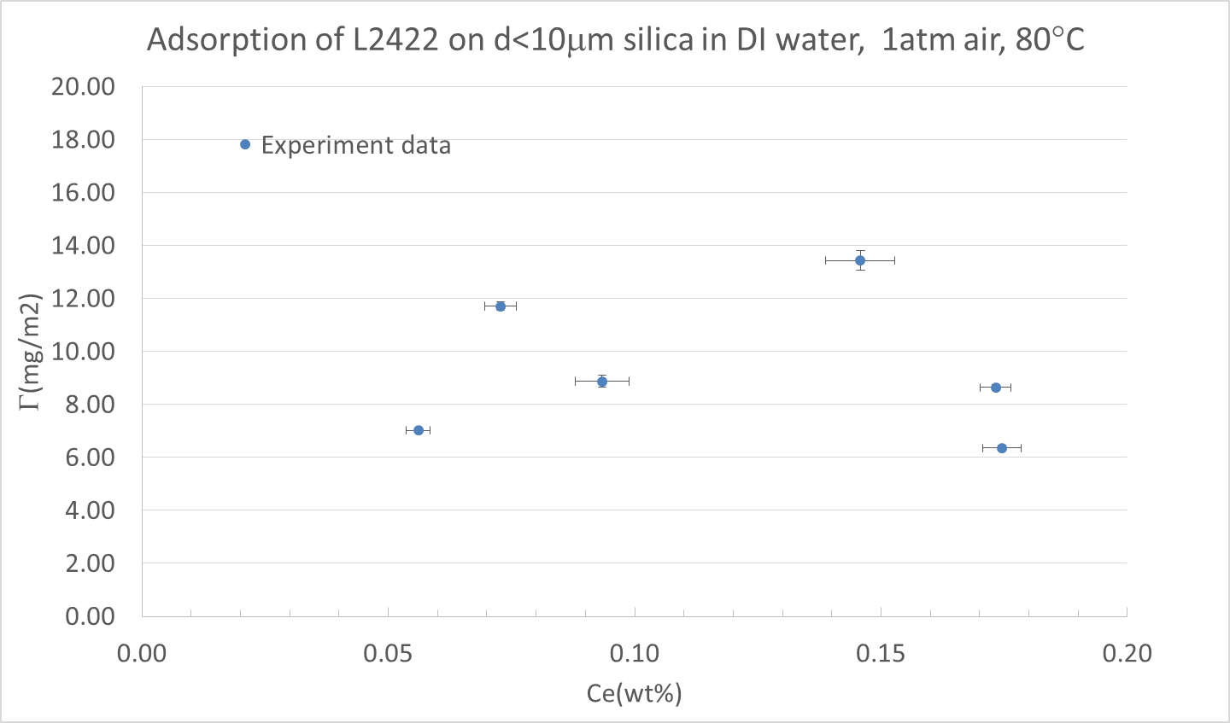
Effect of Temperature
Sciencelab dolomite, 80°C
Sciencelab dolomite, 20°C
US silica,
20°C
US silica,
80°C
The adsorption at 80°C are much higher than that under 20°C on calcite and silica
Degradation beside of adsorption?

Slide 36
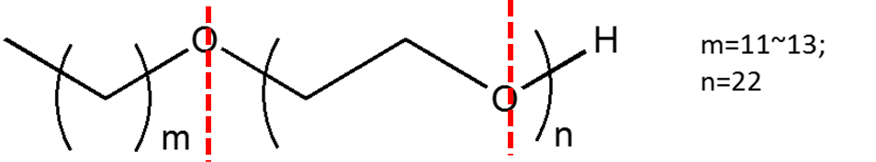
Decomposition
The thermal decomposition of L2422 under high temperature in oxidization environment

