Slide 1

PEMEX PROJECT
Foamability of surfactant blends for fractured reservoirs at 94°C
José Luis López Salinas
Maura Puerto
Clarence A Miller
George J Hirasaki
April 2012

Slide 2
Outline
Surfactants
Aqueous solutions
Viscosity and viscoelasticity
Foam apparatus
Foam experiments
Conclusions

Slide 3
Anionic s
Zwitterionics
Cationics
C-R1-CFG₁
C-R₂-CFG₂
C-R₁-CFG₃
C-R₃-CFG₃
C
A-R₁-AFG
A-R2-AFG
A-R3-AFG
A
Z-RI-ZFG₁
Z-RII-ZFG₂
Z-RI-ZFG₃
Z
Nomenclature:
[Type of Surfactant]-[Hydrocabon chain length]-[Funtional Group]
A-R₁-AFG

Slide 4
Why a surfactant blend is needed ?
Decrease IFT between aqueous phase and crude oil.
Produce clear aqueous surfactant solutions tolerant to divalent ions (Ca²⁺ and Mg²⁺)
Alter wettability of the rock.
Transport the surfactant solution as a foam in the fractured reservoir.
Have stability at 100°C

Slide 5
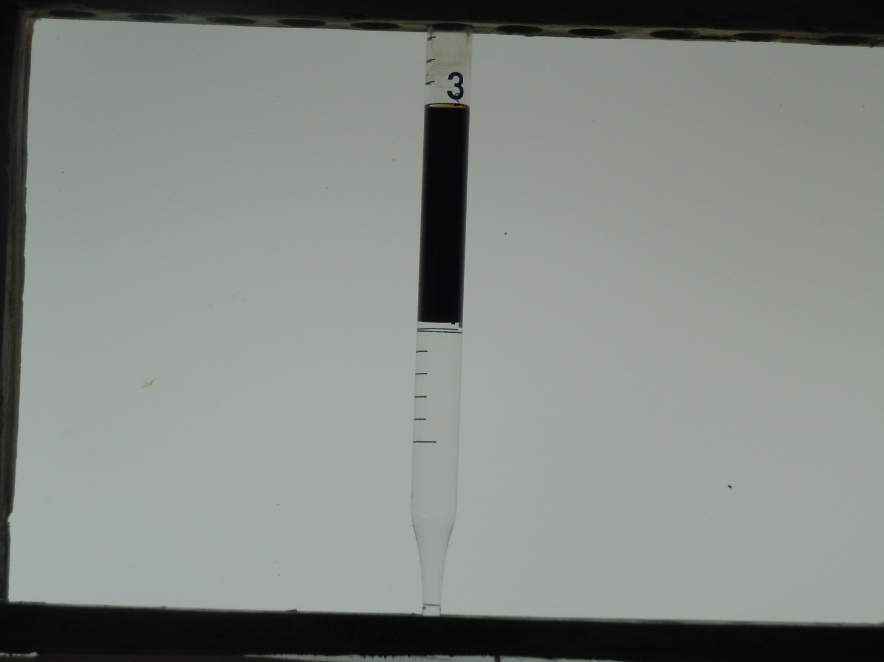
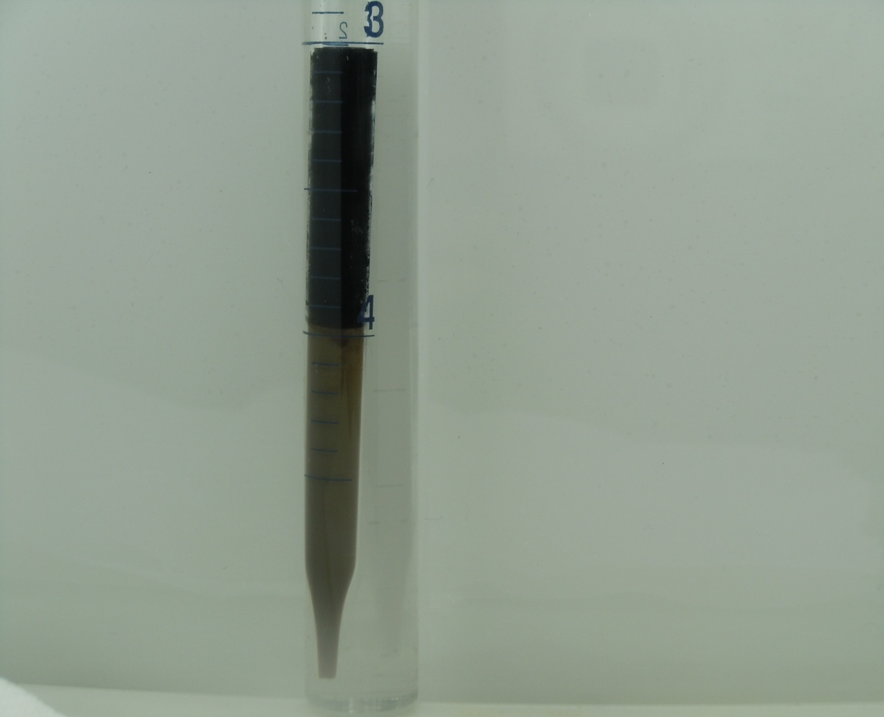
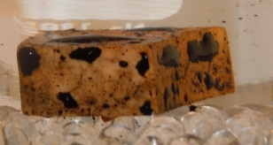
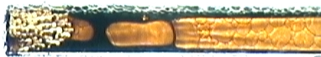
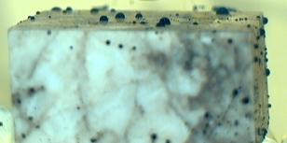
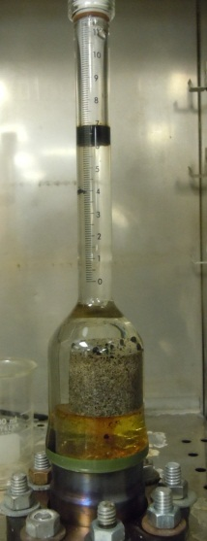
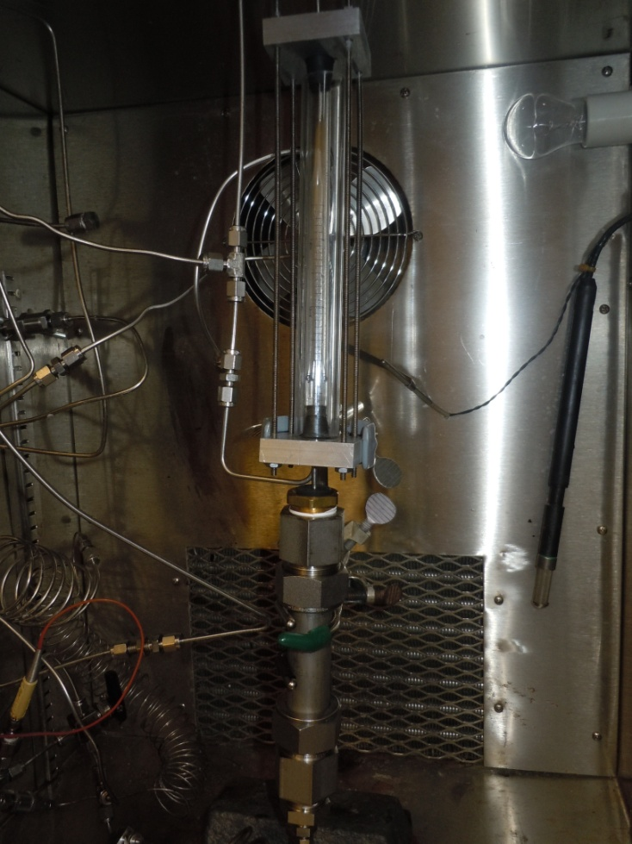
  Complimentary tests run in parallel to determine what surfactants have potential for recovering oil in fractured reservoirs
To be disclose in future presentations
  Phase behavior
  with oil
Oil and foam flow in
“micro channel”
  Wettability
  alteration
Special set up for
foam flow in reservoir rock
Imbibition
Amott cell
  Imbibition in foaming milieu

Slide 6
Aqueous solutions
The use of different kind of surfactants and blends among them were investigated for use as injection composition
      Solutions must be clear
1% of overall surfactant solutions in seawater or formation brine in the temperature range from 25°C to 94°C were studied for a EOR process in a fractured and carbonate reservoir.

Slide 7
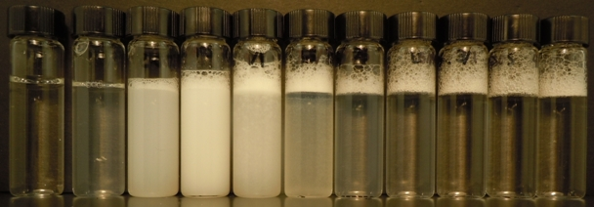
1% Surfactant solution in Seawater
Z-A 30º C (Similar at 94ºC)
Z-R_{I}-ZFG₁ %
100 80 75 67 63 58 50 33 8 0
A-R₂-AFG %
0 20 25 33 37 42 50 67 92 10 0
Picture taken at 30°C, but trend remains at 94°C
Clear when Z/A > 2 and cloudy when < 2

Slide 8
Appearance of surfactant solutions in sea water at 30ºC (Similar at 94ºC)
A-R₂-AFG
Clear solutions studied in foam experiments
Precipitate
Precipitate
Clear solutions if Ca²⁺ and Mg²⁺ are replaced by Na⁺ keeping ionic strength
Clear
Z-R_{I}-ZFG₁
Clear solutions
C-R1-CFG₁
When Z is added to A:
Cloudiness of solution increases, even at high temperature
maximum cloudiness is near to mass ratio of one
cloudiness disappears when Z to A mass ratio is close to 2

Slide 9
Solubility Map in Sea Water 1% Total surfactant concentration
x Cloudy or two layers
o Clear
Z/A= 2
Cloudy
Clear
Z-R_{II}-ZFG₂ Is excellent foam booster, but thermally unstable at harsh conditions of pH and temperature, so a different zwitterionic functional group was studied to overcome this drawback.

Slide 10
Solubility Map in Seawater 1% Total surfactant concentration
x Cloudy or two layers
o Clear
Z/A = 1.66
Cloudy
Clear
Z-R_{I}-ZFG₁ Is good foam booster, and thermally stable at harsh conditions of pH and at reservoir temperature.

Slide 11
Anionic surfactant selection
A-R₁-AFG
A-R₂-AFG Foams in SW_{IS}
A-R₃-AFG
Anionic
Zwitterionic
Cationic
Anionics of different carbon number (same homologous series) are required at 94ºC for tailoring foam behavior at higher or lower salinity
SW_{IS} = NaCl Brine in seawater ionic strength

Slide 12
Viscoelasticity (30ºC) and foam (94ºC) of
Zwitterionic – Anionic blends at 1% in Seawater
A-R₂-AFG
Strong foam and viscoelastic
Z-RI-ZFG₁
Z-RII-ZFG₂
Z-RI-ZFG₃
Zwitterionic
Cationic
So far when mixed with A-R₂-AFG in seawater,
All zwitterionic tested produced viscoelastic, clear solutions and strong foam but,
Z-RI-ZFG₁ and Z-RII-ZFG₂ required 1.66 and 2 mass ratio to be clear
Z-RI-ZFG₃ required 2.75 mass ratio to be clear.

Slide 13
Viscoelasticity (30ºC) and foam (94ºC) of blends Zwitterionic - Cationic
Anionic
Zwitterionic
Z-RI-ZFG₁
Z-RII-ZFG₂
Z-RI-ZFG₃
Cationic
Strong foam and viscoelastic
C-R1-CFG₁
C-R₂-CFG₂
C-R₁-CFG₃
C-R₃-CFG₃
So far,
Only cationic producing clear solutions, foam, and viscoelasticity when mixed with a zwitterionic was C-R₂-CFG_{2.}
C-R₂-CFG₂ by itself in seawater is not clear, but solution became clear, viscoelastic and produced strong foam when mass ratio of Z-RII-ZFG₂ to C-R₂-CFG₂ > 3.
Viscoelasticity strength
Z-RII-ZFG₂ > Z-RI-ZFG₁ > Z-RI-ZFG₃

Slide 14
Apparent viscosity in sand pack @ 1-cm³/min total flow rate and quality 0.7 and 94ºC
A-R₂-AFG
600 cP
430 cP
575 cP
No oil present
Lowest while crude oil was co injected
After crude oil was produced
700 cP
50 cP
700 cP
< 5 cP
< 5 cP
Z-R_{I}-ZFG₁
C-R₁-CFG₁
Testing Foamability in the presence of crude oil:
Co-injected simulated-live oil with surfactant solution in seawater at 1 to 10 ratio
After co-injected a finite slug of oil, injection of oil was stopped
Test Results: Foam built up again reaching, in most of the cases, original-apparent viscosities values disclosed beside Gold Dot in diagram.

Slide 15
Viscoelastic surfactant solutions in seawater (30ºC)
Viscoelasticity has been evaluated by visual observations and experimental rheological measurements are being used to verify observations.
A-R₂-AFG
Viscosity of liquid surfactant
Solution at room temperature
and 10 1/s
50 cP
1 cP
Z-R_{II}-ZFG₂
C-R₁-CFG₁
Z-R_{II}-ZFG₂ needs A-R₂-AFG addition for producing clear solutions with viscoelastic behavior and strong foam.
A-R₂-AFG by itself produced solutions with viscoelastic behavior and foam but,
test temperature should be higher than 30º C for solution to be clear .
Viscoelasticity and foamability remain somewhat when C-R₁-CFG₁ was added to Z-R_{II}-ZFG₂-A-R₂-AFG mixture, but, Z-R_{II}-ZFG₂ or C-R₁-CFG₁ failed to foam when by themselves.

Slide 16
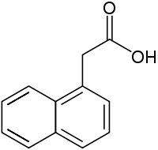
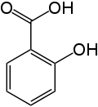
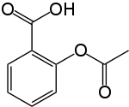
Viscoelasticity and foam behavior of Cationic surfactants
C-R₁-CFG₃ by itself was unable to produce foam or viscoelastic fluid in seawater, but addition of a hydrotrope promoted clear solutions and viscoelasticity.
Hydrotropes tested for seeking clear solutions with viscoelastic behavior
CH₃
Salicylic acid Acetyl salicylic acid 1-Naphtalene acetic acid
SO₃ Na
SO₃ Na
NapTS
Sodium p-toluenesulfonate
Sodium benzenesulfonate
All hydrotropes formed viscoelastic, clear fluids in sea water with C-R₁-CFG₃
Neither of these hydrotropes produced viscoelasticity when mixed with C-R₁-CFG₁ The use those hydrotropes with C-R₁-CFG₁ produced precipitation.

Slide 17
Rheology
A-R₂-AFG in SW
A-R₂-AFG in NaCl Brine (Seawater ionic strength)
Z-R_{II}-ZFG₂- A-R₂-AFG in sea water
Z-R_{II}-ZFG₂- A-R₂-AFG -C-R₁-CFG₁ in sea water
Z-R_{I}-ZFG₁- A-R₂-AFG in sea water
General Observations about rheology results:
All are viscoelastic
Viscoelasticity increased when divalent cations are present (Ca²⁺ and Mg²⁺ )
Adding cationic surfactant to a blend of Zwitterionic-Anionic decreases viscoelasticity

Slide 18
1% A-R₂-AFG in SW and in NaCl brine at the same ionic strength
Seawater contains Ca ²⁺ and Mg²⁺ this is increasing viscosity and viscoelasticity for this anionic surfactant. The same trend was observed with the blends of Zwitterionic + Anionic and with Zwitterionic + Anionic + Cationic surfactants.
Entangled solutions of “wormy” micelles, behave with viscoelasticity… Larson 1999

Slide 19
2.5% A-R₂-AFG in SW_{IS}
1% Z-R_{II}-ZFG₂- A-R₂-AFG in SW
2.5% Z-R_{II}-ZFG₂- A-R₂-AFG -C-R₁-CFG₁
Adding Z-R_{II}-ZFG₂ to A-R₂-AFG, decreases the viscosity, but the viscoelastic behavior prevails, and the shear thinning properties of the fluid still there. The power law index in the shear thinning zone are similar (ca. 0.1) in all the cases.

Slide 20
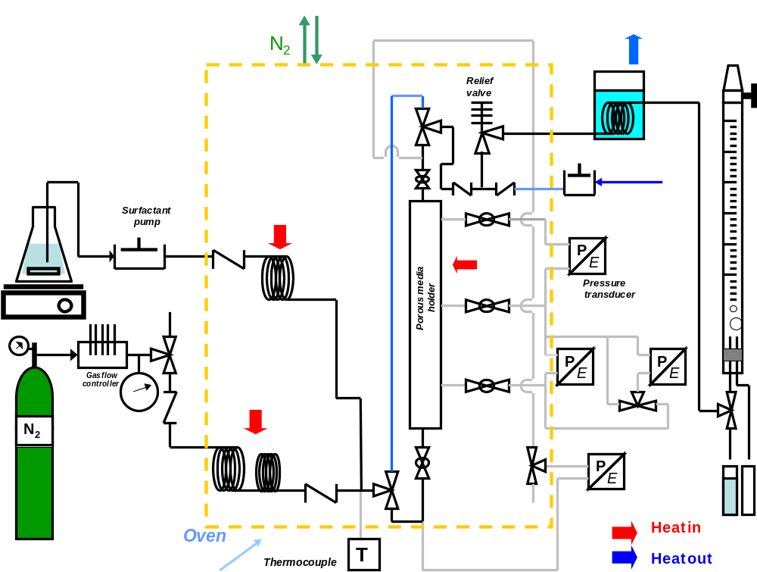
Foam Apparatus and
Experiments
Second
section
First
section
20

Slide 21
 | Anionic |  |  | Zwitterionic |  |  | Cationic |  |  |  | Notes
Experiment | A-R₁-AFG | A-R₂-AFG | A-R₃-AFG | Z-RI-ZFG₁ | Z-RII-ZFG₂ | Z-RI-ZFG₃ | C-R1-CFG₁ | C-R₁-CFG₃ | C-R₃-CFG₃ | C-R₂-CFG₂ | Foams | Brine | Oil | Flow direction
16,17 and 18 |  | x |  |  |  |  |  |  |  |  | Y | SW_{IS} | Y,N | ↑,↓
24,26 | x |  |  | x |  |  |  |  |  |  | Y | SW | N | ↑,↓
15 |  | x |  | x |  |  |  |  |  |  | Y | SW | Y,N | ↑
25 |  |  | x | x |  |  |  |  |  |  | Y | DIW | N | ↑
14 |  | x |  |  | x |  |  |  |  |  | Y | SW | Y,N | ↑
20 |  | x |  |  |  | x |  |  |  |  | Y | SW | N | ↑
19 |  |  |  |  | x |  |  |  |  | x | Y | SW | N | ↑
21 |  |  |  | x |  |  | x |  |  |  | N | SW | N | ↑
28 |  | x |  | x |  |  | x |  |  |  | Y | SW | Y,N | ↑
29 | x |  |  | x |  |  | x |  |  |  | Y | SW | N | ↑
13 |  |  |  |  |  |  | x |  |  |  | N | SW | N | ↑
23 |  |  |  |  |  |  |  | x |  |  | N | SW | N | ↑
22 and 27 |  |  |  |  |  |  |  |  | x |  | Y | SW+ Na pTS | N | ↑
Foam Experiments

Slide 22
A-R₂-AFG foam in SW_{IS} 94°C
First section
Second section
Inlet pressure
Relief valve pressure
Injection is 2 cm³/min of surfactant and 20 sccm of N₂. The foam quality at inlet conditions is 70%. Injection stopped after 1 h, and the system kept producing foam for additional 45 min

Slide 23
Effect of oil on the A-R₂-AFG foam in SW_{IS} 94°C
Oil injection
The surfactant flow rate was 1 cm³/min, Nitrogen injection at 10 sccm. Oil injection was at 0.1 cm³/min for 25 min, as indicated in the figure. After 3.5 h the flow rate was changed to ¼ of the previous.

Slide 24
Apparent viscosity of foam, 1% A-R₂-AFG in SW_{IS} at 94°C
Apparent viscosity vs total flow rate for quality between 0.7 and 0.78

Slide 25
Effect of quality on foam apparent viscosity
Foam quality effect on apparent viscosity at a total flow rate of 3 cm³/min
Apparent viscosity of foam, 1% A-R₂-AFG in SW_{IS} at 94°C

Slide 26
Effect of oil on the Z-R_{I}-ZFG₁- A-R₂-AFG (2-1) foam in Seawater 94°C
Oil injection
The surfactant flow rate was 1 cm3/min, Nitrogen injection at 10 sccm. Oil injection was at 0.1 cm3/min for 25 min, as indicated in the figure. After 3.5 h the flow rate was changed to ¼ of the previous.

Slide 27
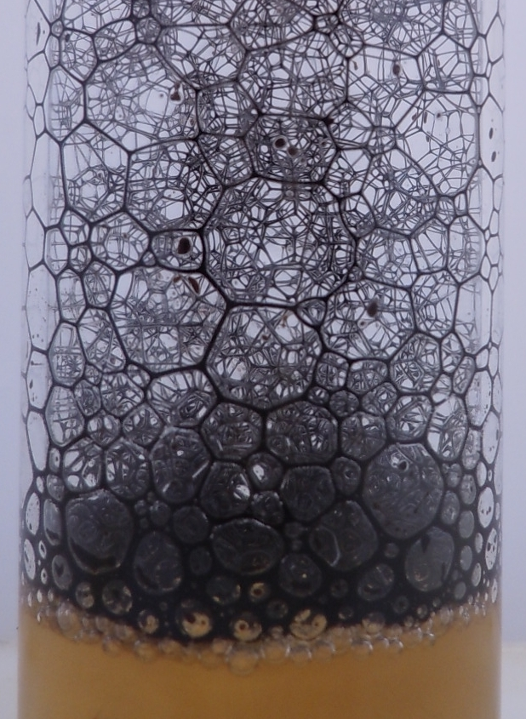

Effect of oil on the Z-R_{I}-ZFG₁- A-R₂-AFG (2-1) foam in Seawater 94°C
Behavior of foam in presence of oil

Slide 28
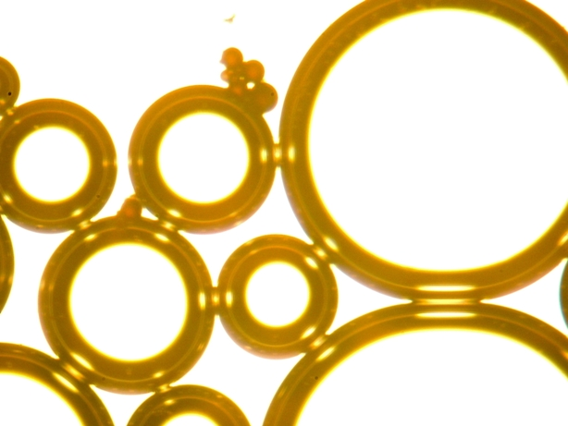
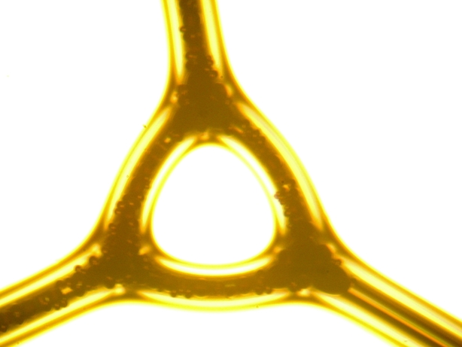
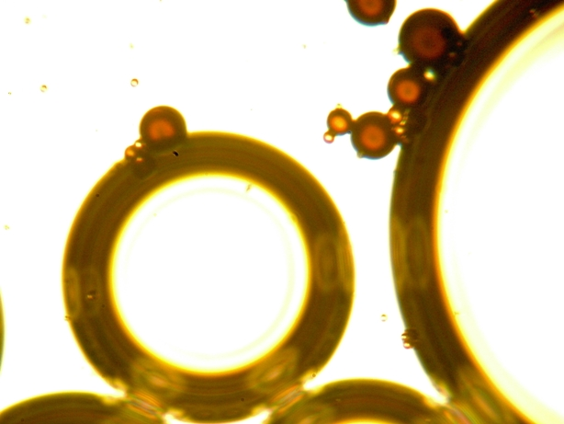
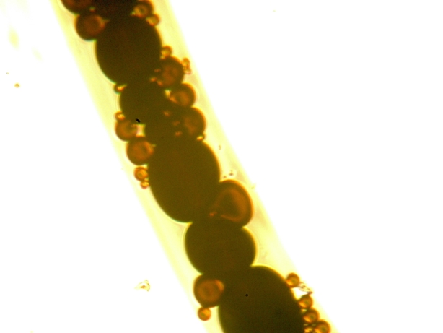
Foam in the presence of oil under the microscope at room temperature
Foam sampled from shaking ~10 ml of 1% solution with 1 cc of synthetic oil.
Aqueous phase
Gas
Gas
Crude oil
stuck
Gas
80μm
80μm
Aqueous phase
Lamella Zoomed
Aqueous phase
Crude oil
Aqueous phase
80μm
Gas
80μm
Crude oil
Effect of oil on the with EL foam in SW, The same trend is observed for the system Z-R_{I}-ZFG₁- A-R₂-AFG (2-1) foam in Sea water 94°C

Slide 29
Comparison of foam for different systems
A-R₂-AFG
Z-R_{I}-ZFG₂- A-R₁-AFG -C-R₁-CFG₁
(13-2-1)
Z-R_{I}-ZFG₁ + A-R₂-AFG (2-1)
C-R₁-CFG₃ NapTS (1-1)
Z-R_{I}-ZFG₂- A-R₂-AFG -C-R₁-CFG₁ (13-2-1)
At low flow rates the surfactant mixture Z-R_{I}-ZFG₂- A-R₂-AFG -C-R₁-CFG₁ (13-2-1) behaves as Newtonian fluid, in contrast to A-R₂-AFG which is shear thinning in broader range of flow rate. The same phenomenon is observed with cationics or when cationic is added.

Slide 30
Conclusions
Viscoelastic surfactant solutions produced strong foam
Anionics:
Can produce foam in salty water, but precipitates if divalent ions are present.
Needs Zwitterionics to produce clear solutions and to foam in sea water.
Zwitterionics:
By themselves are unable to produce foam at test case conditions in sea water.
Required addition of Anionic or Cationic C-R₂-CFG₂ to produce foam and have viscoelasticity.
Cationics :
By themselves are unable to produce foam at test case conditions in sea water.
Requires hydrotropes to produce viscoelasticity in sea water if no zwitterionic surfactant is added.
Produce precipitate when mixed with anionic surfactants in sea water in all proportions, at test conditions.

Slide 31
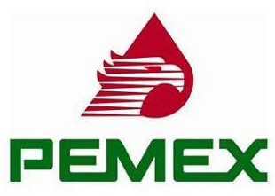
Acknowledgements
PEMEX
Kishore Mohanty, Matteo Pasquali, Aarthi Muthswamy and AmirHosein Valiollahzadeh

Slide 32
END

Slide 33
Backup slides

Slide 34
Foamability of surfactant blends for fractured reservoirs at 94°C
José López-Salinas, Maura Puerto
Objective
The overall objective of the research is to develop an EOR process by tailoring foams for simultaneously reducing remaining oil saturation and controlling fluid mobility in fracture carbonate reservoirs at ~ 94°C. The approach is to find a surfactant formulation that will foam with nitrogen as to deliver the foamed surfactant solution over a large volume of the fractured reservoir. The surfactant solution in the foam must alter wettability and/or lower IFT so liquid spontaneously imbibe into the matrix and increase the water saturation in the matrix. The increased liquid saturation will increase the liquid relative permeability and thus enhance the rate of liquid gravity drainage. If the wettability is altered and/or IFT lowered sufficiently, the draining liquid will be enriched in oil.

Slide 35
Summary
In this study foams were created in situ by simultaneously flowing 1% to 0.1% surfactant solution and nitrogen through homogeneous-silica sandpacks at 94°C. The surfactant blends, with potential to produce robust foams, were selected from Solubility Maps and rheology measurements. Conditions selected for flow testing were as follows:
110 Darcy Sandpack: L= 36.2-cm ID = 2.29-cm
Foam qualities from 0.01 to 0.99
Flow rates from 0.08 to 10cm³ /min
Injection from 30 to 100 psig.
Backpressure 30 ± 0.1 psig.
Most of the experiments were conducted in synthetic sea water but, to evaluate the effect of divalent cations, additional experiments were also done with either formation brine or NaCl-only brine equivalent to seawater in ionic strength. Also were evaluated the presence of crude oil and the direction of flow respect to gravity.

Slide 36
Test results indicated
values of apparent viscosities from 150 to 4000-cP for shear- thinning foams of 15% to 95% qualities.
selected zwitterionic and anionics blends have potential for applications in hard-brines-and-high-temperature reservoirs .
addition of cationic surfactant decreased foam strength at low flow rates.
presence of crude oil weaken foam .
selected formulation appeared to recover oil by imbibition not discussed here.

Slide 37
Previous Talk was part of ….
Jose Lopez, Maura Puerto, Clarence Miller, George Hirasaki
High temperature high salinity foams for EOR applications
Strong foams, with potential for EOR applications in fractured reservoir, were found for surfactant mixtures of anionic, cationic and zwitterionic. The last two were investigated because of their unique characteristics of forming polymer-like structures with anionics. Testing was done at 90°C and 100°C for different surfactants combinations with concentrations from 0.1 % to 1% in brines of salinities between simulated sea water and simulated formation brine of about three-time sea water. Also salinity maps, indicating optimal blend at constant salinity, of anionic blends are disclosed for informing on how oil recovery could be optimized with foams made of surfactants capable of lowering water-oil Interfacial Tension. Transport of surfactant in porous media for various EOR processes, IFT reduction and wettability alteration or both, has to be of minimal adsorption or retention and without chromatographic separation. In this paper there are discussions for the transporting of surfactants in foams for fractured, high-temperature and high-salinity, reservoirs.

Slide 38
Brine Composition
 | Seawater (g/l) | SW_{IS} (g/l) | Formation Brine (g/l)
NaCl | 27 | 44.640 | 106.03
CaCl₂ | 1.3 | 0 | 10.654
CaCl₂ 2H₂O | 0 | 0 | 0
MgCl₂ 6H₂O | 11.2 | 0 | 1.23
Na₂SO₄ | 4.8 | 0 | 0.74

Slide 39
1% Z-R_{I}-ZFG₁- A-R₂-AFG in Seawater
Ln η = -0.81 ln (dγ_{w}/dt) +1.91
Adapted from Carreau, 1997
Rheology of polymeric systems
Using:
b | 150 | Constant
T | 1.4142 | Tortuosity
ko | 2 | Constant
φ | 0.35 | Void fraction
K | 100 darcy | Permeability
u is superficial velocity and ΔP is pressure drop
d_{p} is particle diameter, for unconsolidated porous media

Slide 40
Zwitterionic + Anionic
Anionic

Slide 41
Anionic
Zwitterionic + Anionic + Cationic

Slide 42
Anionic
Cationic
+
Hydrotrope

Slide 43
Anionic
Z+A+C

Slide 44
Cationic
+
Hydrotrope
Total flow rate 2.5 cm³/min ±0.5 cm³/min

Slide 45
Z-R_{II}-ZFG₂- A-R₂-AFG (2-1) 1% in Seawater 25°C

Slide 46
Viscoelastic surfactant solutions in sea water (30ºC)
Viscoelasticity has been evaluated by visual observations and experimental rheological measurements confirmed those observations.
A-R₁-AFG
Z-R_{I}-ZFG₁
C-R₁-CFG₁
A-R₁-AFG and A-R₂-AFG produced similar results when mixed with Z-R_{I}-ZFG₁ and C-R₁-CFG₁

Slide 47
Solubility Map in Seawater 1% Total surfactant concentration
x Cloudy or two layers
o Clear
Z/A = 2

Slide 48
Typical rheological behavior for polymers
G ‘
G ‘
Rubber
Conc.
Polymeric liquid
Random coils
G “
G “
Log G
G “
Log G
Rods
G ‘
G “
G ‘
Dilute systems
Log ω
Log ω
G ‘
Macosko. Rheology, 1994
G ‘α ω ²
Solid -like
Log G
Larson, The structure and Rheology of Complex Fluids
Oxford, 1999
For living polymers (entangled wormy micellar solutions ) their length distribution can vary reversibly with response to changes in concentration, salinity, temperature and even flow …
G “
liquid-like
1
2
G “ α ω
Log ω

Slide 49
Typical rheological behavior for polymers
Conc.
Polymeric liquid
G ‘
Sinusoidal Oscillation
Log G
G “
Jeffrey ‘s
Maxwell ‘s
Log ω
In-phase or elastic modulus
G ‘
G ‘α ω ²
Out-of-phase, viscous or loss modulus
Solid -like
Log G
G “
liquid-like
1
2
G “ α ω
Log ω
Larson, The structure and Rheology of Complex Fluids
Oxford, 1999

Slide 50
Viscoelasticity for a Mixture (Z-R_{II}-ZFG₂- A-R₂-AFG -C-R₁-CFG₁ )
2.5% in Sea water
A-R₂-AFG
C-R₁-CFG₁
Z-R_{II}-ZFG₂
Adding cationic makes
the viscous modulus higher than
Storage modulus at shear rates lower than 40 1/s

Slide 51
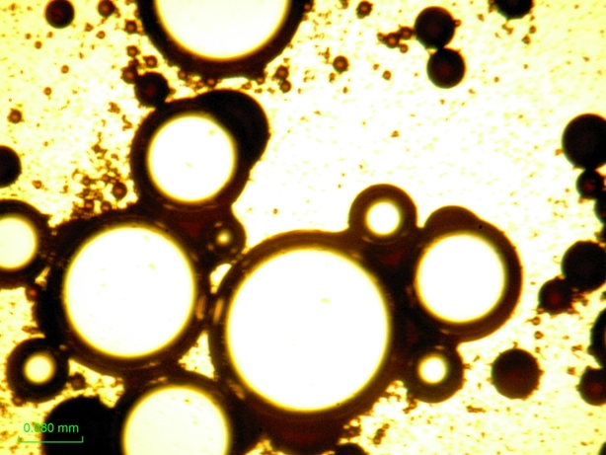
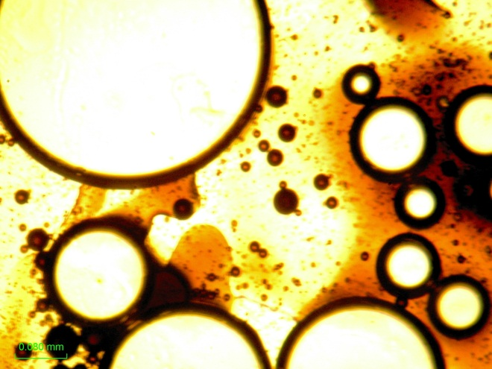
Surfactant blend different from the ones studied in this work

Slide 52
Cox-Merz relation
Dealy and Larson 2006
Structure and Rheology of molten polymers

Slide 53
A-R₂-AFG in 4.46% NaCl (SW Ionic strength)
30°C
Highly viscoelastic
Behaves like concentrated polymeric liquid.
Storage modulus dominates at high shear rate

Slide 55
1% A-R₂-AFG in SW and in NaCl brine at the same ionic strength

Slide 56
1% A-R₂-AFG in SW and in NaCl brine at the same ionic strength
Jeffrey Model
 | Seawater |  | NaCl (Seawater ionic strength)
ID | 0 | 2 | 0 | 2
G_{i} (Pa) | 1.4995 |  | 0.20134
τ_{i} (s) | 0.29 | 0.0174 | 0.55 | 0.1
Relaxation time τ₀
Retardation time τ₂

Slide 57
Maxwell generalized model
Sea Water
 | 1 | 2 | 3
Gi (Pa) | 0.6590 | 2.0441 | 1.2952
τi (s) | 0.0330 | 0.0090 | 0.2788
NaCl (SWIS)
 | 1 | 2 | 3
G_{i} (Pa) | 1.7902 | 0.0457 | 0.12888
τ_{i} (s) | 0.0138 | 1.2864 | 0.41219

Slide 58
Viscoelasticity for a Mixture (Z-R_{II}-ZFG₂- A-R₂-AFG -C-R₁-CFG₁ )
2.5% in Sea water

Slide 59
Comparison
2.5% A-R₂-AFG in SW_{IS}
2.5% Z-R_{II}-ZFG₂- A-R₂-AFG -C-R₁-CFG₁ in SW
1 % A-R₂-AFG in SW
1 % A-R₂-AFG in NaCl (SW_{IS})
1% Z-R_{II}-ZFG₂- A-R₂-AFG in SW
SW_{IS} = Seawater ionic strength
Adding Z-R_{II}-ZFG₂ to A-R₂-AFG, decreases the viscosity but only at high shear rates , but the viscoelastic behavior prevails, and the shear thinning properties of the fluid still there. The power law index in the shear thinning zone are similar (ca. 0.1) in all the cases.

Slide 60
Viscosity (2.5% Z-R_{II}-ZFG₂- A-R₂-AFG -C-R₁-CFG₁ )
A-R₂-AFG
Z-R_{II}-ZFG₂
C-R₁-CFG₁

Slide 61
A-R₂-AFG in Seawater
30°C
ID | 1 | 2
G_{i} | 5 | 10
τ_{i} | 0.05 | 5
This fit includes viscosity measurements in the range between 0.01 to 100 1/s Using Cox-Merz relation

Slide 62
Relaxation time 3.469s
Retardation time 0.00547s
ID | 0 | 2
G_{i} | 11.19 |  | Pa
τ_{i} | 3.469 | 0.00547 | s
This fit includes viscosity measurements in the range between 0.01 to 100 1/s

Slide 64
External Lab Surfactant Blend
Anionic
Zitterionic
Cationic
Behavior of EL Blend in brine solutions appeared complicated:
1% in seawater, viscoelastic and clear, but cloudy in formation brine.
0.1% in seawater cloudy but, clear and foams in formation brine

Slide 65
1.- Comparison of foam experiments
EL with Blends of Anionic-Zwitterionic
Test | Surfactant | Brine | Oil | Flow | μ, cP 2nd Section | μ, cP 1st section
9 | EL | Sea Water | No | Upward | 500 | 500
10 | EL | Sea Water | No | Downward | 650 | 500
11 | EL | Sea Water | Yes | Upward | 500 | 500
12 | EL (0.1%) | FB | No | Upward | 370 | 370
13 | C-R₁-CFG₁ | Sea Water | No | Upward | < 5 | < 5
14 | Z-R_{II}-ZFG₂- A-R₂-AFG (2-1) | Sea Water | No | Upward | 660 | 602
15 | Z-R_{I}-ZFG₁- A-R₂-AFG (2-1) | Sea Water | No | Upward | 700 | 700
The apparent viscosities at 1 cm³/min of liquid flow rate, and a volumetric gas quality ca. 70%

Slide 66
1.- Comparison of foam experiments _ Cont.
EL with Blends of Anionic-Zwitterionic -Cationic
Test | Surfactant | Brine | Oil | Flow | μ, cP 2nd Section | μ, cP 1st section
16 | A-R₂-AFG | SW_{IS} | No | Upward | 600 | 600
17 | A-R₂-AFG | SW_{IS} | Yes | Up | 500-600 | 500-600
18 | A-R₂-AFG and Oil | SW_{IS} | Yes | Up | 600 | 600
19 | Z-R_{II}-ZFG₂ - C-R₂-CFG₂ (3-1) | SW | No | Upward | 400 | 500
20 | Z-R_{I}-ZFG₃- A-R₂-AFG (2.75-1) | SW | No | Upward | 740 | 740
21 | Z-RI-ZFG₁ - C-R₁-CFG₁ (1-1) | SW | No | Up | < 5 | <5
22 | C-R₁-CFG₃ | SW | No | Up | < 5 | < 5
23 | C-R₃-CFG₃ | SW | No | Up | < 5 | < 5
24 | Z-R_{I}-ZFG₁- A-R₁-AFG (2-1) | FB | No | up | 500 | 500
25 | Z-R_{I}-ZFG₁- A-R₃-AFG (2-1) | DIW | No | up | 400 | 400
26 | Z-R_{I}-ZFG₁- A-R₂-AFG (2-1) | SW | Yes | up | 60-600 | 1-600
The apparent viscosities at 1 cm³/min of liquid flow rate, and a volumetric gas quality ca. 70%
SW=Seawater, SW_{IS}=NaCl in seawater ionic strength, FB=Formation brine, DIW =Distilled water

Slide 67
2.- Comparison of foam experiments _ Cont.
EL with Blends of Anionic-Zwitterionic-Cationic
Test | Surfactant | Brine | Oil | Flow | μ, cP 2nd Section | μ, cP 1st section
27* | C-R₁-CFG₃ NapTS (1-1), 0.167% | Sea Water | No | Upward | 480 | 400
28 | Z-R_{I}-ZFG₂- A-R₂-AFG -C-R₁-CFG₁ (13-2-1) | Sea Water | No | Upward | 533 | 693
29 | Z-R_{I}-ZFG₂- A-R₁-AFG -C-R₁-CFG₁ (13-2-1) | Sea Water | No | Upward | 500 | 600
The apparent viscosities at 1 cm³/min of liquid flow rate, and a volumetric gas quality ca. 70%

Slide 68



SET UP Details
Tailored Collection System
Connected directly to Tailored Collection System
Gap
1.66 PV
Gap
0.45 PV
(L=4.44 cm DX=1/4 mm)
PV of plugs = 2.66 cm³
Initial Oil Plugs > 2.4 cm³
Injection thru tubing discharging into screen holding sand
Total DV
4 PV
68

Slide 69
Separator
Core holder

Slide 70

Experiments in parallel with this study
(This is not discussed in this talk)
The present study is subjected to:
a) Wettability alteration
b) Phase behavior with oil
c) Imbibition experiments
d) Imbibition in foaming milieu
e) Studies of foam in contrasting permeabilities
e) Study of foams flowing outside micro channels filled with crude oil
a) Wettability on marble in sea water and with cationic at 94°C
c) Imbibition with A-C-Z in seawater 94°C
d) Imbibition in a flowing foam in cycles 94°C
b) Phase behavior 94°C

Slide 71
 | Anionic |  |  | Zwitterionic |  |  | Cationic
Experiment | A-R₁-AFG | A-R₂-AFG | A-R₃-AFG | Z-RI-ZFG₁ | Z-RII-ZFG₂ | Z-RI-ZFG₃ | C-R1-CFG₁ | C-R₁-CFG₃ | C-R₃-CFG₃ | C-R₂-CFG₂ | Notes
16,17 and 18 |  | x |  |  |  |  |  |  |  |  | SWIS (foams)
24,26 | x |  |  | x |  |  |  |  |  |  | SW (foams)
15 |  | x |  | x |  |  |  |  |  |  | SW (foams)
25 |  |  | x | x |  |  |  |  |  |  | DIW (foams)
14 |  | x |  |  | x |  |  |  |  |  | SW (foams)
20 |  | x |  |  |  | x |  |  |  |  | SW (foams)
19 |  |  |  |  | x |  |  |  |  | x | SW (foams)
21 |  |  |  | x |  |  | x |  |  |  | SW (does not)
28 |  | x |  | x |  |  | x |  |  |  | SW (foams)
29 | x |  |  | x |  |  | x |  |  |  | SW (foams)
13 |  |  |  |  |  |  | x |  |  |  | SW (does not)
23 |  |  |  |  |  |  |  | x |  |  | SW (does not)
22 and 27 |  |  |  |  |  |  |  |  | x |  | SW + Na pTS
Foam Experiments

Slide 72
Info in red is to be
Deleted
Codes

