Slide 1


Pore Structure of Vuggy Carbonates and Rate Dependent Displacement in Carbonate Rocks
Neeraj Rohilla, Dr. George J. Hirasaki
Rice University, Houston, Texas, USA
April 23, 2012

Slide 2
Motivation
Fifty percent of world’s oil in place is in Carbonate reservoirs
Carbonate reservoirs have complex pore structure with micropores, macropores/solution vugs/high permeability fractures
Vugs are irregular in shape and vary in size from millimeters to centimeters
Vuggy pore space can be divided into touching-vugs and separete-vugs
Touching vugs create interconnected pore system enhancing permeability values by orders of magnitude

Slide 3
Problem Statement
Focus of this work is on Brecciated and Fractured rocks.
Poor core recovery: ~ 30 %
Distribution of porosity between micro and macro pores: NMR T2 measurements
Connectivity of the vug/matrix system: Tracer Analysis (Flowing fraction, dispersion and Mass transfer)

Slide 4
Problem Statement (contd.)
Characterization of the pore structure with respect to pore level heterogeneity
  Connectivity of the vuggy/fracture system
  Permeability of the sample as a marker?
  Suitable Representative Element Volume (REV)
Effect of heterogeneity on transport processes relevant to EOR
  Suitable displacement rate for optimum recovery
  Loss of Surfactant as Dynamic adsorption

Slide 5
Outline of the presentation
NMR and Permeability studies
Tracer Flow Experiments
  Theory
  Procedure
Benchmark sandpack experiments
Full Cores versus small plugs for tracer experiments
Flow rate and Mass Transfer
Conclusions

Slide 6
Sample preparation for NMR experiments
Drilling mud and other solid particles from vugs were removed using a water pik
Core-plugs were first cleaned using a bath of tetrahydrofuran (THF) followed by chloroform and methanol
Core-plugs were dried overnight in the oven at 80⁰C
Core-plugs were saturated with 1% NaCl brine solution using vacuum saturation followed by pressure saturation at 1000 psi.

Slide 7
T₂ Relaxation time spectrum for core-plug saturated with 1% brine
T₂ Cut-off

Slide 8
T₂ Relaxation time spectrum for core-plug saturated with 1% brine
T₂ Cut-off
T₂ Cut-off
Sample: 10 V Permeability: 46 mD

Slide 9
T₂ Relaxation time spectrum for core-plug saturated with 1% brine
T₂ Cut-off

Slide 10
T₂ Relaxation time spectrum for core-plug saturated with 1% brine
T₂ Cut-off
T₂ Cut-off

Slide 11
T₂ Relaxation time spectrum for core-plug saturated with 1% brine
T₂ Cut-off

Slide 12
T₂ Relaxation time spectrum for core-plug saturated with 1% brine
T₂ Cut-off
T₂ Cut-off

Slide 13
T2 Log Mean and Permeability for 1.5 inch diameter plugs
Correlation Coefficient (r) = 0.13
No significant correlation between T2 Log mean and permeability

Slide 14
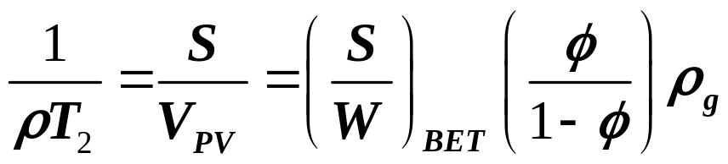
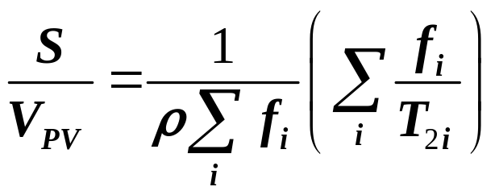
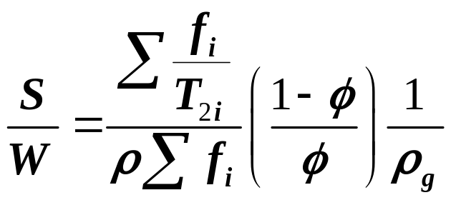
Determination of Specific Surface Area from NMR
T2 Relaxation Spectrum
T2 Relaxation spectrum can be related to S/V ratio of the pores
Surface Relaxivity (ρ) for PEMEX rock can be calculated using BET surface area measured for ground PEMEX rock.
From a given T2 relaxation spectrum (S/W) can be calculated

Slide 15
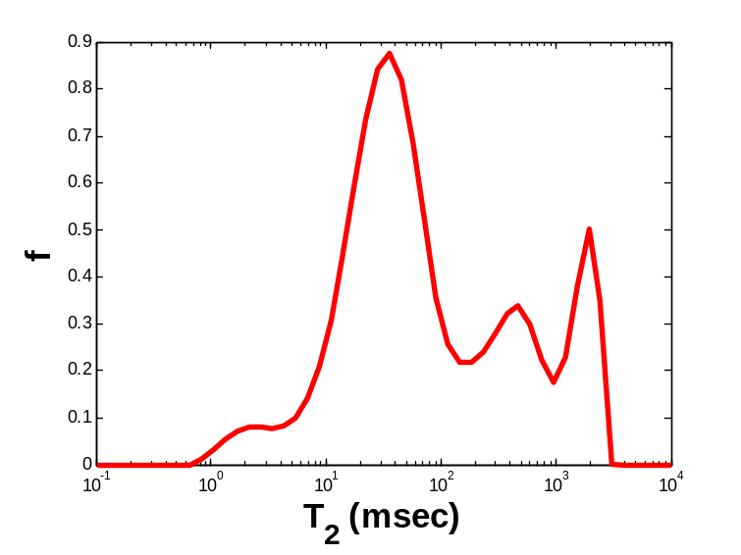
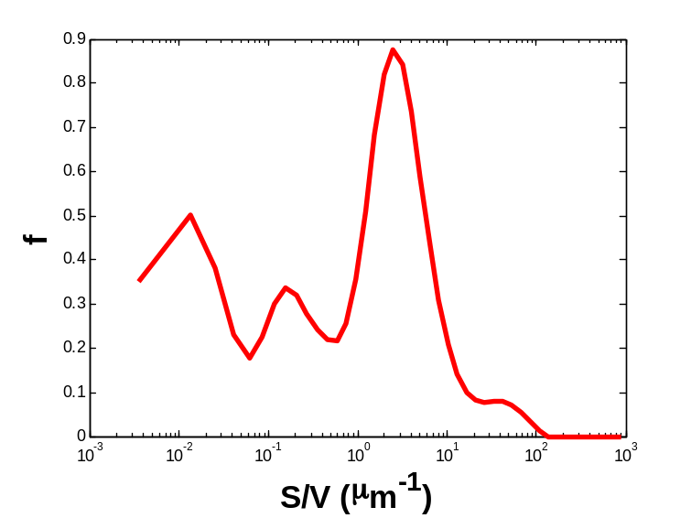
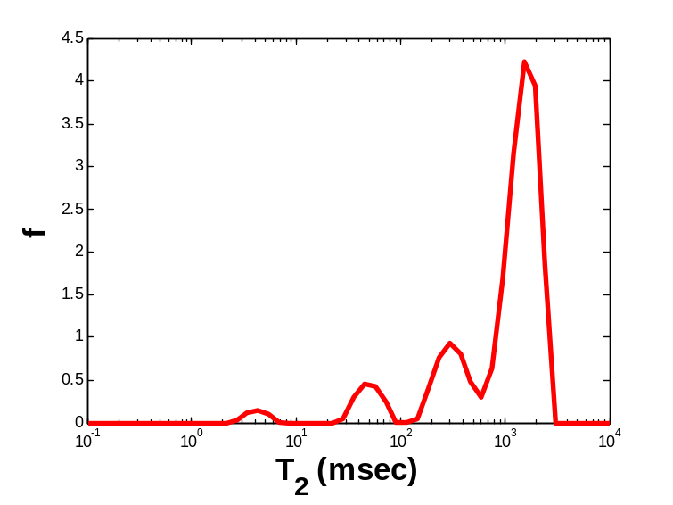
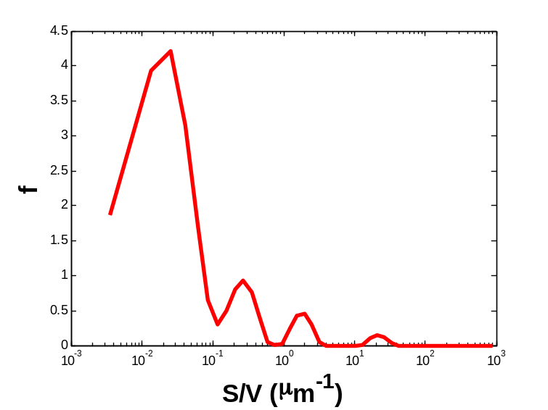
Comparison of T2 and S/V spectrum between Zaap 2 rock and Silurian outcrop sample
Sample # 1
(S/W) = 0.22 m²/gm
Silurian Outcrop
(S/W) = 0.05 m²/gm

Slide 16
Comparison of specific surface area of
different rock samples

Slide 17
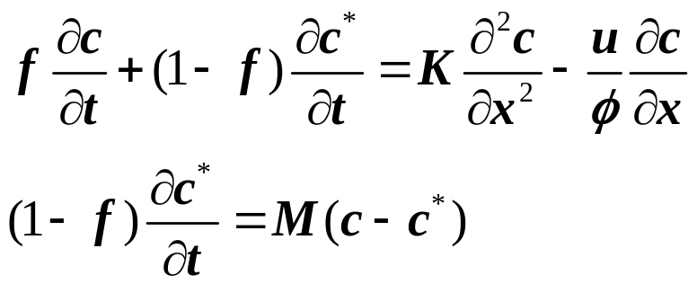

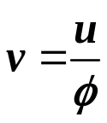
  Tracer Analysis: Mathematical Model
The Coats and Smith model is
introduced by two equations:
Where, K = Dispersion coefficient
f = Flowing fraction
(1-f) = Fraction of dead end pores
M = Mass transfer coefficient
c = tracer concentration in flowing stream
c* = tracer concentration in stagnant volume
u = superficial velocity
= porosity
= interstitial velocity

Slide 18
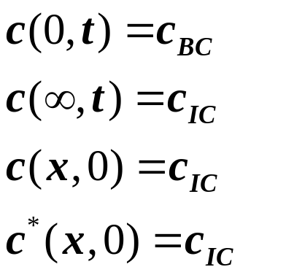
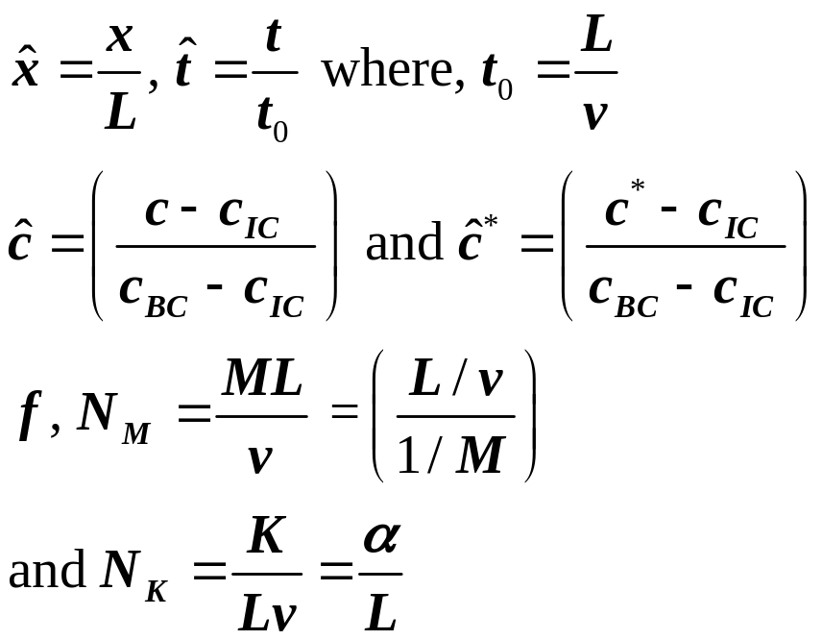

  Tracer Analysis: Mathematical Model
Boundary and Initial conditions
Dimensionless variables and groups:
c_{IC} is initial concentration in system
c_{BC} is injected concentration at the inlet
Pore volume throughput

Slide 19
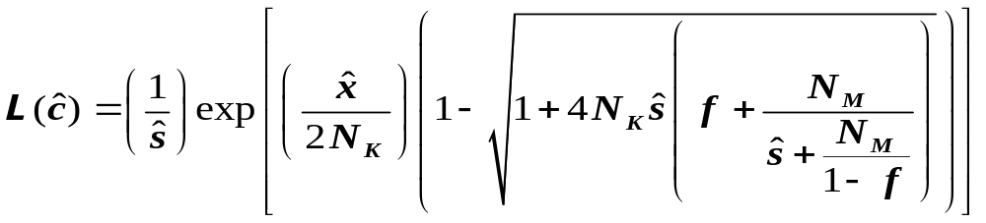
  Tracer Analysis: Mathematical Model
Differential equations are solved using Laplace Transform:
Experimental data is numerically transformed into Laplace domain
Model parameters are obtained by fitting the experimental data in Laplace domain using Lavenberg-Marquardt algorithm

Slide 20
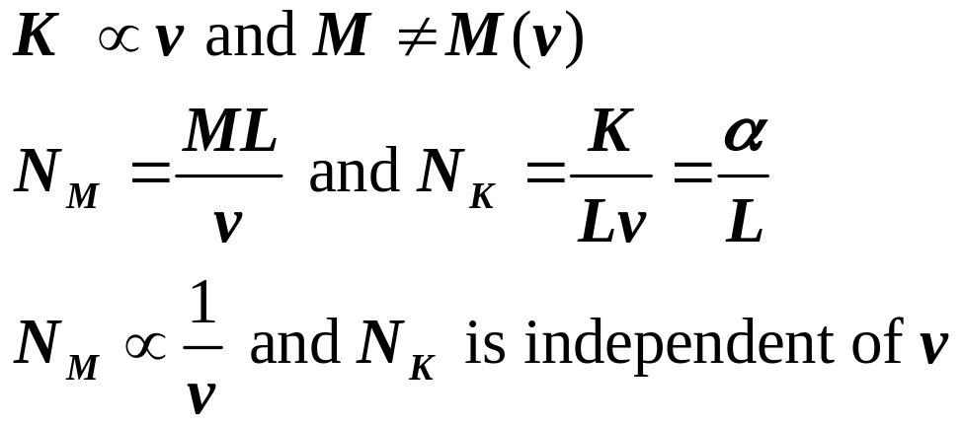
New approach for parameter estimation
Using experimental data at two different flow rates.
Assume Mass transfer coefficient (M) is independent of interstitial velocity and dispersion coefficient (K) varies linearly with interstitial velocity
Parameters are obtained for two sets of experiments simultaneously.

Slide 21
Schematic for experimental setup
LabView® Module for Data Acquisition
Electrode
CORE HOLDER/ SANDPACK
ISCO PUMP
Flow Cell
Hassler Type Core holder is used for rock samples
Sodium Bromide is used a Tracer in the experiments
Initial Tracer Concentration : 100 ppm
Injected Tracer Concentration : 10,000 ppm
Total Halide (Cl⁻ + Br⁻) concentration is kept constant at 0.15 M throughout the experiment

Slide 22
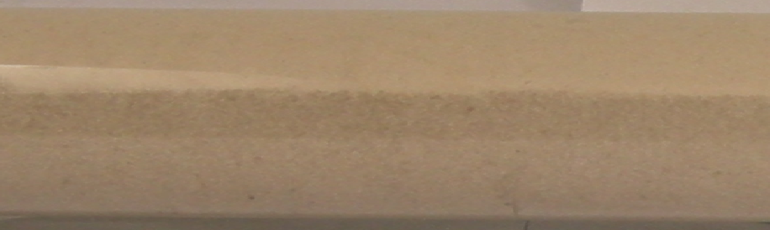
Homogeneous/Heterogeneous Sandpack Systems
Homogeneous sandpack gives f = 0.98
Heterogeneous sandpack has two sand layers which have permeability contrast of 19
Early breakthrough and a delayed response
f = 0.65

Slide 23
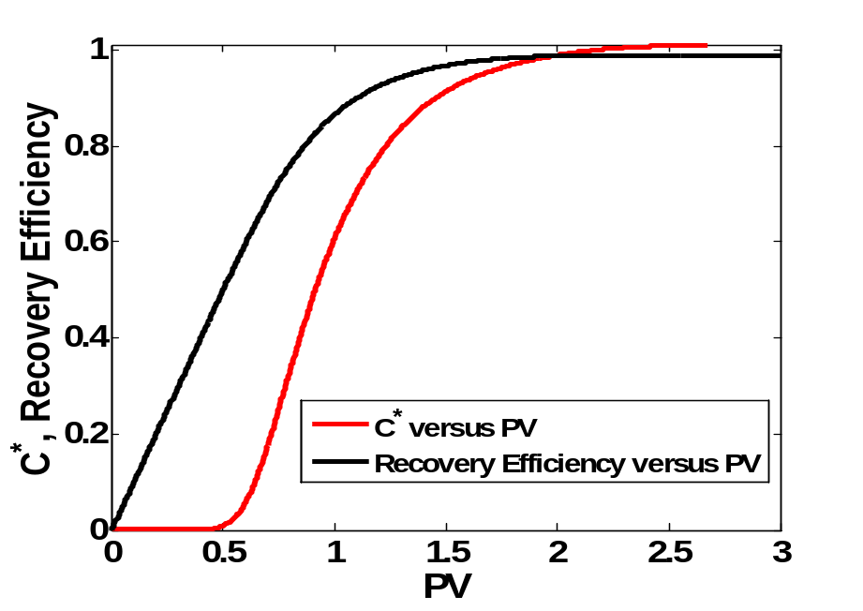
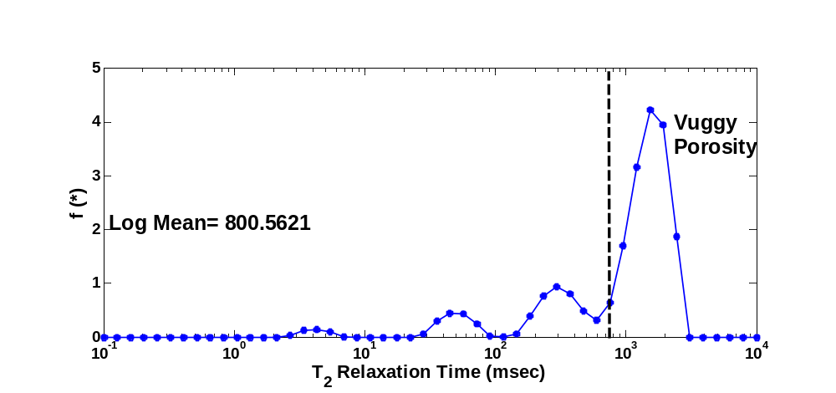
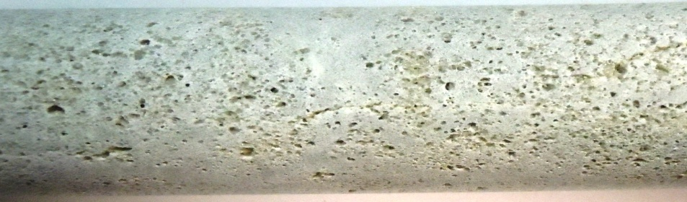
Tracer Analysis for homogeneous outcrop sample
T₂ Cut-off
f = 0.95
N_{K} = 0.1
N_{M} = 0.0001
v = 2.3 ft/day
Flowing Fraction (f) = 0.82
Dispersivity (α) = 1 cm
Mass Transfer: Very small
Sample: Silurian Outcrop
Diameter: 1.5 inch
Length: 4.0 inch
Porosity = 17.2 %
Pore Volume = 20 ml
Permeability: 258 mD

Slide 24
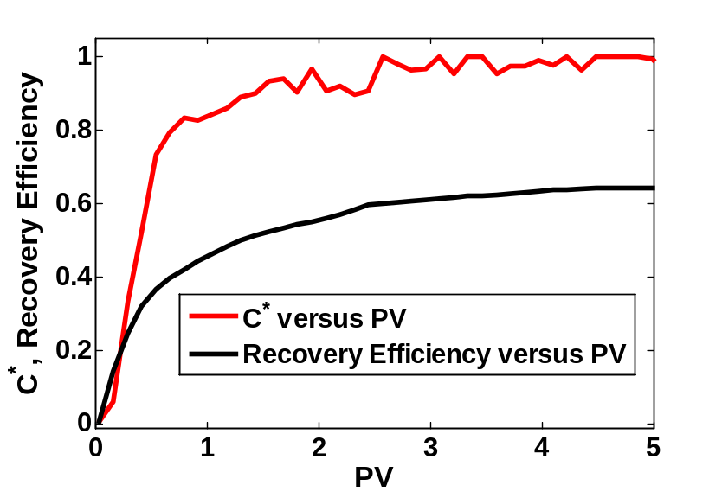
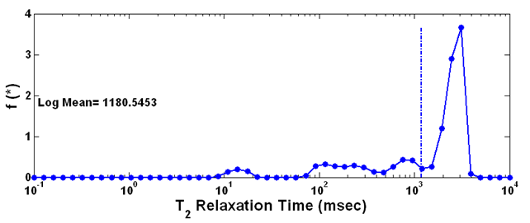
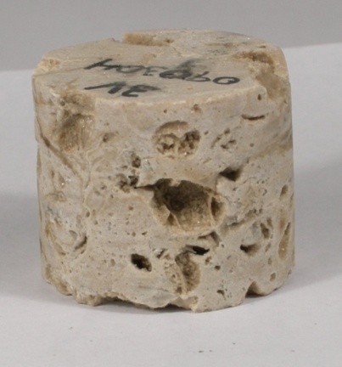
Sample (1.5 inch diameter) with small mass transfer
f = 0.5
N_{K} = 0.31
N_{M} = 0.01
Flowing Fraction (f) = 0.5
Dispersivity (α) = 1 cm
1/M = 0.17 days
v = 15.0 ft/day
Sample: 3V
Permeability: 6 mD

Slide 25
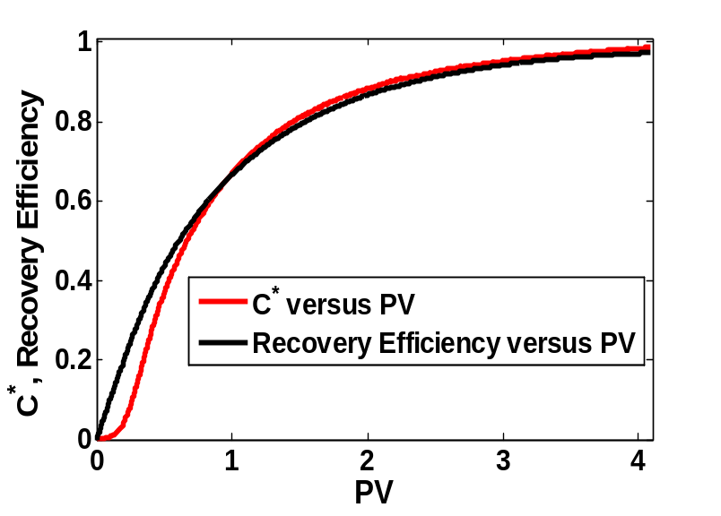
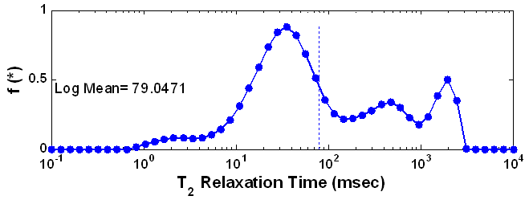
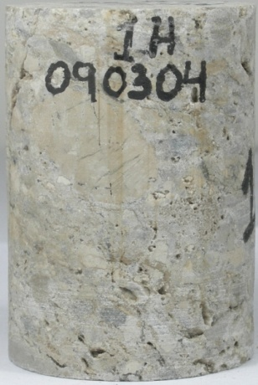
Sample (1.5 inch diameter) showing strong mass transfer
f = 0.2
N_{K} = 0.14
N_{M} = 5.3
Flowing Fraction (f) : 0.2
Dispersivity (α) = 0.8 cm
1/M = 0.02 days
v = 1.4 ft/day
Sample: 1H
Permeability: 2.1 mD

Slide 26
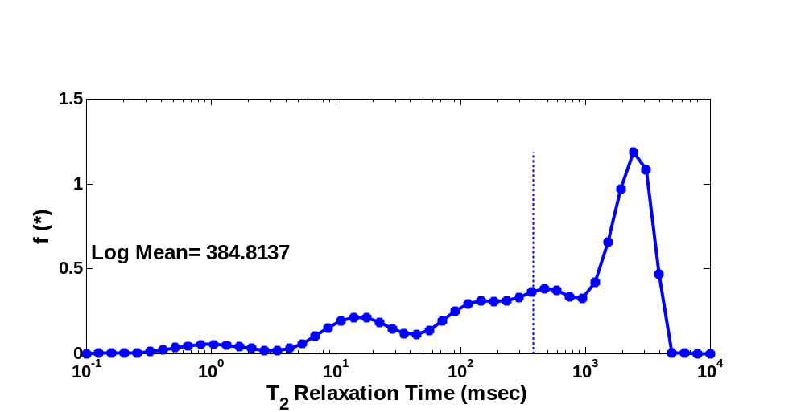
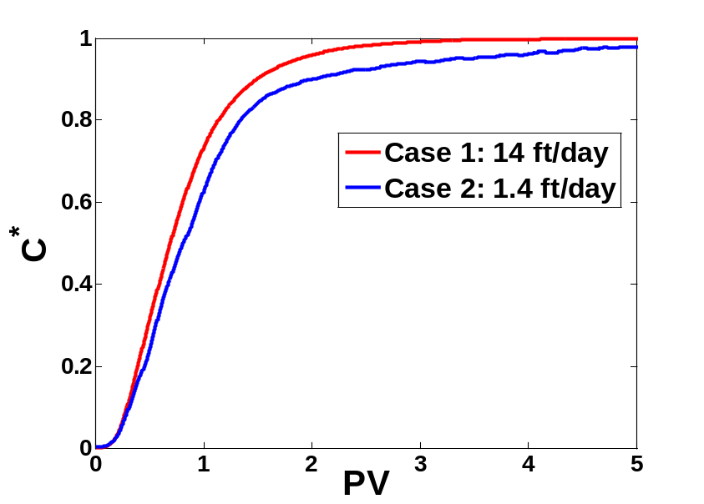
Tracer Analysis for 3.5 inch diameter sample
Flowing Fraction (f) : 0.7
Dispersivity (α) = 1.5 cm
1/M = 3.32 day
Diameter : 3.5 inch
Length = 3 inch
Permeability = 46 mD
Porosity = 8.5 %
Pore Volume = 40 ml
f = 0.7
N_{K} = 0.195
N_{M} = 0.7

Slide 27
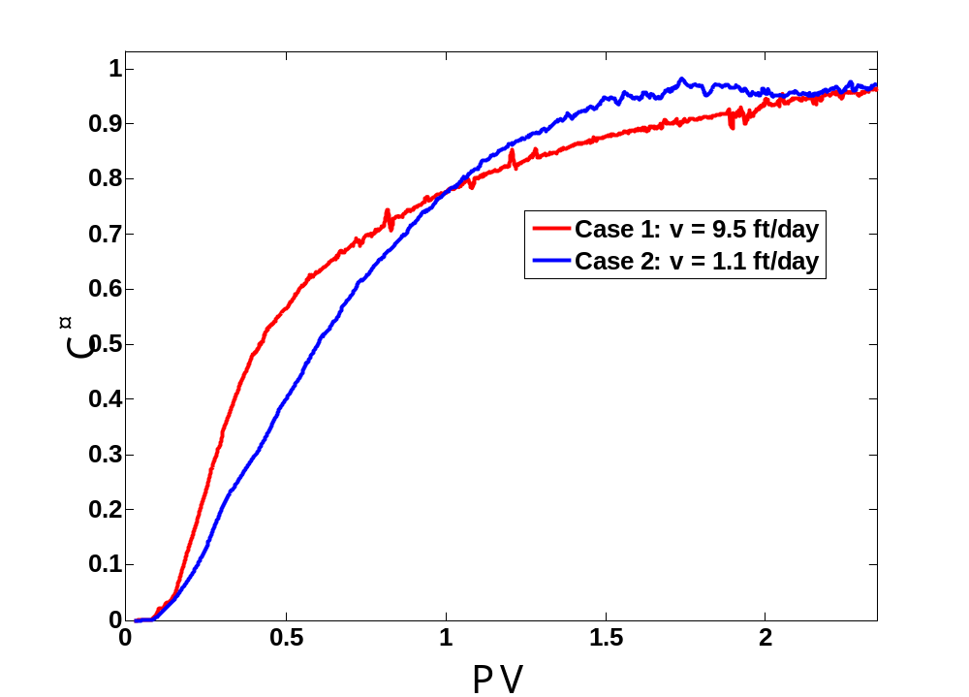
Tracer Analysis for 3.5 inch diameter sample
Diameter : 3.5 inch
Length = 3.625 inch
Porosity = 7.3 %
Permeability = 120 mD
Pore Volume = 41.9 ml
55 ml/hr ~ 9.5 ft/day
6.4 ml/hr ~ 1.1 ft/day
Flowing Fraction (f) : 0.5
Dispersivity (α) = 2.2 cm
1/M = 0.656 day
f = 0.5
N_{K} = 0.235
N_{M} = 0.42

Slide 28
Tracer displacement at different rates
Diameter : 3.5 inch
Length = 3.75 inch
Porosity = 7 %
Permeability = 317 mD
Pore Volume = 41 ml
  115.2 ml/hr ~ 21 ft/day
  10 ml/hr ~ 1.8 ft/day
  2 ml/hr ~ 0.36 ft/day
C*, Recovery Efficiency
Mass transfer is slow
Mobility Ratio = 1
PV
f = 0.47
N_{K} = 0.183
N_{M} = 0.34
Flowing Fraction (f) : 0.47
Dispersivity (α) = 1.7 cm
1/M = 2.45 day

Slide 29
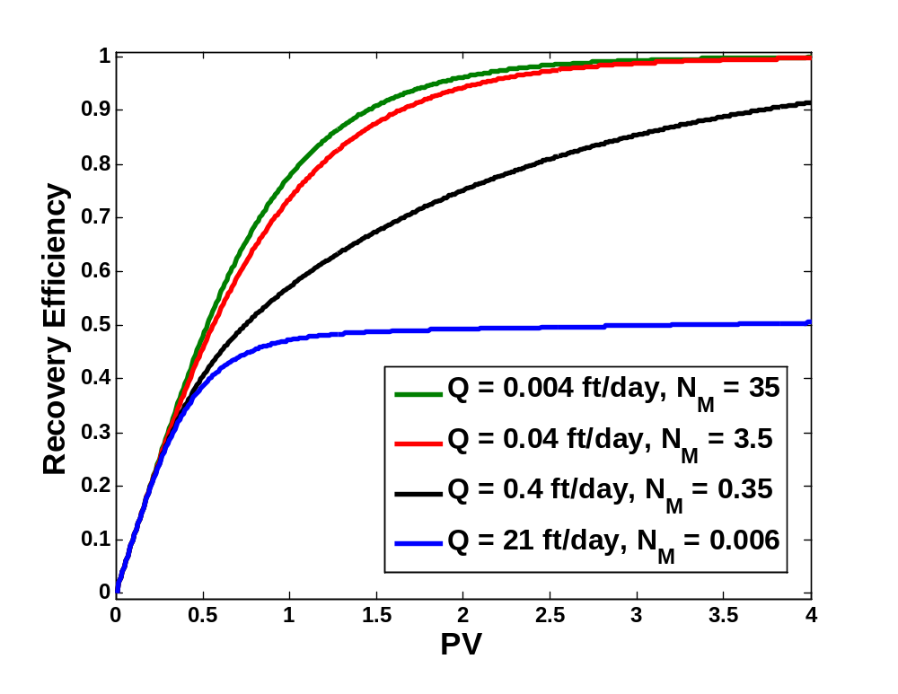
Dependence of Recovery Efficiency on flow rate
Parameters used:
f = 0.47
N_{K} = 0.183
1/M = 2.45 days

Slide 30
Permeability and Sample size
Permeability range for 1.0 inch diameter plugs is 0.01-5 mD (about 15 samples)
Permeability range for 1.5 inch diameter plugs is 1-6 mD (except for one sample with permeability of 45 mD, about 12 samples)
Larger diameter cores (3.5 & 4.0 inch) have permeability in the range of 65-310 mD.
Smaller plugs drilled from big cores have huge variability depending on the heterogeneity of the sample location.

Slide 31
Conclusions
NMR measurements show that samples are very heterogeneous. Samples taken within 3 inches of proximity exhibit different T₂ relaxation spectrum.
Overlap of different relaxation times with that of the vugs may indicate possibility of connected pore network channels but it should be confirmed with other independent analysis.
Permeability is about two orders of magnitude higher for larger diameter (3.5 inch/4.0 inch) diameter samples
Flow experiments on 1.5 inch diameter cores do not suggest the connectivity of vugs and smaller diameter samples (1.5 inch) are not representative element volume

Slide 32
Conclusions
Flowing fraction is in the range of 0.4-0.7 for larger diameter samples
Small flow rates are necessary to ensure mass transfer between flowing and stationary streams for displacement of residual tracer fluid in matrix
At small flowrates (high residence time), the Dynamic adsorption can be significant and needs to be examined more closely.

Slide 33
Acknowledgements
Petróleos Mexicanos (PEMEX)
Consortium for processes in porous media at
Rice University, Houston, TX

Slide 34
Effect of mass transfer on effluent concentration
Small flowing fraction results in early breakthrough
Mass transfer between flowing/stagnant streams can play a significant role for small flowing fraction systems
Strong mass transfer makes effluent concentration curve look if it represents a system with higher flowing fraction and dispersion

Slide 35
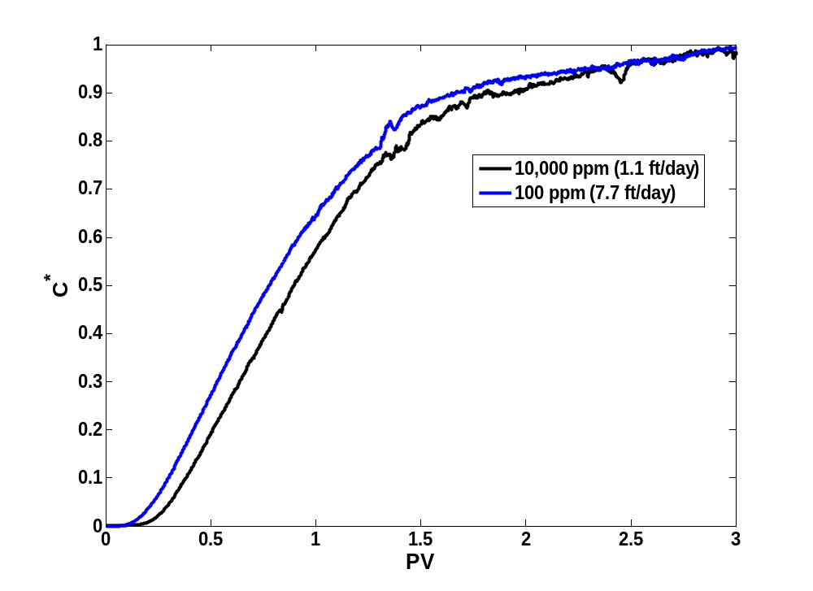
Tracer Analysis for 4.0 inch diameter sample
Diameter : 4.0 inch
Length = 7.5 inch
Porosity = 13 %
Permeability = 65 mD
Pore Volume = 204 ml
f = 0.65
N_{K} = 0.23
N_{M} = 0.05
Flowing Fraction (f) : 0.412
Dispersivity (α) = 2.2 cm
1/M = 2.54 day

Slide 36
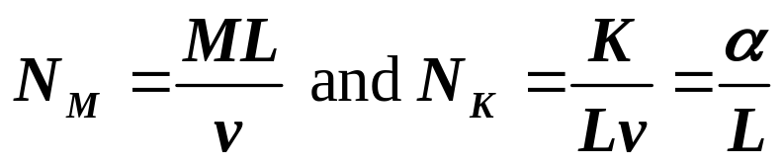
Table of estimated model parameters
Sample (ID) | Diameter (inch) | f | N_{M} | N_{K} | v ft/day | α=K/v cm | 1/M Day
3V | 1.5 | 0.5 | 0.01 | 0.31 | 15 | 1.0 | 0.17
1H | 1.5 | 0.2 | 5.3 | 0.14 | 1.7 | 0.8 | 0.02
3.5_A | 3.5 | 0.39 | 0.05 | 0.23 | 3.1 | 2.2 | 2.54
3.5_B | 3.5 | 0.47 | 0.34 | 0.18 | 0.36 | 1.7 | 2.45
3.5_C | 3.5 | 0.71 | 0.13 | 0.19 | 0.4 | 1.8 | 6.03
4.0_A | 4.0 | 0.65 | 0.48 | 0.12 | 1.1 | 2.3 | 0.17

Slide 37
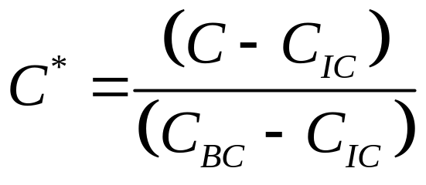
Bromide Electrode Calibration
Slope from Nernst equation = 57 ± 3 mV
Two point calibration works very well even for intermediate concentrations
C_{BC} = 10,000 ppm
C_{IC} = 100 ppm
C*
C* (Actual)

Slide 38
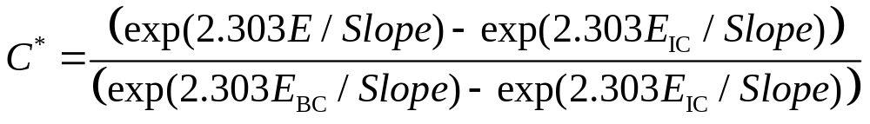
Procedure to obtain reduced concentration
E = E₀ + Slope*Log(C)
Slope is consistent across measurements, however intercept (E₀) changes from day to day.
C = C₀ exp (2.303*E/Slope)
Reduced Concentration
E_{IC} is measured at the beginning of the experiment and E_{BC} is measured at the end of tracer flow experiment

