Slide 1

Sacrificial Agent for Reducing Adsorption of Anionic Surfactants
By: Hadi ShamsiJazeyi, George J. Hirasaki, Rafael Verduzco
Rice University
Chemical and Bio-molecular Engineering Department
17th Annual Meeting of
Rice University Consortium for Process in Porous Media
April 29, 2013

Slide 2
Problem Definition
Materials and Methods
Results and Discussions
Conclusions
Experimental Evidence for the effect of anhydrite on adsorption of anionic surfactants?
Does polyacrylate reduce adsorption of different anionic surfactants on different rocks and minerals?
Why Sodium Polyacrylate?
Any role for Mw of polyacrylate?
What is the adsorption of polyacrylate in comparison with anionic surfactant?
Effect of salinity and divalent ions on application of polyacrylate as sacrificial agent.
How does application of polyacrylate affect the total material cost?
How dynamic and static adsorption tests compares?

Slide 3
Anhydrite reacts with Sodium Carbonate!
Can Polyacrylate be used?
Adsorption of anionic surfactant on a positively-charged surface of rock/mineral
First-layer adsorption is governed by electrostatics
Second-Layer adsorption can happen at high concentrations
2

Slide 4
Anhydrite reacts with Sodium Carbonate!
Can Polyacrylate be used?
Adsorption of anionic surfactant can be decreased by turning the surface charge negative when an alkali is used to raise the pH above pH_{pzc}
2

Slide 5
Anhydrite reacts with Sodium Carbonate!
Can Polyacrylate be used?
2

Slide 6
Anhydrite reacts with Sodium Carbonate!
Can Polyacrylate be used?
2

Slide 7
Introduction and Problem Definition
Materials and Methods
Results and Discussions
Conclusions
Experimental Evidence for the effect of anhydrite on adsorption of anionic surfactants?
Does polyacrylate reduce adsorption of different anionic surfactants on different rocks and minerals?
Why Sodium Polyacrylate?
Any role for Mw of polyacrylate?
What is the adsorption of polyacrylate in comparison with anionic surfactant?
Effect of salinity and divalent ions on application of polyacrylate as sacrificial agent.
How does application of polyacrylate affect the total material cost?
How dynamic and static adsorption tests compares?

Slide 8
List of surfactants
Trade or descriptive name | Chemical structure | Activity (%) | Supplier
Neodol-67 (N) | bC16-17(CH3-CH-CH2-O)7-SO4Na | 22.88 | STEPAN
IOS15-18 (I) | R-CH(OH)-CH2-CH(SO3)-R (~75%) R-CH=CH-CH(SO3-)-R (~25%) where R+R’ = C12-15 | 21.29 | STEPAN
NI-Blend | A Blend of Neodol-67-7PO-Sulfate and IOS15-18 (N:I)=4:1 | -- | --
Petro-step S13B | i-C13-(PO)₇ –SO4Na | 85.50 | TIORCO
3

Slide 9
List of polyacrylates
Trade or descriptive name | Chemical structure | Activity (%) | Supplier
FLOSPERSE 1000 | Sodium Polyacrylate (Mw=2200 Da) | 44 | SNF
FLOSPERSE 3000 | Sodium Polyacrylate (Mw=4500 Da) | 44 | SNF
FLOSPERSE 15000 | Sodium Polyacrylate (Mw=150 KDa) | 30 | SNF
FLOPAM AN 995 BPM | Sodium Polyacrylate (Mw~3 MDa) | 100 | SNF
ACUMER 1100 | Sodium Polyacrylate (Mw=4500 Da) | 47-49 | DOW Chem.
Poly(acrylic sodium salt) | Sodium Polyacrylate (Mw= 5100 Da) | 100 | Sigma-Aldrich
4

Slide 10
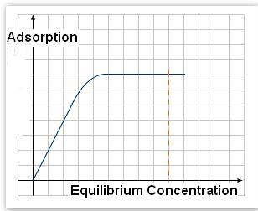
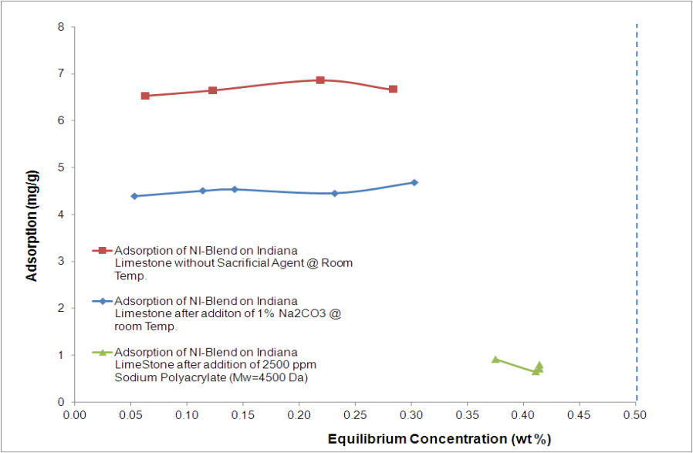

Measurement of Adsorption
Plateau region of adsorption isotherms should be measured.
Both initial and equilibrium concentrations are measured.
Equilibrium concentration should be far enough from initial concentration,
so that the noise in measurement can be neglected.
Concentration of anionic surfactant is measured using potentiometric titration.
Concentration of sodium polyacrylate is measured using a colorimetric method.
5

Slide 11
Introduction and Problem Definition
Materials and Methods
Results and Discussions
Conclusions
Experimental Evidence for the effect of anhydrite on adsorption of anionic surfactants?
Does polyacrylate reduce adsorption of different anionic surfactants on different rocks and minerals?
Why Sodium Polyacrylate?
Any role for Mw of polyacrylate?
What is the adsorption of polyacrylate in comparison with anionic surfactant?
Effect of salinity and divalent ions on application of polyacrylate as sacrificial agent.
How does application of polyacrylate affect the total material cost?
How dynamic and static adsorption tests compares?

Slide 12
Anhydrite Can Affect Sodium Carbonate and Increase Adsorption of Anionic Surfactant
SAR = (# of moles of sodium carbonate) / (# of moles of anhydrite)
6

Slide 13
Introduction and Problem Definition
Materials and Methods
Results and Discussions
Conclusions
Experimental Evidence for the effect of anhydrite on adsorption of anionic surfactants?
Does polyacrylate reduce adsorption of different anionic surfactants on different rocks and minerals?
Why Sodium Polyacrylate?
Any role for Mw of polyacrylate?
What is the adsorption of polyacrylate in comparison with anionic surfactant?
Effect of salinity and divalent ions on application of polyacrylate as sacrificial agent.
How does application of polyacrylate affect the total material cost?
How dynamic and static adsorption tests compares?

Slide 14
Characterization of the Rocks/Minerals
Adsorbent (Powdered Rock/Mineral) | Multi-point BET Surface Area* (m²/g) | T-Method External Surface Area (m²/g) | T-Method Micro-Porous Pore Volume (cc/g) | Average Pore Diameter (nm) | Anhydrite Percentage (%) | Other Notes
purified calcite | 1.318 | 1.222 | 5.008E-5 | 1.820 | 0.07 | (99.5 wt% CaCO₃) Alfa Aesar [Lot # C270009]
industrial calcite | 1.608 | 1.297 | 1.617E-5 | 1.780 | 0.11 | 97.00 wt% CaCO₃ (38.80 wt% Ca) Franklin Industrial Minerals
Carlpool dolomite | 0.7846 | 0.7426 | 1.726E-5 | 4.181 | 1.76 | (20.00 wt% Ca) (10.00 wt% Mg) Earthsafe Organics Carlpool Products
Indiana limestone | 0.9851 | 0.9850 | 1.421E-7 | 4.363 | 0.82 | Kocurek Industries
purified kaolinite | 20.8655 | 19.5626 | 5.832E-4 | 4.969 | 0.03 | Sigma-Aldrich [Lot # 048K0046]
powdered Berea sandstone | 2.6750 | 2.6730 | 3.341E-4 | 1.149 | NA | Kocurek Industries
7

Slide 15
Polyacrylate vs. Sodium Carbonate for Reducing
Adsorption of NI-Blend on Different Rocks/Minerals
8

Slide 16
Reducing Adsorption of Two Different Surfactants
using Polyacrylate on Carlpool Dolomite
9

Slide 17
Introduction and Problem Definition
Materials and Methods
Results and Discussions
Conclusions
Experimental Evidence for the effect of anhydrite on adsorption of anionic surfactants?
Does polyacrylate reduce adsorption of different anionic surfactants on different rocks and minerals?
Why Sodium Polyacrylate?
Any role for Mw of polyacrylate?
What is the adsorption of polyacrylate in comparison with anionic surfactant?
Effect of salinity and divalent ions on application of polyacrylate as sacrificial agent.
How does application of polyacrylate affect the total material cost?
How dynamic and static adsorption tests compares?

Slide 18
Reducing Adsorption of NI-Blend on Carlpool Dolomite:
Polyacrylate vs. Different Chemicals
Monomer Sacrificial Agents
Polymeric Sacrificial Agents
Sodium polyacrylates with different Mw from different vendors
10

Slide 19
Sodium Polyacrylate vs. Other Sacrificial Agents
in the Literature
11

Slide 20
Introduction and Problem Definition
Materials and Methods
Results and Discussions
Conclusions
Experimental Evidence for the effect of anhydrite on adsorption of anionic surfactants?
Does polyacrylate reduce adsorption of different anionic surfactants on different rocks and minerals?
Why Sodium Polyacrylate?
What is role for Mw of polyacrylate?
What is the adsorption of polyacrylate in comparison with anionic surfactant?
Effect of salinity and divalent ions on application of polyacrylate as sacrificial agent.
How does application of polyacrylate affect the total material cost?
How dynamic and static adsorption tests compares?

Slide 21
Effect of Molecular Weight of
Polyacrylate on adsorption of anionic surfactant
12

Slide 22
Introduction and Problem Definition
Materials and Methods
Results and Discussions
Conclusions
Experimental Evidence for the effect of anhydrite on adsorption of anionic surfactants?
Does polyacrylate reduce adsorption of different anionic surfactants on different rocks and minerals?
Why Sodium Polyacrylate?
What is role for Mw of polyacrylate?
What is the adsorption of polyacrylate in comparison with anionic surfactant?
Effect of salinity and divalent ions on application of polyacrylate as sacrificial agent.
How does application of polyacrylate affect the total material cost?
How dynamic and static adsorption tests compares?

Slide 23
Adsorption of Polyacrylate (Mw=4500Da) on Carlpool Dolomite
13

Slide 24
Introduction and Problem Definition
Materials and Methods
Results and Discussions
Conclusions
Experimental Evidence for the effect of anhydrite on adsorption of anionic surfactants?
Does polyacrylate reduce adsorption of different anionic surfactants on different rocks and minerals?
Why Sodium Polyacrylate?
What is role for Mw of polyacrylate?
What is the adsorption of polyacrylate in comparison with anionic surfactant?
Effect of salinity and divalent ions on application of polyacrylate as sacrificial agent.
How does application of polyacrylate affect the total material cost?
How dynamic and static adsorption tests compares?

Slide 25
Effect of salinity
NI-Blend Adsorption
Powdered Berea Sandstone
NI-Blend Adsorption
Carlpool Dolomite
14

Slide 26
Effect of divalent ions
NI-Blend Adsorption
Kaolinite
NI-Blend Adsorption
Pure Calcite
15

Slide 27
Effect of divalent ions
NI-Blend Adsorption on Powdered Berea Sandstone
NI-Blend Adsorption on Carlpool Dolomite
16

Slide 28
Introduction and Problem Definition
Materials and Methods
Results and Discussions
Conclusions
Experimental Evidence for the effect of anhydrite on adsorption of anionic surfactants?
Does polyacrylate reduce adsorption of different anionic surfactants on different rocks and minerals?
Why Sodium Polyacrylate?
What is role for Mw of polyacrylate?
What is the adsorption of polyacrylate in comparison with anionic surfactant?
Effect of salinity and divalent ions on application of polyacrylate as sacrificial agent.
How does application of polyacrylate affect the total material cost?
How dynamic and static adsorption tests compares?

Slide 29


Economical Study:
Effect of Reservoir/Injection (Alfa Dimensionless Number)
*
*
*
*
*
*
*
*
*
*
17

Slide 30

Economical Study:
Effect of Cost of Polyacrylate to Cost of Surfactant
Cost Dimensionless Number
*
*
*
*
*
*
*
*
*
*
18

Slide 31
Introduction and Problem Definition
Materials and Methods
Results and Discussions
Conclusions
Experimental Evidence for the effect of anhydrite on adsorption of anionic surfactants?
Does polyacrylate reduce adsorption of different anionic surfactants on different rocks and minerals?
Why Sodium Polyacrylate?
What is role for Mw of polyacrylate?
What is the adsorption of polyacrylate in comparison with anionic surfactant?
Effect of salinity and divalent ions on application of polyacrylate as sacrificial agent.
How does application of polyacrylate affect the total material cost?
How dynamic and static adsorption tests compares?

Slide 32
Dynamic Adsorption of 0.5 wt% NI-blend
on Carlpool Dolomite with no sacrificial agent
19

Slide 33
Dynamic Adsorption of 0.5 wt% NI-blend
On Carlpool Dolomite with 1000 (ppm) sodium polyacrylate
20

Slide 34
Comparison of Static and Dynamic Adsorptions
PAR = (# of repeating units in polyacrylate) / (# of moles of anhydrite)
Decrease in PAR
22

Slide 35
Introduction and Problem Definition
Materials and Methods
Results and Discussions
Conclusions
Experimental Evidence for the effect of anhydrite on adsorption of anionic surfactants?
Does polyacrylate reduce adsorption of different anionic surfactants on different rocks and minerals?
Why Sodium Polyacrylate?
What is role for Mw of polyacrylate?
What is the adsorption of polyacrylate in comparison with anionic surfactant?
Effect of salinity and divalent ions on application of polyacrylate as sacrificial agent.
How does application of polyacrylate affect the total material cost?
How dynamic and static adsorption tests compares?

Slide 36
Conclusion
Sodium polyacrylate strongly reduces adsorption of different anionic surfactants on different rocks/minerals more than other traditional sacrificial agents even in presence of anhydrite.
No high molecular weight polyacrylate to be used (4500 Da is enough).
Adsorption of sodium polyacrylate does NOT change with presence of anionic surfactant, and is almost 1/4th of the adsorption of NI-Blend on same rock.
Effect of salinity and divalent ions in the brine was tested. In the absence of anhydrite, sodium polyacrylate acts as a better sacrificial agent in purified water. In the presence of anhydrite, purification of water does NOT add advantage.
By choosing the optimal concentration of polyacrylate the total material cost of a dynamic injection can be significantly reduced.
23

Slide 37
THANK YOU
25

Slide 38
Back-Up Slides
26

Slide 39
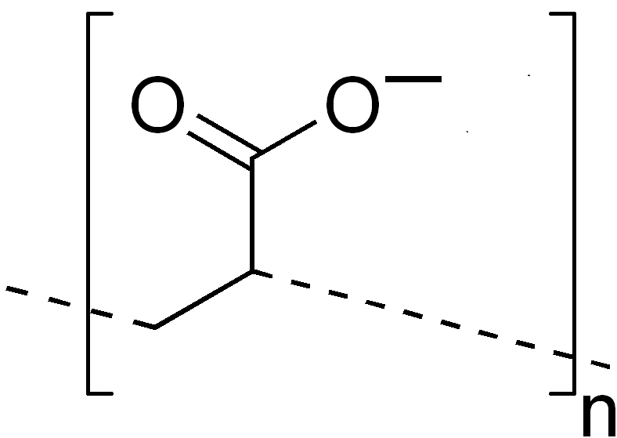
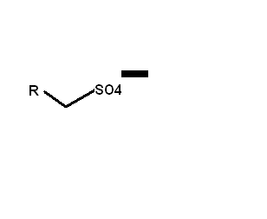
Is Polyacrylate Affecting the titration of Surfactant?
Sodium Polyacrylate has negative charge in neutral pH
Does this mean that Sodium Polyacrylate can interfere with measuring concentration of anionic (sulfate-based) surfactant?
Surfactant has
negative charge in neutral pH
27

Slide 40
Is Polyacrylate Affecting the titration of Surfactant?
(…Continued)
Our strategy is to do the potentiometric titration at pH=3 so that the polyacrylate does not have any charge, but sulfate-based anionic surfactant does.
28

Slide 41
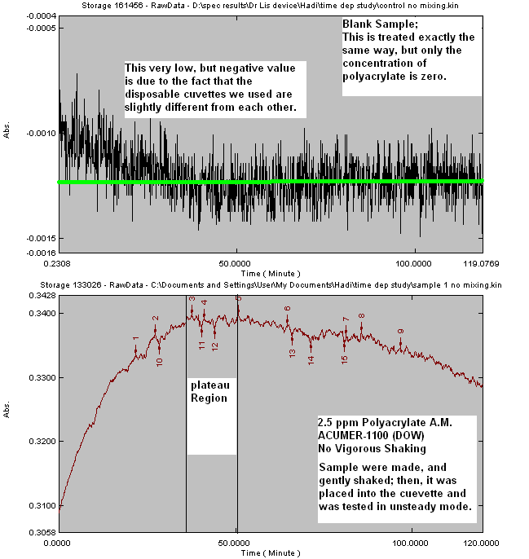
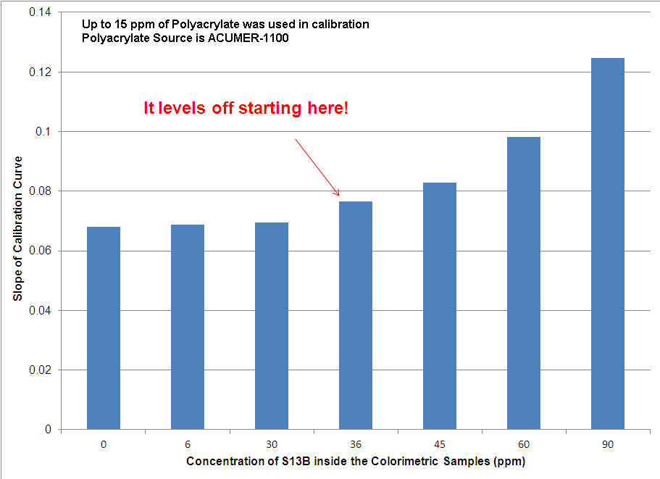
Measurement of Concentration of Sodium Polyacrylate
(Colorimetric Method)
Effect of S13B On Colorimetric
Measurement
29

Slide 42
Dynamic Adsorption of 0.5 wt% NI-blend
on Carlpool Dolomite with 2500 (ppm) sodium polyacrylate
21

