Slide 1


Estimation of parameters for the simulation of foam flow through porous media: Part 2; non-uniqueness, numerical artifacts and sensitivity
Kun Maª, Rouhi Farajzadeh^{b,c}, Jose L. Lopez-Salinasª, Clarence A. Millerª, Sibani Lisa Biswalª and George J. Hirasakiª*
ª Department of Chemical and Biomolecular Engineering, Rice University, Houston, TX 77005, USA
^{b} Shell Global Solutions International, Rijswijk, The Netherlands
^{c} Delft University of Technology, The Netherlands

Slide 2
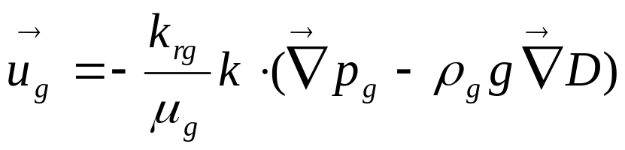
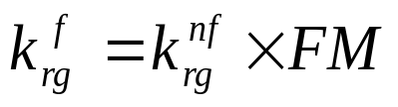
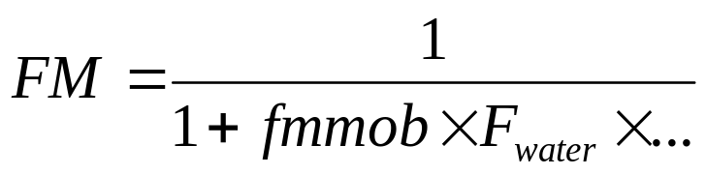
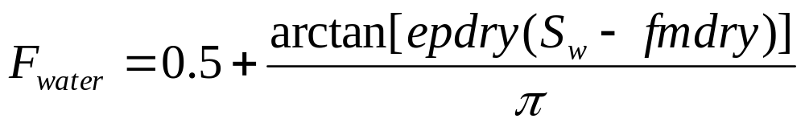
Modeling the dry-out effect of foam flow through porous media
fmmob: the reference foam mobility reduction factor;
fmdry: the critical water saturation (volume fraction) above which the maximum foam strength is reached;
epdry: the slope which regulates how abrupt the foam dries out neary fmdry.
Ashoori E, Heijden TLM, Rossen WR (2010) Fractional-Flow Theory of Foam Displacements With Oil. SPE Journal 15:pp. 260-273
Computer Modeling Group (2007) STARSTM User's Guide. Calgary, Alberta, Canada

Slide 3
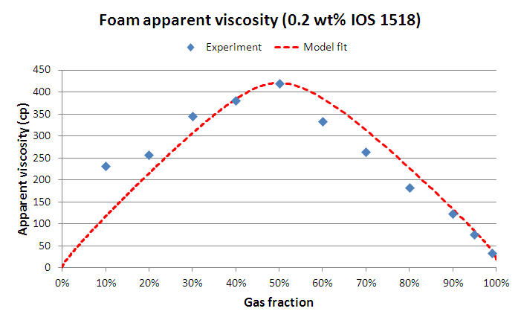
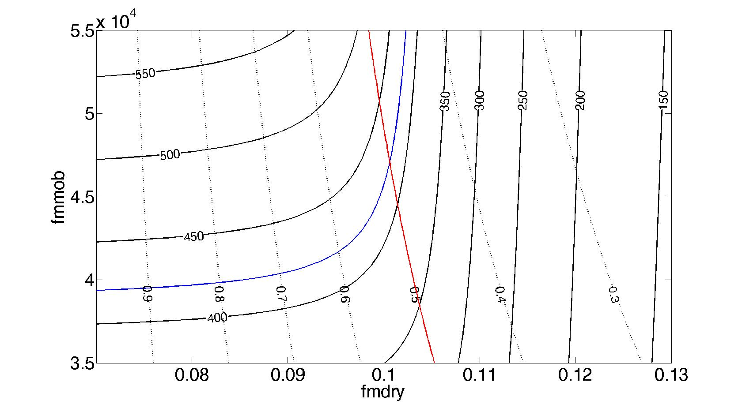
Findings in Part 1 of this series of work
Hybrid contour plot method
Fit to steady-state data
Ma, K.; Lopez-Salinas, J.L.; Puerto, M.C.; Miller, C.A.; Biswal, S.L.; Hirasaki, G.J., Energy & Fuels (in press).

Slide 4
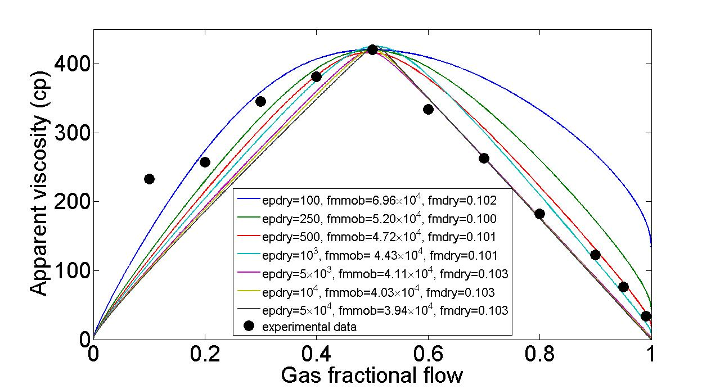
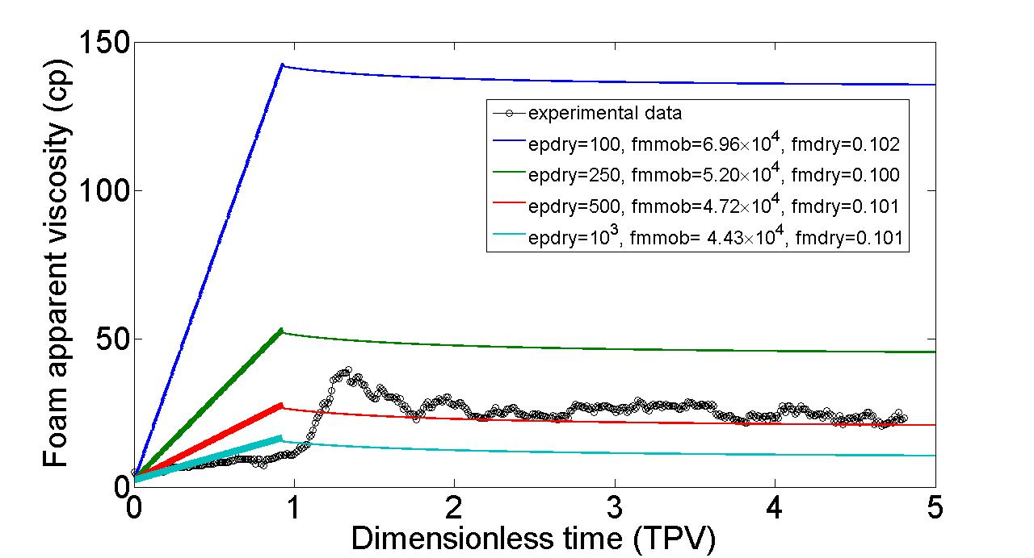
Findings in Part 1 of this series of work
Fit to steady-state data with different epdry
Fit to transient experimental data
Ma, K.; Lopez-Salinas, J.L.; Puerto, M.C.; Miller, C.A.; Biswal, S.L.; Hirasaki, G.J., Energy & Fuels (in press).

Slide 5
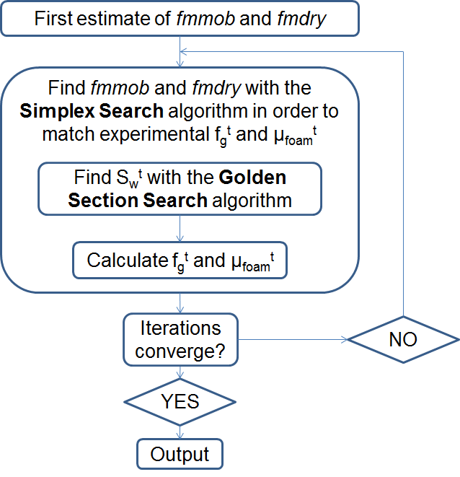
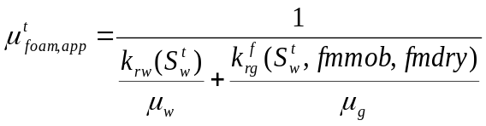
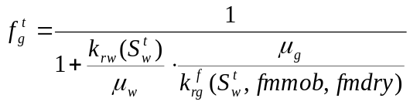
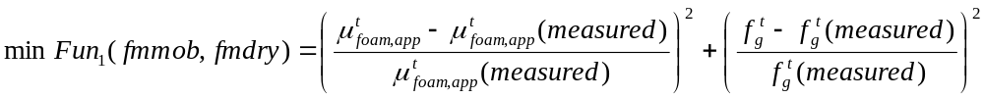

Non-graphical solution to match the transition foam viscosity

Slide 6
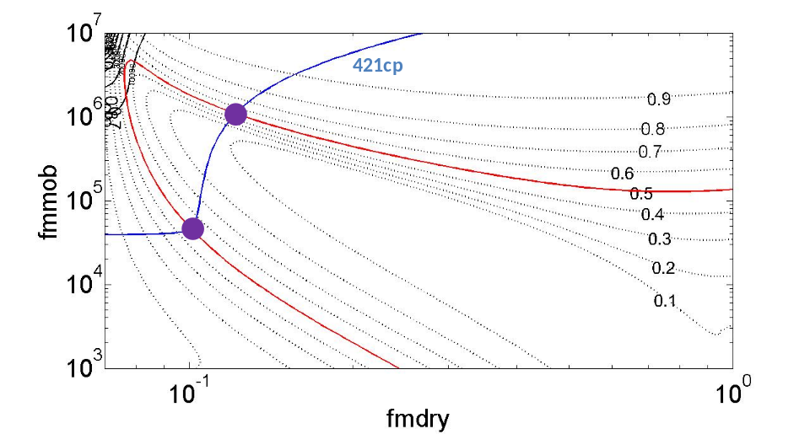
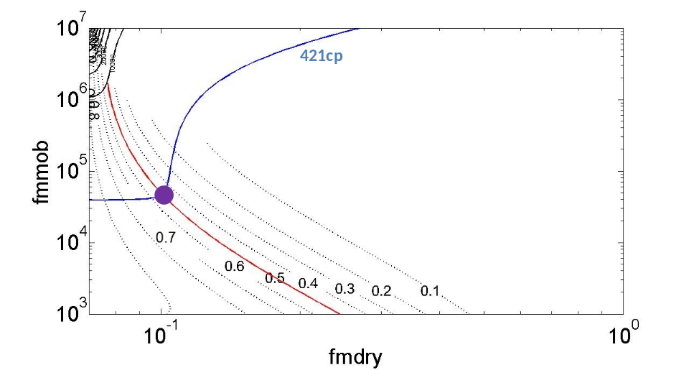
Non-unique solutions to match the transition foam viscosity
Hybrid contour plot method
If we apply the constraint fmdry<S_{w}^{t} …

Slide 7
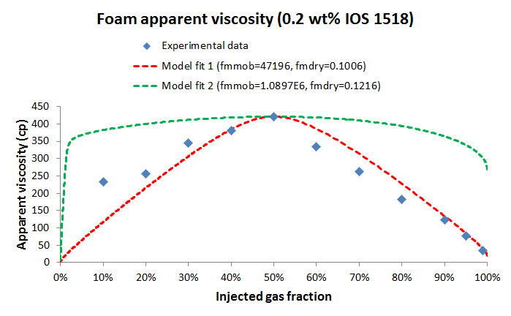
Non-unique solutions to match the transition foam viscosity
Ma, K.; Farajzadeh, R.; Lopez-Salinas, J.L.; Miller, C.A.; Biswal, S.L.; Hirasaki, G.J., SPE 165263 for presentation at the SPE Enhanced Oil Recovery Conference held in Kuala Lumpur, Malaysia, 2-4 July 2013.

Slide 8
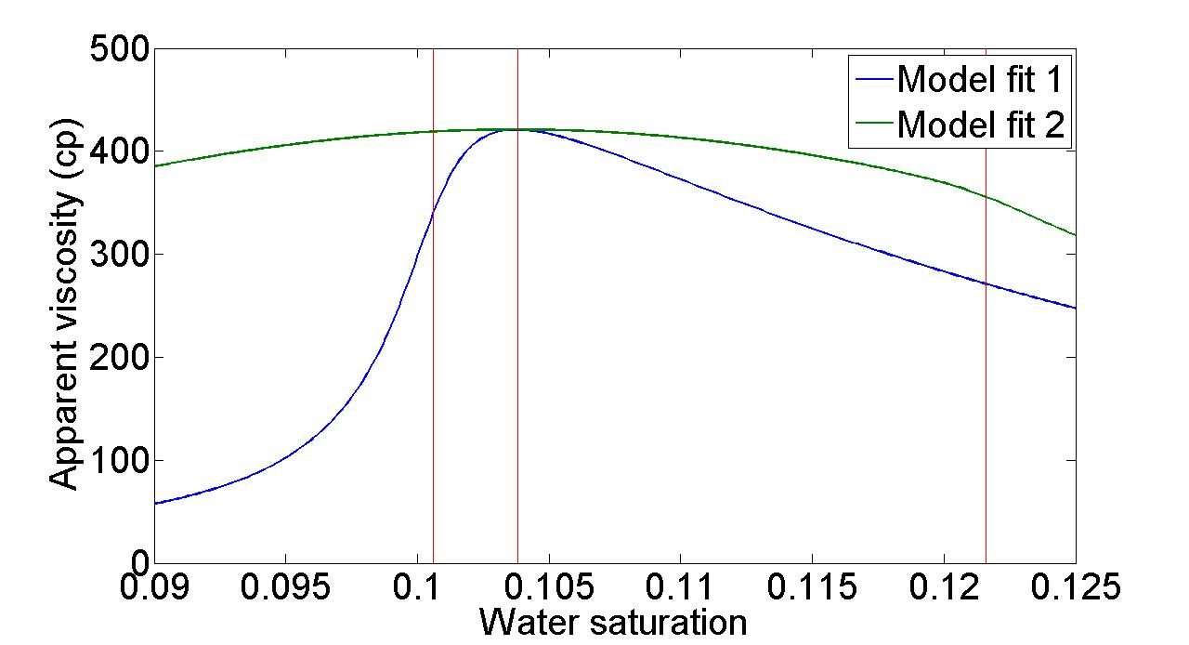
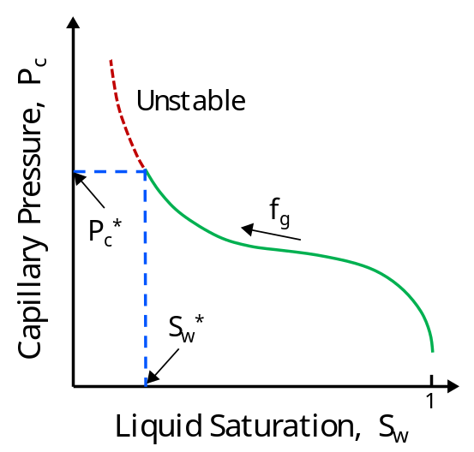
Non-unique solutions to match the transition foam viscosity
S_{w}^{t}=0.1037
fmdry=0.1006 (model fit 1)
fmdry=0.1216 (model fit 2)
Khatib, Z. I., G. J. Hirasaki, et al. (1988); Farajzadeh, R., A. Andrianov, et al. (2012)
fmdry<S_{w}^{t}
fmdry>S_{w}^{t}
Ma, K.; Farajzadeh, R.; Lopez-Salinas, J.L.; Miller, C.A.; Biswal, S.L.; Hirasaki, G.J., SPE 165263 for presentation at the SPE Enhanced Oil Recovery Conference held in Kuala Lumpur, Malaysia, 2-4 July 2013.

Slide 9
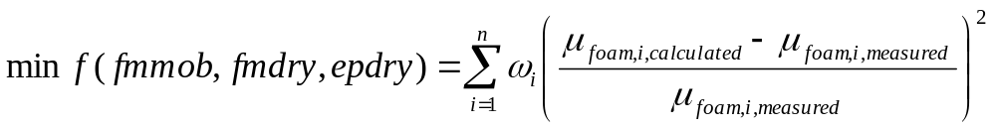




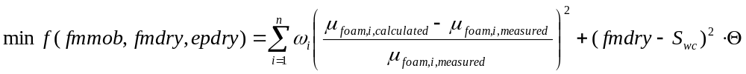
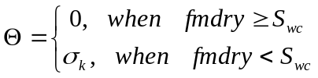
Multi-variable multi-dimensional search (fit to all experimental data)
Unconstrained search with a penalty function
Ma, K.; Farajzadeh, R.; Lopez-Salinas, J.L.; Miller, C.A.; Biswal, S.L.; Hirasaki, G.J., SPE 165263 for presentation at the SPE Enhanced Oil Recovery Conference held in Kuala Lumpur, Malaysia, 2-4 July 2013.

Slide 10
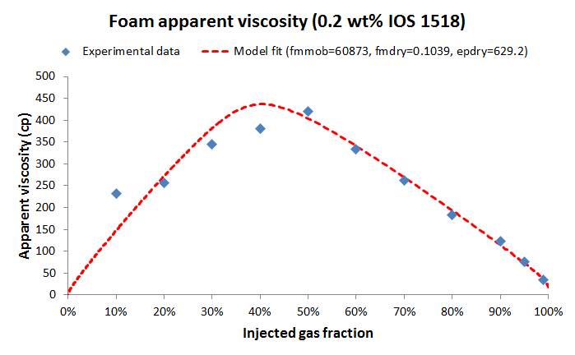



Multi-variable multi-dimensional search (fit to all experimental data)
when
otherwise

Slide 11
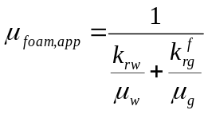

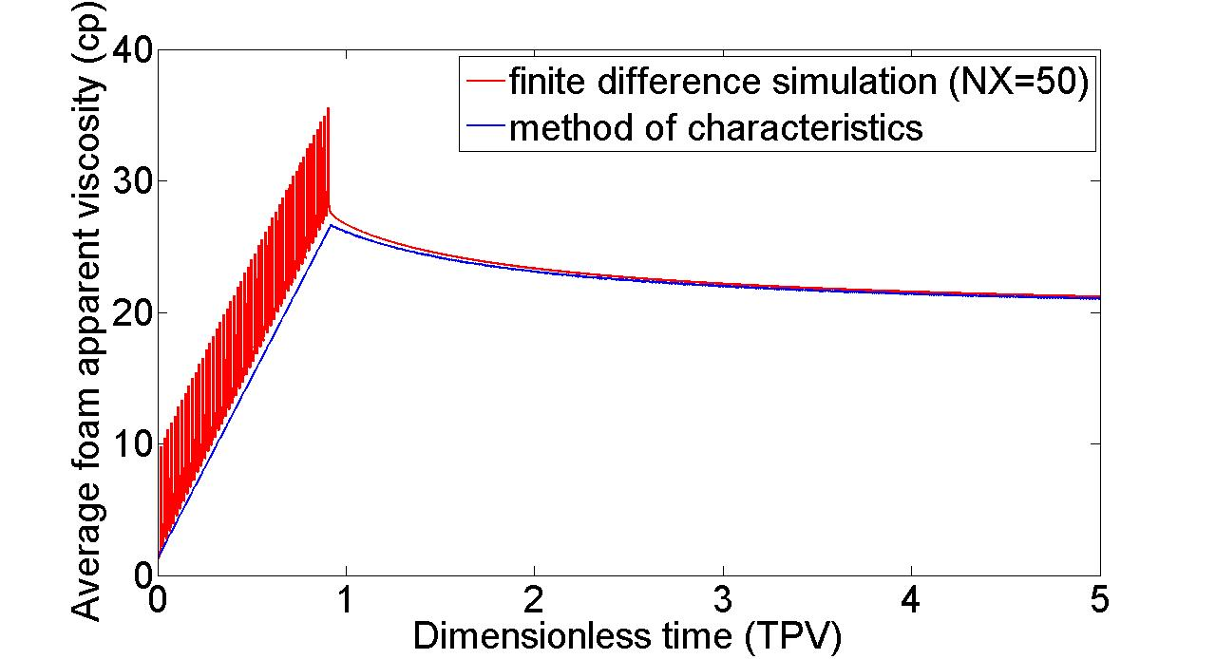





Numerical oscillation in transient foam simulation
local foam apparent viscosity
average foam apparent viscosity

Slide 12
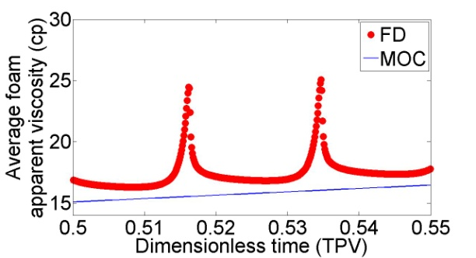
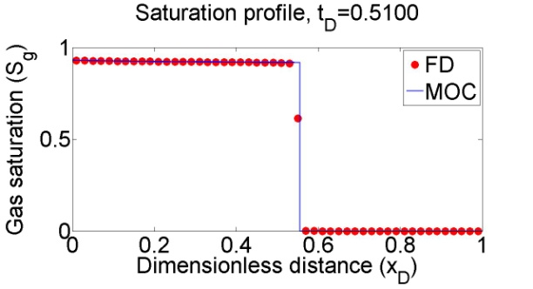
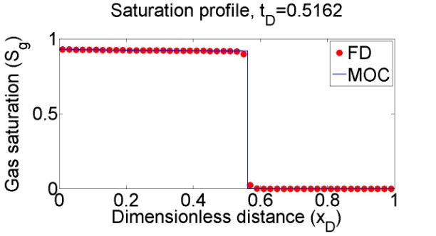
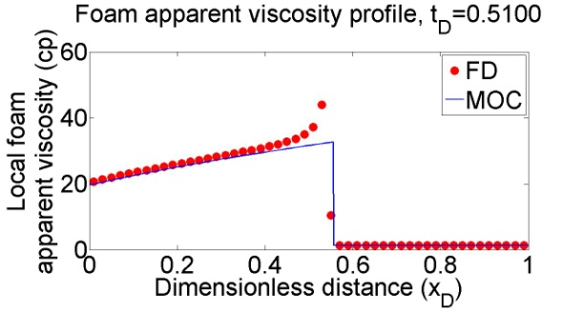
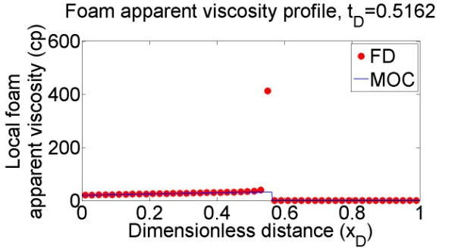
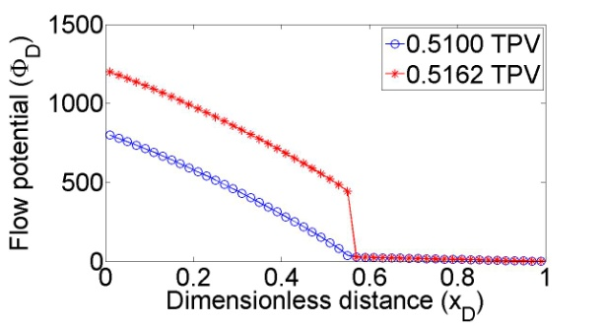
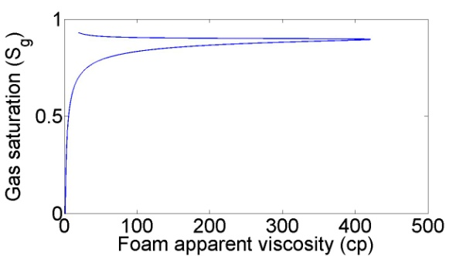
Numerical oscillation in transient foam simulation

Slide 13
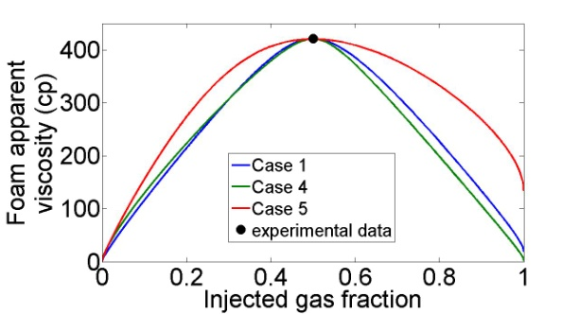
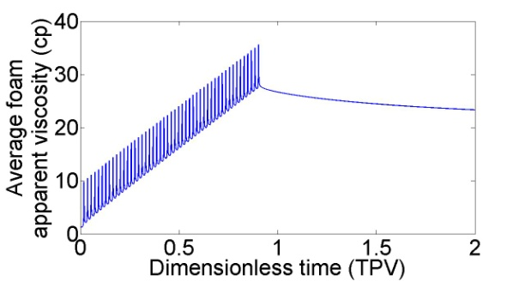
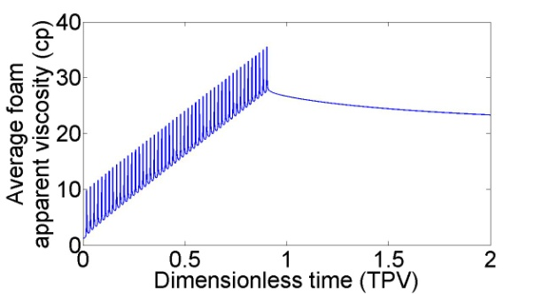
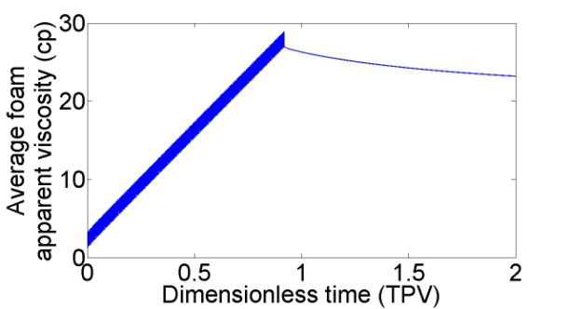
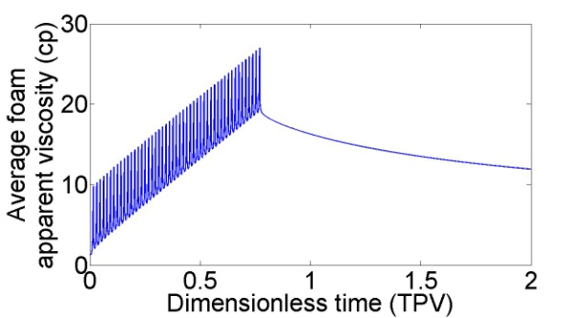
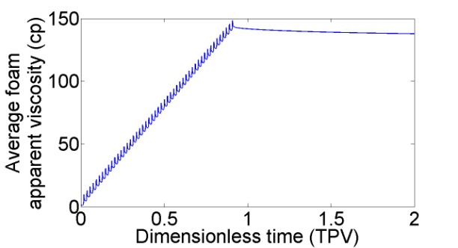


Numerical oscillation in transient foam simulation
Case 1
Case 2
Case 3
Case 4
Case 5
Parameter | Case 1 | Case 2 | Case 3 | Case 4 | Case 5
Δt_{D}/Δx_{D} | 0.005 | 0.0005 | 0.005 | 0.005 | 0.005
NX | 50 | 50 | 200 | 50 | 50
epdry | 500 | 500 | 500 | 500 | 100
fmmob | 47196 | 47196 | 47196 | 28479 | 69618
fmdry | 0.1006 | 0.1006 | 0.1006 | 0.2473 | 0.1020
n_{w} | 1.96 | 1.96 | 1.96 | 4.0 | 1.96

Slide 14
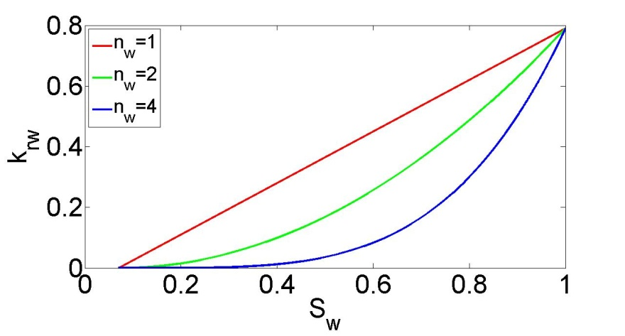
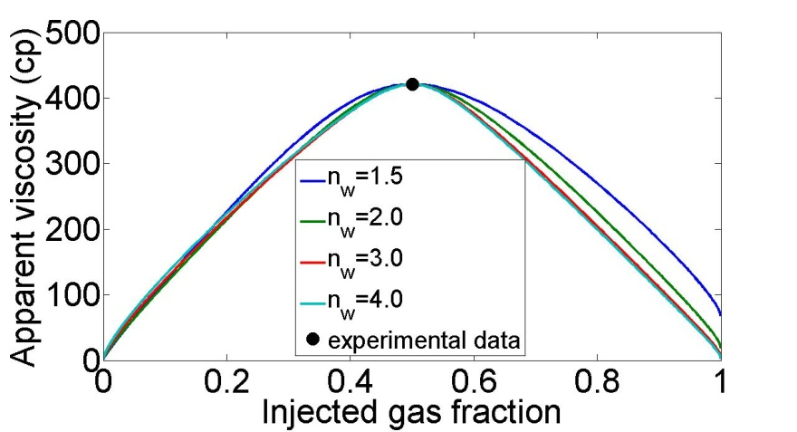
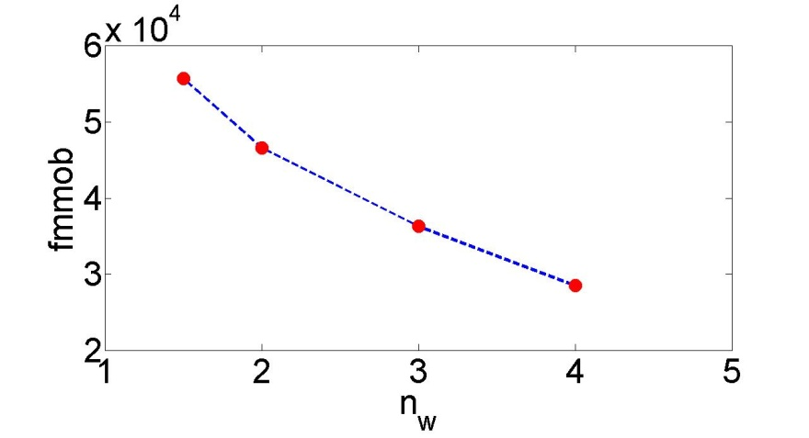
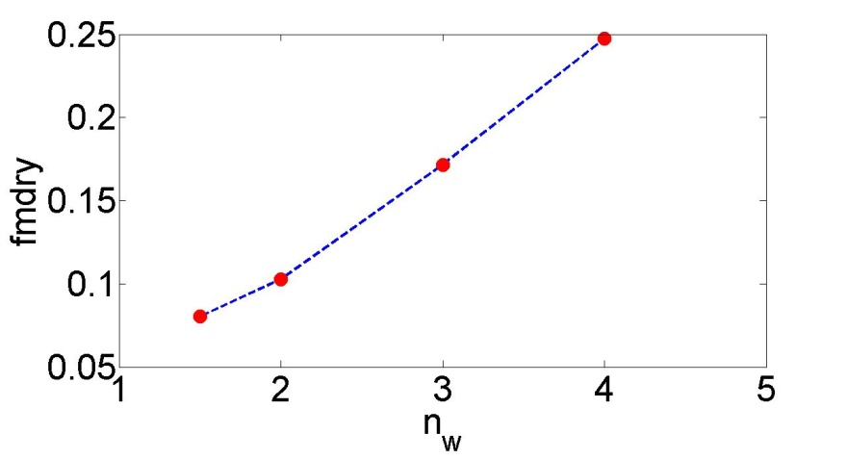
Sensitivity of foam parameters to n_{w}

Slide 15
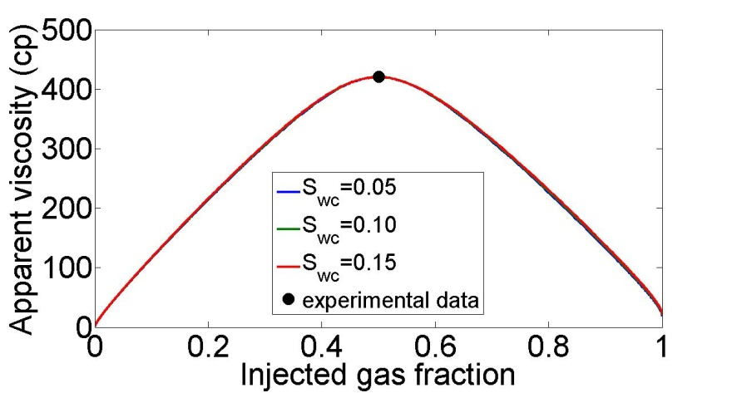
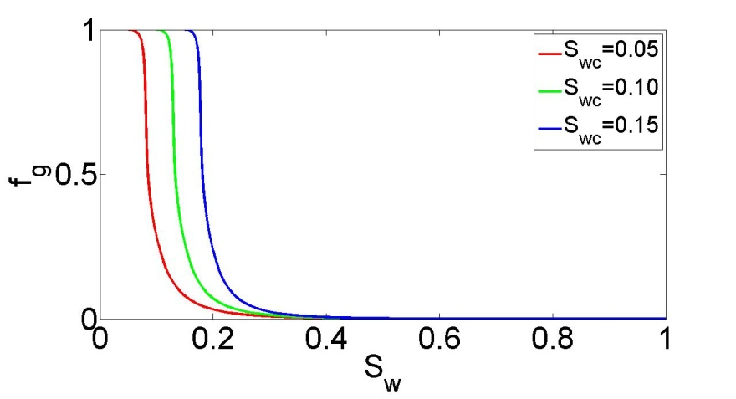
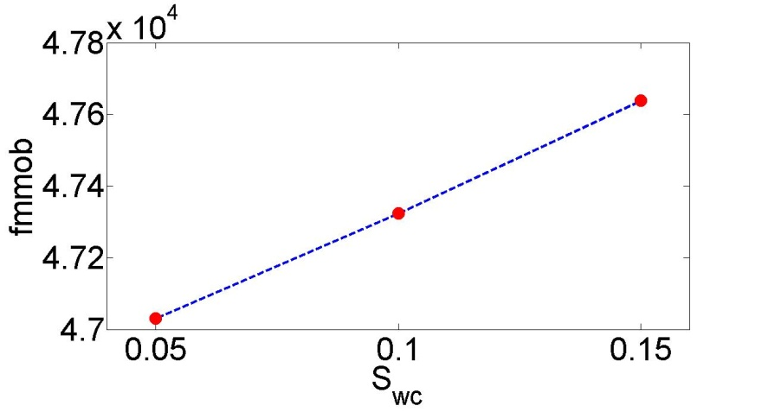
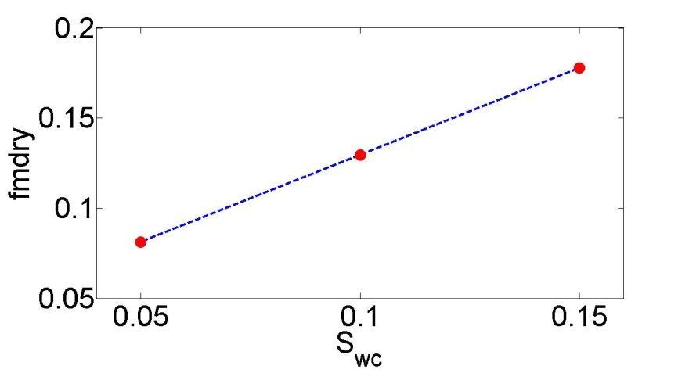
Sensitivity of foam parameters to S_{wc}

Slide 16
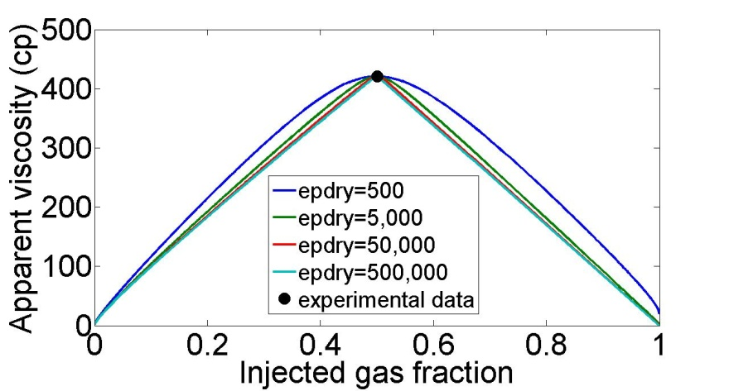
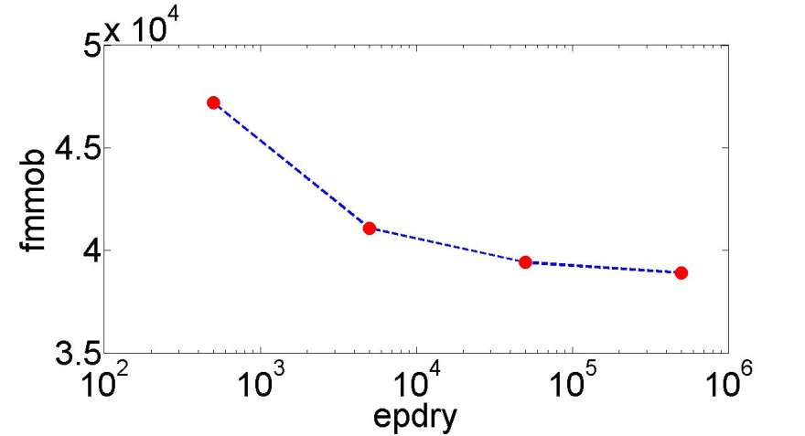
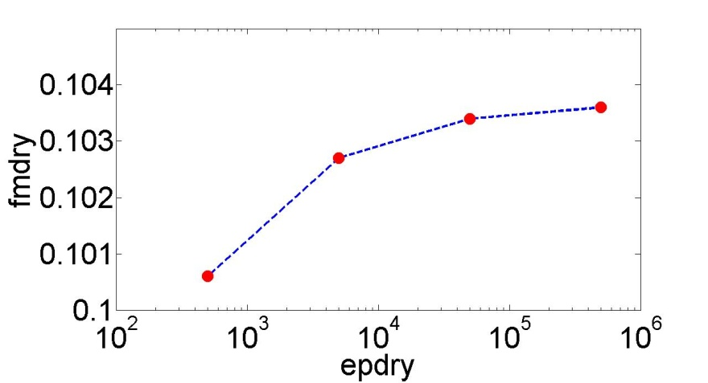
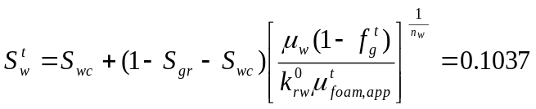
Sensitivity of foam parameters to epdry

Slide 17
Conclusions
For a preset epdry, it is found that two pairs of values of fmmob and fmdry can sometimes match steady-state f_{g}^{t} and μ_{foam}^{t}. By applying the constraint fmdry<S_{w}^{t}, one can rule out the solution which does not match the rest of experimental data points.
To match all available data points using multi-dimensional multi-variable search, one can use the unconstrained optimization approach with an appropriate initial guess which is close to the global optimum. The penalty function method for constrained optimization can be applied for a wider range of initial guesses.

Slide 18
Conclusions
Finite difference simulation for the transient foam process is generally consistent with the method of characteristics. A less abrupt change in foam mobility in the foam displacement front is needed to minimize the oscillation numerical artifact in the average foam apparent viscosity history. Small epdry leads to lower amplitude in numerical oscillation and larger apparent viscosity when foam breaks through.
Foam parameters are sensitive to the parameters in relatively permeability curves. For foam parameter estimation by matching steady-state f_{g}^{t} and μ_{foam}^{t}, the water relative permeability exponent n_{w} affects the estimation of both fmmob and fmdry, and the connate water saturation S_{wc} is particularly influential in estimating fmdry. An increase in epdry causes a decrease in fmmob, but no substantial change is found in fmdry.

Slide 19
Acknowledgements / Thank You / Questions
Abu Dhabi National Oil Company (ADNOC)
the Abu Dhabi Oil R&D Sub-Committee
Abu Dhabi Company for Onshore Oil Operations (ADCO)
Zakum Development Company (ZADCO)
Abu Dhabi Marine Operating Company (ADMA-OPCO)
the Petroleum Institute (PI), U.A.E
US Department of Energy (under Award No. DE-FE0005902)
Petróleos Mexicanos (PEMEX)
Shell Global Solutions International

