Slide 1
Improved Absorbents for CO2 Capture
Influence of the Alkanolamine Solvent
Sumedh Warudkar
PhD Candidate (Defended)
Chemical and Biomolecular Engineering
17th Annual Meeting of the Consortium for Processes in Porous Media
Rice University, Houston, TX
April 29th, 2013

Slide 2
CO₂ and Climate Change
Atmospheric CO₂ variation and global temperature anomaly [Ref: 1,2,3]

Slide 3
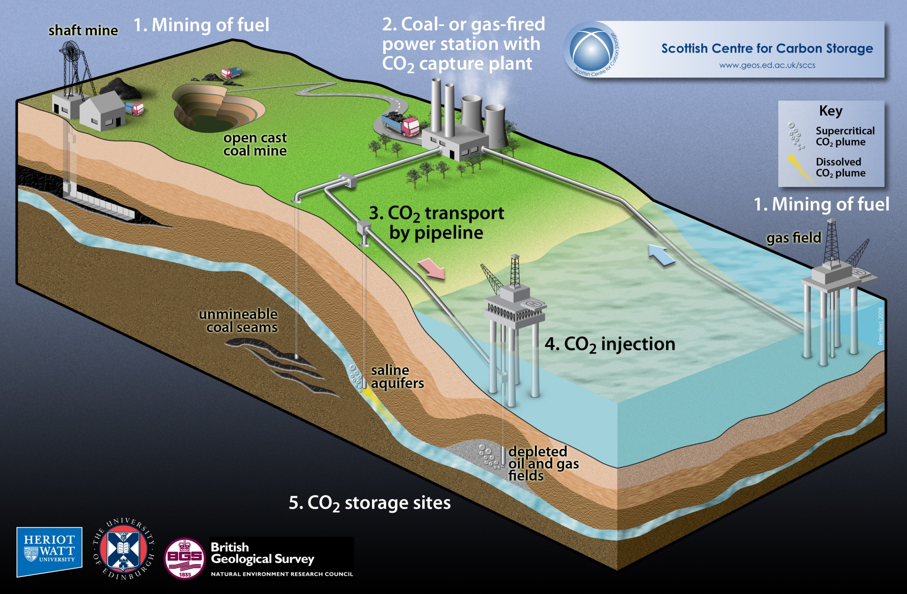
Carbon Capture and Storage
Schematic representation of Carbon Capture and Storage [Ref: 4]

Slide 4
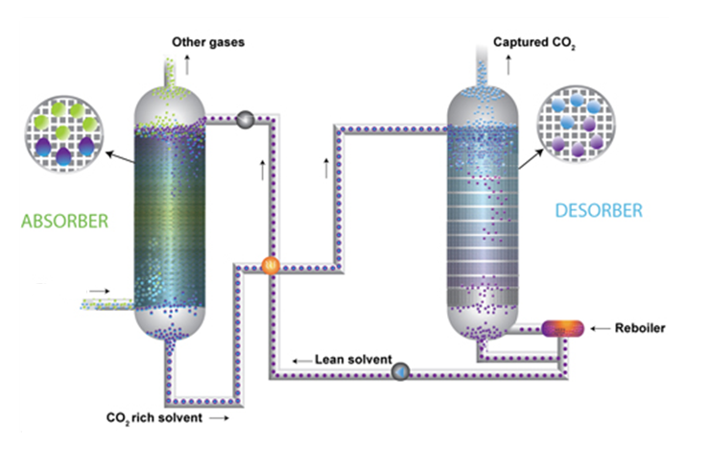
Amine Absorption Process
Application: Carbon Capture
Feed: Flue gas
Pressure: 1 – 1.5 atm
Stripper Pressure: 1.5 – 2 atm
Temperature: 110ºC – 125ºC
Steam: 4 – 4.5 atm
Schematic of the amine absorption process applied for post-combustion carbon capture [Ref: 5]

Slide 5
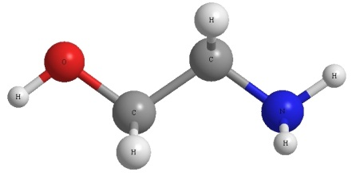
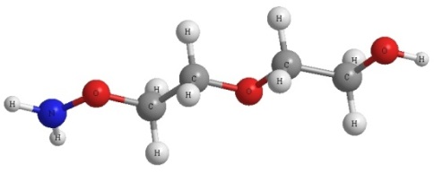
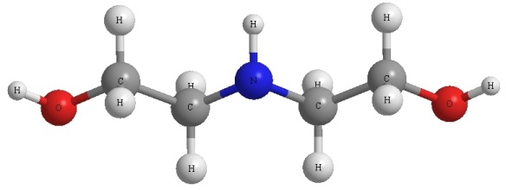
Alkanolamine Absorbents
Monoethanolamine (MEA)
Advantage
Low molecular weight
High reaction rate with CO₂
Low amine circulation rate
Drawbacks
High heat of reaction
MEA concentrations above 30 wt% and CO₂ loadings above 0.40 moles-CO₂/mole-amine are corrosive
High volatility
Diglycolamine (DGA)
Advantage
High DGA concentrations around 50 – 70 wt% can be used due to low volatility
High reaction rate with CO₂
Low amine circulation rate
Drawbacks
High heat of reaction
CO₂ loadings above 0.4 moles-CO2/mole-amine are highly corrosive
Diethanolamine (DEA)
Advantage
Low volatility
Low heat of reaction
Drawbacks
High amine circulation rate
Secondary amine, low reaction rate
DEA concentrations above 40 wt% are corrosive
CO₂ loadings above 0.4 moles-CO2/mole-amine are highly corrosive
A qualitative comparison of various commercial alkanolamines [Ref: 6]

Slide 6


Amine – CO₂ Reaction
Monoethanolamine – A Representative Case
Ionization of Water
$$H_{2}O↔H^{+}+{OH}^{−}$$
Dissociation of Carbon Dioxide (CO₂)
$$CO_{2}+H_{2}O↔{HCO_{3}^{}}^{−}+H^{+}$$
Reaction of Monoethanolamine with CO₂
$$OH{−\left(CH_{2}\right)}_{2}−NH_{2}+CO_{2}↔OH{−\left(CH_{2}\right)}_{2}−NH_{2}^{+}COO^{−}$$
Reaction of Monoethanolamine Carbamate with a base (amine)
$$OH{−\left(CH_{2}\right)}_{2}−NH_{2}^{+}COO^{−}+OH{−\left(CH_{2}\right)}_{2}−NH_{2}→OH{−\left(CH_{2}\right)}_{2}−NHCOO^{−}$$
$+OH{−\left(CH_{2}\right)}_{2}−NH_{3}^{+}$
Overall Reaction of Monoethanolamine with CO₂
$$2 OH{−\left(CH_{2}\right)}_{2}−NH_{2}+CO_{2}↔OH{−\left(CH_{2}\right)}_{2}−NHCOO^{−}+OH{−\left(CH_{2}\right)}_{2}−NH_{3}^{+}$$

Slide 7
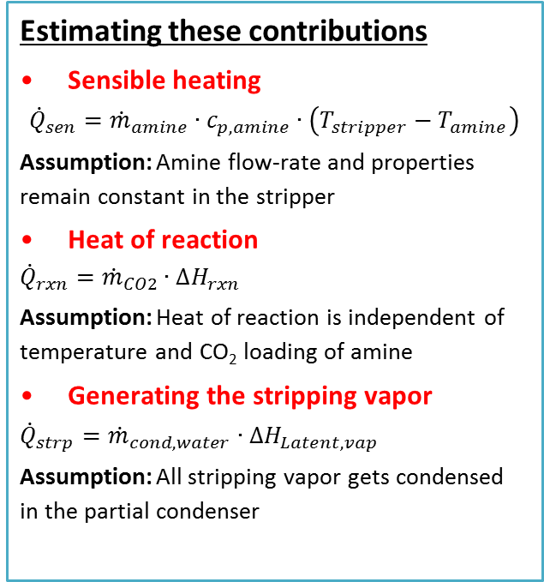
Dissecting the Reboiler Energy Duty
Methodology and Assumptions
Reboiler Duty
Sensible heating
Energy required to raise the temperature of the rich amine solution (~100ºC) to that in the desorber (110ºC - 115ºC)
Heat of reaction
Energy required to reverse the endothermic reaction between alkanolamines and CO₂
Generating the stripping vapor
Energy required to produce stripping vapor (mostly steam) that transports the energy for the above two processes and to dilute the CO₂ released in the desorber column
Estimating these contributions
Sensible heating
$${\dot{Q}}_{sen}={\dot{m}}_{amine}∙c_{p, amine}∙\left(T_{stripper}−T_{amine}\right)$$
Assumption: Amine flow-rate and properties remain constant in the stripper
Heat of reaction
$${\dot{Q}}_{rxn}={\dot{m}}_{CO2}∙{∆H}_{rxn}$$
Assumption: Heat of reaction is independent of temperature and CO₂ loading of amine
Generating the stripping vapor
$${\dot{Q}}_{strp}={\dot{m}}_{cond, water}∙{∆H}_{Latent, vap}$$
Assumption: All stripping vapor gets condensed in the partial condenser

Slide 8
Dissecting the Reboiler Energy Duty
Contributions of physical processes
Contribution of constituent physical processes to reboiler energy duty – A representative case (DEA 40 wt%, 150 kPa) [Ref: 7]

Slide 9
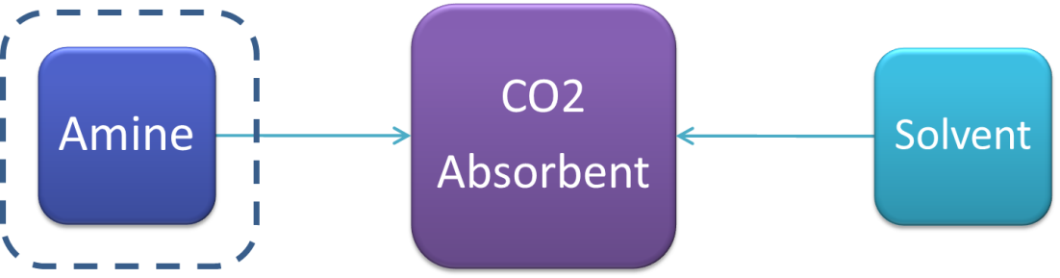
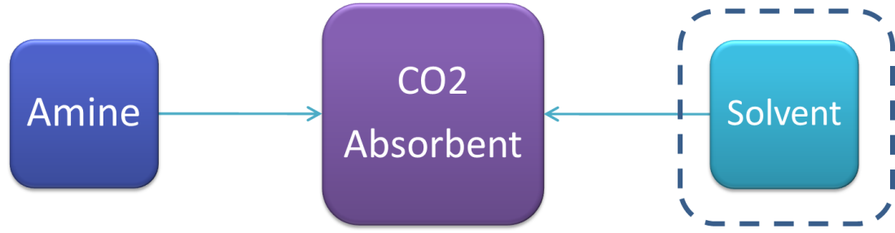
Current Research on Developing Novel Absorbents
Influences
Heat of reaction
Sensible heating
University of Texas at Austin
  Piperazine promoted Potassium Carbonate (PZ/K₂CO₃)
  Concentrated Piperazine (PZ)
Alstom
  Chilled Ammonia Process
Mitsubishi Heavy Industries
  Hindered amines (KS-1, KS-2)
Influences
Stripping vapor
Sensible heating

Slide 10
Why Water?
A comparison of the Heat of Vaporization and Specific Heat Capacity
Comparison of specific heat capacity and heat of vaporization of water and various alcohols [Ref: 8]

Slide 11
Vapor-liquid Equilibrium
Effect of Methanol Addition
Rich Amine Loadings
Moles-CO₂/mole-amine
Lean Amine Loadings
Moles-CO₂/mole-amine
Comparison of vapor liquid equilibrium for aqueous diethanolamine – with and without methanol [Ref: 9, 10]

Slide 12
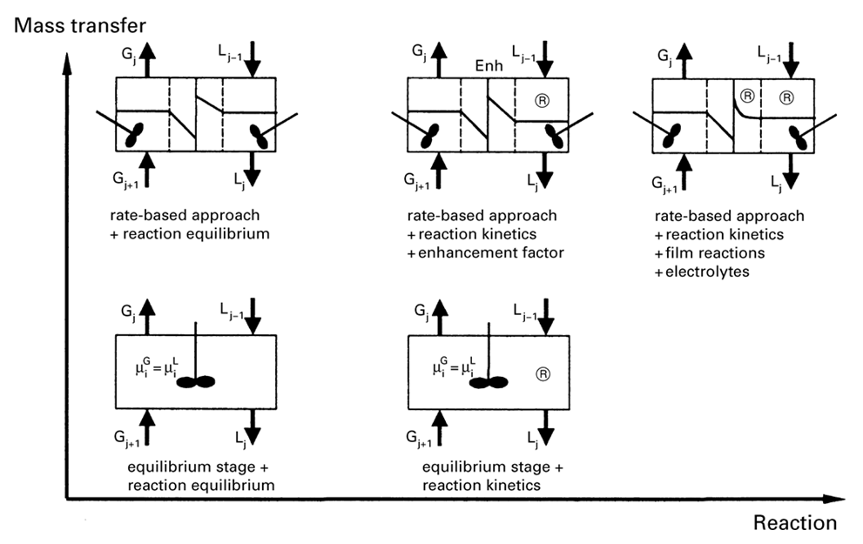
Approaches to Modeling Amine Absorption
Commercial Process Simulators
Requires extensive thermodynamic data – reaction kinetics, vapor liquid equilibria and heats of mixing.
Evaluating Reboiler Duty for Alcohol blended Alkanolamines
A graphic representation of the reaction kinetics and thermodynamic complexity of models used for describing reactive absorption processes [Ref: 11]

Slide 13
Estimating Reboiler Duty
Validating the “Equilibrium Assumption”
1.6%
6%
A comparison between the reboiler heat duty evaluated using the “equilibrium approach” and ProMax [Ref: 12]

Slide 14
Reboiler Duty
Effect of Methanol Addition
18%
17%
Effect of addition of methanol to aqueous diethanolamine on reboiler duty [Ref: 12]

Slide 15
Reboiler Operating Temperature
Effect of Methanol Addition
Effect of addition of methanol to aqueous diethanolamine on reboiler temperature [Ref: 12]

Slide 16
Estimated Parasitic Power Loss
Can Utilize Waste Heat at 20 psia, 140ºC
Can Utilize Waste Heat at 20 psia, 140ºC
Effect of addition of methanol to aqueous diethanolamine on the estimated parasitic power loss [Ref: 12]

Slide 17
Solvent Polarity
Dielectric constants for water, methanol and ethanol [Ref: 8]

Slide 18
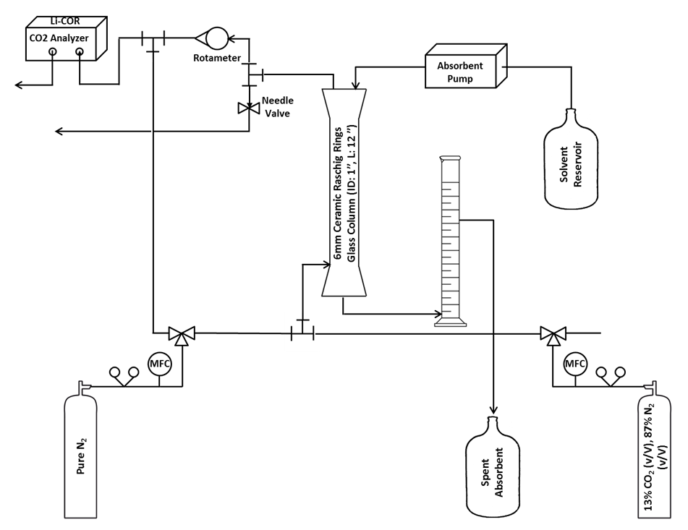
CO₂ Removal Studies
Effect of alcohol addition
Experimental setup developed to screen the CO₂ removal performance of different absorbent blends [Ref: 12]

Slide 19
CO₂ Removal Experiments
Degree of CO₂ removal for 30 wt% DGA in different solvents – water, methanol and ethanol. Absorbent flow-rate: 0.02 LPM, Gas flow-rate: 3 SLPM, CO₂ content: 13% (v/V) [Ref: 12]

Slide 20
How soluble is CO₂ in alcohols?
CO₂ solubility in water, methanol and ethanol [Ref: 13, 14, 15]

Slide 21
Kinematic viscosity of DGA solutions
In Water, Methanol and Ethanol
Kinematic viscosity for 30 wt% DGA solutions in various solvents – water, methanol and ethanol

Slide 22
Summary
My Hypothesis
Addition of a co-solvent to conventional absorbents such as aqueous alkanolamines can result in reduction in parasitic power loss.
Findings
A proof-of-concept case was developed using published vapor-liquid equilibrium data for methanol blended aqueous diethanolamine (DEA) (DEA:Aq:MeOH::40:40:20 wt%).
Addition of methanol to aqueous diethanolamine (DEA) resulted in a significant increase in the equilibrium partial pressure of CO₂.
Reboiler duty for the methanol blended diethanolamine (DEA) system was estimated by adopting an equilibrium approach at 150 kPa and 200 kPa. Addition of methanol reduced the reboiler duty by ~18% as compared to that for aqueous diethanolamine (DEA).
Addition of methanol resulted in a decrease in the stripper/reboiler operating temperature by ~15ºC. As a result, a 150 kPa stripper utilizing the methanol blended diethanolamine (DEA) can utilize waste heat.
As compared to aqueous diglycolamine, methanolic and ethanolic solutions of 30 wt% diglycolamine (DGA) appeared to increase the CO₂ removal in bench-scale studies. It is believed that this is a result of higher CO₂ solubility in alcohols than in water.

Slide 23
Acknowledgements
Personnel
Dr. George Hirasaki, AJ Hartsook Professor in Chemical Engineering, Rice U.
Dr. Michael Wong, Professor in Chemical Engineering and Chemistry, Rice U.
Dr. Kenneth Cox, Professor-in-the-Practice, Chemical Engineering, Rice U.
Dr. Joe Powell, Chief Scientist at Shell Oil Company
Members of the Hirasaki and Wong research groups
Funding and Material Support
US Department of Energy (DE-FE0007531)
Rice Consortium on Processes in Porous Media
Schlumberger Ltd.
Huntsman Corporation

Slide 24
References
National Oceanographic and Atmospheric Administration
A. Neftel, et al. “Historical carbon dioxide record from the Siple Station ice core”, Carbon dioxide Information Analysis Center (1994)
JM Barnola et al., “Historical carbon dioxide record from Vostok ice core”, Nature (1987)
Scottish Center for Carbon Storage
Image Courtesy: http://www.co2crc.com.au/aboutccs/cap_absorption.html
A.L. Kohl and R. Nielsen, Gas Purification, Gulf Publishing Company (1997)
S Warudkar, et al., Influence of stripper operating parameters on the performance of amine absorption systems for post-combustion carbon capture: Part I. High pressure strippers, International Journal of Greenhouse Gas Control (2013)
D. Green, et al., Perry’s Chemical Engineers’ Handbook. McGraw-Hill Publications (2007)
M. Z. Haji-Sulaiman, et al. Analysis of equilibrium data of CO2 in aqueous solutions of diethanolamine (DEA), methyldiethanolamine (MDEA) and their mixtures using the modified Kent-Eisenberg Model, TransIChemE (1998)
K.N. Habchi Tounsi, et al., Measurement of carbon dioxide solubility in a solution of diethanolamine (DEA) mixed with methanol, Ind. Eng. Chem. Res (2005)
E.Y. Kenig, et al., Reactive absorption: Optimal process design via optimal modeling, Chemical Engineering Science (2001)
S Warudkar, et al., “Effect of various co-solvents on the energy consumption for carbon capture” (In preparation)
I. Dalmolin, et al., Solubility of carbon dioxide in binary and ternary mixtures with ethanol and water, Fluid Phase Equilibria (2006)
K. Suzuki, et al., Isothermal vapor-liquid equilibrium data for binary systems at high pressures: carbon dioxide-methanol, carbon dioxide-ethanol, carbon dioxide-1-propanol, methane-ethanol, methane-1-propanol, ethane-ethanol, and ethane-1-propanol systems, J. Chem. Eng. Data (1990)
Image Courtesy: http://www.diytrade.com/china/pd/7727866/Silicon_carbide_ceramic_foam_filter.html

