Slide 1
The Effect of Surfactant Partitioning and fmsurf on Foam Transport
Yongchao Zeng, Kun Ma

Slide 2
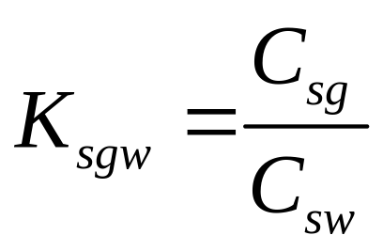
Surfactant for Foam Flooding
Anionic surfactants
do not partition into the gas phase
Non-ionic surfactants
CO₂ soluble
can partition into the CO₂ phase

Slide 3
Non-Ionic CO₂ Soluble Surfactant
Lower adsorption on carbonate formation
More in-depth robust foam
Ren, G. (2011) SPE Enhanced Oil Recovery Conference 19-21 July 2011,Kuala Lumper, Malaysia

Slide 4
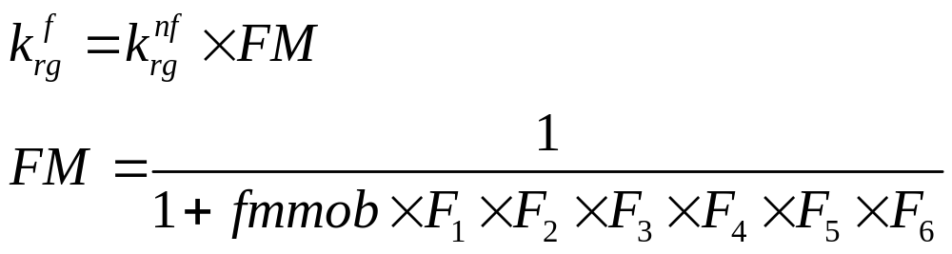
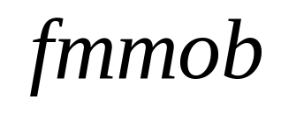
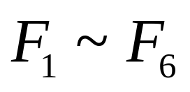
STARS Foam Model
The STARS Model
reference mobility reduction factor
contribution of different factors on
foam strength
Ren, G. (2011) SPE Enhanced Oil Recovery Conference 19-21 July 2011,Kuala Lumper, Malaysia

Slide 5
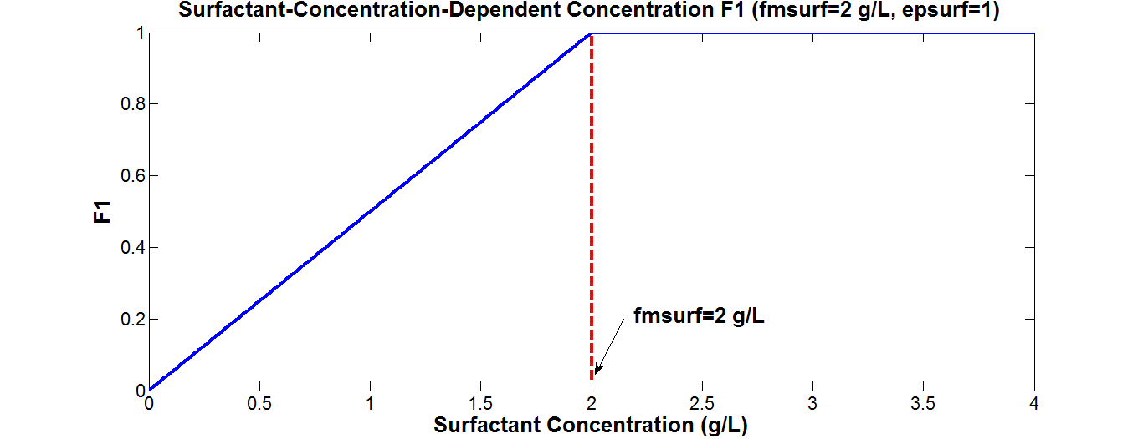
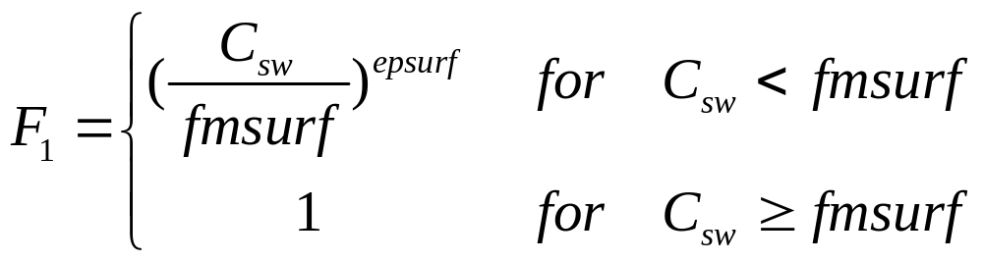
Surfactant-Concentration-Dependent function
Ren, G. (2011) SPE Enhanced Oil Recovery Conference 19-21 July 2011,Kuala Lumper, Malaysia

Slide 6
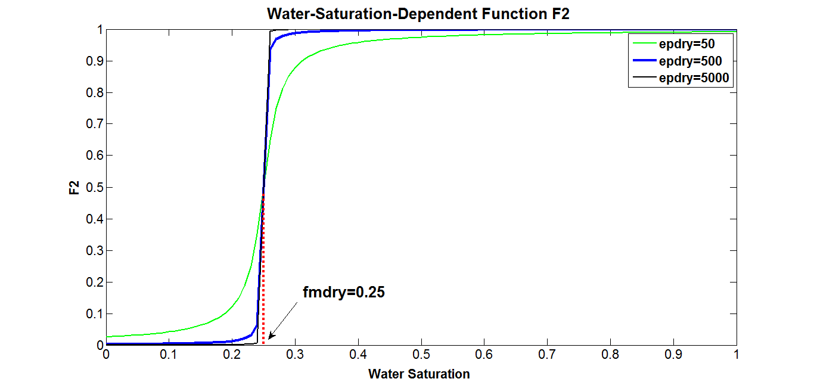
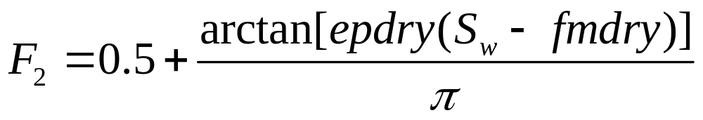
Water-Saturation-Dependent Function
Ren, G. (2011) SPE Enhanced Oil Recovery Conference 19-21 July 2011,Kuala Lumper, Malaysia

Slide 7
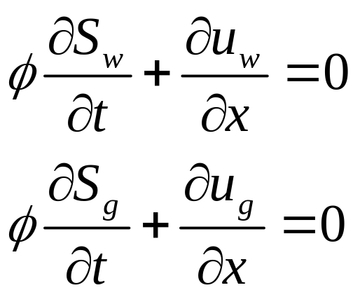
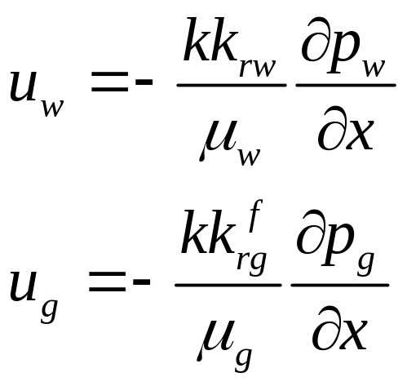
1-D Foam Simulator
Conservation of Mass
Conservation of Momentum: Darcy’s Law
Ma K . (2013) Transport of Surfactant and Foam in Porous Media for Enhanced Oil Recovery Processes, PhD Dissertation, Rice University.

Slide 8
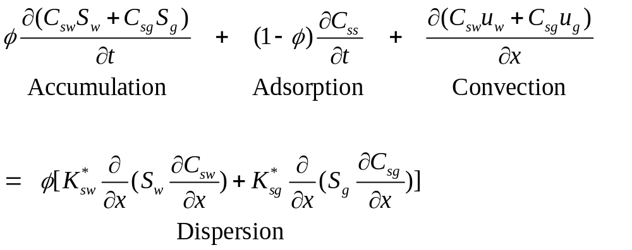
1-D Foam Simulator
Surfactant Partitioning
Ma K . (2013) Transport of Surfactant and Foam in Porous Media for Enhanced Oil Recovery Processes, PhD Dissertation, Rice University.

Slide 9
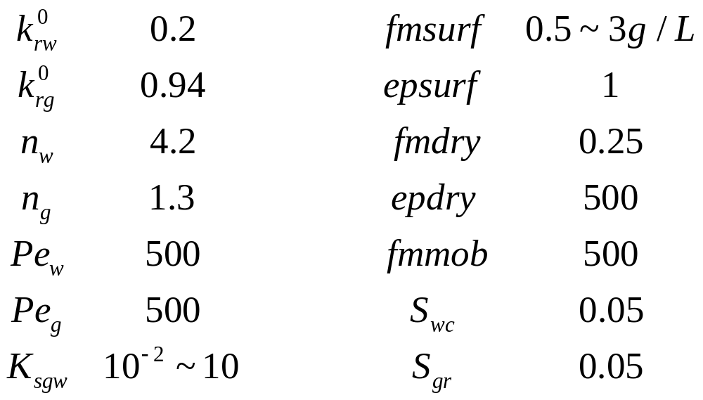
Important Parameters
Ma K . (2013) Transport of Surfactant and Foam in Porous Media for Enhanced Oil Recovery Processes, PhD Dissertation, Rice University.

Slide 10
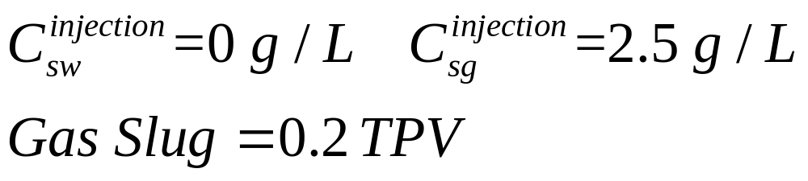
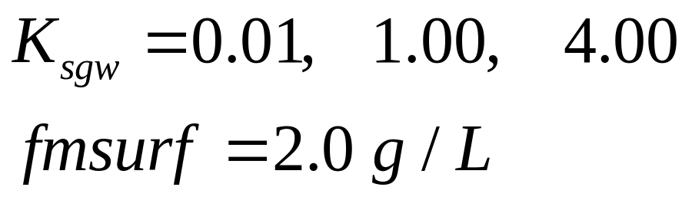
Single Slug of Gas Followed by Water
I.C.
1-D formation core saturated with water
B.C.
Parameter
Notes:
This cartoon shows how the pressure profile changes with time.

Slide 11
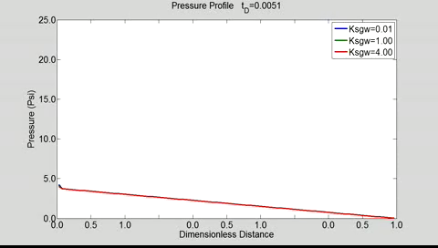

Slide 12
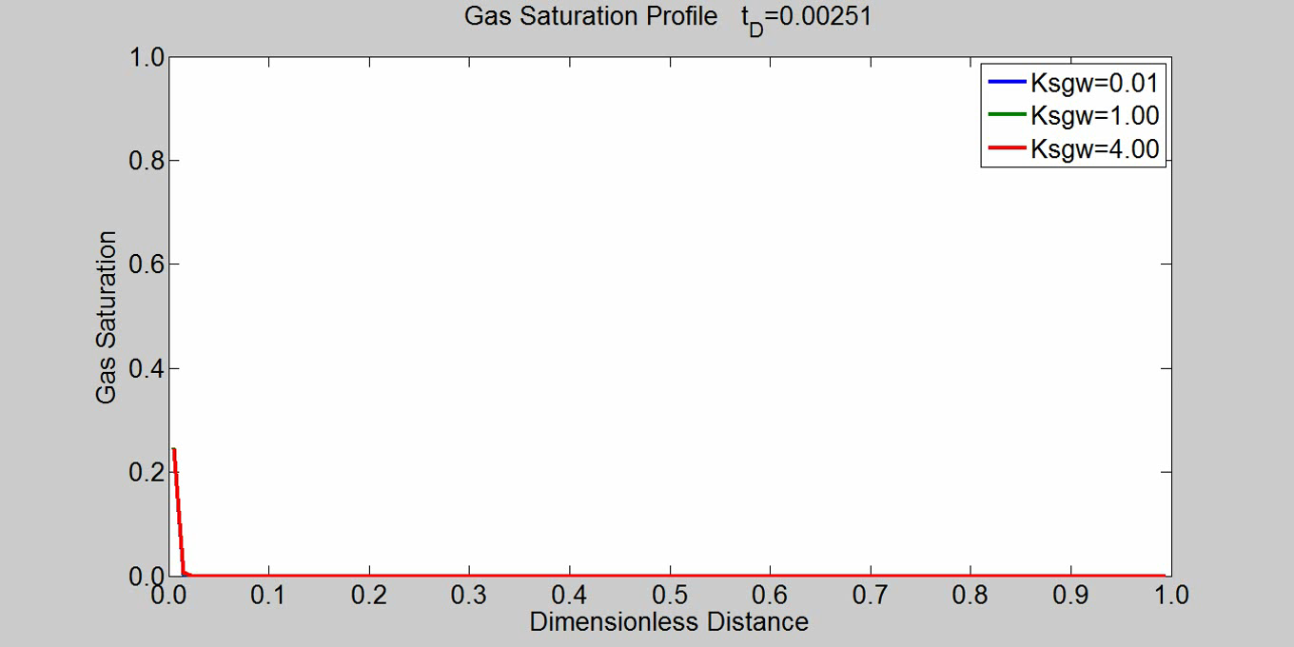
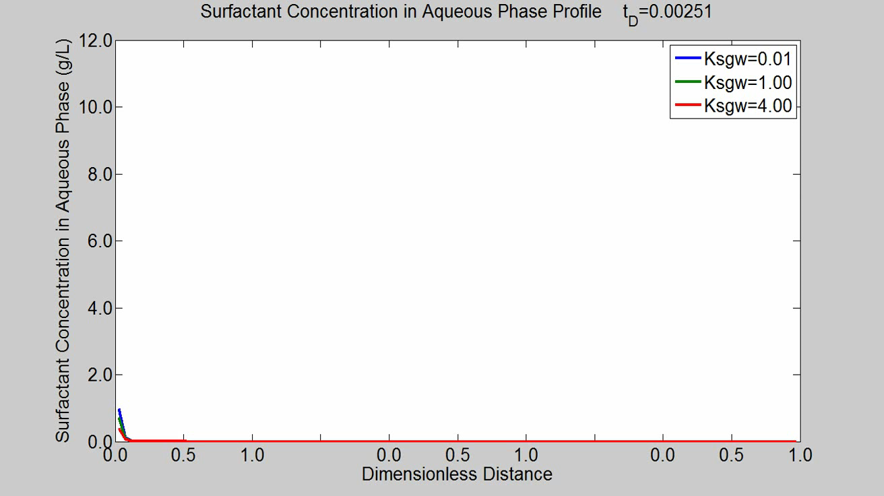
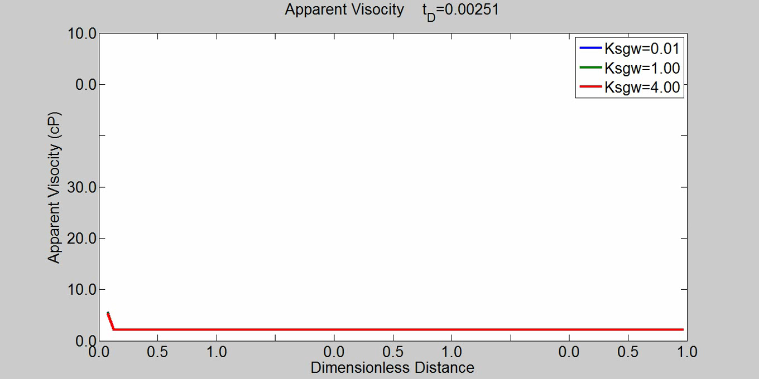

Slide 13
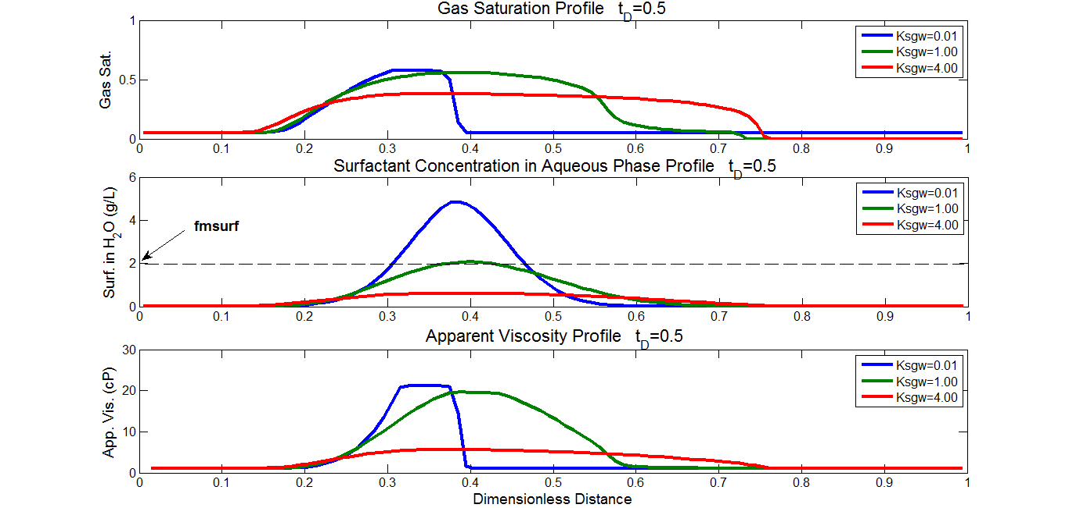

Slide 14
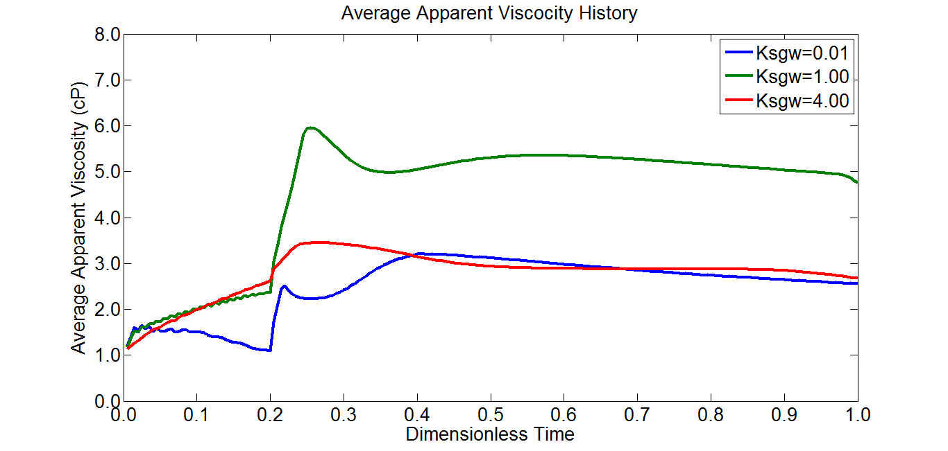

Slide 15
Effect of Partition Coefficient
(Surfactant injected in gas phase)
Small partition coefficient will keep the surfactant concentrated in a small region. It will result in an early gas breakthrough however a slower foam propagation velocity.
Large partition coefficient will spread out the surfactant concentration thus elongating the foam bank. It will accelerate foam propagation speed. However when C_{sw} drops below fmsurf, foam strength will decrease sharply.
Unity partition coefficient will distribute surfactant in a relatively large region and keep the surfactant concentrated at around fmsurf. Foam travels at a moderate speed thus largest apparent viscosity can be expected.

Slide 16
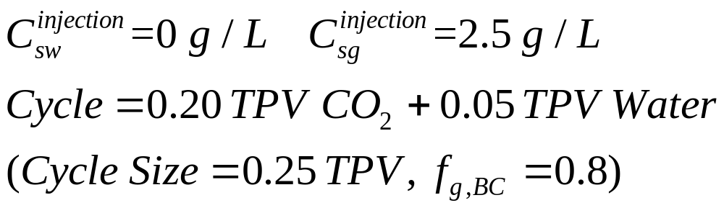
WAG—surfactant injected in CO₂ Phase
I.C.
1-D formation core saturated with water
B.C.
Parameter

Slide 17
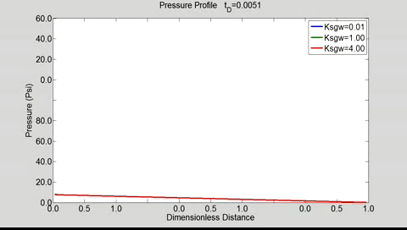

Slide 19
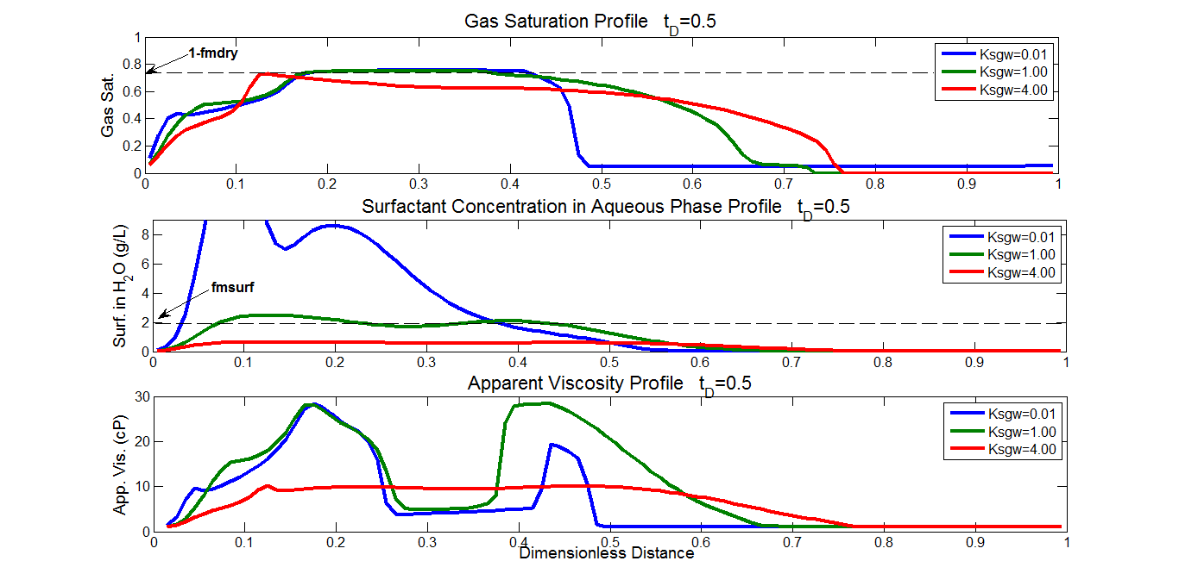

Slide 20
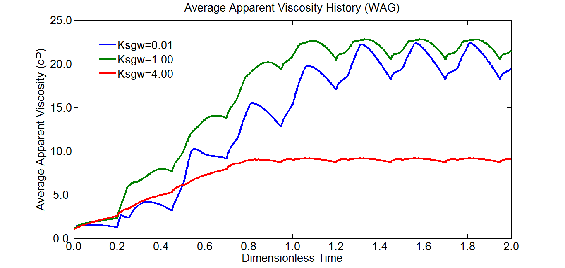

Slide 21
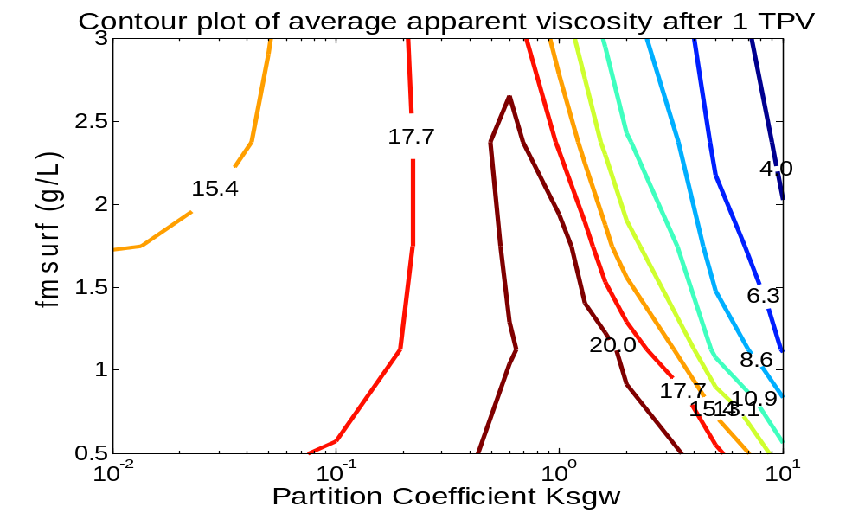
Effect of K_{sgw} and fmsurf
Given surfactant injection concentration (2.5 g/L in Gas Phase)
Given foam quality (f_{g,avg}=0.8)

Slide 22
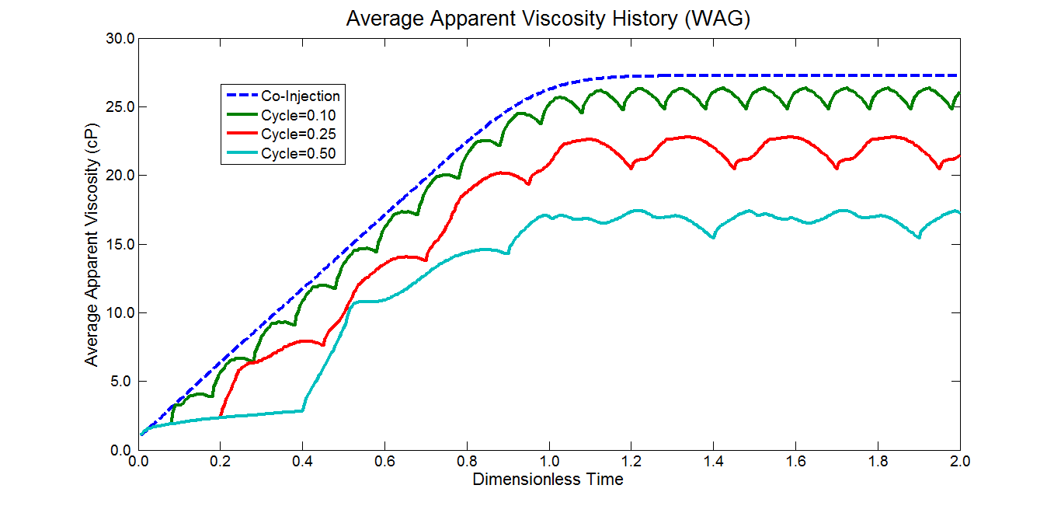
WAG Cycle Size v.s. Co-Injection

Slide 23
Conclusion
K_{sgw} | Small | Large
Gas Breakthrough | Early | Late
Foam Propagation | Slow | Fast
Surfactant Con. | Concentrated | Diluted
Foam Bank Size | Short | Long

Slide 24
Conclusion
For a certain injection strategy and surfactant concentration, a smaller fmsurf will help to generate stronger foam (larger apparent viscosity).
Smaller cycle size will enhance foam strength. When cycle size is small enough, it will approach co-injection foam strength.

Slide 25
Future Work
The influence of surfactant partitioning and fmsurf in a 2-D or 3-D heterogeneous system with the presence of gravity segregation and fractures.
Notes:
In the future we can do…

Slide 26
References
Ren, G. (2011) SPE Enhanced Oil Recovery Conference 19-21 July 2011,Kuala Lumper, Malaysia
Ma K . (2012) AlchE Spring Meeting & 8th Global Congress on Process Safety, 1-5 April 2012, Houston, TX
Ma K . (2013) Transport of Surfactant and Foam in Porous Media for Enhanced Oil Recovery Processes, PhD Dissertation, Rice University.

Slide 27
Acknowledgement
This work was financially supported by
Rice University's
Consortium for Processes in Porous Media

Slide 28
Thank you

