Slide 1

Adsorption of Betaines
Hadi ShamsiJazeyi, George J. Hirasaki, Rafael Verduzco
Rice University
Chemical and Bio-molecular Engineering Department
18th Annual Meeting of
Rice University Consortium for Process in Porous Media
April 21, 2014

Slide 2
Outline
Introduction
Adsorption measurement
Can polyacrylate reduce adsorption of lauryl betaine?
Different chemicals as sacrificial agent for betaines
Effect of pH (surface charge) on adsorption of betaines
Effect of anionic surfactant on pH dependency of betaine adsorption
Hypothesis: molecular mechanism of adsorption of betaines

Slide 3
Introduction
Surfactant adsorption on the rock is a major cost issue for EOR
Betaine is a class of zwitterionic surfactants (with two opposite charge on each surfactant molecule)
Adsorption of betaine can be very high at certain conditions
Polymeric sacrificial agent (sodium polyacrylate) was tested for reducing adsorption of anionic surfactants and showed up to
80% reduction in total cost of materials
We study conditions by which the adsorption of betaine is minimum

Slide 4

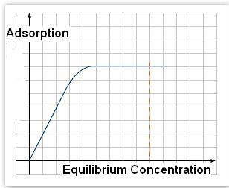
Measurement of Concentration and Adsorption of Lauryl Betaine
Plateau region of adsorption isotherms should be measured.
Both initial and equilibrium concentrations are measured.
Equilibrium concentration should be far enough from initial concentration, so that the noise in measurement can be neglected.
Concentration of betaine is measured by two phase titration at pH<1
We made sure that the anionic surfactant has no effect on betaine measurement at this low pH

Slide 5
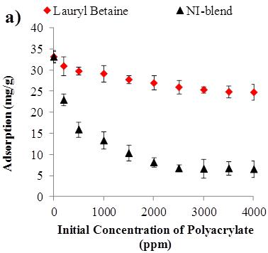
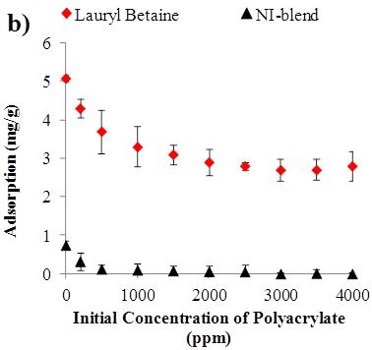
Can Polyacrylate Reduce Adsorption of Lauryl Betaine?
Adsorption on Kaolinite
Room Temperature, Batch Adsorption Study
Adsorption on Silica
Room Temperature
Batch Adsorption Study

Slide 6
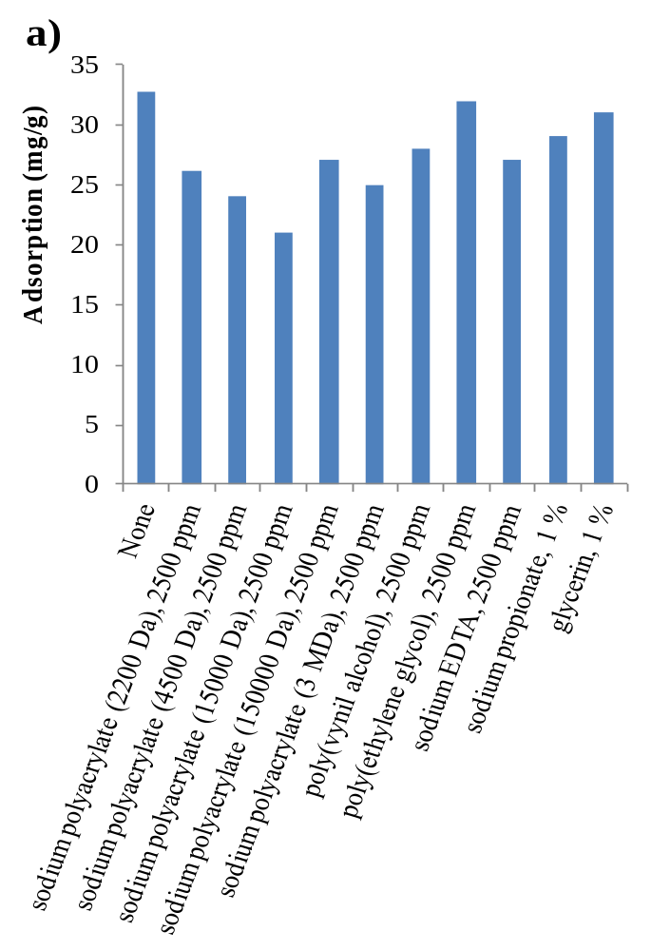
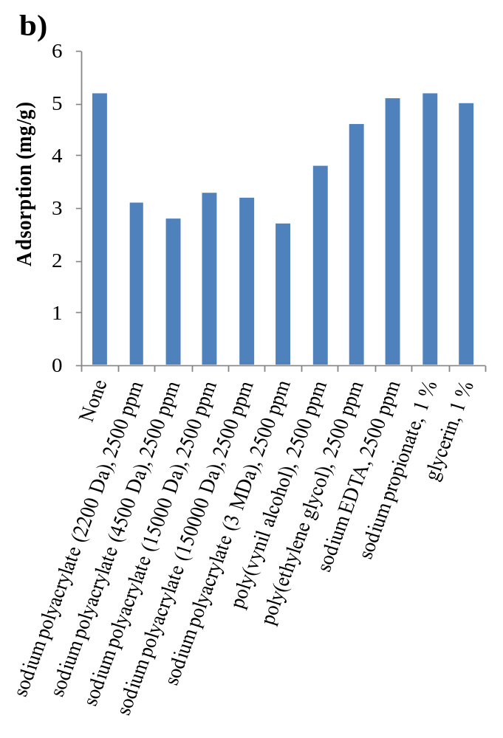
Different chemicals as sacrificial agent for betaines
Adsorption on Kaolinite
Adsorption on Silica

Slide 7
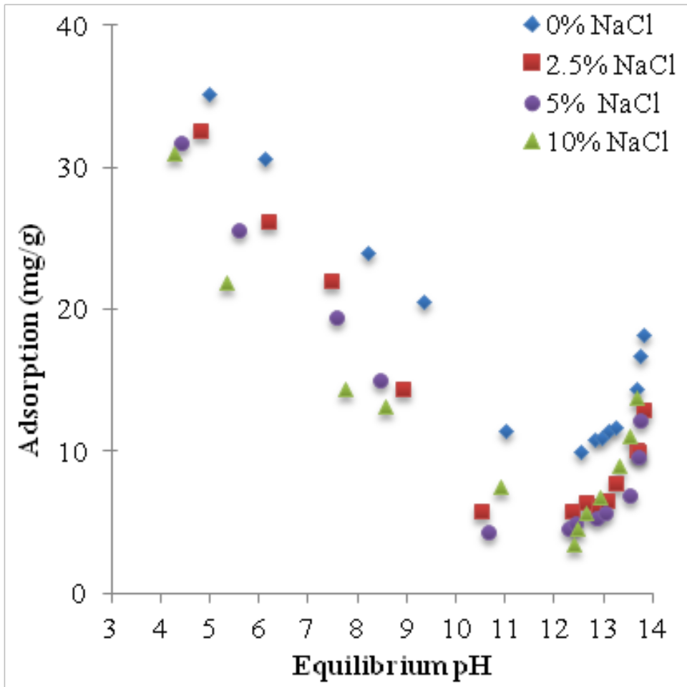
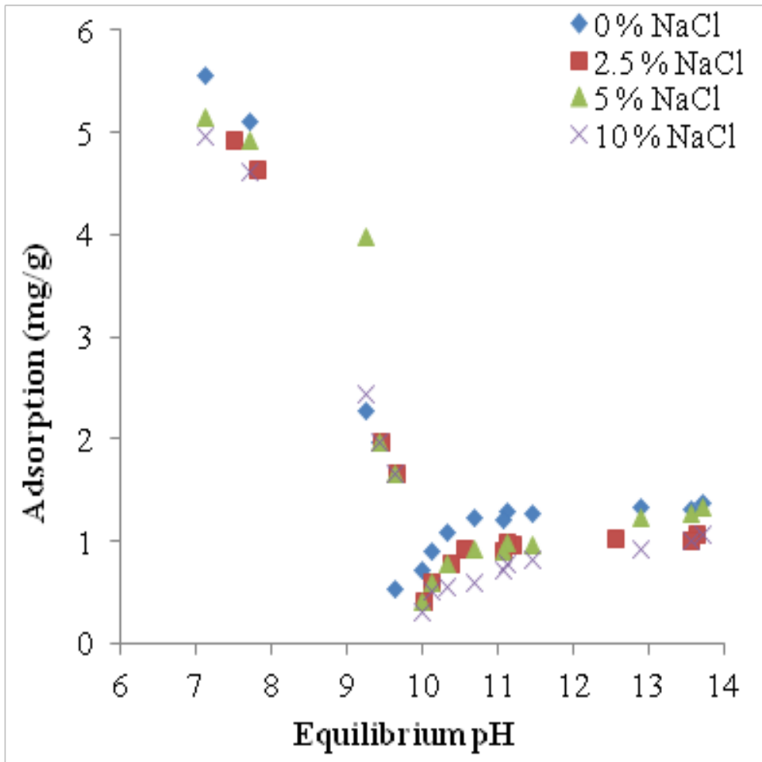
Effect of pH (surface charge) on adsorption of betaines
Adsorption on Kaolinite
Adsorption on Silica
Increase in pH → Adsorption Decreases then Increases and may Plateau

Slide 8
Effect of pH on Zeta Potential and Surface Charge
Ionic strength = 0.1 M
Room temperature
Kaolinite data from: D.J.A. Williams, K.P. Williams, Electrophoresis and zeta potential of kaolinite, J. Colloid Interface Sci., 65 (1978) 79-87
Increase in pH → More Negative Charge on the Surface of Rock

Slide 9
Effect of pH on the Charge of Lauryl Betaine
Basic Region
Titrated with NaOH
Both positive and negative charges are present
Increase in pH in the Basic Region Has No Significant Effect on Charge of Lauryl Betaine

Slide 10
Summary of Experimental Evidence
Adsorption of lauryl betaine decreases with increase in pH, but in a basic pH range, adsorption increases and may plateau.
This basic pH range starts at pH 10 and 12 for silica and Kaolinite, respectively.
It was shown that the charge of betaine does not change in the pH range that the adsorption trend changes
It was also shown that the surface of the rocks (silica or Kaolinite) becomes more negative with increase in pH
Repulsive force on negative charge of betaine
Attractive force on Positive charge of betaine
-- -- -- -- -- -- -- -- -- -- -- -- --
Adsorbent Surface

Slide 11
Hypothetic molecular mechanism for adsorption of betaines
1
3
5
Increase in pH
Decrease in Adsorption
Increase in pH
Increase in Adsorption
+ + + -- + -- + + + -- + + + --
Adsorbent Surface
1
1
+ + -- -- + -- + + + -- + -- + +
2
Adsorbent Surface
+ -- -- -- + -- + -- -- + + -- -- +
3
Adsorbent Surface
-- -- -- -- -- + -- -- -- + -- -- --
4
Adsorbent Surface
-- -- -- -- -- -- -- -- -- -- -- -- --
5
Adsorbent Surface

Slide 12
Effect of anionic surfactant on pH dependency of betaine adsorption
Adsorption on Kaolinite @ 0% NaCl
Adsorption on Kaolinite @ 2.5% NaCl

Slide 13
How Anionic Surfactant Reduces Adsorption of Betaines?
Mechanism in low pH range
(where positive charges exist)
Competitive Adsorption
Mechanism in high pH range
(where only negative charges are dominant)
Betaine-anionic surfactant interactions
Adsorption of betaine in the absence of anionic surfactant
+ + + -- + -- + + + -- + + + --
-- -- -- -- -- -- -- -- -- -- -- -- --
Adsorbent Surface
Adsorbent Surface
Adsorption of betaine in the presence of anionic surfactant
+ + + -- + -- + + + -- + + + --
-- -- -- -- -- -- -- -- -- -- -- -- --
Adsorbent Surface
Adsorbent Surface

Slide 14
Conclusions
Many chemicals tested to reduce adsorption of lauryl betaine, including sodium polyacrylate, but the reduction in adsorption is not as desired.
The effect of pH on adsorption of lauryl betaine on silica and Kaolinite was investigated.
With increase in pH, adsorption decreased and reached a minimum but then increased or reached a plateau.
Although increase in pH makes the charge of the surface more negative, it does not have any effect on charge of betaine at pH>7
Bending of the betaine molecule due to increased negative surface charge is hypothesized to be responsible for a second increase in adsorption.
Anionic surfactant can reduce the adsorption of betaine. This is explained by competitive adsorption and interaction between betaine and anionic surfactant.

Slide 15
Back-Up Slides

Slide 16
List of surfactants
Trade or descriptive name | Chemical structure | Activity (%) | Supplier
Neodol-67 (N) | bC16-17(CH3-CH-CH2-O)7-SO4Na | 22.88 | STEPAN
IOS15-18 (I) | R-CH(OH)-CH2-CH(SO3)-R (~75%) R-CH=CH-CH(SO3-)-R (~25%) where R+R’ = C12-15 | 21.29 | STEPAN
NI-Blend | A Blend of Neodol-67-7PO-Sulfate and IOS15-18 (N:I)=4:1 | -- | --
MACKAM LB-35 | C12-N⁺-COO⁻ | 27.9 | Rhodia
3

