Slide 1


Foam Transport in
Porous Media Micromodels
Charles Conn, advised by Dr. Sibani Lisa Biswal
Rice University, Chemical and Biomolecular Engineering
Consortium for Processes in Porous Media 2014
April 21st, 2014

Slide 2
ENHANCED OIL RECOVERY: FOAM
Micromodel studies of foams in porous media

Slide 3
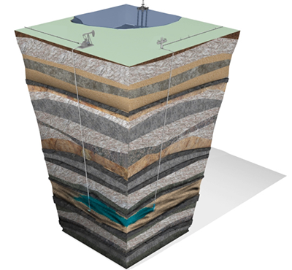
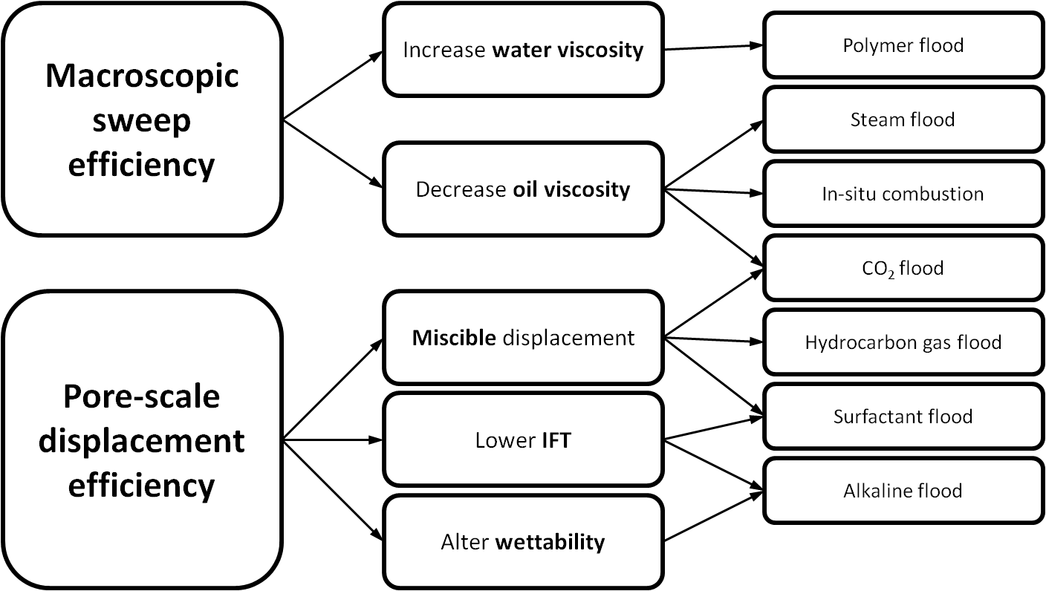
Why Enhanced Oil Recovery (EOR)?
Produces oil not accessible by conventional methods
Uses existing reservoirs, infrastructure, & markets
Increasingly economical with increasing oil prices

Slide 4
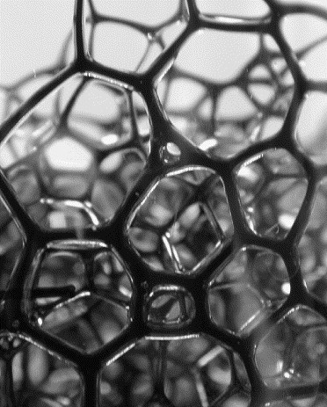
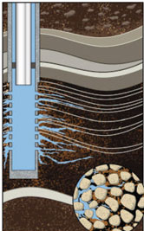
Mobility Control
Challenges in gas flooding – premature gas breakthrough, channeling through high-permeability regions, fingering due to low viscosity
Possible Solution: Foam
Applications in enhanced/improved oil recovery (EOR/IOR) and
CO₂ sequestration
Questions:
How can foam mobilize trapped oil in porous media?
What is the fracture/matrix interaction during a foam flood?
Source: Vikingstad, Skauge (2005); adapted from Hanssen, Surguchev (1995); epmag.com

Slide 5
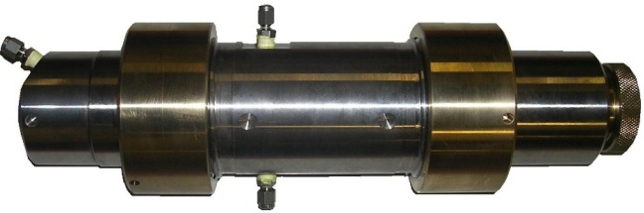
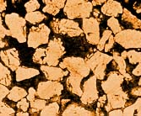

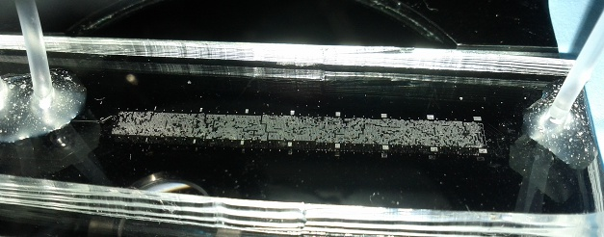
Problem & Motivation
Can we design a microfluidic system to study foam behavior in porous media?
Most porous media studies:
Black-box process
Must infer foam behavior from pressure
Time consuming, downtime
Heterogeneous, hard to directly compare
?
With microfluidic models:
Optically transparent, visual
Designed porous media
Well-controlled injection conditions
On-chip mixing of injected fluids for screening (e.g. salinity, surfactant blends)
Tunable wettability
Source: Conn et al, in preparation

Slide 6
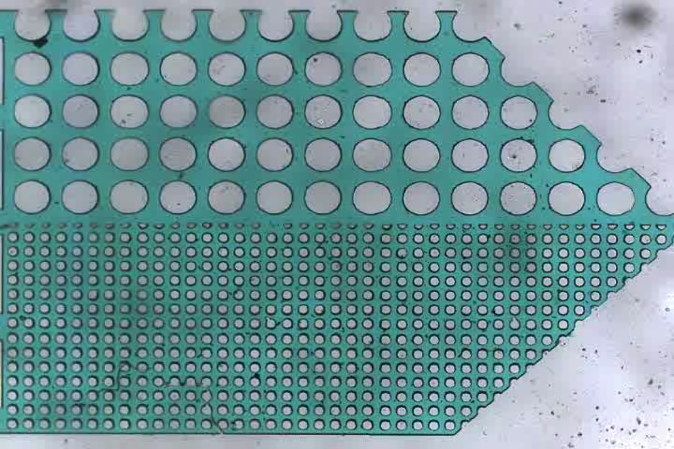
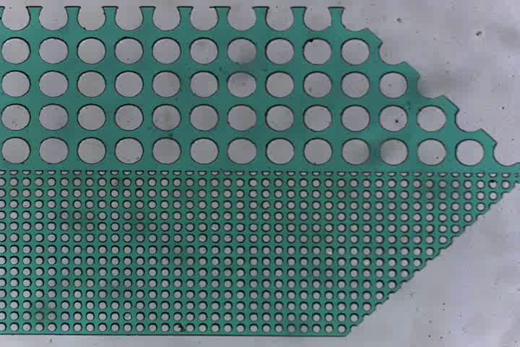
Water Displacement in Micromodels
Gas (air) only
Foam
blue = water
gas only displaces high-perm, bypass of low-perm
foam displaces both high-perm and low-perm regions
trapped
bubbles
lamellae
resistance
Mobility Ratio:
Effective displacement: M < 1
Source: Ma 2012

Slide 7
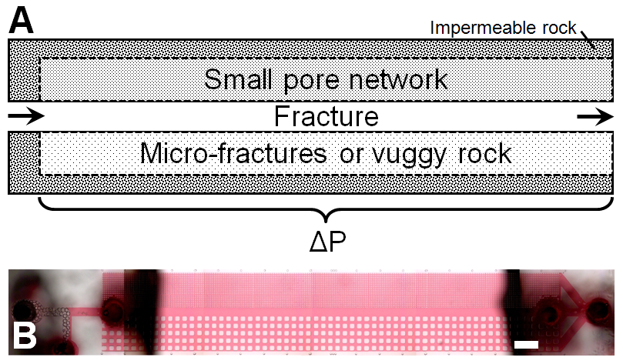
Layered Micromodel
red = oil
Flood with foam, watch oil displacement…
Source: Conn et al, in preparation

Slide 8
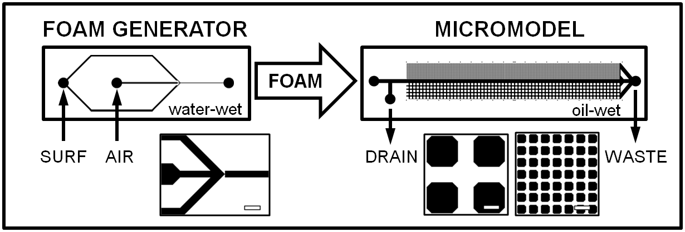
Experimental Design
SURFACTANT
OIL
AOS 14-16
GAS
Paraffin Oil
25 cP
MATERIALS
1:1 ratio
1% surf
SWIS
Air
lauryl betaine
Oil Red O
Source: Conn et al, in preparation

Slide 9
CONTROL EXPERIMENTS
(floods without foam)

Slide 10
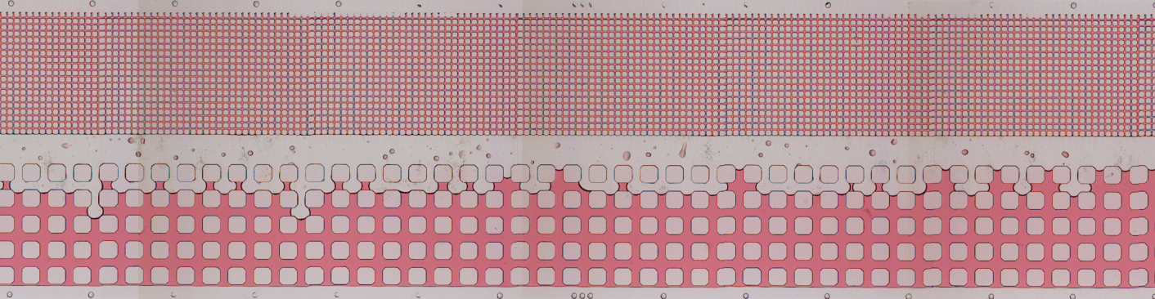
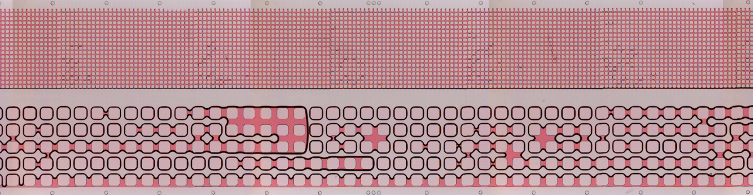
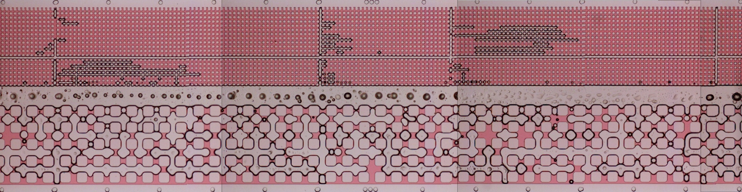
Control Experiments
red = oil | white = water or air
1 mm
WATER FLOOD
GAS FLOOD
(high pressure!)
WATER & AIR FLOOD
Source: Conn et al, in preparation

Slide 11
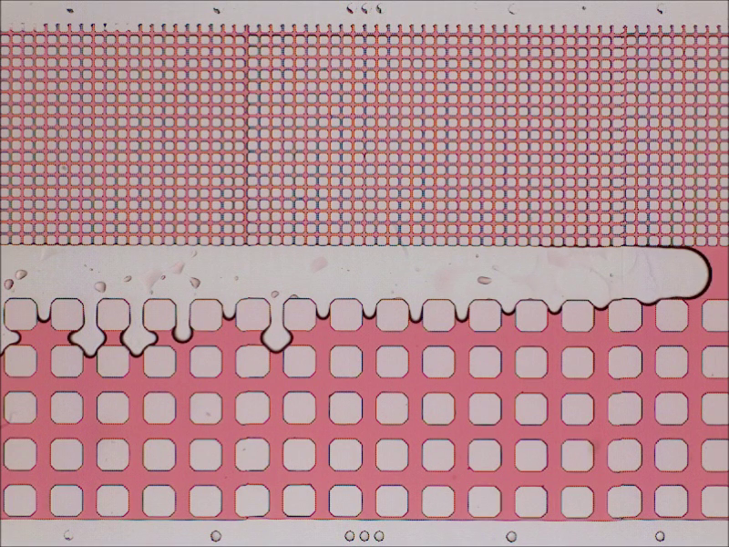
CONTROL – Waterflood
Source: Conn et al, in preparation

Slide 12
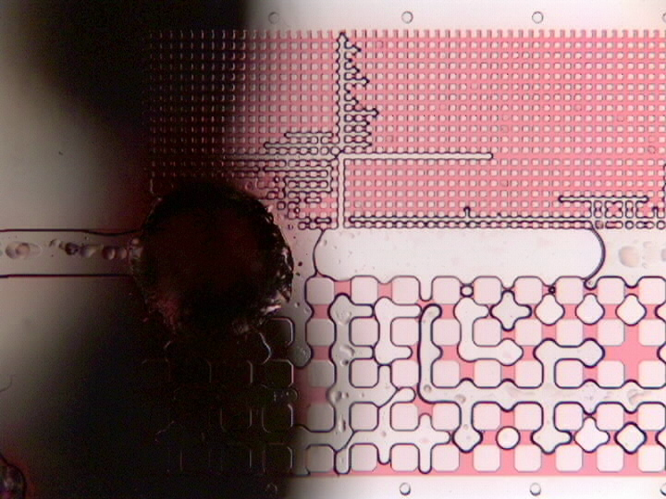
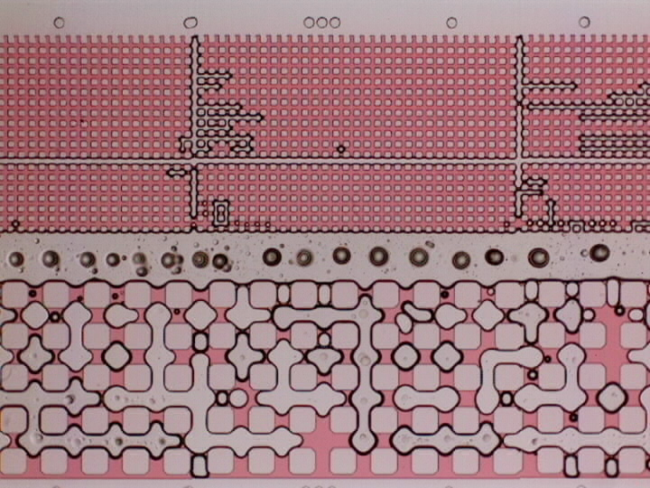
CONTROL – Water & Gas Flood
Source: Conn et al, in preparation

Slide 13
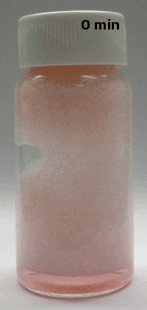
FOAM EXPERIMENTS
(floods with foam)
Foam stability in presence of oil

Slide 14
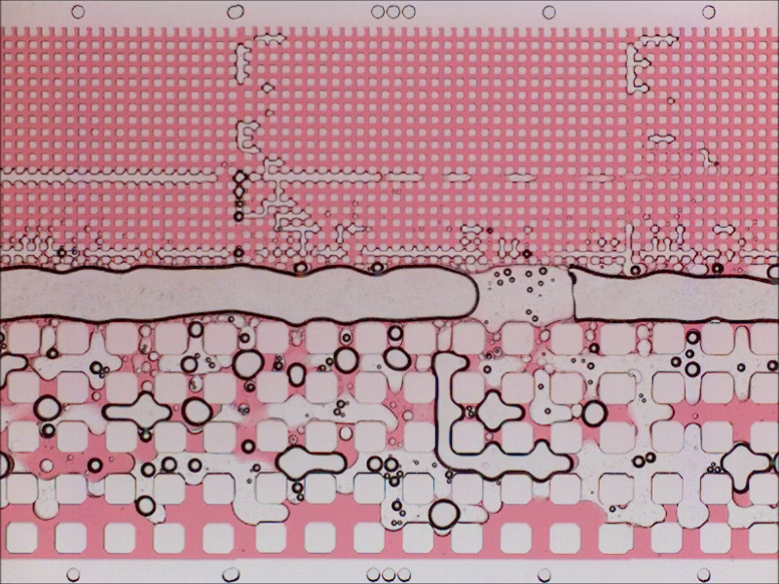
Poor Foaming Surfactant
Source: Conn et al, in preparation

Slide 15
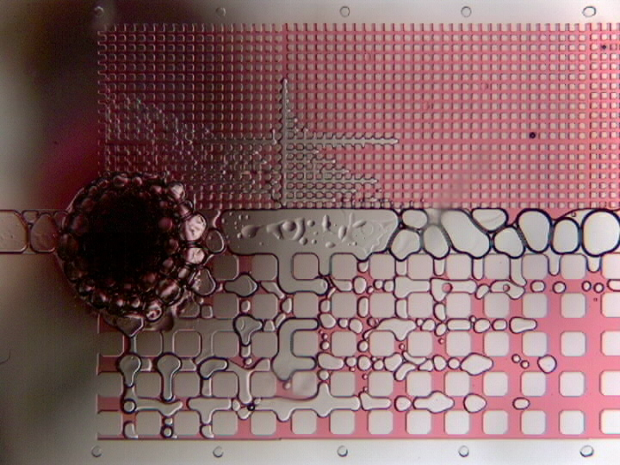
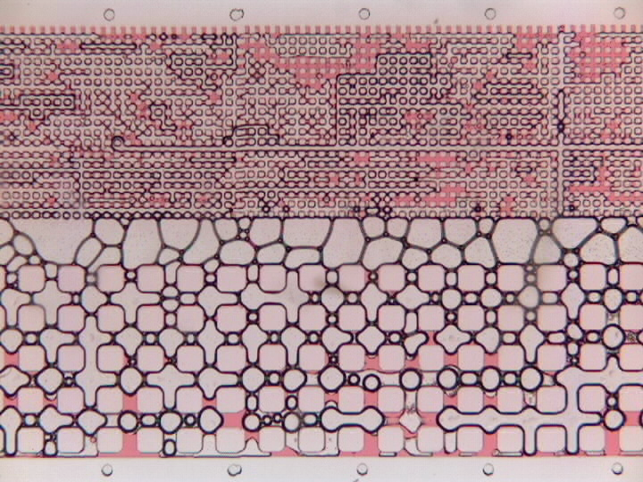
Good Foaming Surfactant
Mechanisms
Bubble blocking, lamellae resistance in high-perm zones
Phase separation due to different capillary entry pressures
CEP_{surf-oil} < CEP_{gas-oil}
Source: Conn et al, in preparation

Slide 16
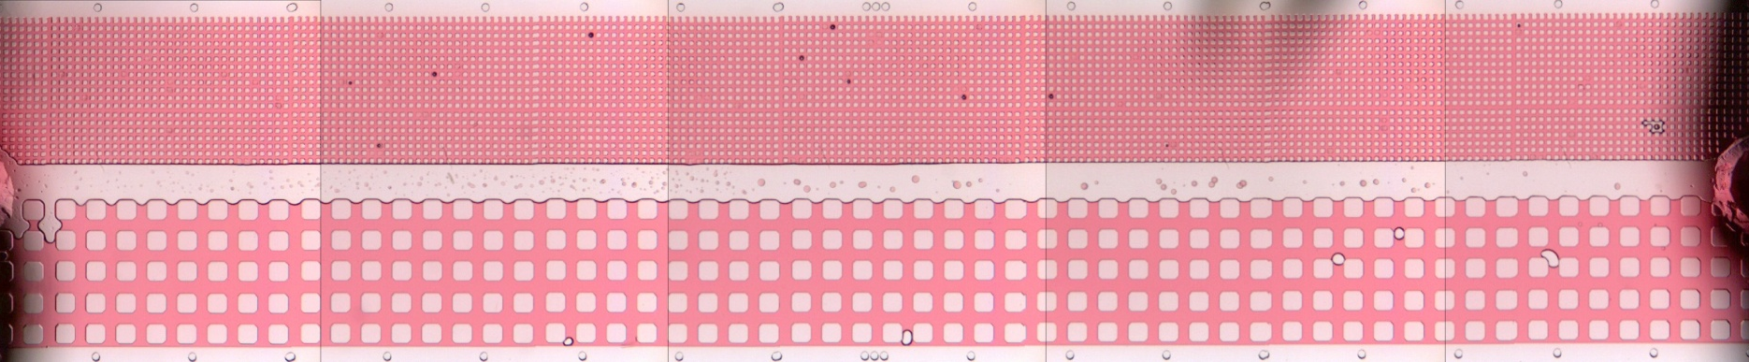
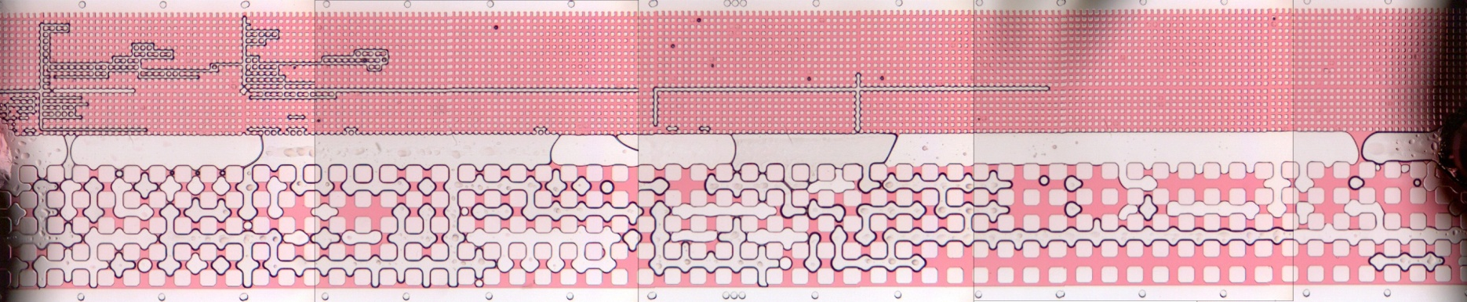
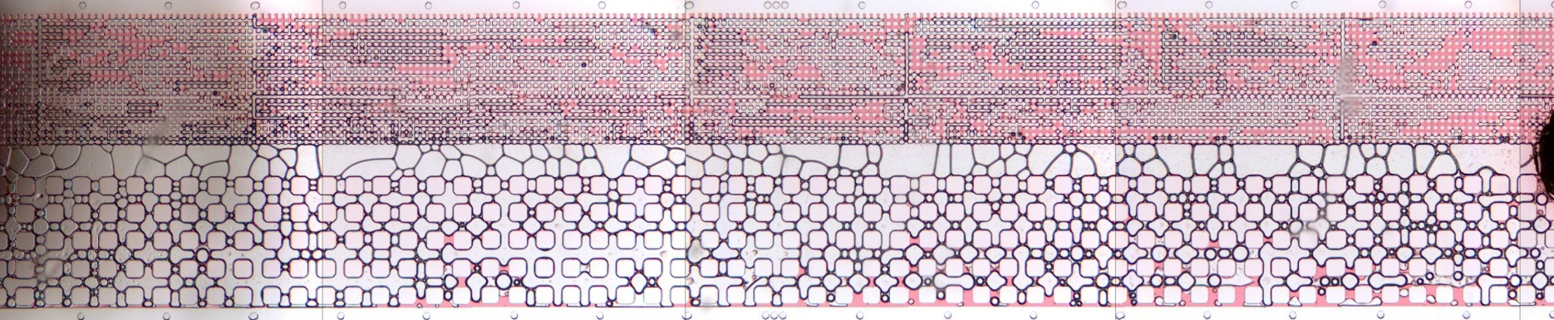
Superior Foam Performance
WATERFLOOD (200x the liquid flow rate in the foam case!)
red = oil | white = aqueous or air
‘WAG’ ANALOG
FOAM FLOOD
Source: Conn et al, in preparation

Slide 17
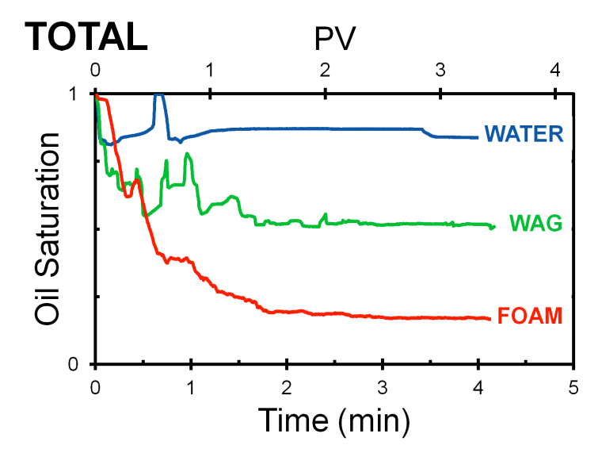
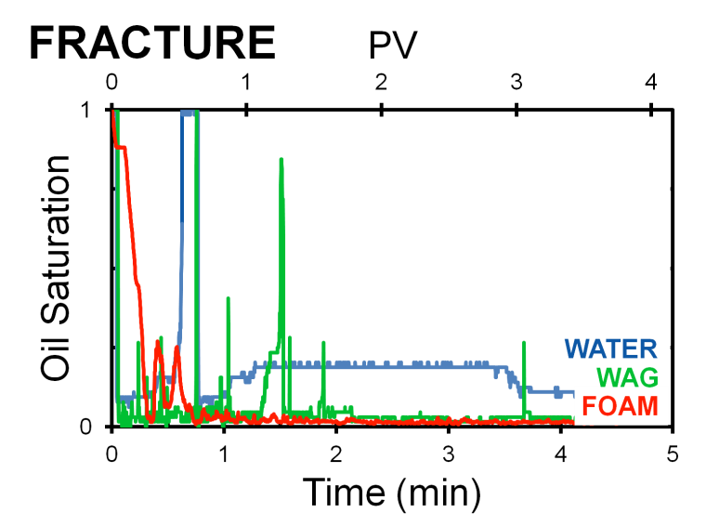
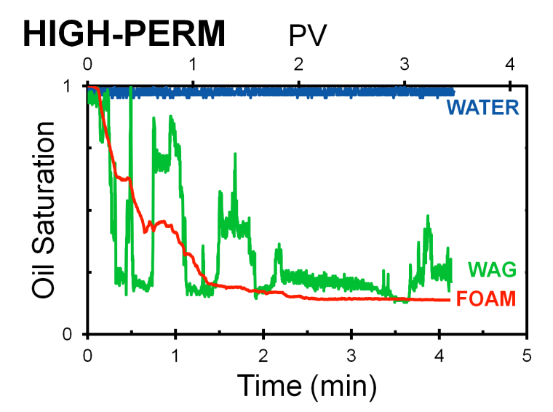
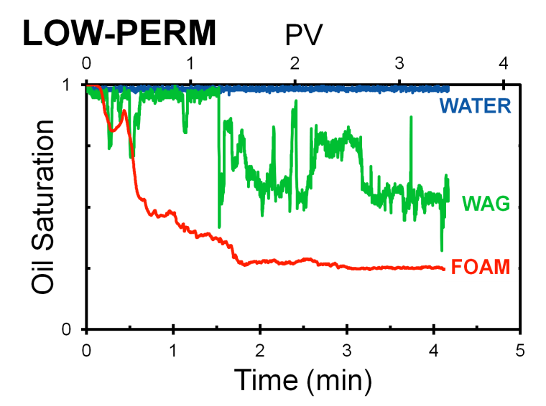
Oil Saturation
13.7%
due to wettability
25.1%
Source: Conn et al, in preparation

Slide 18
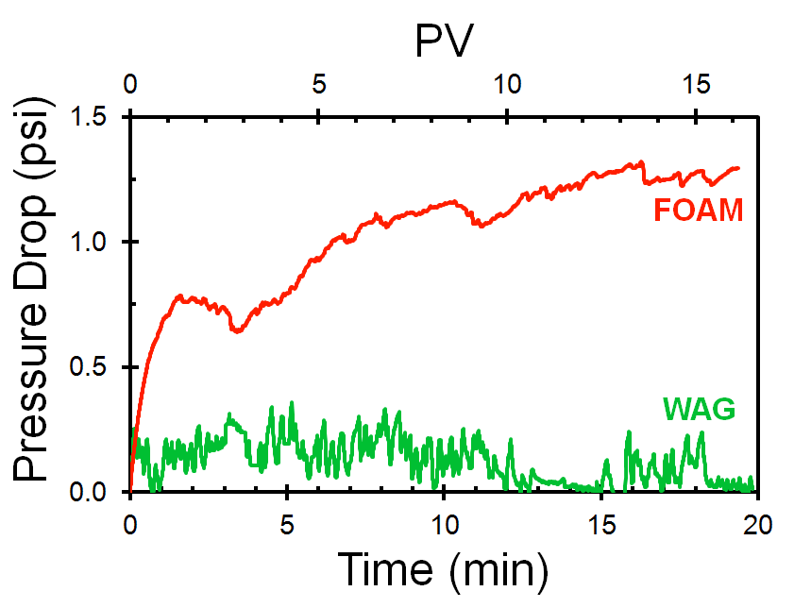

Pressure Drop
trapped
bubbles
lamellae
resistance
Mobility Ratio:
Effective displacement: M < 1
Source: Conn et al, in preparation

Slide 19
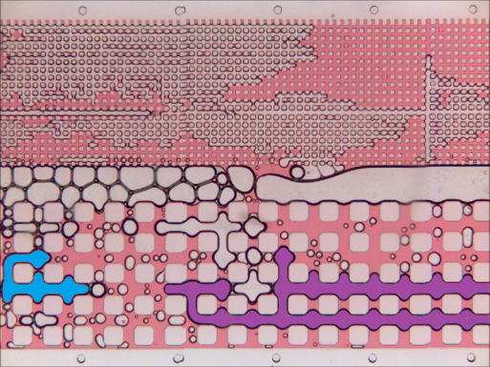
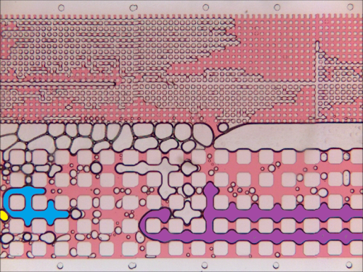
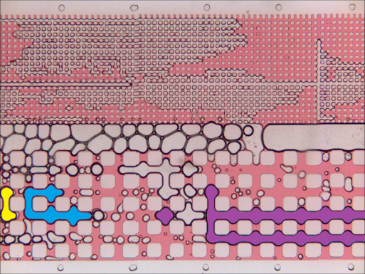
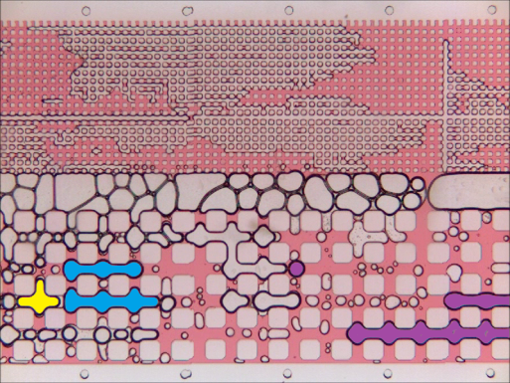
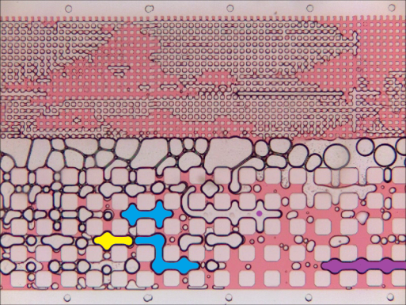
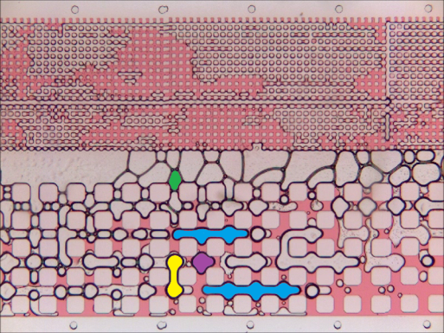
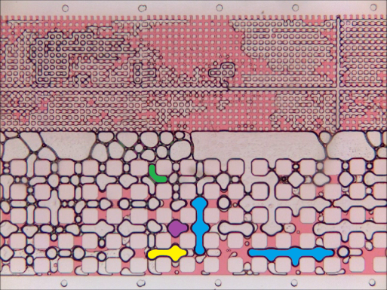
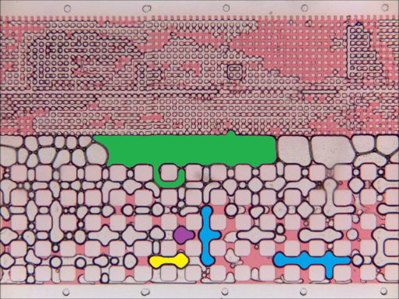
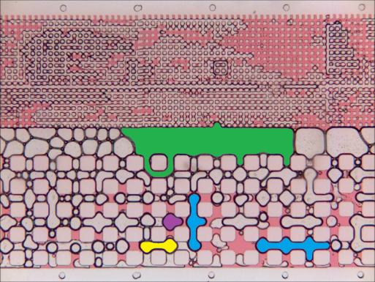
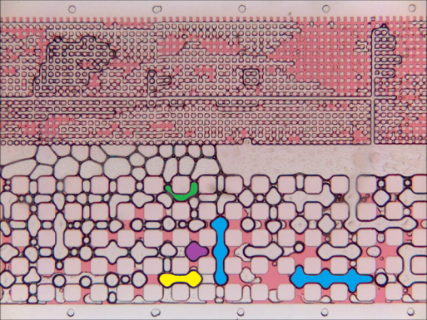
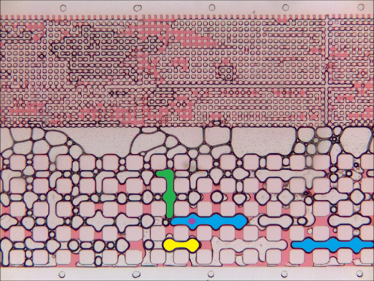
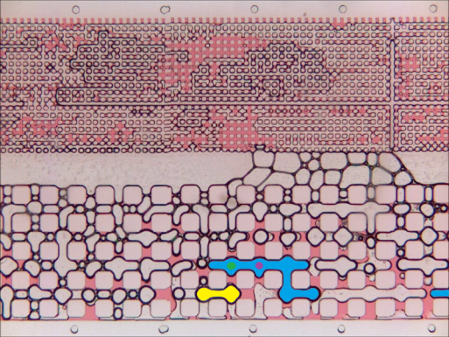
Bubble Tracking
time
How is foam generated and destroyed in porous media?
Source: Conn et al, in preparation

Slide 20
Conclusions
Demonstrated water/air/foam floods in oil-wet PDMS
Stable foam in the presence of oil
Permeability heterogeneity (fracture/low/high-perm)
Improved oil mobilization with foam given identical injection conditions
Bridged single-pore with core/sandpack scale expts
Oil displacement resolved to each permeability section
Foam increased macro/micro ΔP, overcoming CEP
Phase separation due to capillary entry pressures (CEP)
Liquid-rich low-perm and gas-rich high-perm
Foam should not be treated as a homogeneous phase
Source: Conn et al, in preparation

Slide 21
THANK YOU
Questions?

