Slide 1

NMR Core-Analysis in Unconventional Resource Plays
Rice University Consortium on Processes in Porous Media
Department of Chemical & Biomolecular Engineering
Philip M. Singer
George J. Hirasaki
Walter G. Chapman
Dilipkumar N. Asthagiri
Zeliang Chen
Jinlu Liu

Slide 2
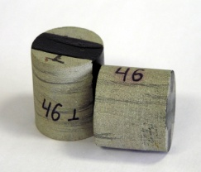
Outline
NMR Background
Porosity Models in Shale
Answer-Products in Shale
Equipment & Computational Tools
Challenges to Investigate

Slide 3
NMR Background
B₀
H
H
H
O
H
H
μ_{N}
T₁
H
H
H
H
H
H
C
C
H
H
H
H
C
B₁
H
H
H
S
H
H
T₂
Logging: detect fluids only
Core-analysis: fluids & solids

Slide 4
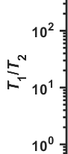
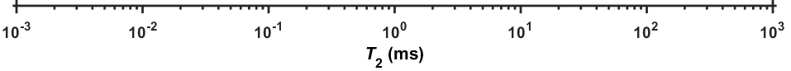
NMR Log Porosity Model
Kerogen
Bitumen
Irreducible Oil
Structural
Water
Movable Light Oil
Clay Bound Water
T_{E}

Slide 5
NMR Core Porosity Model
Kerogen
Bitumen
Irreducible Oil
Structural
Water
Movable Light Oil
Clay Bound Water
T_{E}
T_{2-cutoff}
Gaussian decay
Solid
Exponential decay
Liquid

Slide 6
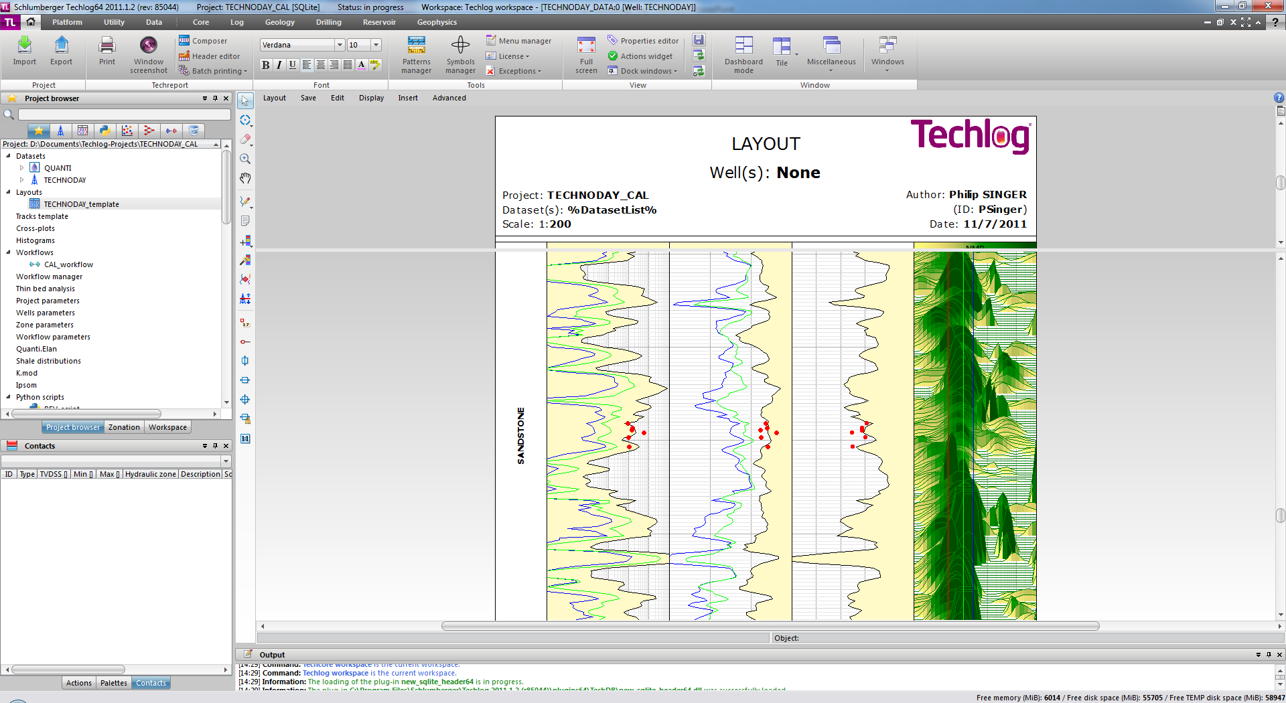
NMR Answer-Products
Current:
Total porosity: Kerogen (from porosity deficit)
Movable fluid porosity: T_{2-cutoff} (calibrated from core)
Research (validate & calibrate with core):
Fluid typing (saturation): T₁/T₂ ratio
Pore-size distribution: ρT₂
Wettability: Restricted D(T₂)
Permeability transform
0.3 T₂ (ms) 5000
E. Rylander et al. SPE-164554 (2013)

Slide 7
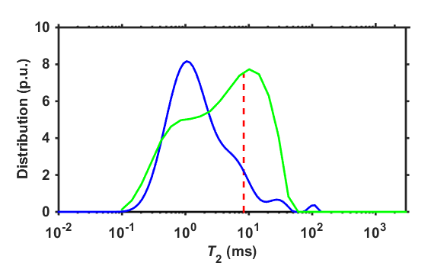
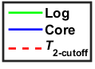
Log Calibration with Core
Eagle-Ford Tight-Oil
42 API
1500 scf/bbl
2 MHz
100 C
T_{e} ~ 0.4 ms
P.M. Singer et al. SCA-18 (2013)

Slide 8
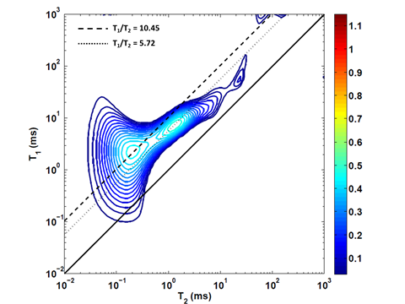
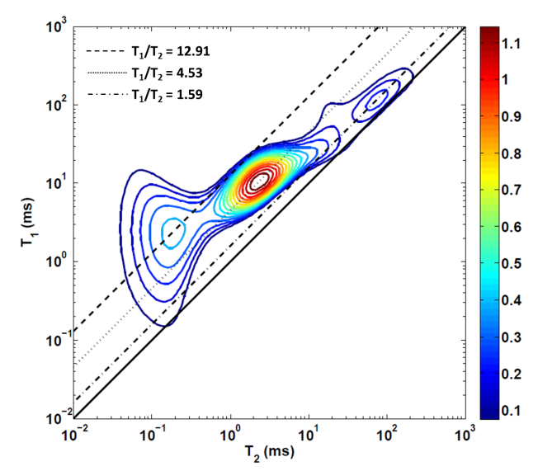
Core Re-Saturation
As-Received
Oil Re-Saturated (2000 psi)
Zoning
R. Kausik et al. SCA-73 (2014)

Slide 9
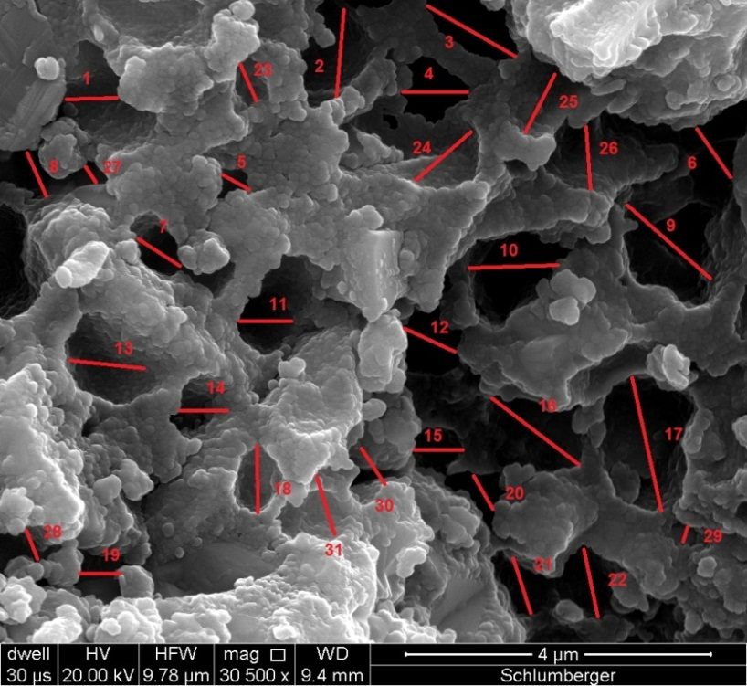
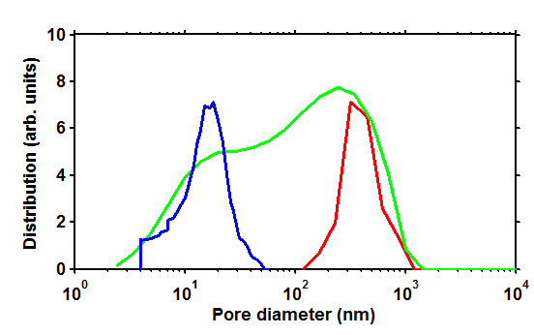
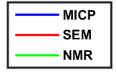
Pore-Size Distribution
ρ = 5 nm/ms
T. Jiang et al. SPWLA-LL (2013)

Slide 10
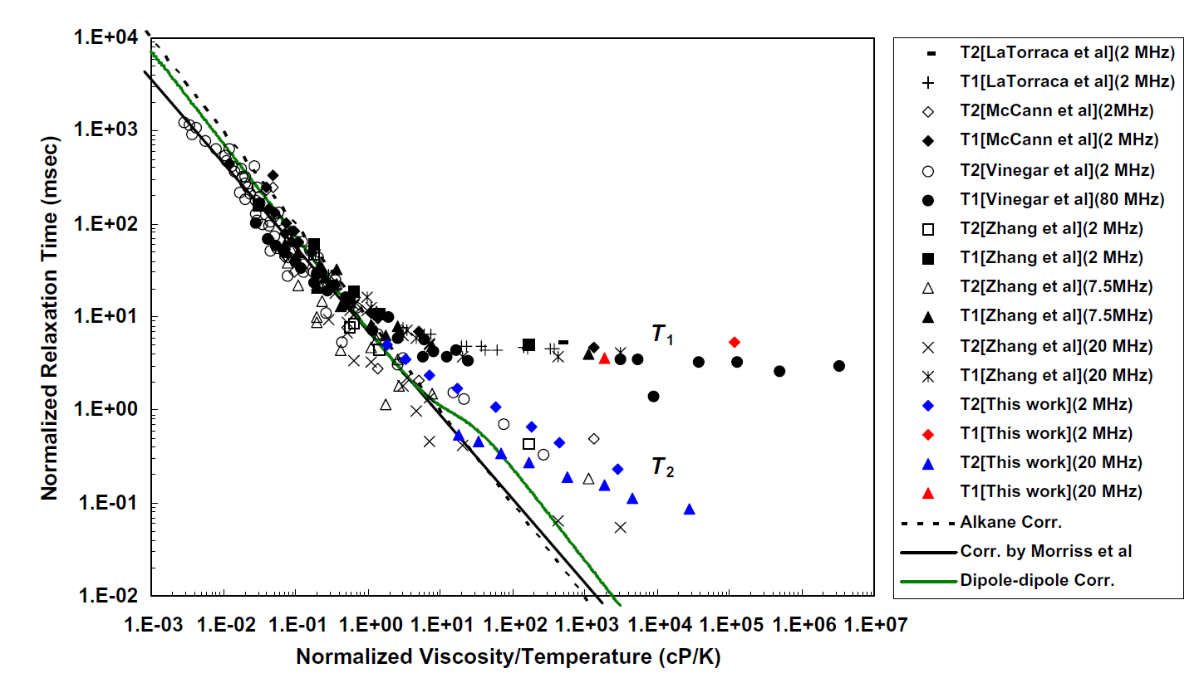
Bulk Crude-Oils
Theory
Experiment
Z. Yang et al. JMR-192 (2008)

Slide 11


NMR Core Equipment
Low-field 2 MHz
Core dia.: 0.5”, 1.0”, 1.5”
T_{E} (ms): 0.03, 0.06, 0.1
T₁-T₂, D-T₂, Profile-T₂
1.0” dia., 0.1 ms
5,000 psi confining
4,500 psi differential
100 C

Slide 12
Computational Chemistry
Model hydrocarbon phase-behavior & storage in nano-pores, requires:
Hydrocarbon composition
Pressure & temperature
Pore-size from NMR core data
Wettability from NMR core data
Model hydrocarbon transport in nano-pores using:
In-situ NMR core-flooding data
Real-time monitoring of core-flood front
Saturated pore-size distribution across core
H
Kerogen
C
H
H
H
H
C
H
H
H
H
H
H
C
C
H
H
H
H
H
C
H
C
H
H
H
H
H

Slide 13
Theory and Modeling
Atomic length scale
Ab initio quantum chemical & empirical force-field based simulations
Quasi-chemical theory to interpret simulation results
Atomic-to-pore length scale
Empirical force-field based simulations + accelerated sampling techniques
iSAFT (interfacial Statistical Associating Fluid Theory)
Pore-to-core length scale
Density functional theory for modeling phase-behavior

Slide 14
Challenges to Investigate
Surface relaxation with nano-pore confinement
Exponential (fluid) versus Gaussian (solid) decay
Deviations from theory at long correlation times (solid-like)
Internal gradients in the motional averaging regime
Hydrocarbon phase-behavior and storage in shale
Hydrocarbon transport (non-Darcy flow) in shale
Permeability transforms in shale

