Slide 1
Nanoparticle Interactions with Surfactant Micro-emulsions
Luqing Qi,¹ Hadi ShamsiJazeyi,¹ Jason Mann,² Maura Puerto,¹ James M. Tour,² Rafael Verduzco,¹ George J. Hirasaki¹
¹Department of Chemical and Biomolecular Engineering
²Department of Chemistry
19th Annual Meeting of
Rice University Consortium for Process in Porous Media
April 22, 2015

Slide 2
Goal
● Prepare and characterize nanoparticles (NPs) that can segregate to the middle phase microemulsion at high salinities and penetrate porous media
● Investigate the interaction of nanoparticles with surfactants towards an approach to prepare blends with low interfacial tension (IFT) and low adsorption

Slide 3
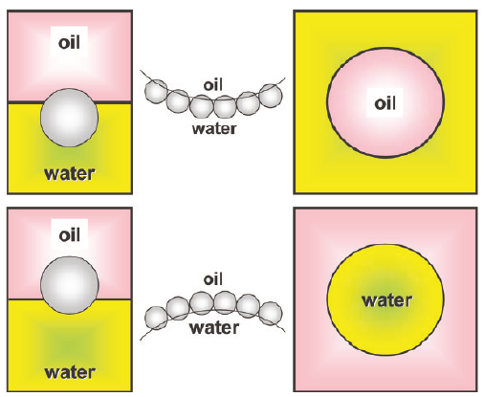
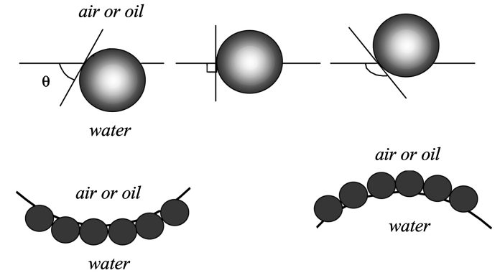
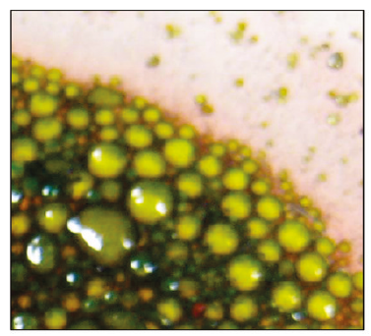
Prior studies have shown NPs stabilize macro-emulsions
“unmodified nanoparticles …..show improved stability of large emulsion droplets”¹
“Emulsions have been stabilized by carbon nanotube-silica nanohybrids. “
1. B. P. Binks, Curr. Opin. Colloid Interface Sci., 2002, 7, 21–41.
2. M. Shen, D. E. Resasco, Langmuir 2009, 25(18), 10843–10851

Slide 4
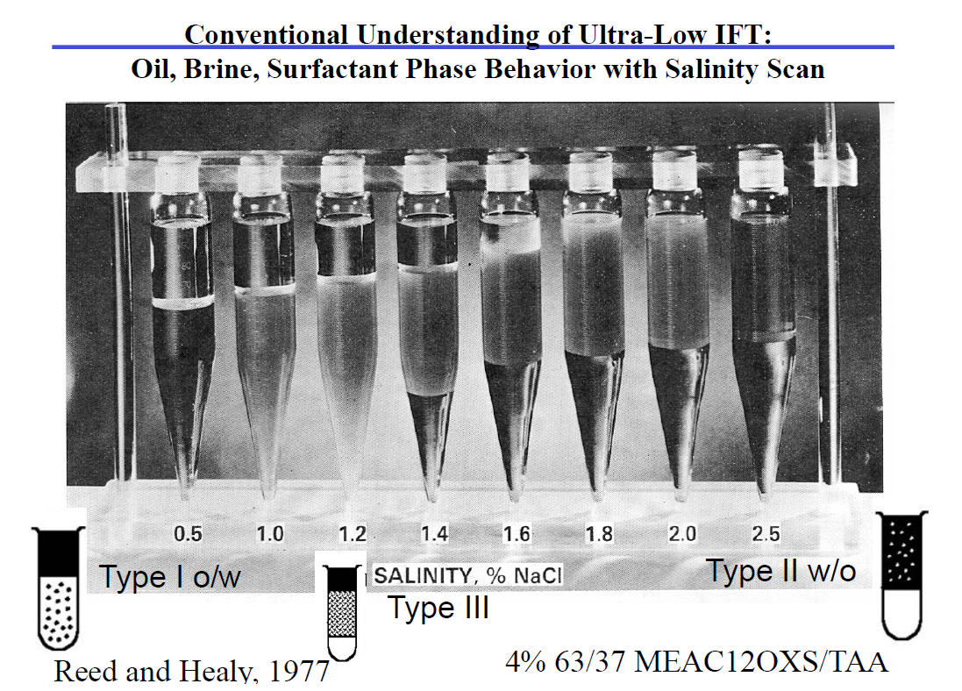
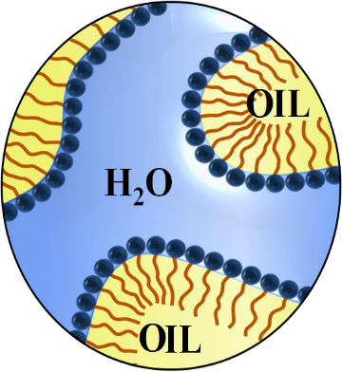
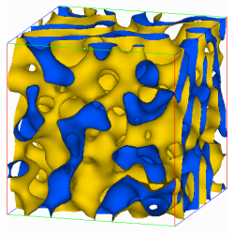
Nanoparticles that stabilize bicontinuous microemulsions could be beneficial for EOR
Reed and Healv (1976, June 1). Multiphase Microemulsion Systems. SPE jounals.
As salinity increases, Winsor typeⅠ to
Winsor type Ⅲ, then to Winsor type Ⅱ
Microemulsion is a bicontinuous phase

Slide 5
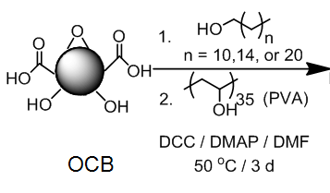
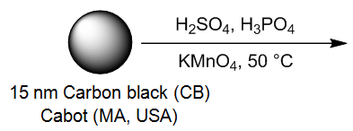
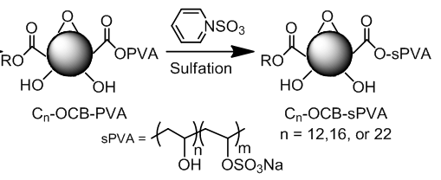
Preparation of NPs: Surface modification of oxidized carbon black
hydrophobic
hydrophilic
Oxided Carbon black
sPVA: Lightly sulfated PVA
ssPVA: Highly sulfated PVA

Slide 6


Library of NPs with amphiphilic polymer chains on the surface
PVA—more Hydrophilic chain
sPVA—more Hydrophilic chain
ssPVA-OCB
sPVA-OCB
ssPVA--most Hydrophilic chain
PVA-OCB
C₁₆--Hydrophobic chain
Oxided Carbon black
C₁₆PVA-OCB
C₁₆ssPVA-OCB
sPVA: Lightly sulfonated PVA
ssPVA: Highly sulfonated PVA
C₁₆sPVA-OCB
The amphiphilicity is the balance between alkyl group and sulfate group
The degree of sulfation can be controlled

Slide 7
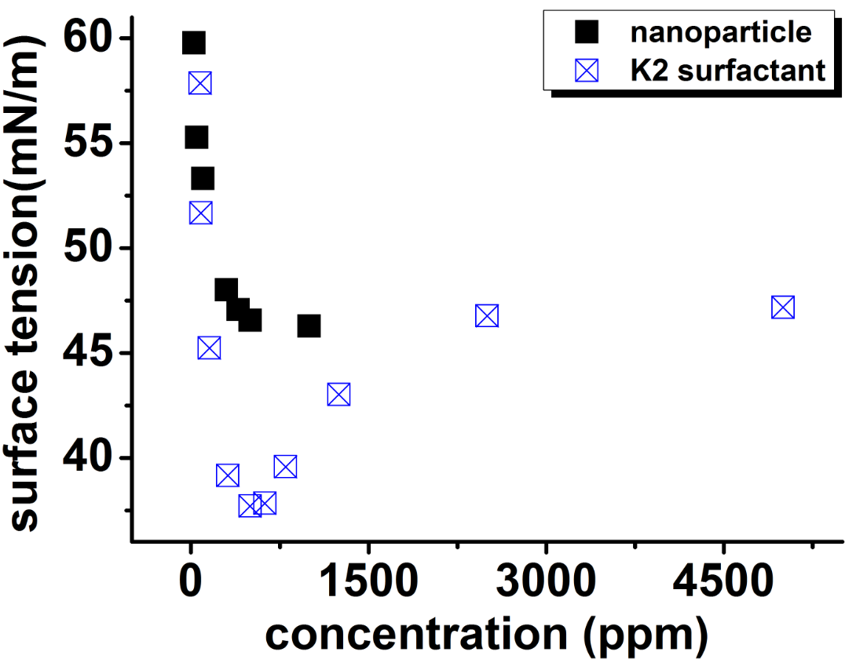
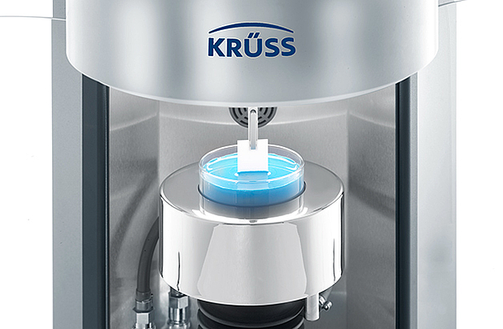
Amphiphilic nanoparticles are surface active
K3: C_{n}(n<14) propoxy ethoxy sulfates
Nanoparticle: C₁₆ sPVA-OCB
Measured using Wilhelmy plate method,
Kruss K100 tensiometer
CMC of K2 surfactant

Slide 8
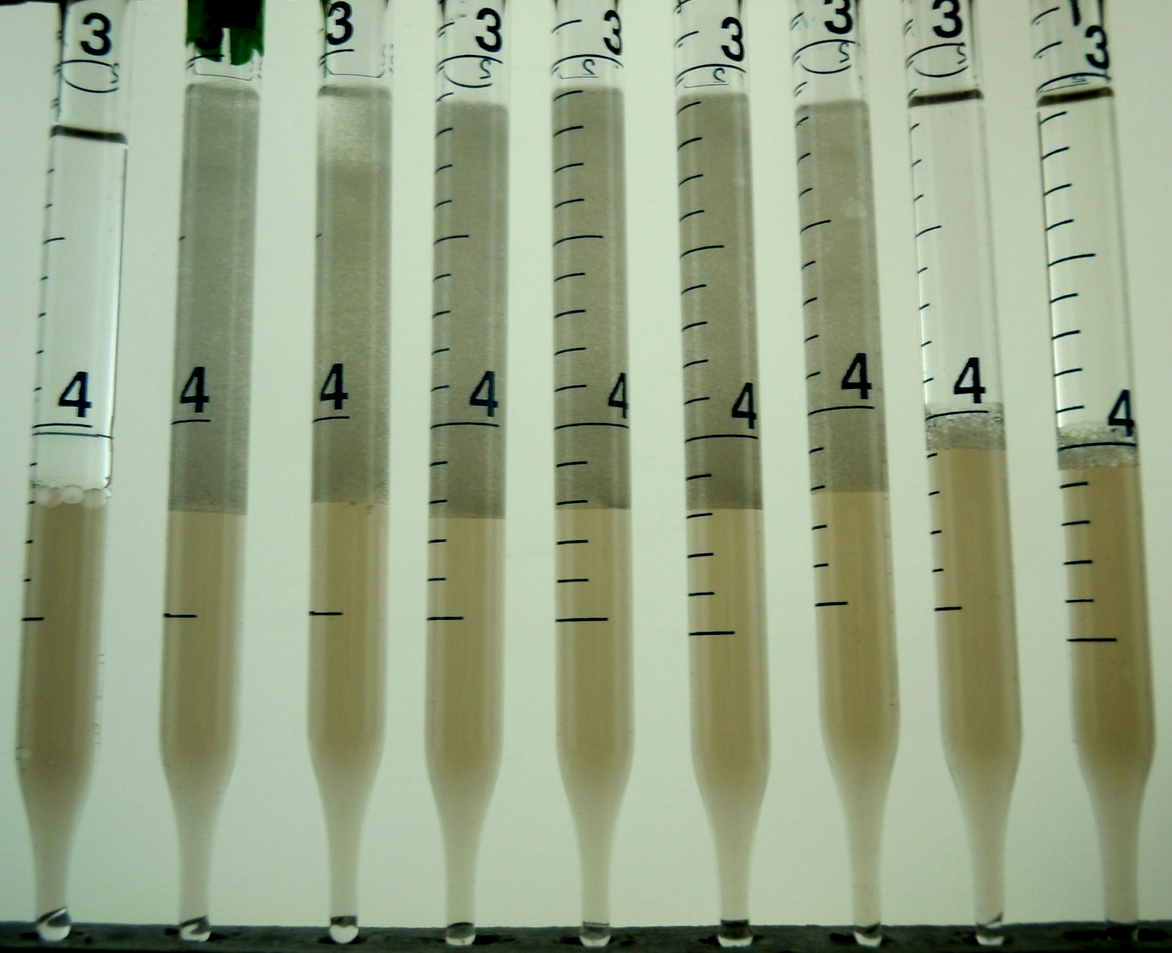
No microemulsion observed from salinity scan of nanoparticle
Salinity %
0.0 5.3 6.4 7.6 9.9 10.5 11.4 14.7 16.0
Oil phase: n-octane
No surfactant was used
NP: 2mg/g partially sulfated poly(vinyl alcohol)-OCB ("sPVA-OCB")
Pickering emulsion observed in a salinity scan: flat interface, emulsion is kinetically stable
Pickering emulsion:
a macro-emulsion stabilized by solid particles adsorbed onto the interface between the two phases.

Slide 9
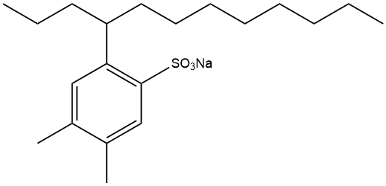
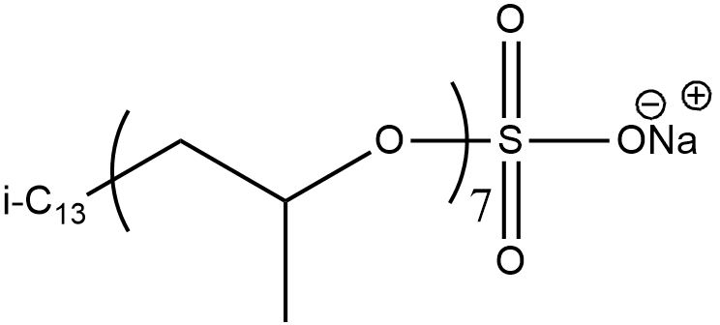
Surfactant-Nanoparticle blends can potentiall produce stable microemulsions
OXS from Exxon
Salinity scan of surfactant first, then surfactant& NPs blend
S13B
From TIORCO
Alfoterra K2-4 1S and Alfoterra K3-4 1S
From Sasol
C_{n}(n<14) propoxy ethoxy sulfates
K2 and K3 have same PO,EO number,
K3 has long hydrophobe part

Slide 10
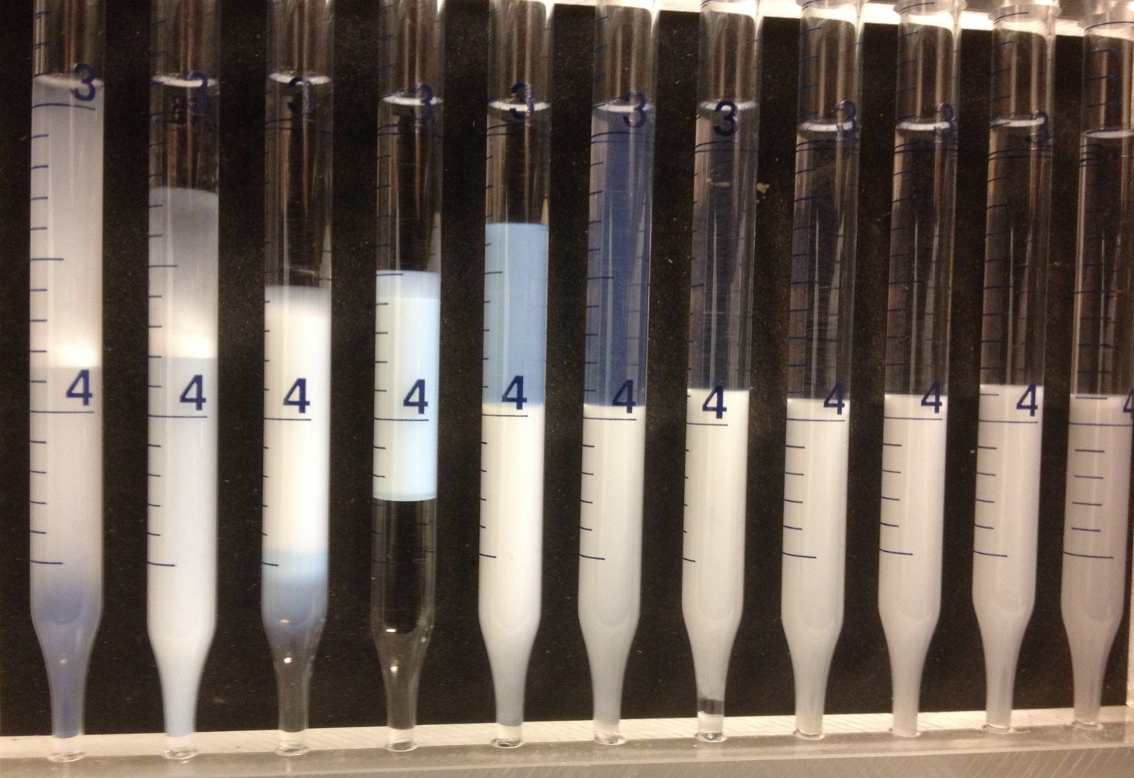
Salinity scan for S13B surfactant
1cc Aqueous: S13B 2wt%, SBA 2.5wt%
1cc oil: octane
the optimal salinity between 4.0~4.5%
Salinity % 3.0 3.5 4.0 4.5 5.0 5.5 6.0 6.5 7.0 7.5 8.0

Slide 11
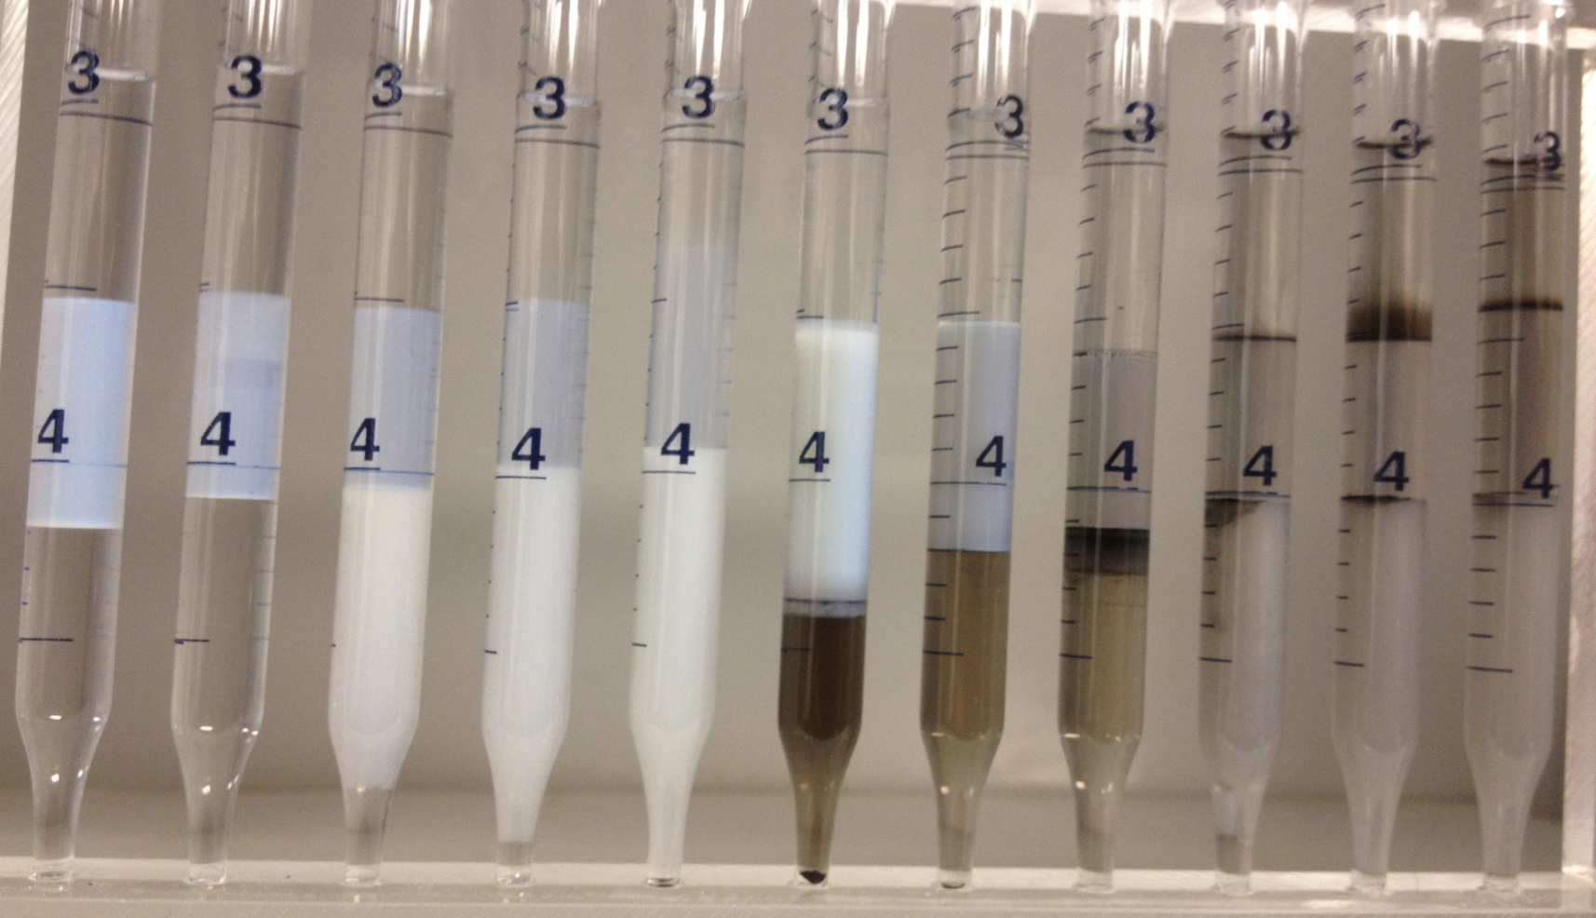
PVA-OCB does not penetrate into microemulsion phase
1cc Aqueous: S13B 2wt%, Nacl 4.3wt%, PVA-OCB 0.2wt%
1cc oil: octane
without OCB
with PVA-OCB
SBA % 3.0 3.5 4.0 4.5 5.0 2.5 3.0 3.5 4.0 4.5 5.0

Slide 12
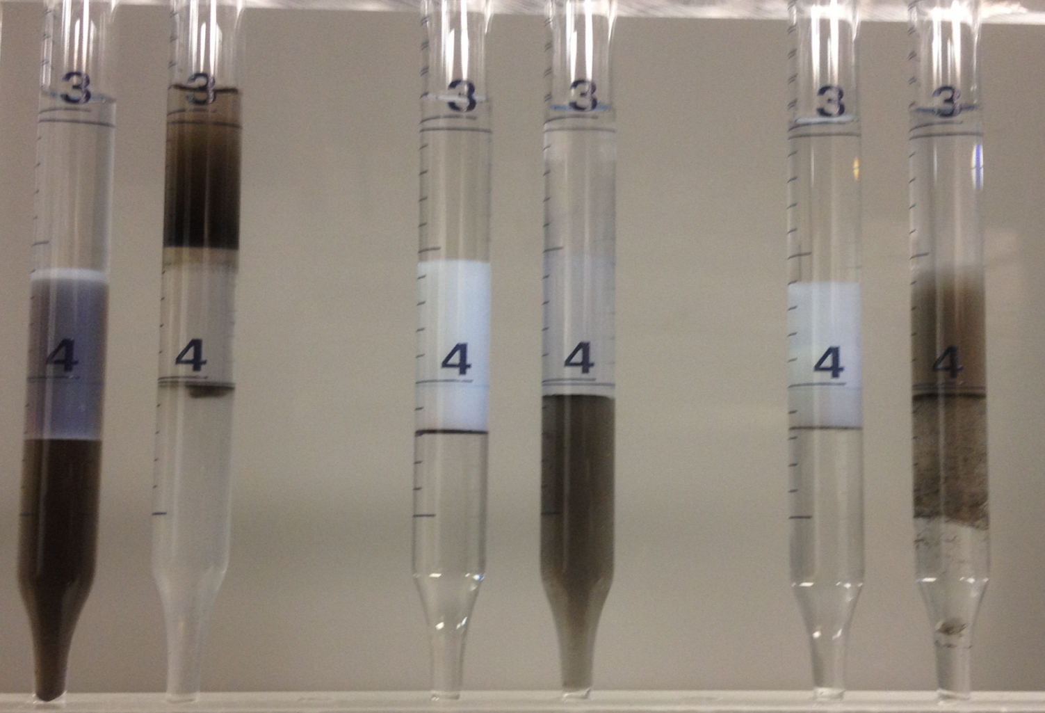
C₁₆sPVA-OCB disperses in microemulsion, but aggregate with time
1cc Aqueous: S13B 2wt%, Nacl 4.3wt%, OCB 2wt%
1cc oil: octane
sPVA-OCB C₁₆PVA-OCB C₁₆sPVA-OCB
Aggregate after
a few days
SBA% 3.0 5.0 3.0 5.0 3.0 5.0

Slide 13

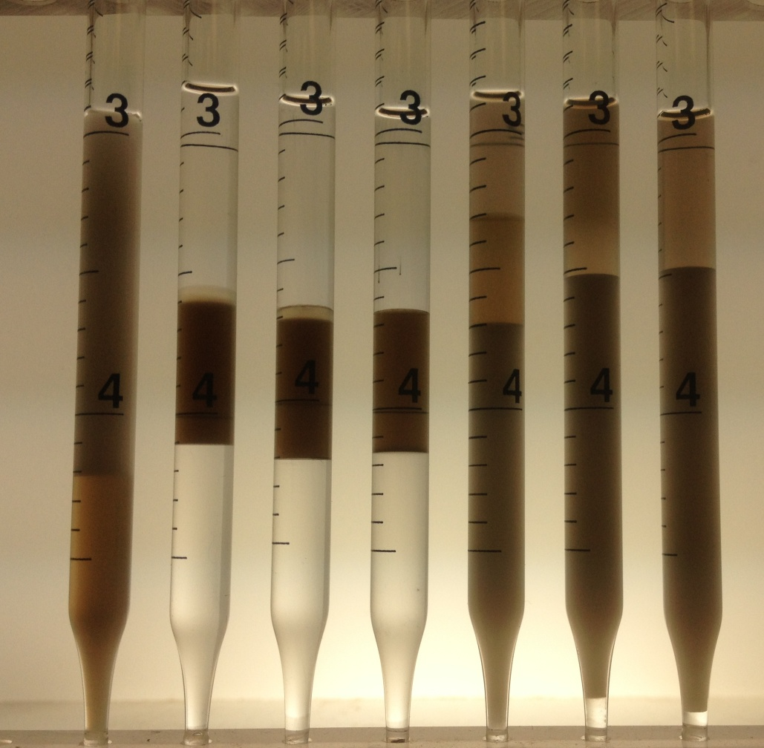
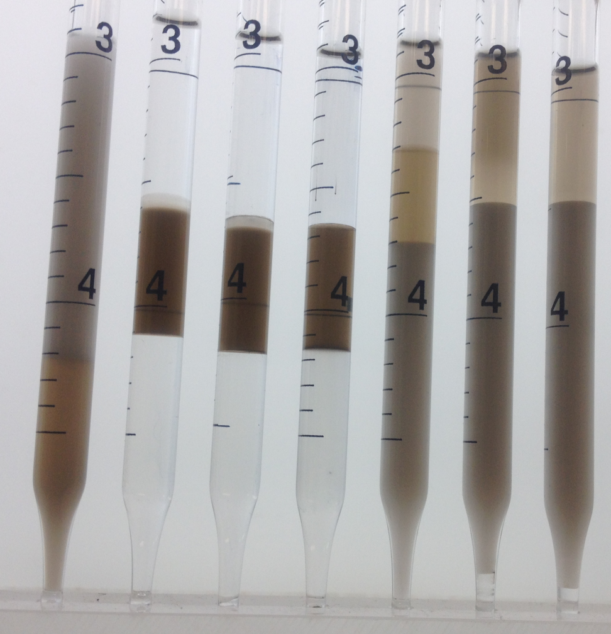
Highly sulfated C₁₆ssPVA-OCB NPs are stable in microemulsion
1cc Aqueous:C₁₆ssPVA-OCB 0.2wt%, S13B 2wt%, SBA 5wt%
1cc oil: octane
S13B 4.3% optimal salinity
Homogeneous dispersion
Salinity % 3.3 3.5 3.7 3.9 4.1 4.3 4.5 3.3 3.5 3.7 3.9 4.1 4.3 4.5

Slide 14
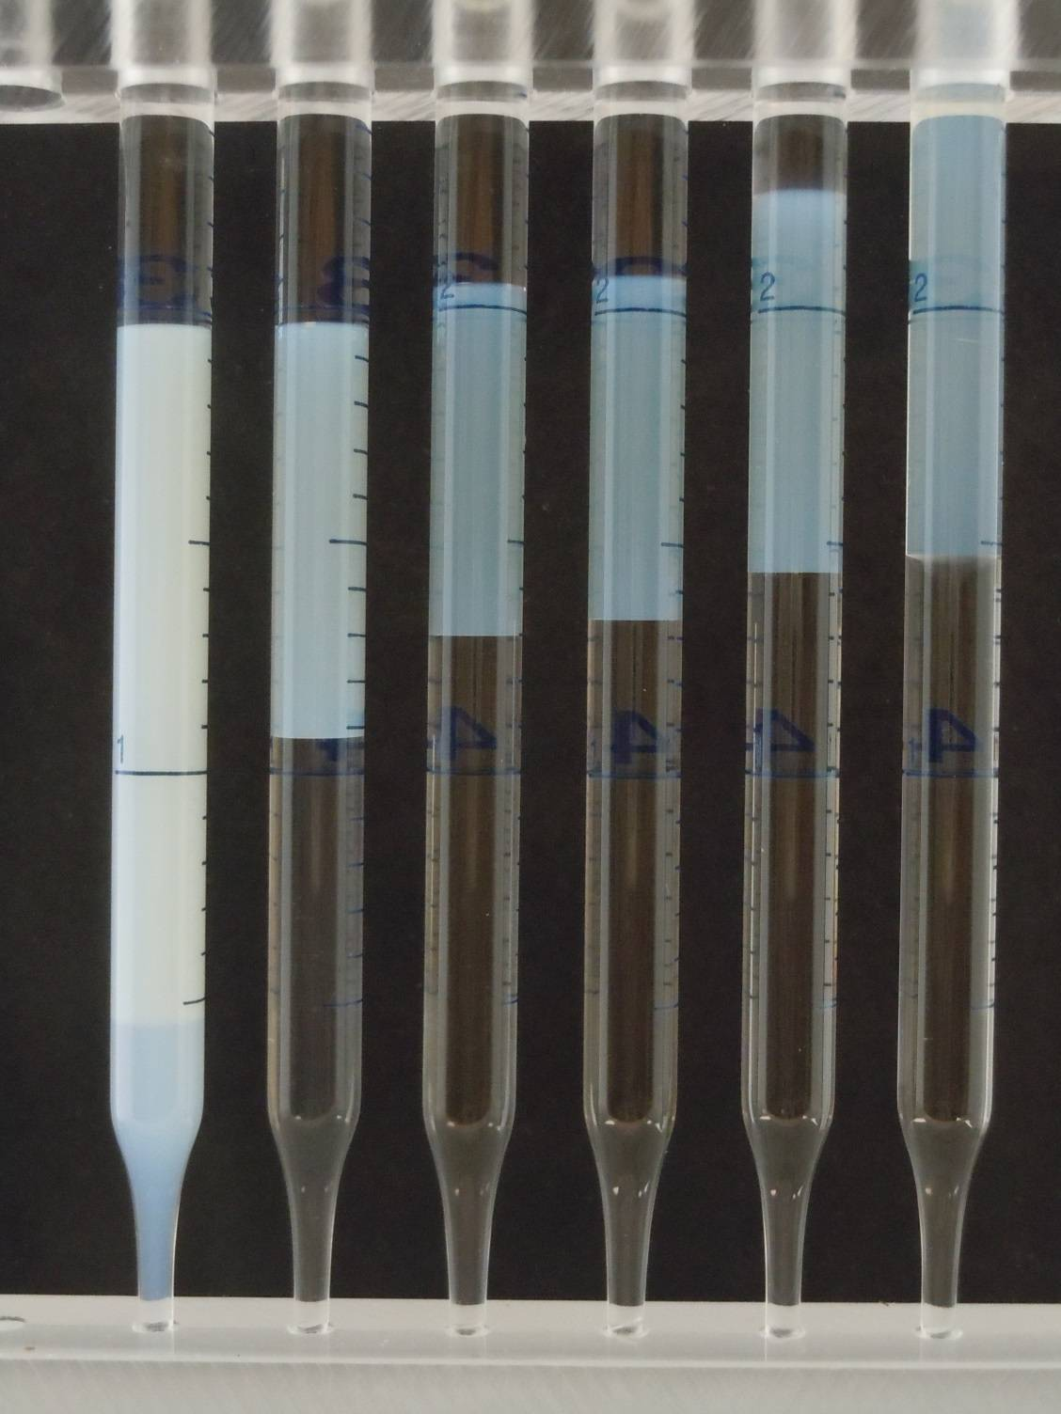
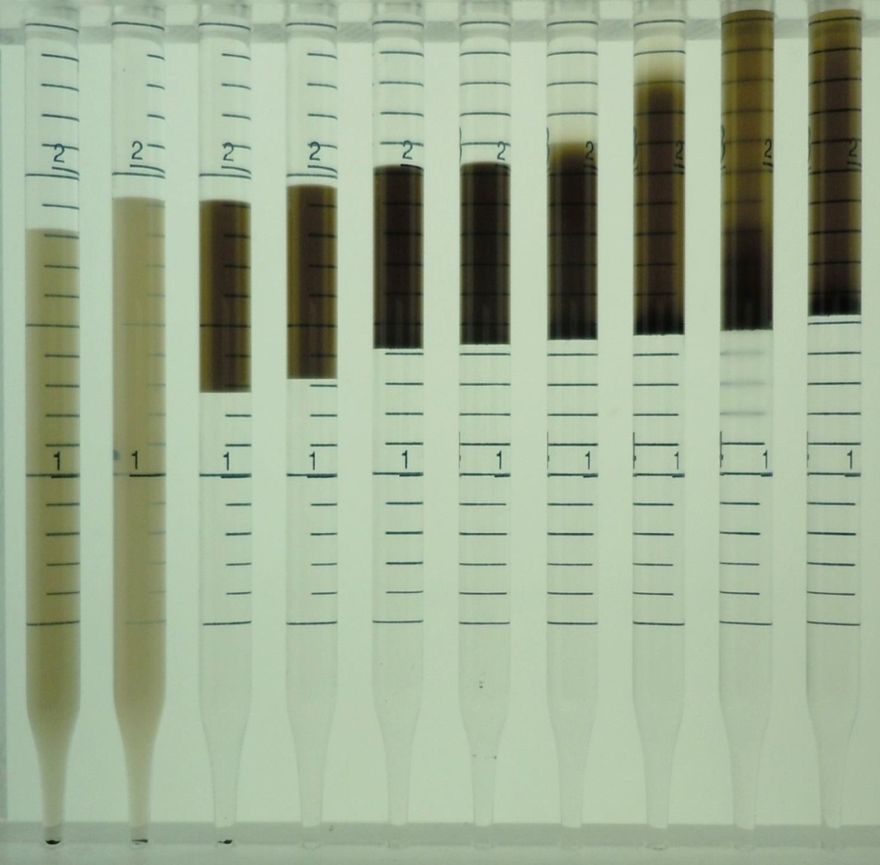
Highly sulfated NPs are stable in microemulsions at various salinities:
OXS surfactant + NP
1cc Aqueous: OXS 2wt%, SBA 2.5wt%, C₁₆ssPVA-OCB 0.2wt%,
1cc oil: octane
OXS 1.6% optimal salinity
S13B 4.3% optimal salinity
optimal salinity ~1.6%
Salinity %
1.5 1.6 1.7 1.8 1.9 2.0
1.4 1.6 1.7 1.8 1.9 2.0 2.1 2.2 2.3 2.4

Slide 15

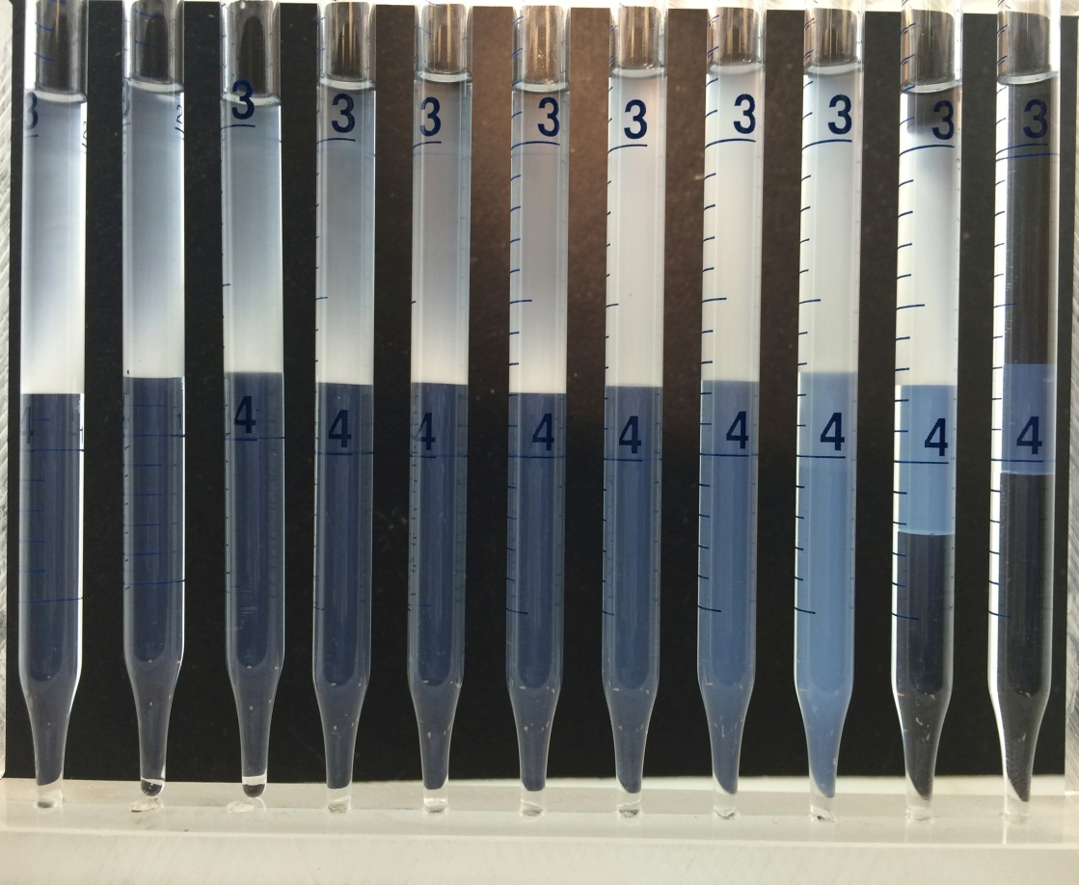
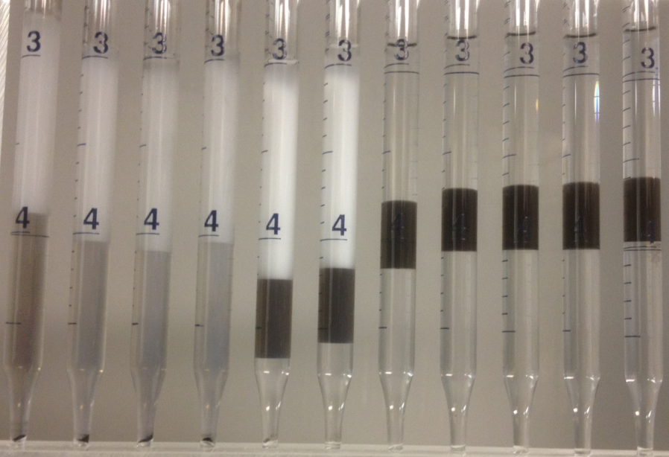
Highly sulfated NPs are stable in microemulsions at various salinities:
AF-K3-4 surfactant + NP
OXS 1.6% optimal salinity
1cc Aqueous: AF K3-4 1S 4wt%, SBA 2.5wt%, C₁₆ssPVA-OCB 2%
1cc oil: octane
S13B 4.3% optimal salinity
K3 11.9% optimal salinity
Salinity %
9.5 9.7 9.9 10.1 10.3 10.5 11.0 11.5 12.0 12.5 13.0 11.0 11.2 11.4 11.6 11.8 12.0 12.2 12.4 12.6 12.8 13.0

Slide 16
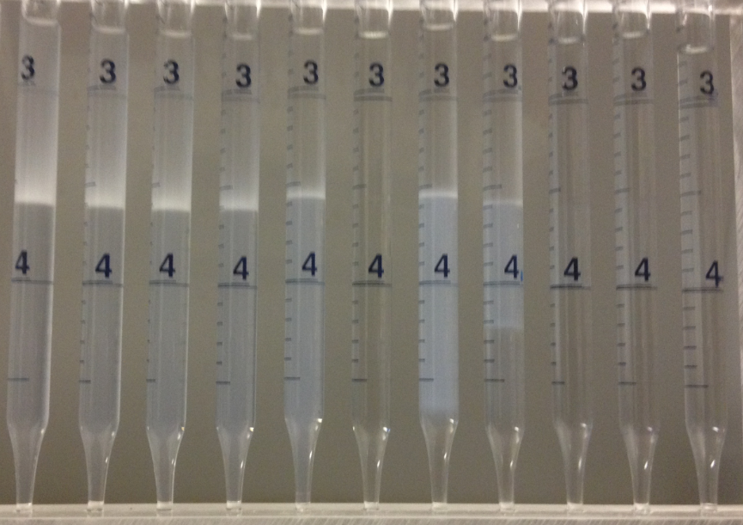
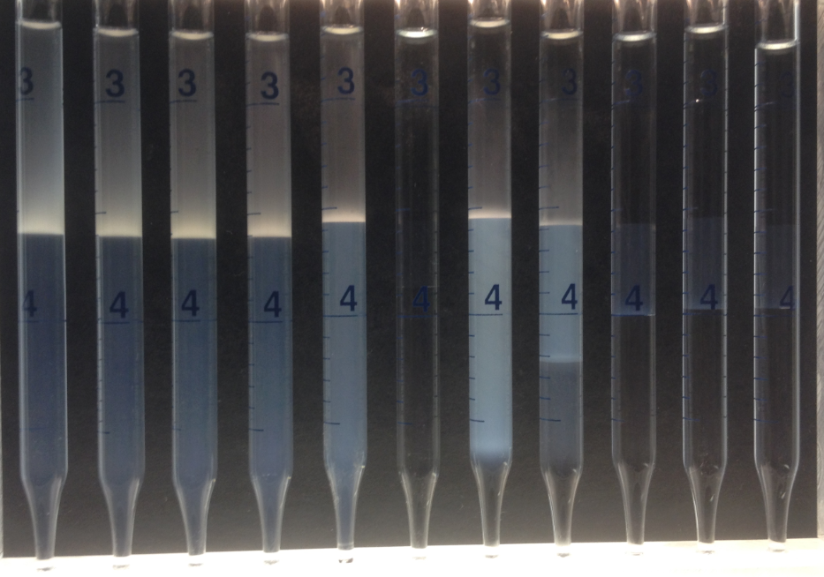
Alfoterra K2-15 surfactant exhibits an optimal salinity near 15 %
OXS 1.6% optimal salinity
1cc Aqueous: AF K2-4 1S 4wt%, SBA 2.5wt%
1cc oil: octane
S13B 4.3% optimal salinity
Optimal salinity between 15.2~15.4 %
K3 11.9% optimal salinity
Salinity %
14.0 14.2 14.4 14.6 14.8 15.0 15.2 15.4 15.6 15.8 16.0 14.0 14.2 14.4 14.6 14.8 15.0 15.2 15.4 15.6 15.8 16.0

Slide 17
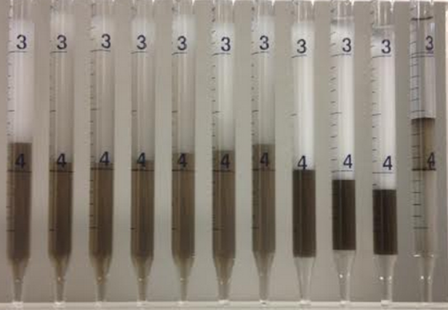
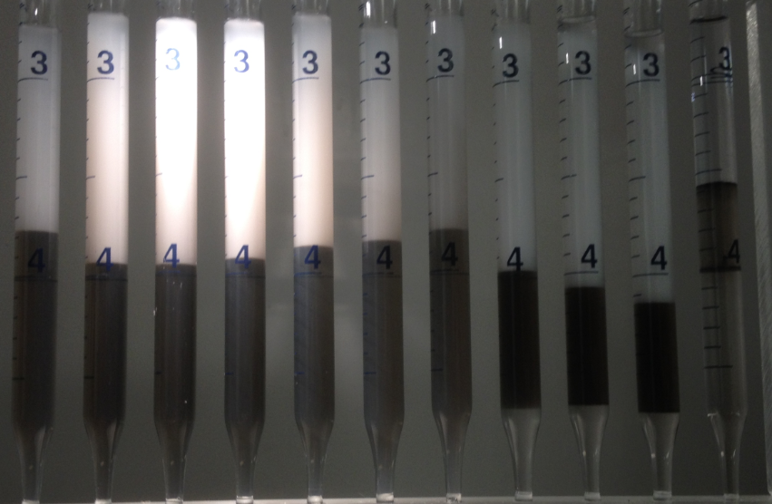
C₁₆ssPVA-OCB disperses in K2 microemulsion at 15 % salinities
OXS 1.6% optimal salinity
1cc Aqueous: AF K2-4 1S 4wt%, SBA 2.5wt%, C₁₆ssPVA-OCB 2%
1cc oil: octane
S13B 4.3% optimal salinity
K3 11.9% optimal salinity
K2 15.2% optimal salinity
Salinity %
14.0 14.2 14.4 14.6 14.8 15.0 15.2 15.4 15.6 15.8 16.0 14.0 14.2 14.4 14.6 14.8 15.0 15.2 15.4 15.6 15.8 16.0

Slide 18
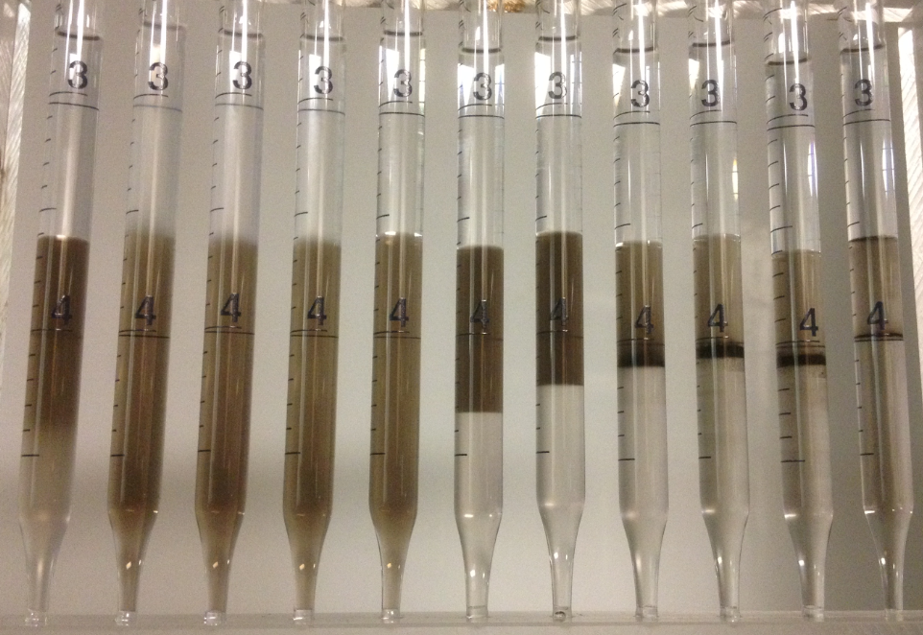
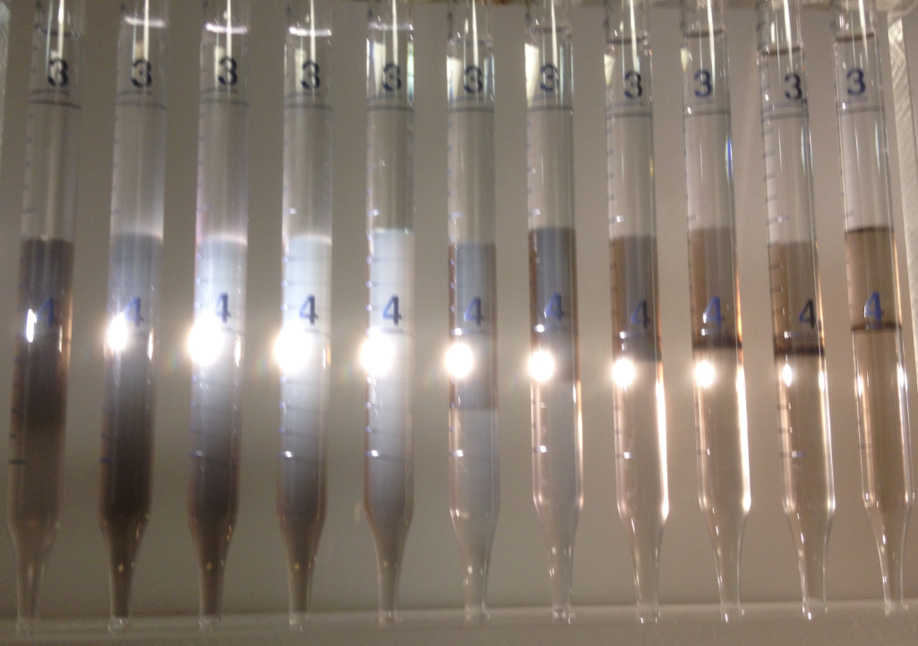
C₁₆ssPVA-OCB stays stable at high salinity microemulsions after a week
1cc Aqueous: AF K2-4 1S 4wt%, SBA 2.5wt%, C₁₆ssPVA-OCB 2%
1cc oil: octane
After a week, 15.0~15.2% stays stable, 15.4~16.0% precipitates severely. i.e. at salinity a little higher than optimal, less water in microemulsion, and C₁₆ssPVA-OCB more easily precipitates out
Salinity %
14.0 14.2 14.4 14.6 14.8 15.0 15.2 15.4 15.6 15.8 16.0 14.0 14.2 14.4 14.6 14.8 15.0 15.2 15.4 15.6 15.8 16.0

Slide 19
NPs disperse in surfactant microemulsion at all salinities tested
The amphiphilic C16ssPVA-OCB disperses and stay stable in microemulsion from low salinity to ultra high salinity
OXS 1.6% optimal salinity
ssPVA--most Hydrophilic chain
S13B 4.3% optimal salinity
C₁₆--Hydrophobic chain
K3 11.9% optimal salinity
C_{n}(n<14) propoxy ethoxy sulfates
K2 and K3 have same PO,EO number,
K3 has long hydrophobe part
K2 15.2% optimal salinity

Slide 20
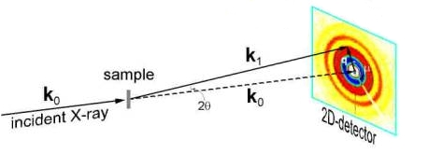
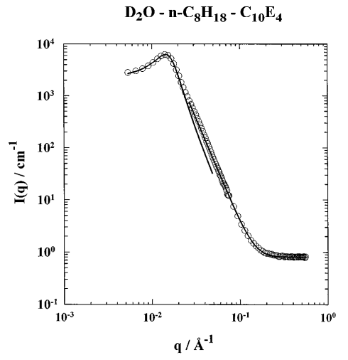
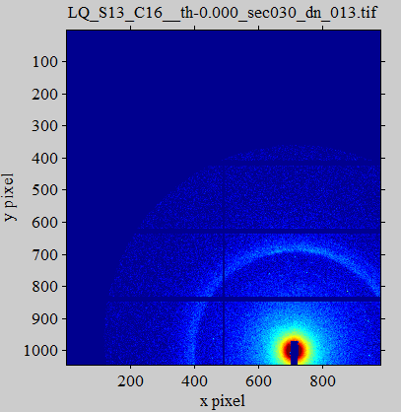
Small-angle X-ray scattering(SAXS) provides measure of domain size
https://www.sni-portal.de/kfs/Methoden/smallanglescattering.php
T. Sottmann, R. Strey, and S.-H. Chen
J. Chem. Phys. 106, 6483 (1997)

Slide 21
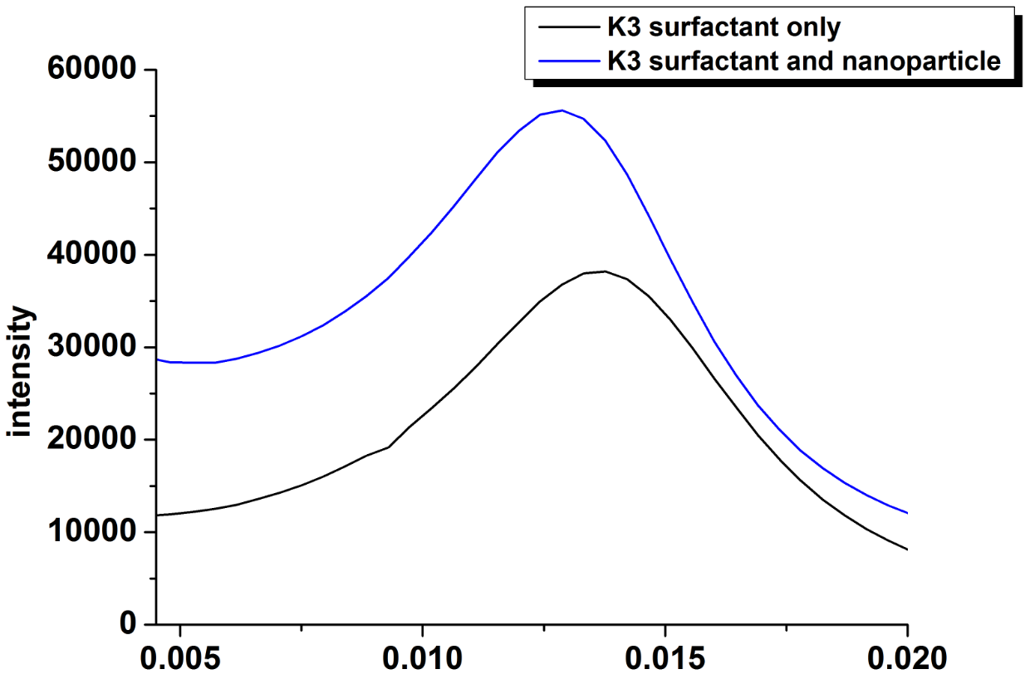
SAXS measurement reveals a small increase in domain size with NPs present
K3: C_{n}(n<14) propoxy ethoxy sulfates
Nanoparticle: C₁₆ssPVA-OCB
Domain size ≈48nm
Domain size ≈44nm
q(Å)
Experiment done in Argonne national lab

Slide 22
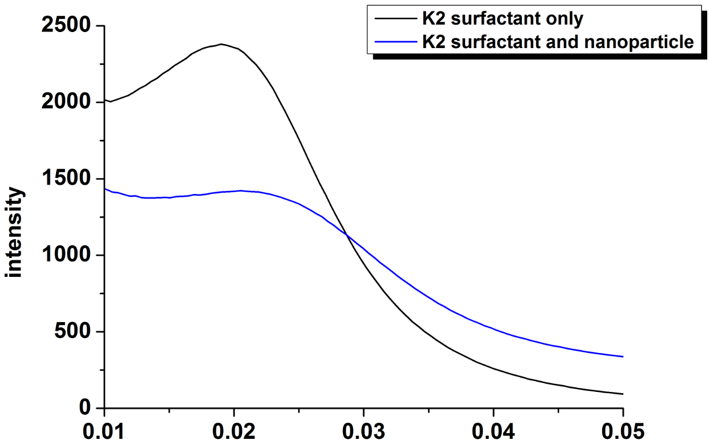
SAXS measurements show a small decrease in domain size for K2 microemulsion
K2: C_{n}(n<14) propoxy ethoxy sulfates
Nanoparticle: C₁₆ssPVA-OCB
Domain size ≈31nm
0.02Å
q(Å)
Experiment done in Argonne national lab

Slide 23
Domain size is relatively insensitive to the presence of NPs
Domain size of octane-water-surfactant microemulsion is comparable with the size of NPs ( diameter is roufhly 50 - 100nm)
With addition of NPs, no significant change in domain size
30~50nm

Slide 24
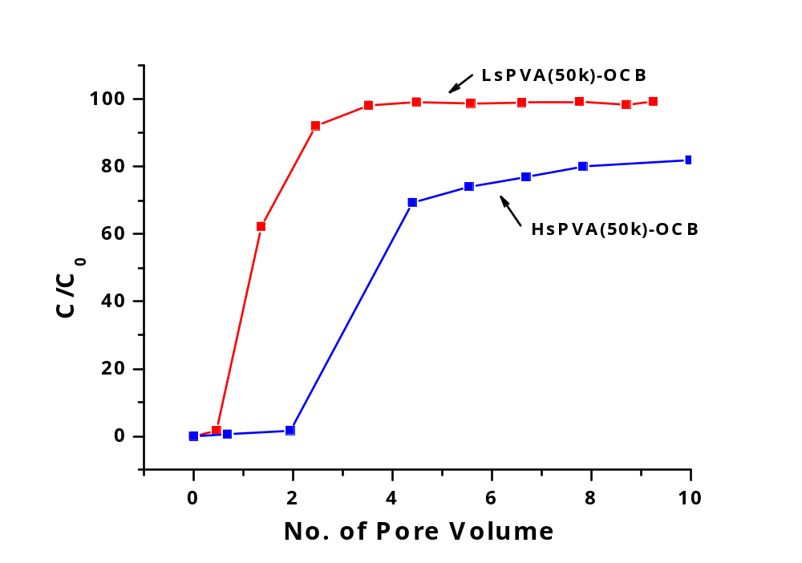
Breakthrough Studies in Sandstone Column
More than 95% of LsPVA-OCB can flow through sandstone column at 70 ºc in API brine
sPVA(50 K)-OCB was dispersed in API brine (8 wt% NaCl, 2 wt% CaCl2)
The concentration of nanoparticles was 20 mg/L
Flow rate is 8 mL/h (linear velocity 12.2 m/d)

Slide 25
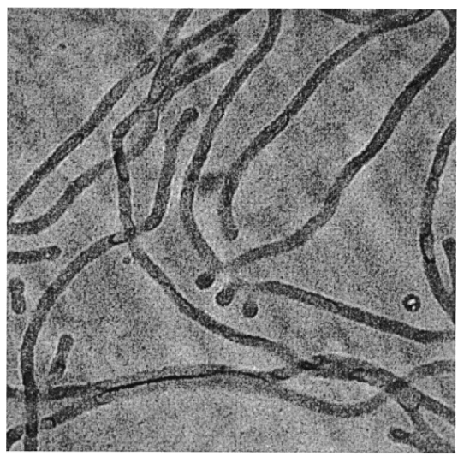
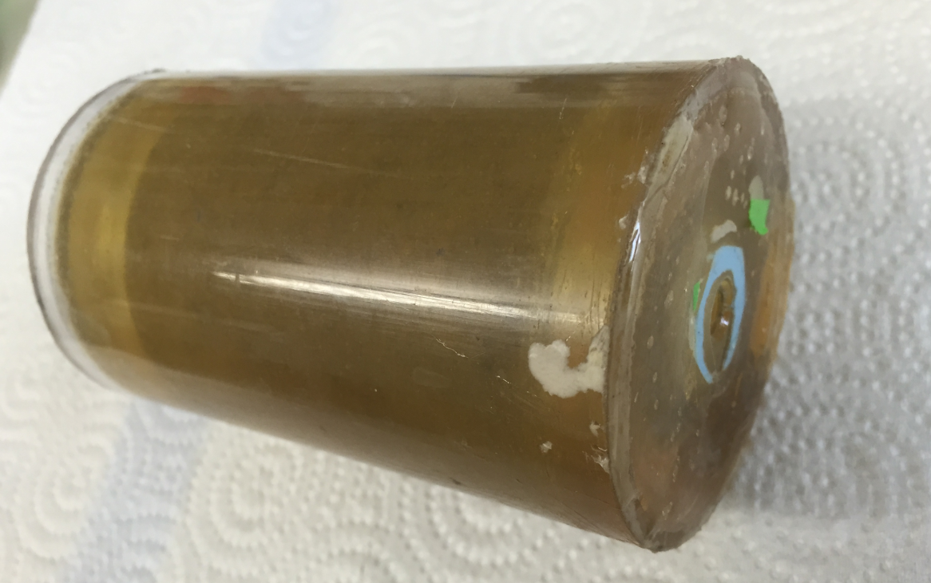
Future work
Inject the NPs and surfactant blend into core (epoxy sealed Berea core ready), and test the adsorption of surfactant w/o Nps
2. Analyze the micro-structure of NPs-surfactant microemulsion by cryo-TEM measurements
Y. Y. Won, A.K. Brannan, H. T. Davis, F. S. Bates
J. Phys. Chem. B 2002, 106, 3354-3364

Slide 26
Summary
We can prepare amphiphilic nanoparticles through modificaiton of oxidized carbon black
The amphiphilicity of the nanoparticle can be adjusted by the composition of the polymers attached to the surface.
Highly sulfated nanoparticles are found to be most stable and able to penetrate bicontinuous microemulsion phases.
SAXS measurements show that the NPs do not significantly change the domain size for the bicontinuous microemulsion.

Slide 27


The authors acknowledge the financial support from Rice University Consortium for Processes in Porous Media and Advanced Energy Consortium(AEC).
This research used resources of the Advanced Photon Source, a U.S. Department of Energy (DOE) Office of Science User Facility operated for the DOE Office of Science by Argonne National Laboratory under Contract No. DE-AC02-06CH11357.

Slide 28
Backup slides
Dynamic light scatterring(DLS)
Sample Name | Average Diameter (nm)
PVA_OCB_10k | 61
PVA_OCB_10ks | 38
PVA_OCB_10kss | 215
PVA_OCB_6k | 43
PVA_OCB_6ks | 63
PVA_OCB_6kss | 240
PVA_OCB_2k | 54
PVA_OCB_2ks | 170
C16PVA_OCB_2k | 72
C16PVA_OCB_2ks | 151
C16PVA_OCB_2kss | 123

Slide 29
Backup slides
Thermogravimetric Analysis (TGA)
number | type | Weight added | At 200℃ | At 600℃ | Polymer fraction
1 | 2k PVA-OCB | 14.4280mg | 86.0% | 9.0% | 89.53%
2 | sPVA-OCB | 12.5300mg | 79.5% | 17.5% | 77.99%
3 | C₁₆-PVA-OCB | 14.9840mg | 96.0% | 9.0% | 90.63%
4 | 16k sPVA-OCB | 15.4390mg | 94.0% | 5.7% | 93.94%
5 | C₁₆-ssPVA-OCB | 14.2190mg | 83.0% | 24.5% | 70.48%
6 | 6k sPVA-OCB | 8.0760mg | 95.0% | 12.0% | 87.37%
7 | 6k PVA-OCB | 18.7910mg | 64.0% | 2.5% | 96.09%
8 | C₁₆-sPVA-OCB | 9.3870mg | 96.0% | 2.6% | 97.29%
9 | 10k PVA-OCB | 23.5380mg | 43.7% | 2.0% | 95.42%
10 | 10k ssPVA-OCB | 2.1390mg | 80.0% | 50.5% | 36.88%
11 | 10k ssPVA-OCB
12 | 6k ssPVA-OCB | 10.6790mg | 72.5% | 14.9% | 79.45%
13 | 6k ssPVA-OCB | 1.4610mg | 79.9% | 2.5% | 96.87%

Slide 30
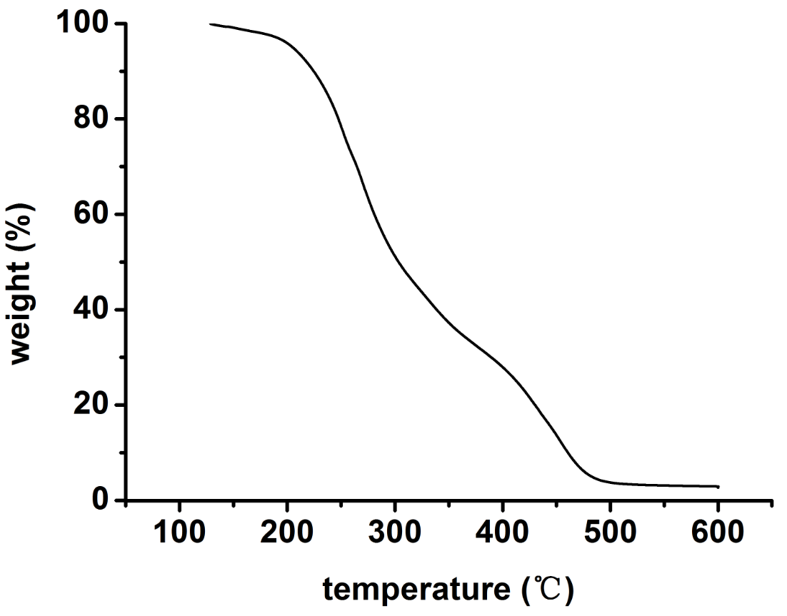
TGA curve
C₁₆PVA-OCB

