Slide 1
Nanocapsules for Oil Detection and Extended-Reach pH Modification
James M. Tour
Rice University
www.jmtour.com

Slide 2
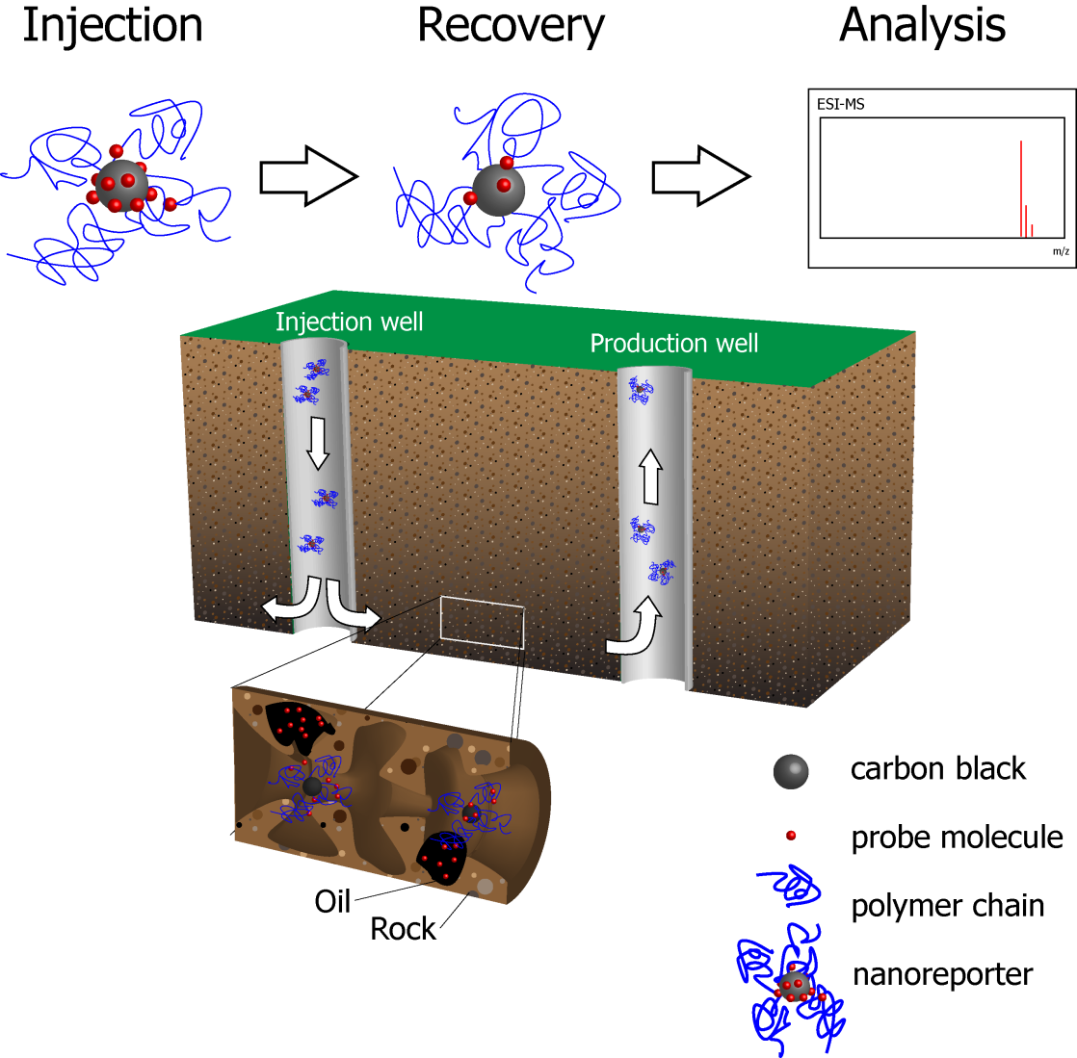
Schematic of Oil Detection by Nanoreporters
Nanoparticles (NPs) with hydrophobic signaling cargo (red rectangles) are injected into the subsurface.
The nanoreporters encounter oil and release their hydrophobic signaling cargo into the oil.
The nanoreporters are recovered and analyzed for the signaling cargo for the existence of saturated oil residual (SOR).
Core material: functionalized carbon black (“fCB”)
Cargo molecules: triheptylamine (TPA) or ¹⁴C-labeled triphenylamine (TPA*)
Batch desorption studies were conducted to understand the partition behavior of TPA

Slide 3
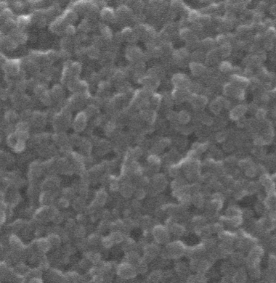
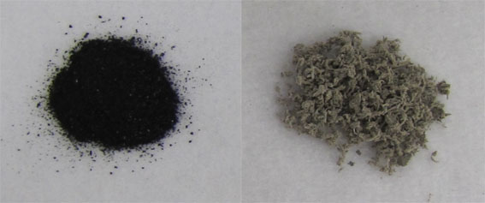
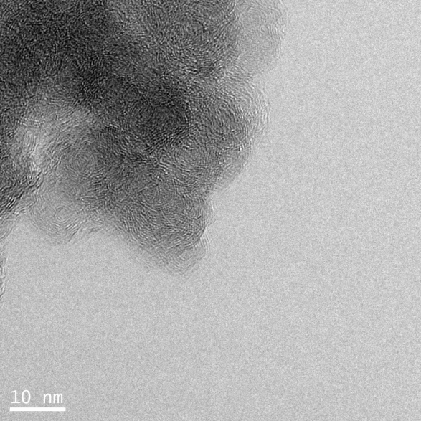
Early Work: Carbon Black-based Formulation
SEM image of 50 nm carbon black (CB)
A heavily oxidized and
carboxylated carbon core
PVA-OCB NPs
H₂SO₄, H₃PO₄
KMnO₄, 50 ºC
CB
powder
PVA-OCB
powder
100 nm
Cabot (MA, USA)
  Zeta potential of PVA-fCB is 3.84x10⁻¹ mV
  PVA-fCB is almost neutral and it will not bind to charged porous media
TEM of 15 nm fCB
3
Notes:
3
Early work on carbon black, now we are switching to magnetite as well.

Slide 4
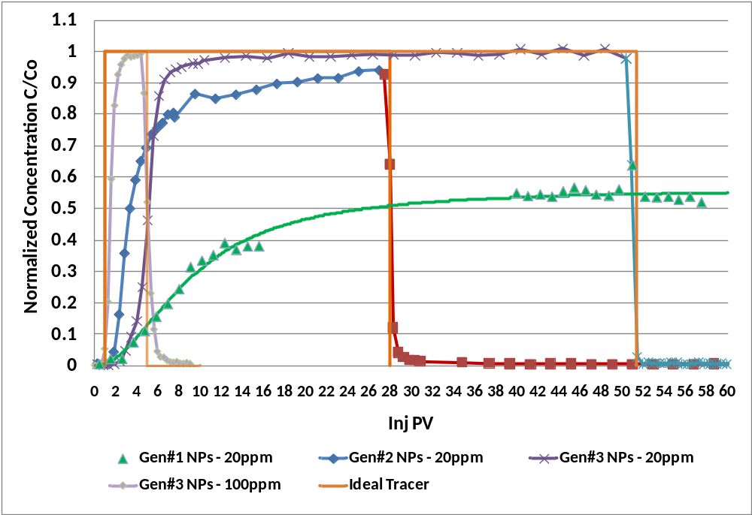
Transport Studies in Berea Sandstone – HCCs-PEG (Gen#1), OCB-PVA (Gen#2), CB-PVA (Gen#3)
Experimental Details
Sample: NPs in 31 kppm seabrine
Core size: 1” (D) x 1.5” (L)
Core type: Berea Sandstone
Core Permeability: 300mD
T = 28 ºC
Outlet P = 1 atm
Injection rate: ~0.1 cc/min
Linear velocity: 0.113 cm/min (5.3 ft/day)
Gen#3 – Acceptable Performer
Gen#1 – Poor Performer
Retention of Gen#3 particles: 10 micrograms/g of Berea Sandstone

Slide 5
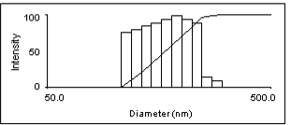
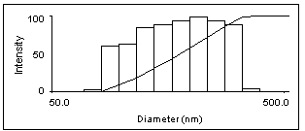
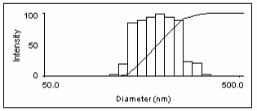
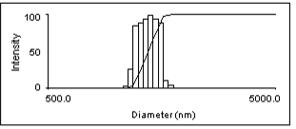
Early work: 2000 Mn PVA coated OCB
25 °C
Size distribution of PVA-OCB became broader as temperature was increased
The cloud point of 2000 Mn PVA is ~70 °C
The diameter of OCB is in the range of 30 to 40 nm
45 °C
55 °C
70 °C
Notes:
5
PVA(Mn=2000)-OCB (30-40nm core). The following slide explains how sulfonation works.
5

Slide 6
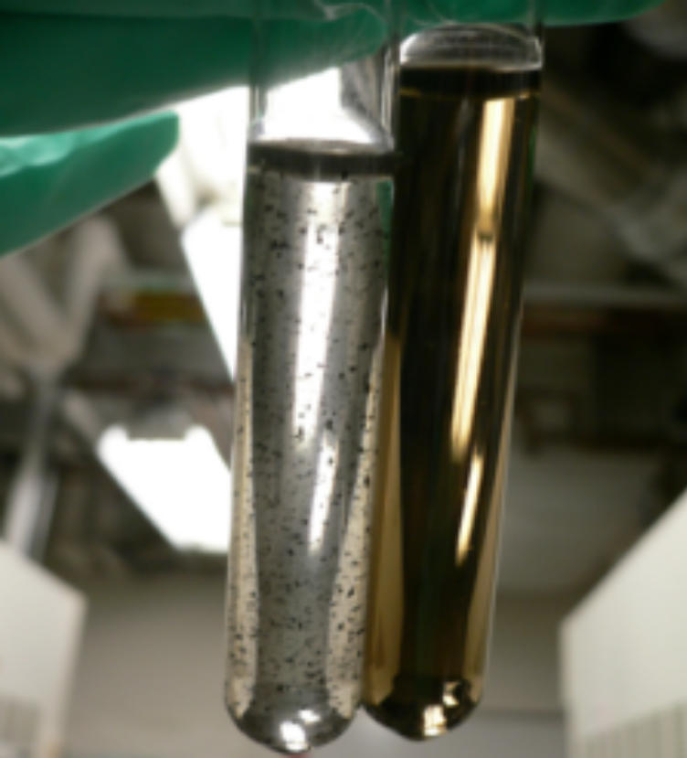
Stability of Sulfated PVA Coated CB
sPVA:
Awaiting XPS data
HsPVA: Highly sulfated PVA
4.5 mL 1 M ClSO₃H/CH₃COOH, 75 °C
LsPVA: Lightly sulfated PVA
3.0 mL 1 M ClSO₃H/CH₃COOH, 60 °C
PVA (50 K)-fCB (left) vs. LsPVA (50 K)-fCB (right)
in API standard brine at 100°C
API brine (Ionic Strength 3.77 M): NaCl (1.4 M), CaCl₂ (0.19 M)
Synthetic seawater (Ionic Strength 0.55 M): CaCl₂ (3.5 mM), MgCl₂ (5.5 mM), KCl (19.8
mM), NaCl (0.5 M), Na₂SO₄ (0.5 mM), NaHCO₃ (2.0 mM)
Notes:
6

Slide 7
Nanoparticles Transport in API Solution at 70 ºC
LsPVA-fCB
LsPVA-fCB
Calcite columns
Sandstone columns
HsPVA-fCB
PVA-fCB
HsPVA-fCB
PVA-fCB
No. of pore volume
No. of pore volume
More than 90% of sPVA-fCB can flow through calcite and sandstone columns at 70 ºC in API brine
sPVA(50 K)-fCB was dispersed in API brine (8 wt% NaCl, 2 wt% CaCl₂)
The concentration of nanoparticles was 20 mg/L

Slide 8
Breakthrough Studies in Different Oil Content Columns
Breakthrough of TPA/sPVA-fCB in sandstone-packed columns at 25 °C (a) without isoparL; (b) with 29% isoparL in column and (c) with 58% isoparL in the column
Flow rate is 8 mL/h (linear velocity 12.2 m/d)
x is the oil saturation in the column and k_{p} is the partition coefficient (1.03*10⁻⁴ kg-NP/L).

Slide 9
Correlation Studies under More Realistic Conditions
Nanoparticles were dispersed in API brine, the concentration of sPVA-CB was 30 mg/L
Columns were packed with ground calcite with oil saturation 0.58 (the volume of isoparL/PV)
The release of probe molecules only slightly depends on the flow rate

Slide 10
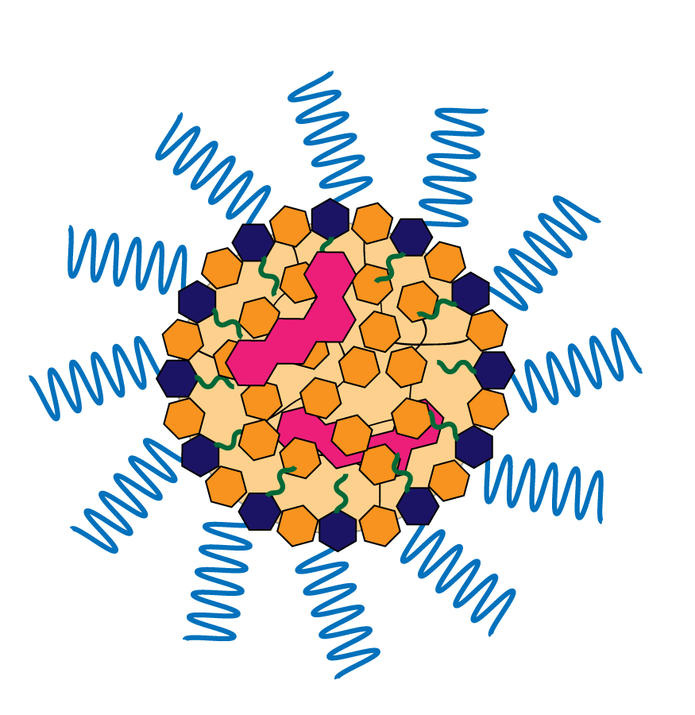
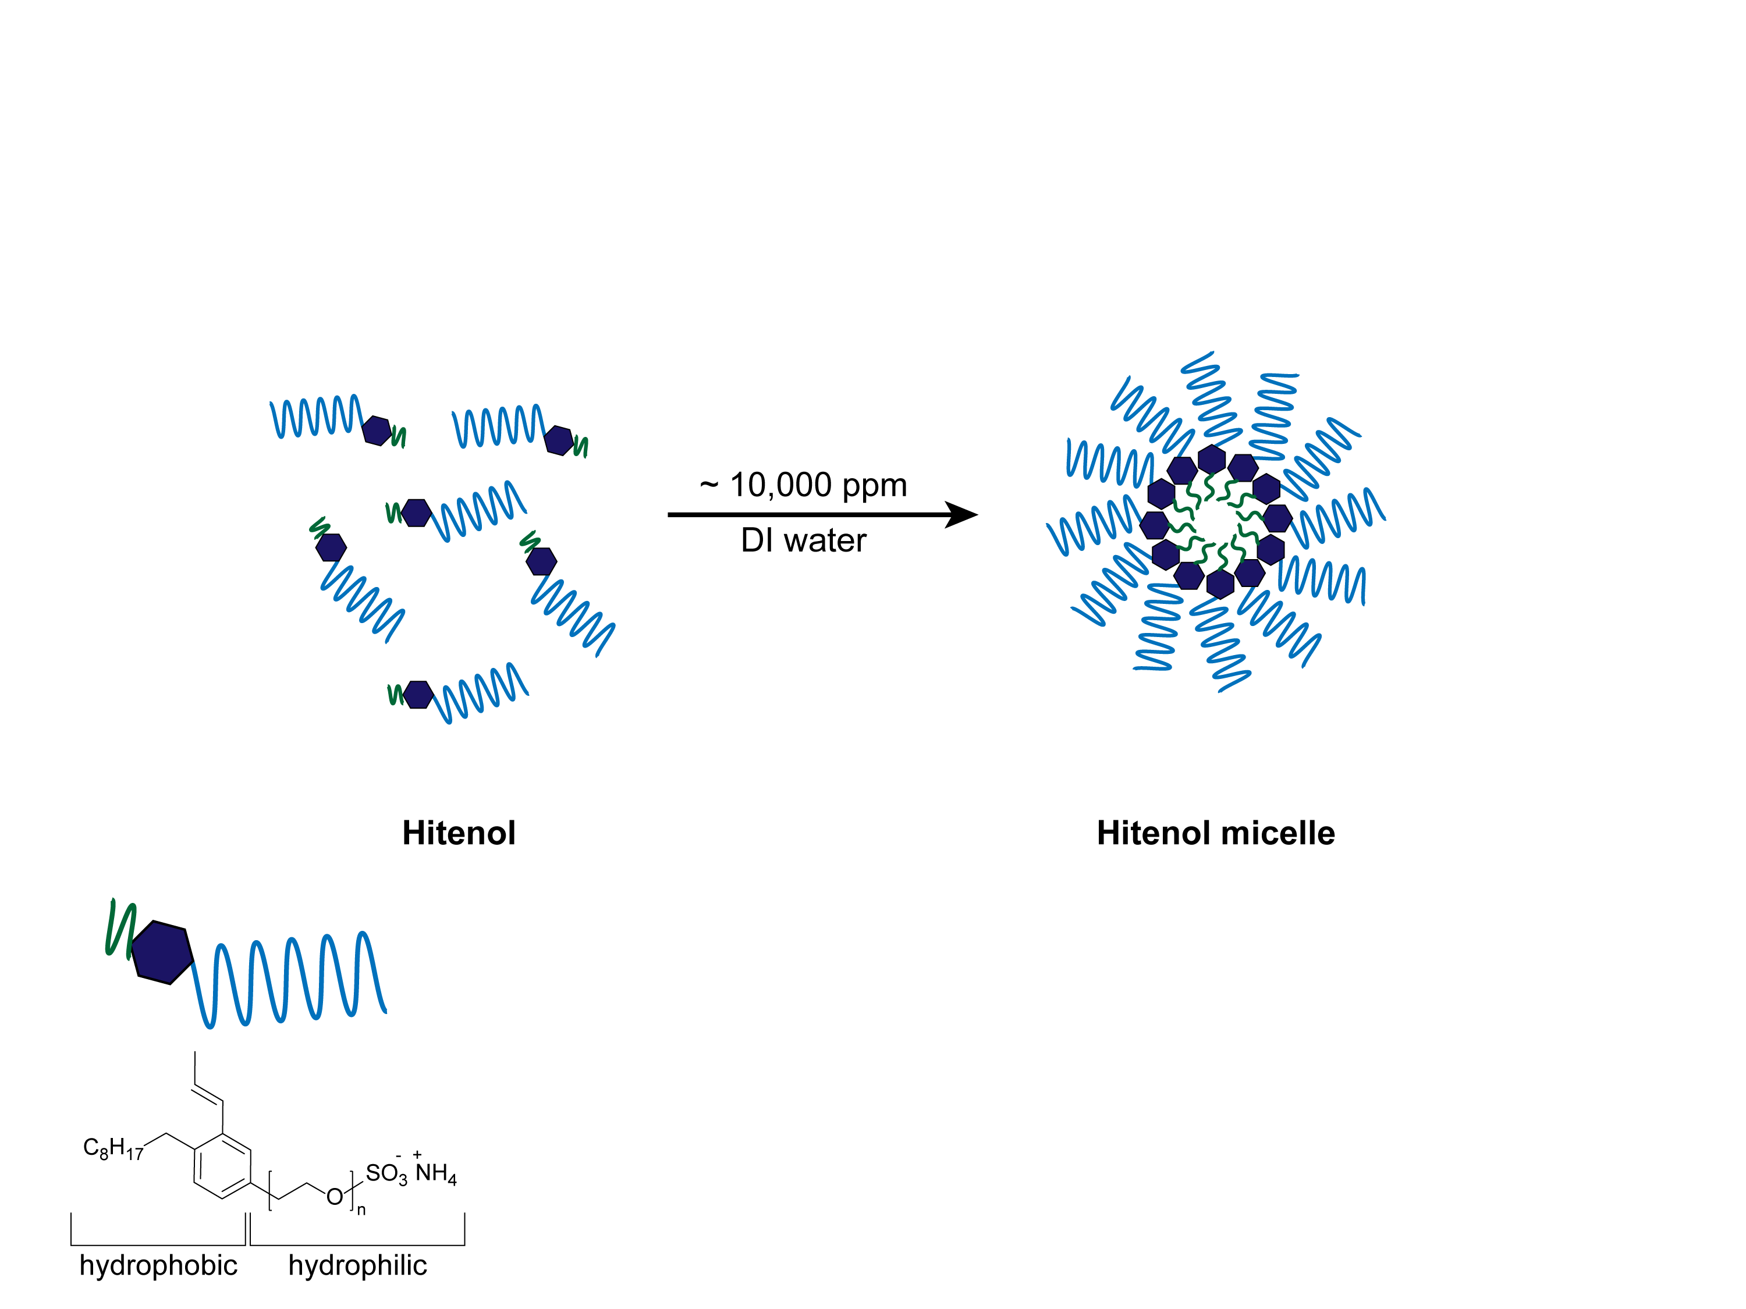
Second generation nanoreporters: cross-linked micelle
Step 1:
Formation of micelle
Step 2:
Cross-linking & tracer loading
Dissolve
1. Load tracer
in H₂O
2. cross-link
Surfactants
Micelles
NPs
Surfactant:
Tracer:
Cross-linker:
Hitenol
Nile Red
Divinylbenzene
10
Notes:
XLM: crosslinked micelle, it is named by Mike Wong

Slide 11
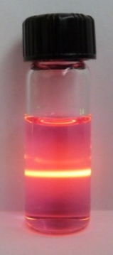
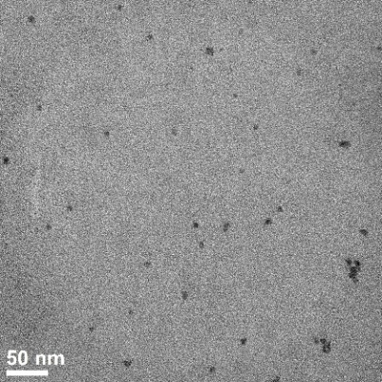
Size of Hitenol-DVB/Nile red NPs in API brine
TEM image
(NP radius ~10-15 nm)
Hitenol-DVB/Nile red NPs remain the similar size at 25 -100 ºC
Hitenol/Nile red micelles decrease in size at high temperature
11

Slide 12
Detection methods
UV-Vis spectrum
Fluorescence spectrum
Nanoparticles
Nile red
Detection conditions:
Nanoparticle: UV-Vis at 215 nm
Nile red: fluorescence at 623 nm (excitation at 550 nm)

Slide 13
Breakthrough behavior study (DVB/Hitenol = 2)
No oil sandstone column (SOR=0%)
50% oil sandstone column (SOR=50%)
Both show good breakthrough
Breakthrough of Nile red is above 98% in no oil sandstone column
Breakthrough of Nile red is about 80% in 50% oil sandstone column
13

Slide 14
Control experiment: no cross-linker
No oil sandstone column (SOR=0%)
50% oil sandstone column (SOR=50%)
Both show poor breakthrough
Instability of the Hitenol micelle structure
Physical adsorption of Nile red onto rock surface
Migration of Nile red into oil phase
Instability of the Hitenol micelle structure
Physical adsorption of Nile red onto rock surface
14

Slide 15
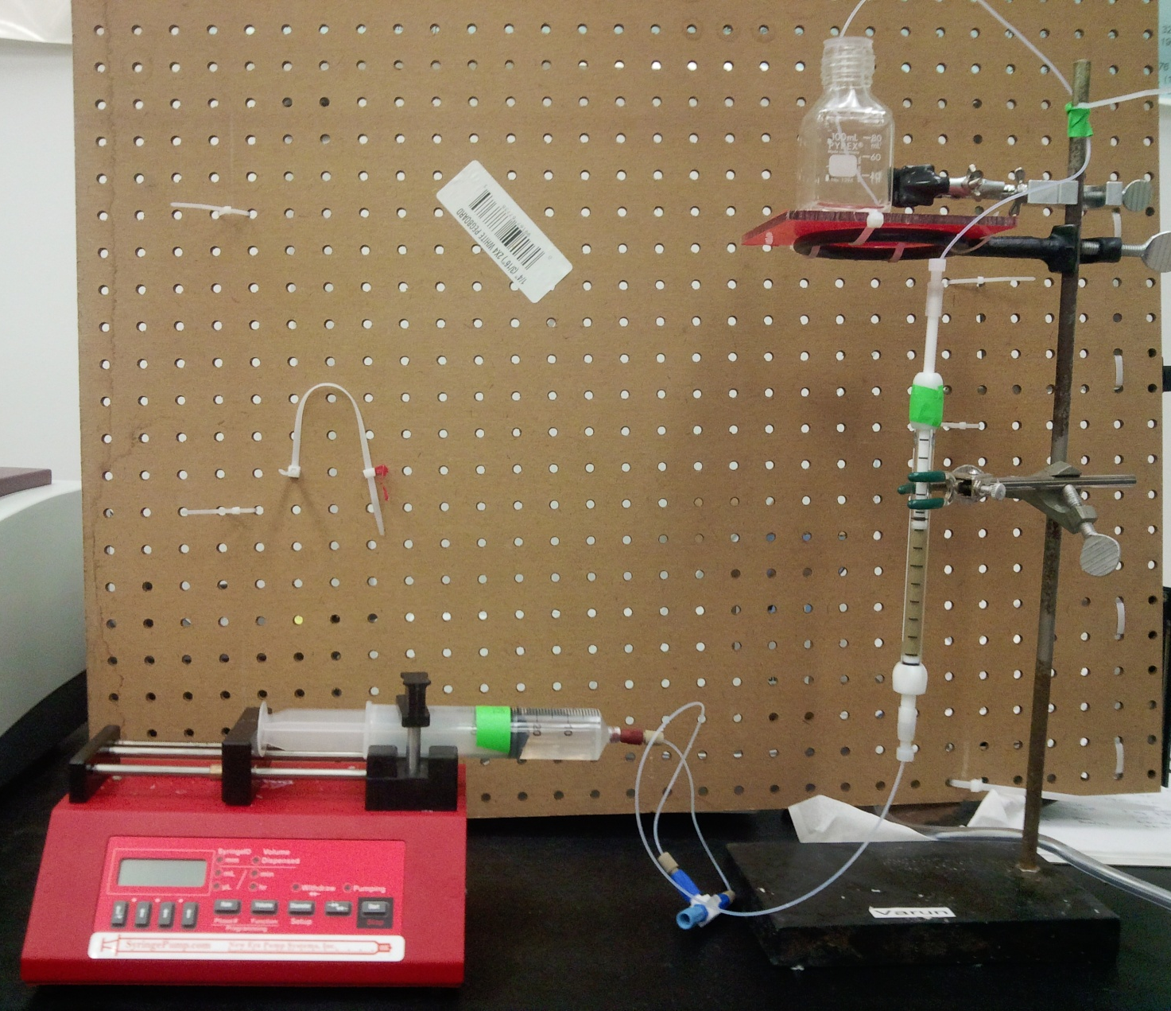
Breakthrough Apparatus Setup
Effluent collection
7 cm length with 0.3421 cm² cross sectional area
Packed with cleaned crushed Berea sandstone (106-250 mesh)
The sandstone was washed 3 x using 1 wt% acetic acid and deionized water, dried and packed into the column.
Packed
column
Syringe pump

Slide 16
Column Preparation
The XLM with DVB:Hitenol=4:1 was used
Ambient temperature
Dry column was flushed with API brine (linear velocity at 33.6 m/day) for around 200 pore volumes (PV) to remove the air bubble
A non-reactive tracer (tritiated water or 2 M NaBr solution) was intorduced into the column to measure the porosity and dispersion coefficient of the column
The column was flushed with 10 PV API brine to remove the non-reactive tracer
XLM solution was injected into the column at flowrate of 8 mL/h (13.44 m/day or 7.5 min residence time)
Effluent was collected and measured for the XLM concentration

Slide 17
Breakthrough of XLM at Different Concentration
Two different concentrations of XLMs were used (1000 ppm and 38.5 ppm), 7.5 min residence time (13.44 m/day)
Retardation factor: 4.4
Dispersion coefficient: 0.0015 cm²/s
Porosity: 0.419
Low concentration XLM has poor breakthrough due to the adsorption onto sandstone

Slide 18
Breakthrough Profiles Summary for Hitenol/DVB
NPs with a Hitenol/DVB ratio of 1:4 show the best breakthrough at ~ 70 %.

Slide 19
Breakthrough Profiles for Hitenol-Noigen-DVB
Noigen : Hitenol = 8 : 2 (molar ratio)
Breakthrough of NPs is 45 % at 2.5 PVs and the rapidly reaches 94 % at 3.3 PVs.
The zeta potential of the NPs is -28.49±2.42 mV.

Slide 20
Breakthrough Profiles for Hitenol-Noigen-DVB
Noigen : Hitenol = 9 :1 (molar ratio)
NP breakthrough reaches 53 % by 2.5 PVs and rapidly increases to 98 % at 3.3 PVs.
The zeta potential of the NPs is -15.19±1.84 mV.

Slide 21
Breakthrough Profiles for Hitenol-Noigen-DVB
Noigen/ Hitenol | Zeta potential (mV)
0 | -44.70±4.05
4 | -28.49±2.42
9 | -15.19±1.84

Slide 22
Future work: time-releasing nanoreporters
Step 1:
Formation of micelle
Step 2:
Cross-linking & tracer loading
Dissolve
1. Load tracer
in H₂O
2. cross-link
Surfactants
Micelles
NPs
Surfactant:
Tracer:
Temperature responsive cross-linker:
Hitenol
Nile Red
1,6-hexanediol diacrylate
(HDDA)
22

Slide 23
Nanocapsules for Well Acidization
Delivery of acids to hydraulic fractures forming during the fracturing process

Slide 24
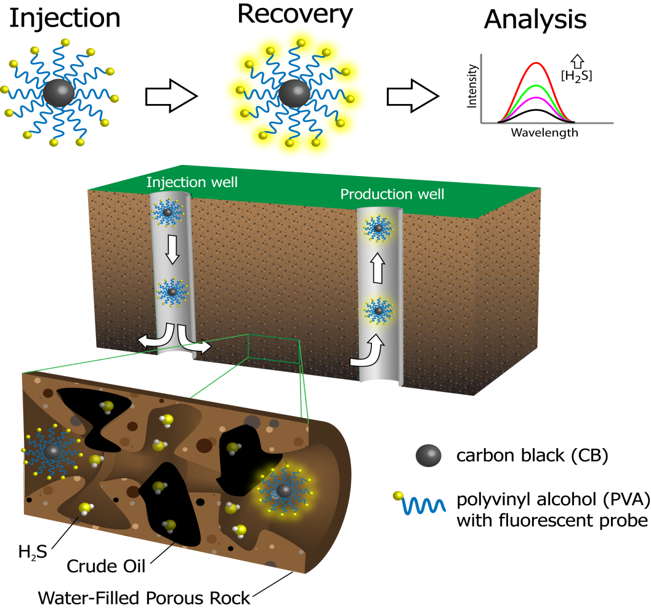
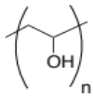
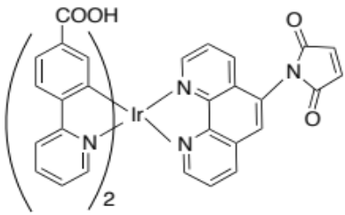

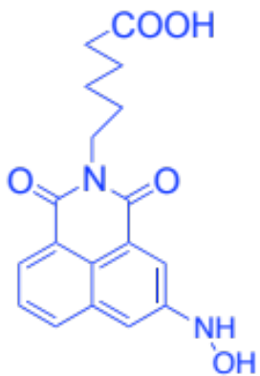
Nanoreporter for H₂S Detection in the Subsurface
1st Gen. nanoreporter:
=
=
FP-PVA-FCB
2nd Gen. nanoreporter:
=
naphthalimide-based molecule

Slide 25
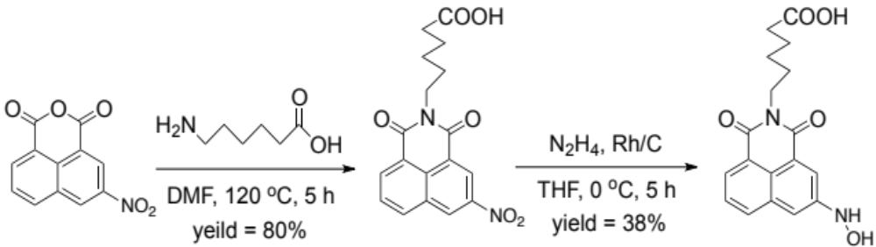
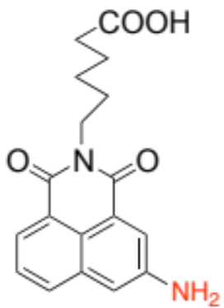
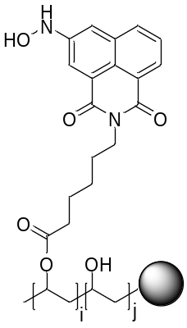
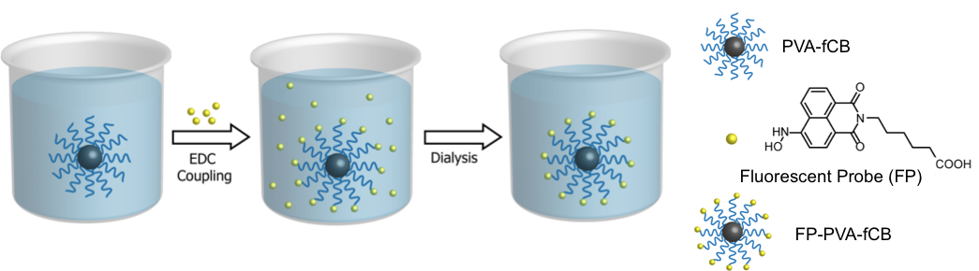
Preparation of the Gen. 2 Nanoreporter for H₂S Detection
(A)
H₂S
3-nitro-1,8-naphthalic anhydride
2 EWG:
in a pull-pull way
ICT is forbidden
Non-fluorescent
1 EDG + 1 EWG:
in a push-pull way
ICT is allowed
Fluorescent
(B)
ICT: intramolecular charge transfer
PVA(50k)-fCB
FP-PVA(50k)-fCB

Slide 26
Apparatus for Breakthrough Study
Nanoreporters
Syringe pump
UV-vis
spectrometer
NPs
GC glass
vials
Na₂S solution
Fluorescence
spectrometer
Fluorescent
probes
Syringe pump
Ground core materials: sandstone (provided by AEC)
Flow rate: 0.6 mL/h for each syringe, retention time 2 h
Nanoparticles were dispersed in synthetic seawater
Temperature: 25 °C

Slide 27
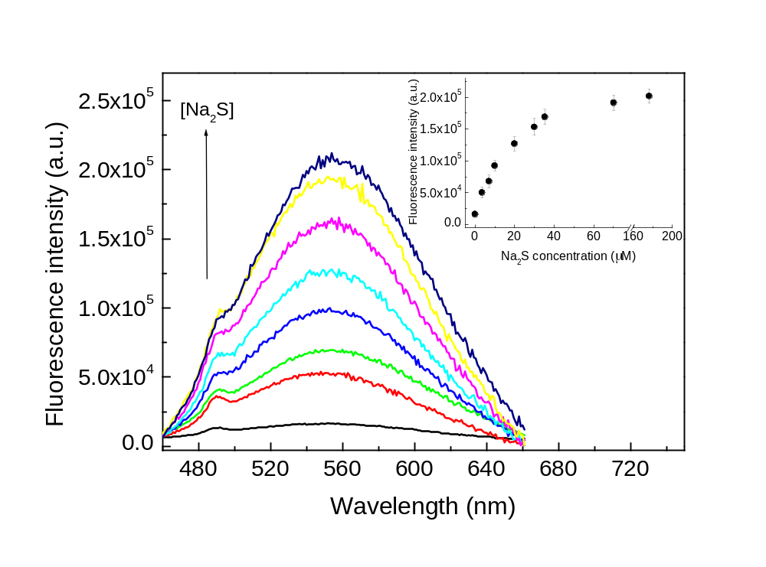
FP-PVA-fCB Nanoreporter for H₂S Detection
50 μM FP-PVA(50k)-FCB and various concentrations of Na₂S_{(aq)} (0~170 μM) were injected to the column simultaneously.
The fluorescence increase showed a linear correlation with the injected Na₂S_{(aq)}, and reached 11-fold enhancement as 70 μM Na₂S_{(aq)} reacted with the nanoreporter.

Slide 28
H₂S Detection in Kuwaiti oil field Berea sandstone
Kuwaiti oil field and Berea sandstone in order to simulate the oilfield environment. The dolomite had crude oil trapped on the surface; the total organic carbon content of the dolomite was 4.97%. The FP-PVA(50k)-CB and 65 μM Na₂S in the synthetic seawater were simultaneous injected into the oil-dolomite column. Figure left shows the relative breakthrough performance when the nanoreporter was pumped through the column. The FP-PVA(50k)-CB not only had >95% breakthrough efficiency in 6 PV, but also exhibited an obvious change in fluorescent enhancement before and after reacting with the H₂S (right).

Slide 29


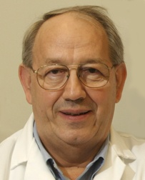



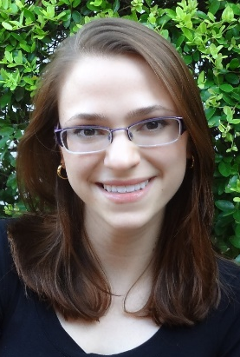




Nanoreporter Project Team Members, Supported by the Advanced Energy Consortium
Jim
Mike
Mason
Amy
Fei
Ben
Macy
Claire
Steven
Varun
Yinhong

