Slide 1



Asphaltene Aggregation and Deposition in Porous Micromodel
Yu-Jiun “Nate” Lin
Peng He, Mohammad Tavakkoli, Francisco M. Vargas, Sibani Lisa Biswal
April 2015
Biswal Research Group

Slide 2
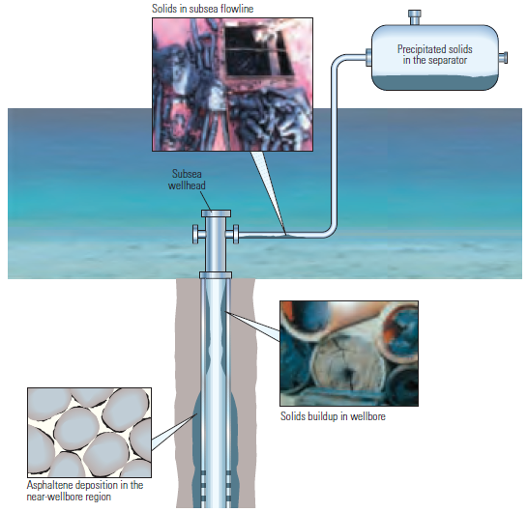
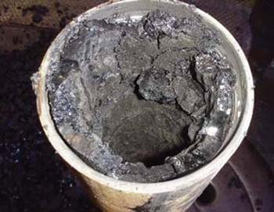
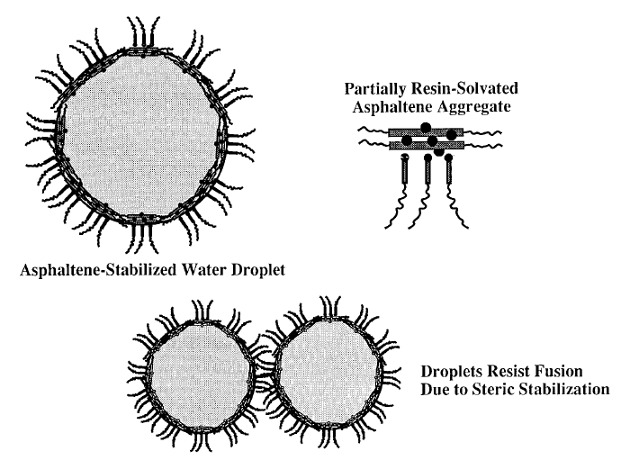
Types of Asphaltene Problems
Solids in subsea flow line
Solids in separators
Plugging
W/O Emulsion
Asphaltene deposition
in near-wellbore region
Solids built up
in wellbore
*L. Alvarez et al., Fuel, 2010
*Oilfield review, Summer 2007
Notes:
Asphaltene deposition in pipelines and oil reservoirs has resulted in a great amount of devastating problems by reducing well productivity since decades ago.
As you can see, this figure illustrates asphaltene can deposit in different parts of oil production facilities, which are the separator, flow lines, wellbore, and near-wellbore region.
We need full understanding about the mechanism of asphaltene deposition to prevent these problems.
Moreover, asphaltene-stabilized water-in-oil emulsions cause fluids in oil production process to be highly viscous, which increases the costs for transportation. These stable emulsions make separation of water and oil for high quality of oil very difficult.

Slide 3
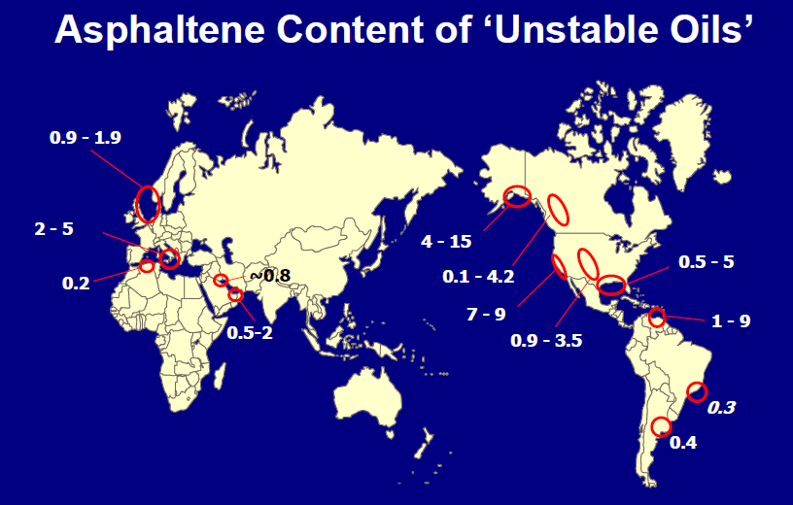
Worldwide Asphaltene Problem
Venezuela
North Sea
Canada
Middle East
Gulf of Mexico
High cost of remediation:
~ $500 k/well onshore
~ $3 MM/well offshore
Asphaltene deposition problems to date are confined to specific areas and relatively light fluids, however :
Increased focus on the EOR unravels new potential challenges in the area of precipitation/deposition of previously “ stable” hydrocarbon fluids.
*SPE Distinguished Lecturer Program

Slide 4
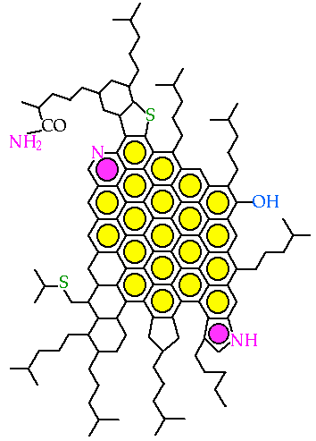
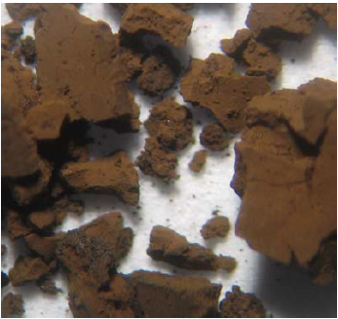
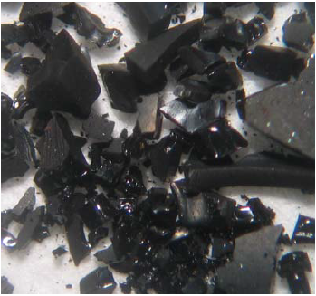
What is Asphaltene?
Polydisperse distribution, a global asphaltene molecule does NOT exist
Precipitate due to pressure, temperature, and composition change
Insoluble: n-alkane (n-heptane and n-pentane)
Soluble: aromatics (toluene and xylene)
n-C₅ asphaltene
n-C₇ asphaltene
(Oil industry)
Precipitation -> simulation tools by Dr. Vargas (simplified equation for deposition)
Deposition -> needs more experiments -> microfluidic devices
*J. Creek, EnergyFuels, 2013
*Jill Buckley’s Lab (New Mexico Tech)
Notes:
What is asphaltene? Asphaltene is brownish, black, strong self-associating, and the heaviest part of the crude oil.
In general, asphaltene is defined as a fraction of crude oil insoluble in excess normal alkanes, such as n-pentane or n-heptane but soluble in benzene or toluene
Typical looking of C5 and C7 asphaltene , C5 is more powder-like and C7 is more crystal-like
C5 means the precipitant is n-pentane, and C7 is n-heptane

Slide 5
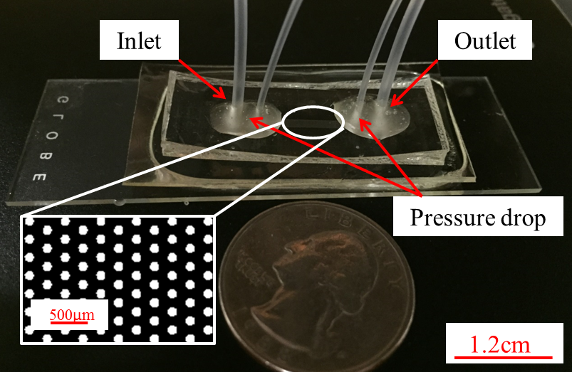
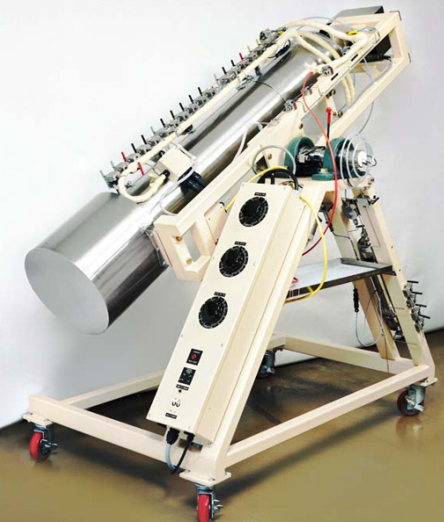
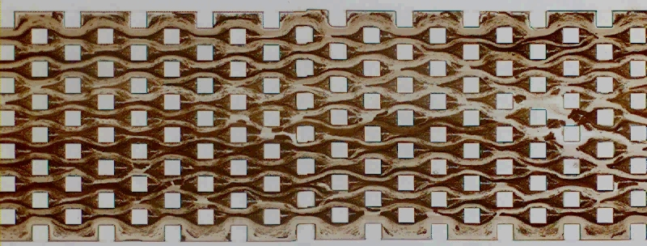
Organic-resistant NOA81 Microchannel
Reduced reagent consumption
Lab on a chip (mixing, heating, separation, reaction)
Compatible with crude oils and toluene
Reusable and transparent
Wide temperature range (-150ºC ~ 125ºC)
Easy to adjust the surface properties
BLACK BOX
(core flooding)
Deposition is detected both macroscopically (pressure drop) and in the pore scale (visualization).
500µm
*N.H.G. Rahmani et al., SPE 121414, 2009
*L.-H. Hung et al., Lab Chip, 8, 983–987, 983, 2008
* Yu-Jiun Lin et al. Lab on a Chip, in preparation 2015

Slide 6
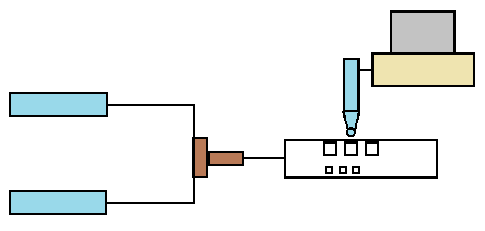
Schematic Experimental Setup
Pressure transducer
Fixed length for constant aggregation time (100s)
Computer
Syringe pump
Precipitant
Microscope
Change composition
T and P are constants
T-junction
Micro-channel
Oil
Vial
Vial
Sample collection
for viscosity measurement
* Yu-Jiun Lin et al. Lab on a Chip, in preparation 2015
Notes:
20 font

Slide 7
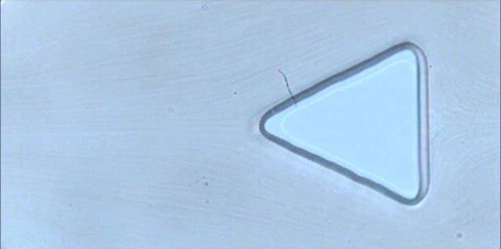
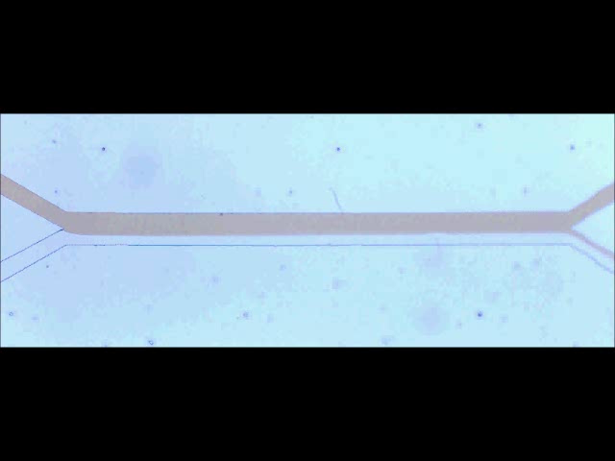
Visualization of Asphaltene Deposition
Deposition time: 10 mins
Flow direction
25µm
600µm
Notes:
20 font

Slide 8

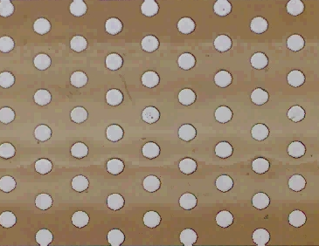
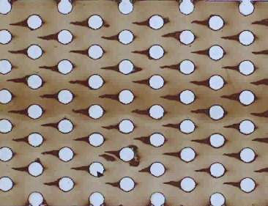
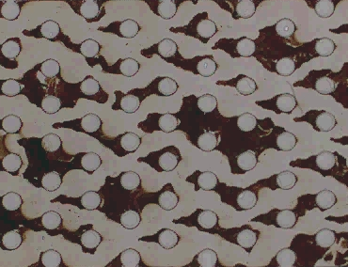
Bulk - Deposition Potential
Spherical
Fractal
Chunk
(1) 40 - 50 vol%
(2) 55 – 60 vol%
(3) 65 – 80 vol%
5µm
5µm
30µm
250µm
250µm
250µm
By mixing n-heptane with model oil, aggregates will change into three phases (spherical, fractal, chunk), and these aggregates will change behaviors of deposition.
* Yu-Jiun Lin et al. Lab on a Chip, in preparation 2015
Notes:
We have known that ….
In the figure, for 40-50% of heptane, spherical aggregates are small enough to be carried by fluids with a very low deposition rate
For 55-60%, the fractal aggregates start to form and enhance the deposition rate
After 65%, the chunk aggregates appear, and they cause the bridging effect

Slide 9
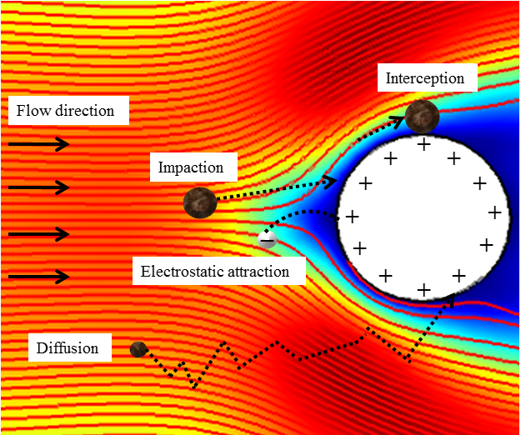
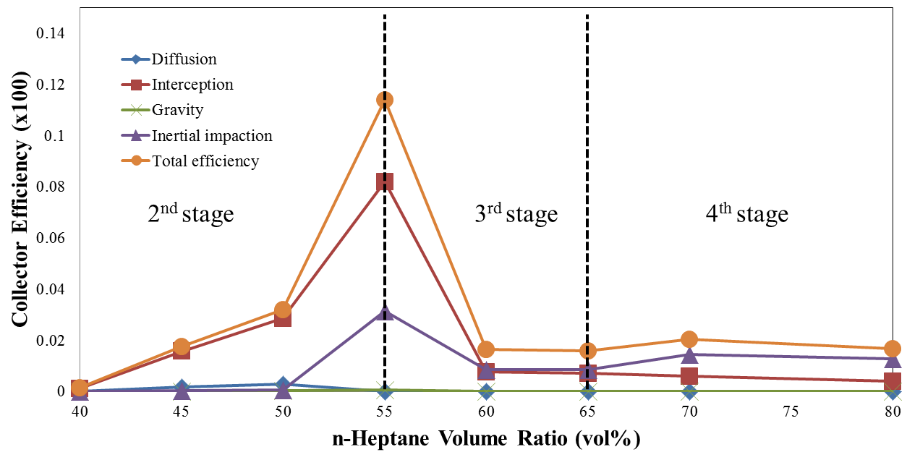
Bulk - Prediction Model
$$η_{Total}={C_{A}^{∗}(η}_{Diffusion}+η_{Intception}+η_{Impaction}+η_{Gravity})$$
Particle collection model for the fibrous filter (near-wellbore region) -> both size and concentration of particles
With this capability, we can analyze and predict the ability of dispersants
* Yu-Jiun Lin et al. Lab on a Chip, in preparation 2015
Notes:
After obtaining the size and particle concentration, the particle collection model … is utilized

Slide 10
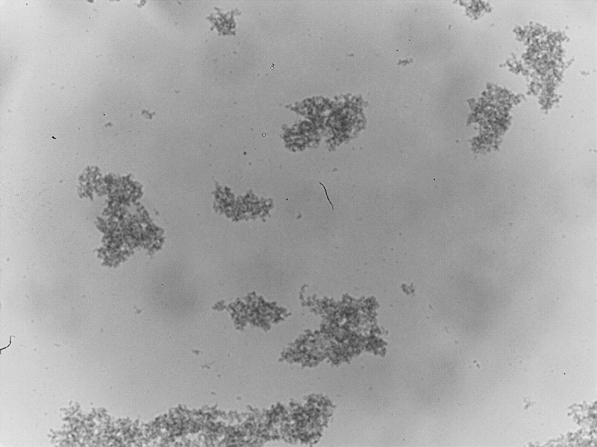
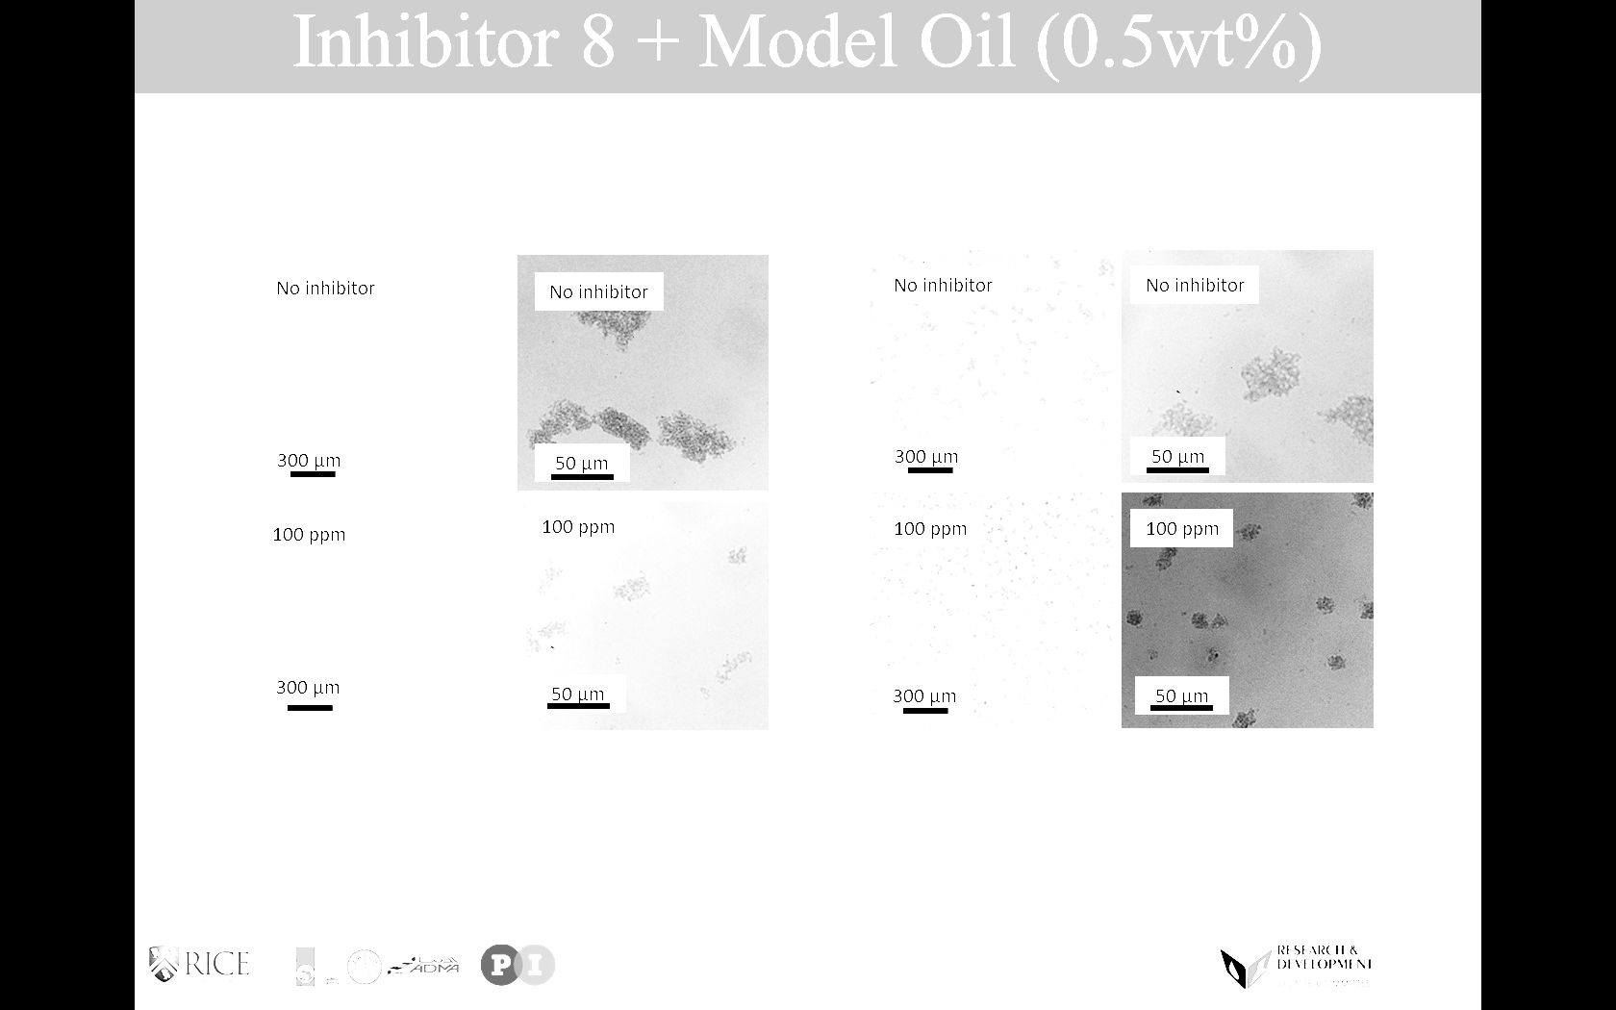
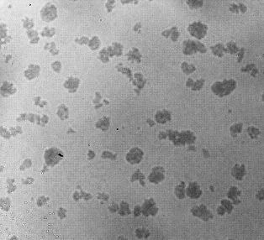
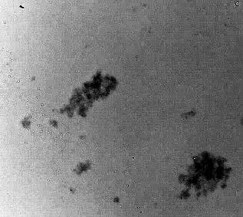
Dispersant + 0.5wt% Model Oil
No dispersant
100 ppm dispersant X
Mixing 100 ppm of dispersant X, Y, and octylphenol (resin-like molecule) changes the aggregation morphology significantly.
By obtaining the size and the concentration of these particles, the capture efficiency can be calculated.
100 ppm octylphenol
100 ppm dispersant Y
 | Radius (µm)
Dispersant X | 13.55
Octylphenol | 14.12
Dispersant Y | 25.04
No dispersant | 49.51
* Yu-Jiun Lin et al. EnergyFuels, in preparation 2015
Notes:
Three dispersants are chosen, dispersant X, Y, and octylphenol
The sizes are obtained by microscopic analysis.

Slide 11
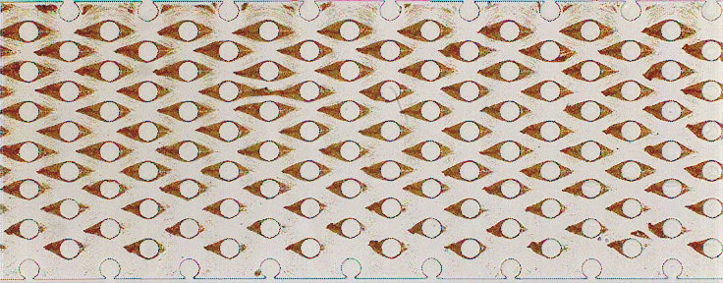
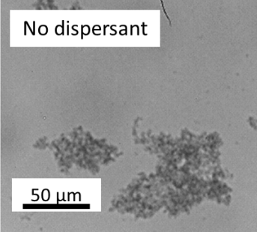
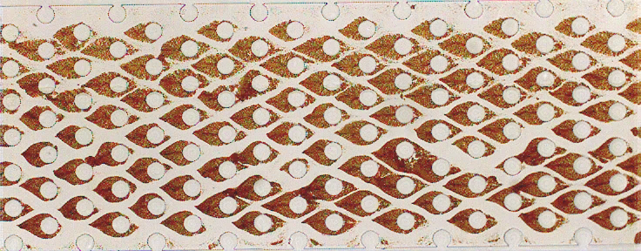
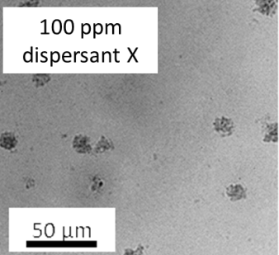
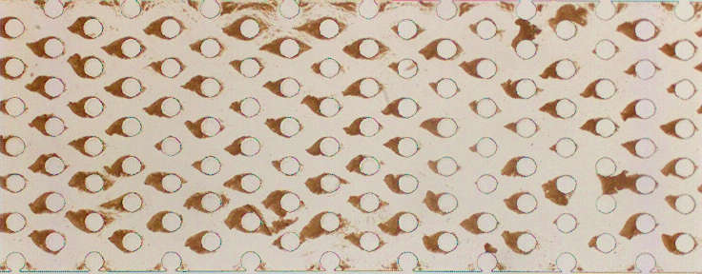

Dispersant + 0.5wt% Model Oil
No dispersant
500 μm
Deposition patterns are also changed by adding dispersants
Dispersant X : stronger dispersant
Dispersant Y : weaker dispersant
Only aggregation morphology is affected by dispersants, but not precipitation.
100 ppm dispersant X
500 μm
100 ppm dispersant Y
500 μm
* Yu-Jiun Lin et al. EnergyFuels, in preparation 2015
Notes:
Flow tests also show that the deposition rate is highly dependent on the particle size

Slide 12
Deposition Rate
Deposition rate: Octylphenol ~ Dispersant X > No dispersant > Dispersant Y
Size: No dispersant > Dispersant Y > Octylphenol ~ Dispersant X
Because of identical amounts of precipitation, smaller size means higher particle concentration
* Yu-Jiun Lin et al. EnergyFuels, in preparation 2015
Notes:
After image processing, we can find that octylphenol and dispersant X have the same deposition rate because of similar particle size
With high particle concentration, dispersant X and octylphenol have the highest deposition rate
Aggregates are large without dispersant, so the impaction by the inertia dominates. Therefore, dispersant Y has the lowest deposition rate.

Slide 13
Deposition Rate and Capture Efficiency
Theoretical
Experimental
Dispersant X
Dispersant Y
Octylphenol
No dispersant
Using the particle size from microscopy and particle concentration from absorbance, the efficiencies can be acquired by the collector model. Results from experiments and theory are qualitatively consistent.
* Yu-Jiun Lin et al. EnergyFuels, in preparation 2015
Notes:
The black column represents results from theory, and the white ones are from experiments.

Slide 14
Pore-scale Interstitial Velocity Simulation
Experiment
Simulation
Beginning
Beginning
10 mins
10 mins
With the ability to visualize real time deposition, the video can be used to simulate the interstitial velocity profile, and calculate the drag forces.
Drag forces are higher in red areas, which matches the deposition patterns.
* Done by Dr. Peng He
* Yu-Jiun Lin et al. EnergyFuels, in preparation 2015

Slide 15
Conclusion
Organic-resistant microfluidic devices are fabricated for visualizing real-time asphaltene deposition processes.
A capture efficiency model successfully predicts the potential of asphaltene deposition by two parameters, size and concentration, consistent with the results from pressure drop measurements and deposition rate.

Slide 16

Acknowledgements
Supported by

Slide 17


Slide 18
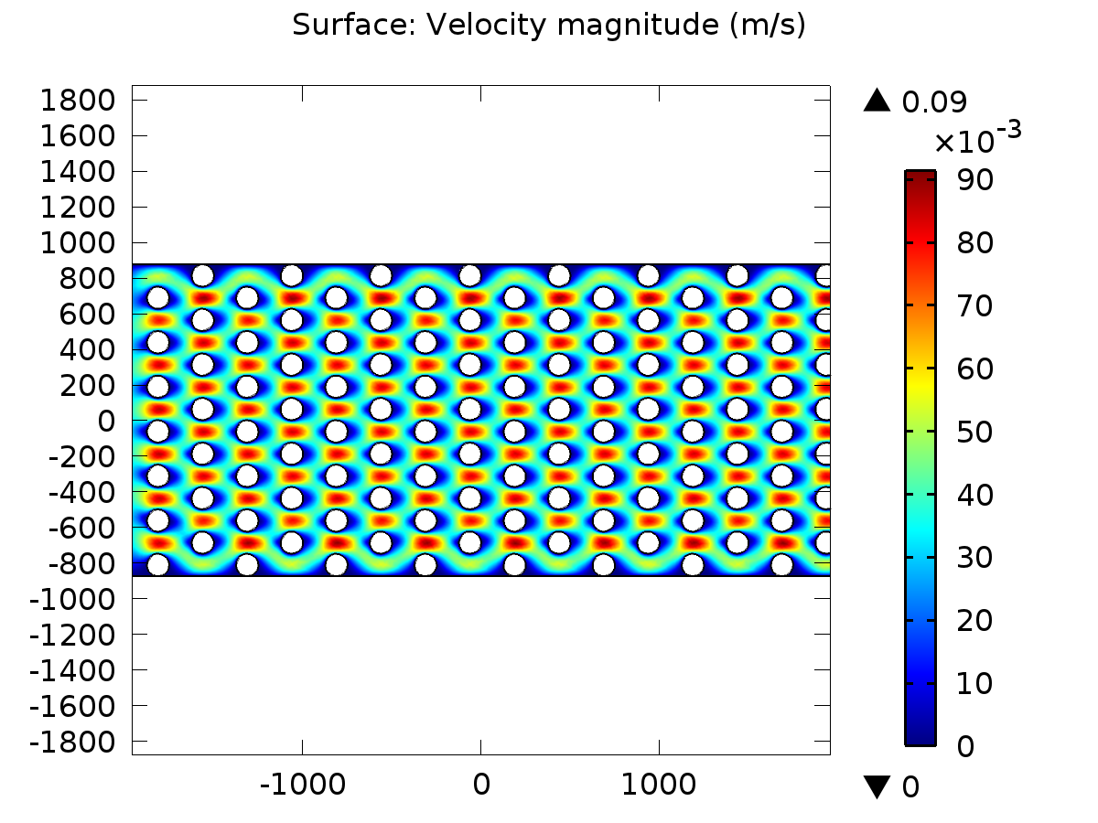

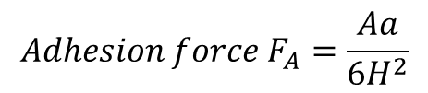




Pore-scale Particle-surface Interaction
$${Drag force F}_{D}=1.7(6πμaV)$$
$$a$$
$$FD$$
$$FA$$
$${Adhesion force F}_{A}=\frac{Aa}{6H^{2}}$$
In the pore scale, a combination of drag force and adhesion force acting on a particle can be estimated to analyze the deposition rate.
$A$: Hamaker constant
* Goldman et al. (1967) and O’Neill (1968)
* G. Ziskind, Reviews in Chemical Enigneering, 2006
* Doris Gonzalez et al. PhD thesis, Rice University 2008
Notes:
In addition to the capture efficiency calculated macroscopically, we can also analyze the particle-surface interaction in the pore scale
As

Slide 19



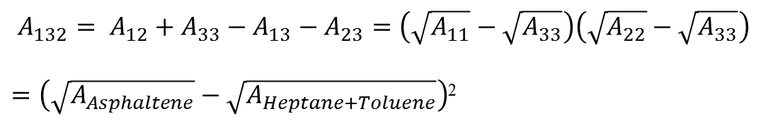
Pore-scale - Hamaker Constant (vdW)
Hamaker constant : a material property that represents the strength of van der Waals interactions between macroscopic bodies
2- Rich phase
Asphaltene
3- Lean phase
80 vol% Heptane + 20 vol% Toluene
1- Substrate
NOA 81 + Asphaltene thin layer
A₁₃₂ Sticking Tendency
Asphaltene
$A_{132}= A_{12}+A_{33}−A_{13}−A_{23}=\left(\sqrt{A_{11}}−\sqrt{A_{33}}\right)\left(\sqrt{A_{22}}−\sqrt{A_{33}}\right)$
$=\left(\sqrt{A_{Asphaltene}}−\sqrt{A_{Heptane+Toluene}}\right)$²
 | A₁₃₂(x10²⁰J)
No dispersant | 0.051
Dispersant X | 0.002
steric repulsion
* Doris Gonzalez et al. PhD thesis, Rice University 2008

Slide 20
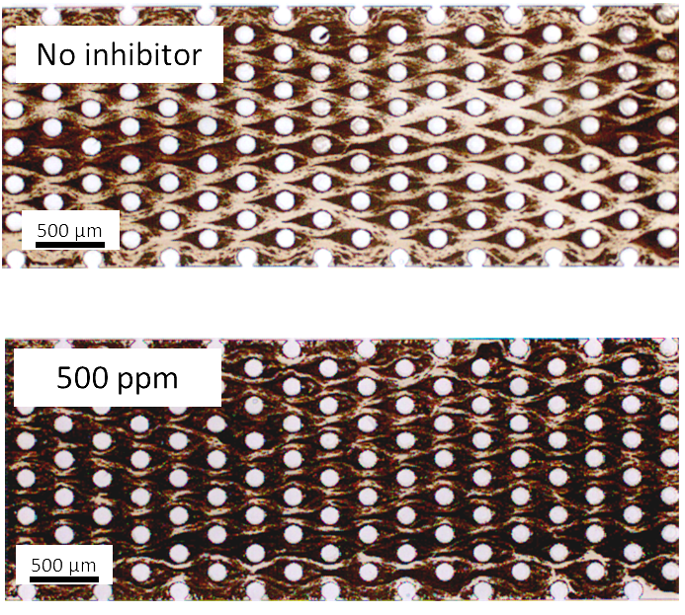
Dispersant X+ Crude Oil
With addition of dispersant X, the deposition rate of asphaltenes from the crude oil increases
* Yu-Jiun Lin et al. EnergyFuels, in preparation 2015

Slide 21
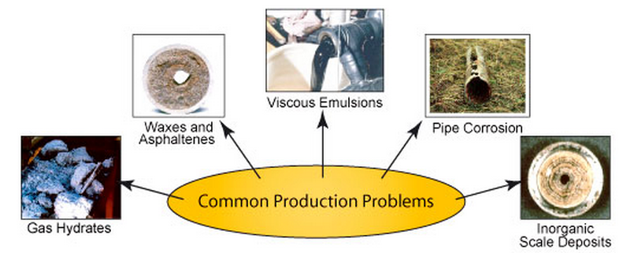
Flow Assurance
The ability to produce multiphase fluids from reservoirs to processing plants in an economically and technically feasible way.
Main Technical Areas :
Prediction (Deposition Potential) --- Simulation
Prevention (Monitoring and Control) --- Sensor
Inhibition (Chemical treatment) --- Chemicals
Remediation (Recovery and Removal) --- Chemicals and mechanical force
*Oilfield review, Summer 2007

Slide 22
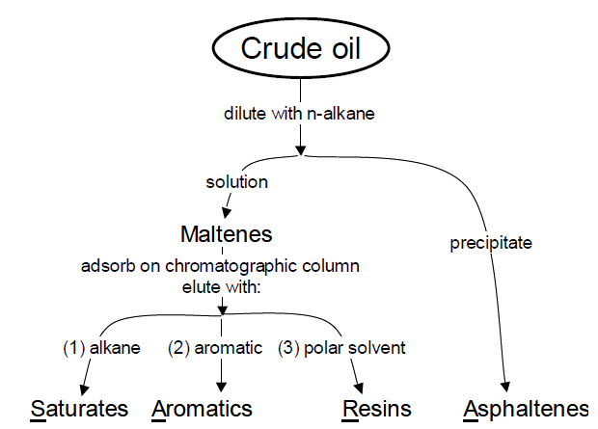
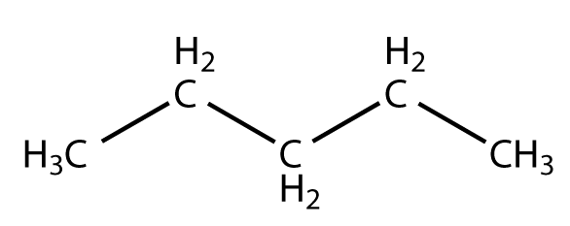
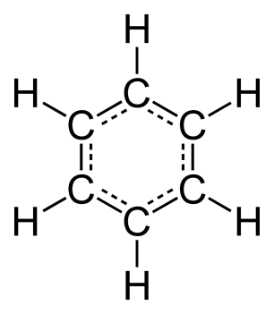
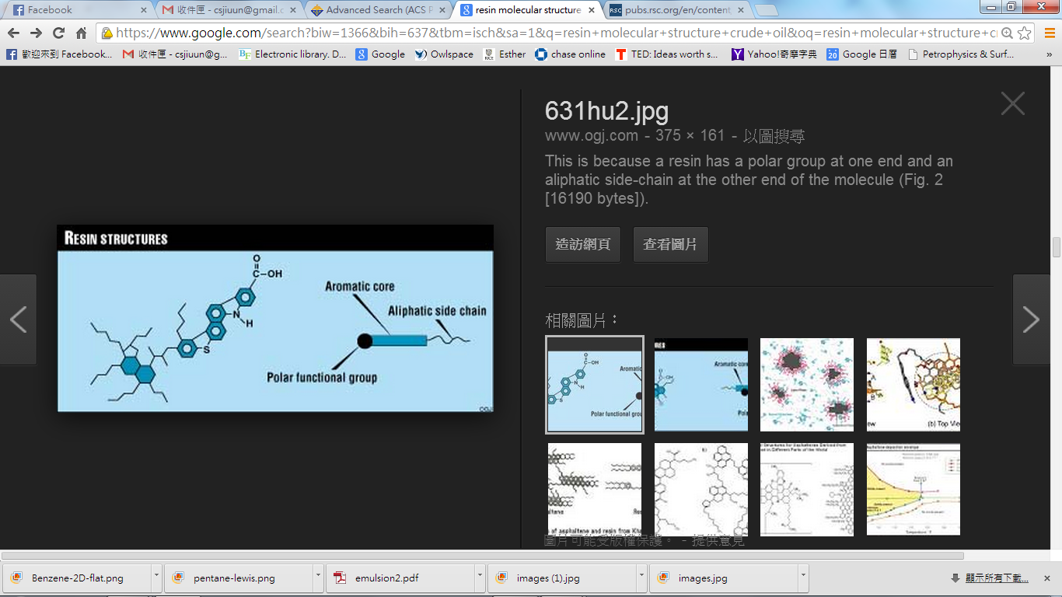
Crude Oil Components : SARA
*S. R. Panuganti et al., Fluid Phase Equilibria ,359, 2013
*Jill Buckley’s Lab (New Mexico Tech)
Notes:
Asphaltene is a planar molecule with aromatic rings in the center and aliphatic chains on the sides, and there are some heteroatoms embedded such as N, O, and metal

Slide 23
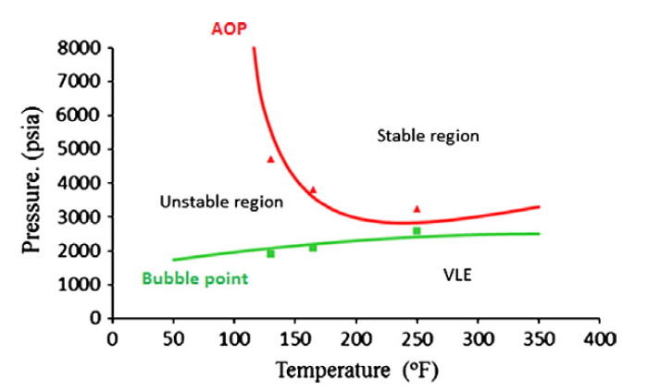
Asphaltene Phase Behavior
Asphaltene Precipitation Envelope
Reservoir
Bubble point
AOP: Asphaltene Onset Pressure
AOP
Temperature and pressure can alter phase behavior of asphaltenes. Solvents can also be used to control asphaltene precipitation.
*F. M. Vargas et al, Fuel, 2013
Notes:
This is asphaltene precipitation envelope
As you can see, x-axis y-axis
Red line is AOP
Green line is bubble pt
Follow the oil production process, the oil will transport from reservoir to the surface, and the pressure and temperature will decrease.
It is like the black arrow in the left picture

Slide 24
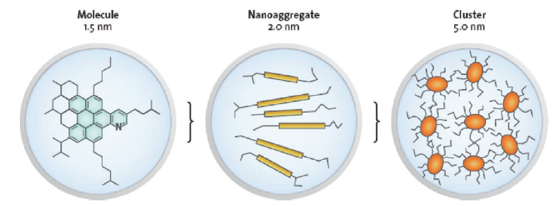
Asphaltene Stages
Yen-Mullins Model
(Dissolved phase)
(Precipitated phase)
(Aggregated phase)
P, T, or {X} changes
Sub-microaggregate
Colloidal Science
*O. C. Mullins et al, Energy Fuels, 2012
*Jill S. Buckley, Energy Fuels, 2012
*Vargas, F. M. et al., Energy Fuels, 2010
Notes:
As you can see, this picture is Yen-Mullins Model, it describes hierarchy of the asphaltene
First, in dissolved phase, asphaltenes will be molecules, nanoaggregates, and clusters.
nanoaggregates with aggregation number of 6, and cluster with number of 8.
If PTX changed, asphaltenes will turn into precipitated phase and form sub-microaggregates, from here colloidal science comes in.
There will be two ways after precipitation, one is deposition, another is aggregation.
If the size of asphaltene aggregates are above a critical value, these aggregates will flow passing by the surface without depositing

Slide 25
Asphaltene Stages
Deposited phase mainly from diffusion
(Aggregated phase)
Arterial Deposition
Flowing-through phase by inertia
Critical size?
Deposited phase in porous media
(from particle filtration theory)
-- First one to apply fibrous filtration theory on asphaltene deposition in porous micromodel
Inertial impaction
Interception
Brownian diffusion
Sedimentation
Electrostatic attraction
*O. C. Mullins et al, Energy Fuels, 2012
*Jill S. Buckley, Energy Fuels, 2012
*Vargas, F. M. et al., Energy Fuels, 2010
Notes:
If the size of asphaltene aggregates are above a critical value, these aggregates will flow passing by the surface without depositing

Slide 26
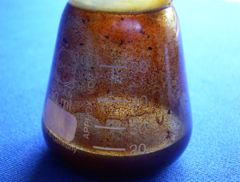
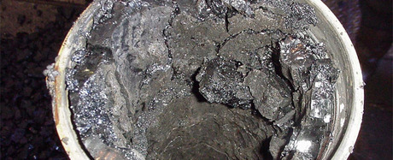
Understanding Asphaltene Precipitation and Deposition
Precipitation
Deposition
Precipitated asphaltene aggregates that are able to flow do not pose major problems in flow assurance
Asphaltene aggregates that precipitate and deposit onto surfaces lead to plugging problems
*Jill S. Buckley, Energy Fuels, 2012
*Vargas, F. M. et al., Energy Fuels, 2010
Notes:
An asphaltene problem occurs in a two-step process: (1) precipitation of asphaltene from the reservoir fluid, which can be estimated by thermodynamic modeling and (2) deposition of the precipitated particles onto the surfaces, which ultimately results in plugging and formation damage.
Asphaltene precipitation is a necessary but not sufficient condition for deposition to take place.
Deposition depends on a number of factors, such as surface characteristics, phase behavior, rheology and fluid flow patterns.

Slide 27
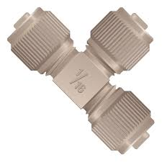
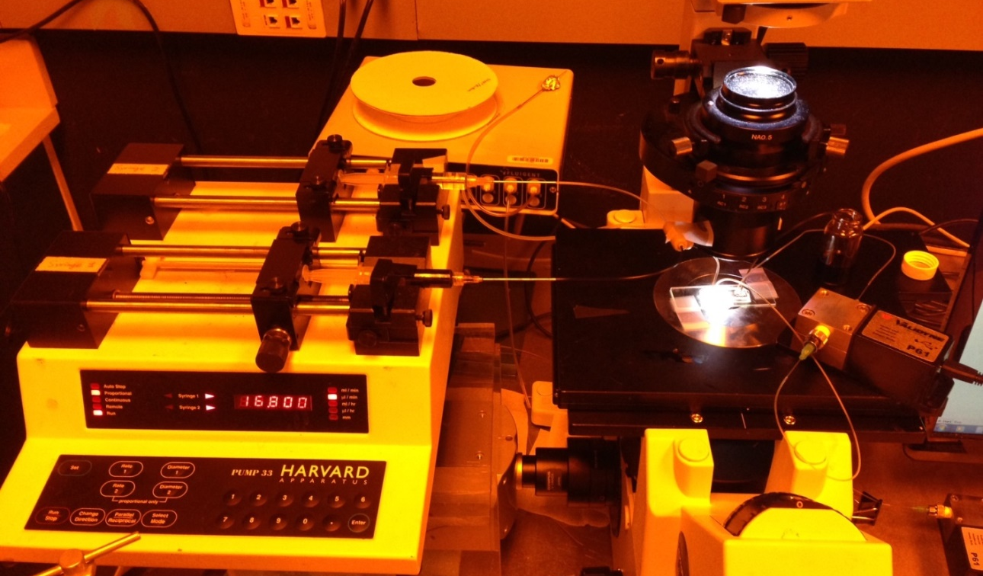
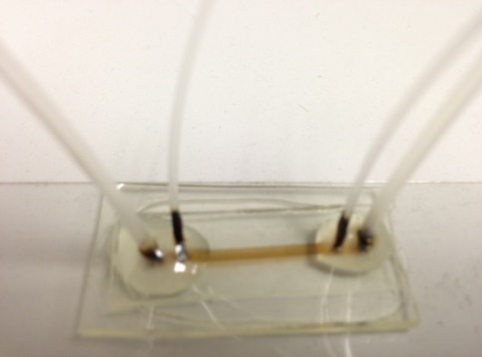
Experimental Setup
T-junction
Inverted microscope
Precipitant
Vial
Crude oil
Pressure
transducer
Syringe pump
Micro-channel
Assumptions :
Precipitation is completed in T-junction.
Deposition is the major reaction in the microchannel.
(Aggregation + Deposition) becomes (Aggregation -> Deposition)

Slide 28
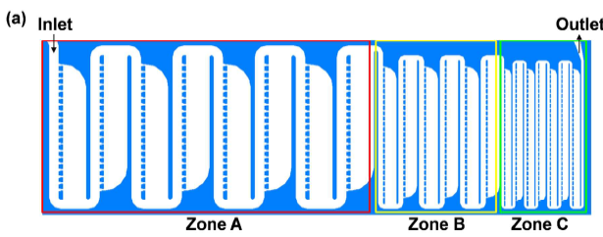
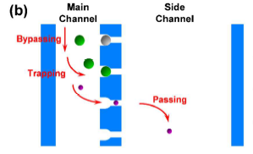
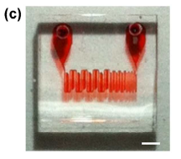
Microfluidic Device
Lab on a chip (mixing, heating, separation, reaction)
Reduced reagent consumption
Faster analysis and response times due to short diffusion distances
Large surface to volume ratio of small components facilitates rapid heat transfer
Example: Particle sorting
Zone A: target 15 μm
Zone B: target 6 μm
Zone C: target 3 μm
Force: magnetic force or gravity
1mm
*J. Kim et al. Lab on a chip, 2012

Slide 29
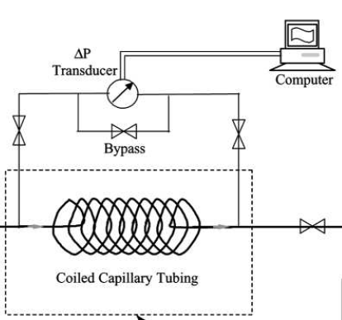
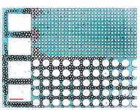
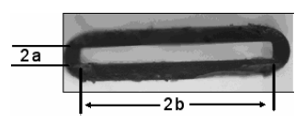
Previous Work in Microchannel
50μm
500μm
Glass capillary tube -> not easy to design a complex pattern
Stainless steel -> not transparent
PDMS -> not organic resistant
Use transparent, organic resistant, and porous media design -> NOA 81
*E. S. Boek et al, Energy&Fuels, 2008
*J. Wang et al, J. Disp. Sci. &Tech., 2004
*K. Ma et al, Soft Matter, 2012

Slide 30

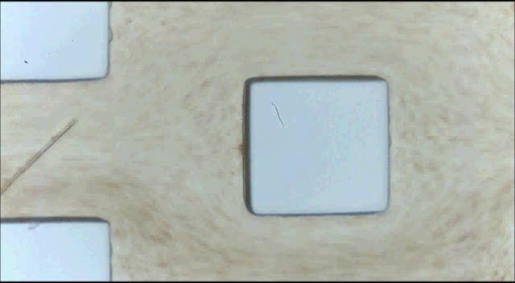

Real-time Asphaltene Deposition
n-C7 70%, Oil 30%
23 ºC
Flow rate : 60 μl/min
22μm
125μm
Flow direction
Notes:
Reduce the porosity and permeability

Slide 31

Characterization of Micromodel
Contact angle | 79.5º±2.67
Reynolds number, Re | 1.01
Initial permeability, k (Darcy) | 5.23
Porosity, $∅$ | 74.79%
Pore volume | 0.124µl
Pore throat | 20µm×125µm
Péclet number for particles, ${Pe}_{p}$ | 10⁵ - 10⁸
Hydrophilic surface
Laminar flow
Empty space in the porous media
Convection-driven
Permeability is the property of rocks that is an indication of the ability for fluids (gas or liquid) to flow through rocks.

Slide 32



Aggregation: Radius of Gyration
Volume fraction of n-heptane (vol%) | Radius of gyration, $R_{g}$ (µm)
40 | 0.9105
45 | 0.9105
50 | 0.9105
55 | 13.557
60 | 30.040
65 | 31.718
70 | 49.776
80 | 59.508

Slide 33

Precipitation and Deposition
Flowing
Flow stopped
Circle : precipitates
Rectangle : deposits
Deposits form under flowing.
When flow is stopped, asphaltenes precipitate. If the flow is restarted, these precipitates are removed. However, deposits remain.

Slide 34

Deposition per Pore Volume
Pore volume : empty space in the porous media
Bridging
Slope will be the deposition rate (μm²/PV_{mix})

Slide 35

Deposition Rate
Effective particle : particle with chances to stick to surfaces
Four Stages:
0 – 40 vol% : no deposition is detected due to two reasons :
1. only small amounts of particles exist
2. particles are so small that they are carried through by fluids
40 – 55 vol% : increase for increasing number of effective particles
55 – 65 vol% : micro-aggregates start to form, the number of effective
particles decreases -> lower chance to stick to surfaces
65 – 80 vol% : increase for bridging

Slide 36


Slide 37

Deposition per Pore Volume

Slide 38

Washing Effect
Good solvent
(1:1 heptane : toluene)
Poor solvent
(2:1 heptane : toluene)
By poor solvent (2:1 heptane : toluene), some asphaltenes are removed, and a more compact deposit forms.

Slide 39
Indirect Method

Slide 40
Indirect Method

Slide 41

Direct Method
Smaller aggregates show less scattering
Results of direct spectroscopy for 0.5 wt% C5+ asphaltene in toluene diluted with n-heptane and aged for 10 minutes. Inhibitor acts at high concentration of n-C7 and breaks asphaltene aggregates.

Slide 42
Macroscale - Deposition Rate
By mixing n-heptane with model oil, aggregates will change into three phases (spherical, fractal, chunk), and these aggregates will change behaviors of deposition.
* Yu-Jiun Lin et al. EnergyFuel, in preparation 2015

Slide 43


Bulk - Permeability Reduction
$$Darcy^{′}s law Q=−\frac{kA}{μL_{p}}∆P$$
By applying Darcy’s law with measured pressure drop, the permeability reduction curves are obtained, and permeability is impaired significantly by asphaltene deposition.
* Yu-Jiun Lin et al. Lab on a Chip, in preparation 2015

