Slide 1
19th Annual Meeting of the
Rice University Consortium on Processes in Porous Media
Rice University
April 22, 2015

Slide 2
Consortium Members
Baker - Hughes
CESI Chemical
Chevron
Conoco Phillips
Core Labs*
Denbury Resources
Ecopetrol
Exxon Mobil
Halliburton
Huntsman
Kinder Morgan
Korean National Oil Co.
Kuwait Oil Company
Lubrizol
Marathon
Oil Chem*
PETRONAS
PTS*
Repsol
Sasol
Solvay Rhodia
Schlumberger
Shell
SINOPEC
Saudi Aramco
SNF
TIORCO
Total
* In-kind contributions

Slide 3
Faculty & Collaborators
George J. Hirasaki
Clarence A. Miller
Walter G. Chapman
Ken Cox
Lisa Biswal
Michael S. Wong
Rafael Verduzco
Francisco Vargas
Scott Wellington
Ed Billips (Chemistry)
Jim Tour (Chemistry)
Keith Johnston (UT)
Quoc Nguyen (UT)
Arne Graue (U. Bergen)
Rouhi Farajzadeh (TU Delft, Shell)
Ali Al Sumati (PI)
Maghsood Abbaszadeh (IPS)

Slide 4
Staff, Visiting Scientist, & Post-Doc
Maura Puerto (retired Exxon)
Zhen Wang (PhD, Zhejiang University)
Indra Mukherjee, (PhD, Jadavpur University)
Suvasree Mukherjee (PhD, Jadavpur University)
Bin Huang, (Northeast Petroleum University)
Chen Fu , (Northeast Petroleum University)
Ying (Annie) Wang, (PhD, New Mexico Tech)
Philip Singer (PhD, MIT)

Slide 5
Current Ph.D. Students
Aarthi Muthuswamy
Yongchao Zeng
Luqing Qi
Leo Wang
Yu-Jiun (Nate) Lin
Ding Li (visiting, China University of Petroleum)
Gedeng (Gordon) Ruan
Pengfei (Patrick) Dong
Guoqing (Michael) Jian
Daniel Vecchiolla
Jason Mann
Tao Deng
Leilei Zhang
Zeliang Chen

Slide 6
Undergraduate Students
Connie Shen
Austin Woo
Tung Nguyen
Maggie Jerome
Michael Mardock
Jesus Duran
Astron Liu
Chang (Carson) Da
Jeffrey Joyce
Alina Datta-Gupta
Ramsey Padilla
Hojin Kim
Javier Perez
Naina Noorani
Chunnan (Gillian) Jiang
Chang Tian

Slide 7
Ph. D. graduates in oil & gas industry
Robert Szafranski (1997), Exxon-Mobil
Sho-Wei Lo (1999), BHP Billiton
Dicksen Tanzil (2001), BRIDGES to Sustainability
Gigi Qian Zhang (2001) Baker Hughes
David Ting (2003), Shell
Alejandro Pena (2003), Schlumberger, Sugarland
Jason Chen (2005), Marathon
Leslie Zhang (2005), Schlumberger, Houston
Mark Flaum (2006 ), Schlumberger - Sugarland
Wei Yan (2006), Bectel, IPS
Vivek Anand (2007), Schlumberger - Sugarland

Slide 8
Ph. D. graduates in oil & gas industry (cont.)
Shunhua Liu (2008), Oxy
Gaurav Bhatnagar (2008), Shell
Doris Gonzalez (2008), BP
Clint Aichele (2009), Oklahoma State University
Tianmin Jiang (2009), Schlumberger
Francisco Vagas (2009), Rice University
Arjun Kurup (2009),
Robert Li (2011), Shell
Elton Yang (2011), Chevron – Richmond
Michael Rauschhuber (2011), Chevron – Richmond
Sayantan Chatterjee (2012), Shell
Neeraj Rohilla (2012), TIORCO

Slide 9
Ph. D. graduates in oil & gas industry (cont.)
Kun Ma (2013) Total
Sumedh Warudkar (2013) Shell
Sai Panuganti (2013) BP
Charles Conn (2014) Shell
Aparna Raju Sagi (2014) Shell
Leyu Cui (2014) Total
Hadi Shams Jazayi (2014) Clariant Oil Services

Slide 10
Processes in Porous Media Consortium
Focus Areas
  NMR well logging
  Wettability alteration & low IFT EOR
  Foam mobility control
  Emulsion separation
  Asphaltene deposition
  Gas hydrate
Core competency
  Formation evaluation
  Enhanced oil recovery
  Flow assurance
Products
  Graduates
  Theses
  Preprints for publications
  Computer code (upon request)

Slide 11
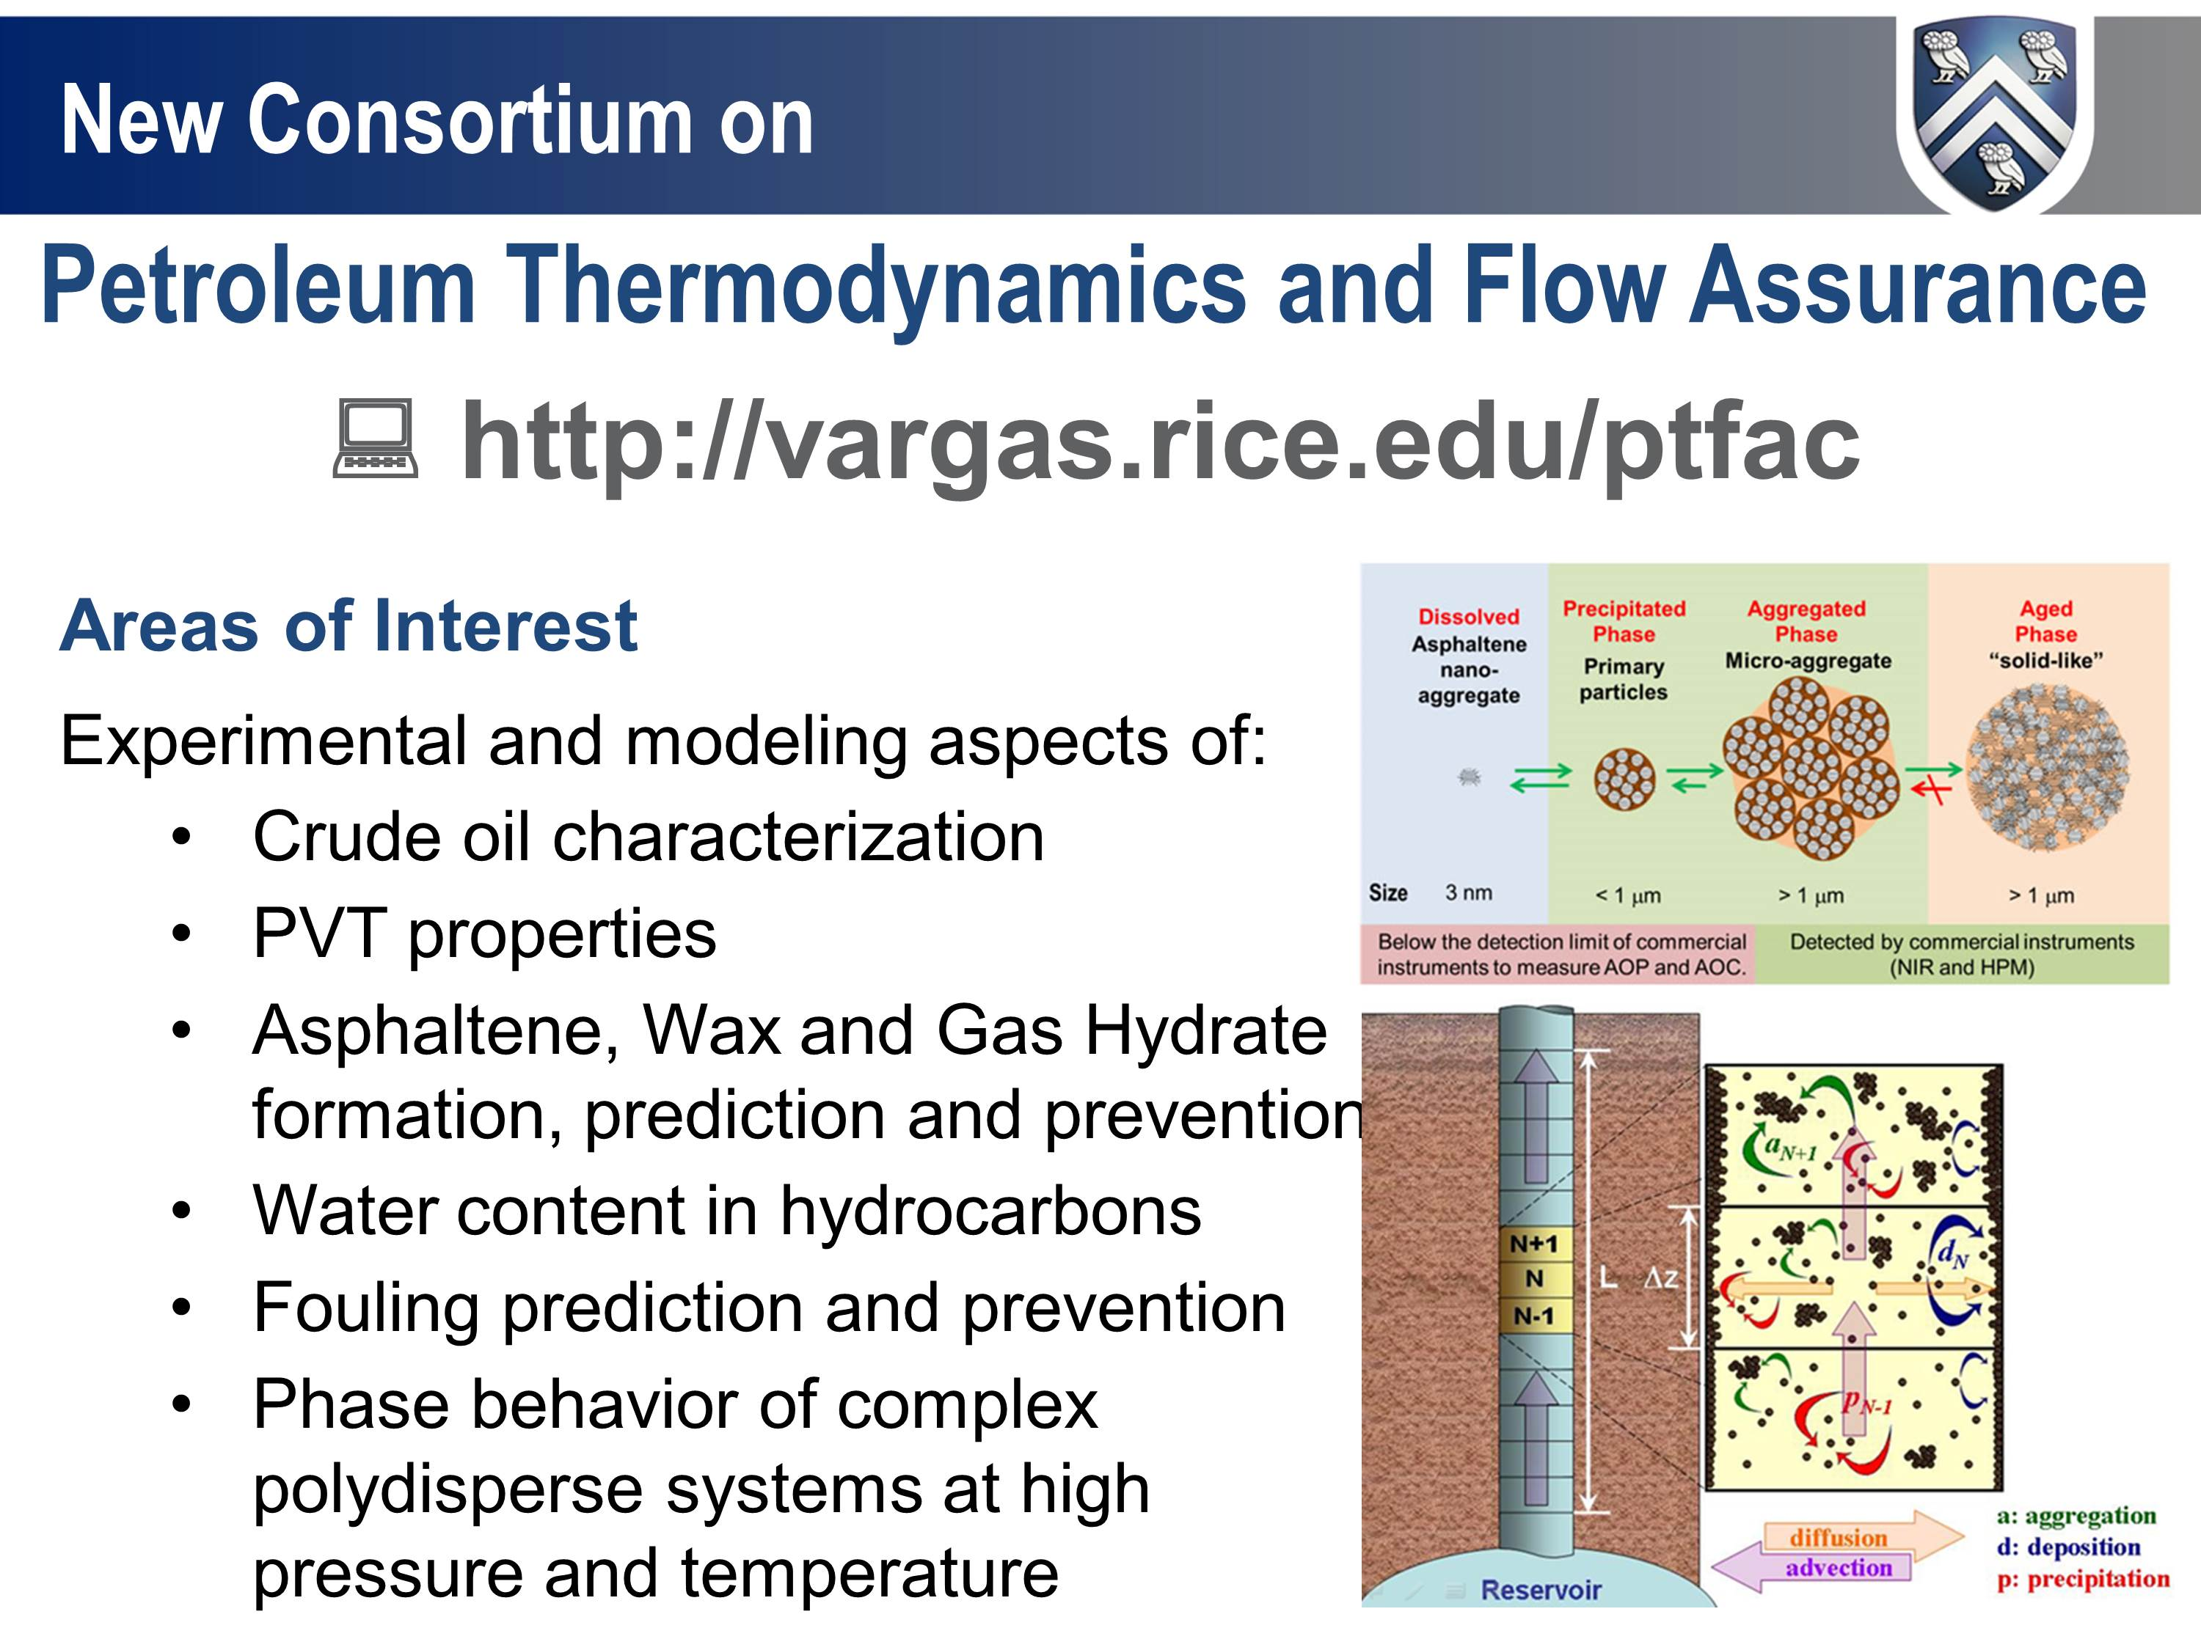

Slide 12
Department of Energy; Nortex
Novel CO₂ Foam Concepts and Injection Schemes for Improving CO₂ Sweep Efficiency in Sandstone and Carbonate Hydrocarbon Formations (2010-2014)
Quoc Nguyen, UT
Keith Johnston, UT
Arne Graue, U. Bergen
George Hirasaki, Rice
Lisa Biswal, Rice
Cost-share with Consortium
Preparing pilot in East Seminole

Slide 13
Department of Energy
Post-Combustion Carbon Dioxide Capture
2011-2014
Faculty
  Michael S. Wong
  George J.Hirasaki
  Ken R. Cox
  Ed Billips (Chemistry)
PhD and Post-doc
  Zhen Wang (Post-Doc)

Slide 14
Proprietary Research
National Oil Company – EOR
ADNOC – CO₂ Foam, Low IFT, & Asphaltene, Wettability, with UT, PI, Masdar, MIT, Vanderbilt
IOC – ASP Formulations
IOC – Emulsion separation
IOCs – Hydrocarbon gas (WAG) mobility control
AEC – Nanoparticles for low IFT

Slide 15
Manuscripts on: Website: http://www.owlnet.rice.edu/~gjh/Consortium/
Polymer Coated Nanoparticles for EOR, Hadi ShamsiJazeyi (Download)
Adsorption of Anionic and Cationic Surfactants on Carbonates, Kun Ma (Download)
Reducing Adsorption of Anionic Surfactants for EOR: Hadi ShamsiJazeyi (Download)
Precip. Asphaltene at High-Pressure and High- Temperature , by Mohammad Tavakkol (Download)
Asphaltene Dep. in Different Dep. Environ.: Part 1. Model Oil, by Mohammad Tavakkol (Download)
Asphaltene Dep. in Different Dep. Environ.: Part 2. Real Oil, by Mohammad Tavakkol (Download)
Investigation of Oil-Asphaltene Slurry Rheological Behavior, by Mohammad Tavakkoli (Download)
Effects of Hardness and Cosurfactant on Phase Behavior, by Maura Puerto (Download)
Adsorption of a Cationic Surfactant on Carbonate Minerals, by Leyu Cui (Download)
Asphaltene Behavior in Crude Oil Systems, PhD thesis by Sai Panugant (Download)
Polydisperse behavior of asphaltenes during precipitation, by Mohammad Tavakkoli (Download)
Property Scaling Relations for Nonpolar Hydrocarbons, by Sai Panugant (Download)
SAFT model for upstream asphaltene applications, by Sai Panugant (Download)
PC-SAFT Characterization of Crude Oils and Asphaltene, by Sai Panuganti (Download)
Tar Mat from Asphaltene Compositional Grading, by Sai Ravindra Panuganti, et al.(Download)
Carbon Capture, High Pressure Stripper, by Sumedh Warudkar, et al. (Download)
Carbon Capture, Low Pressure Stripper, by Sumedh Warudkar, et al. (Download)
Sacrificial Agent for Surfactant Adsorption, by Hadi Shams Jazaya, et al. (Download)
Surfactant Flooding Low Salinity, Fractured Carbonate Reservoir, by Aparna Raju Sagi, et al.
…

Slide 16
Agenda
7:30-8:00 Coffee
8:00-8:15 Introduction, George Hirasaki
8:15-8:35 NorTex Petroleum Cluster, Update on CO₂ Field Pilots, Arne Graue
8:35-8:55 Effect of Surfactant Synergism on Foam Rheology, Aarthi Muthuswamy
8:55-9:15 Effect of Gas Type and Composition on Foam Rheology, Yongchao Zen
9:15-9:30 Algorithm to Estimate Foam Parameters, Yongchao Zen
9:30-9:50 Micromodels for Visualizing Foam Transport, Lisa Biswal
9:50-10:10 Coffee
10:10-10:30 CO₂ Mobility Control and Adsorption with Nonionic Surfactant, Michael Jian
10:30-10:50 Sodium Ions for Optimal Salinity of ASP, Ding Lei
10:50-11:10 Molecular Dynamics on Synergism between Lauryl Betaine and AOS, Le Wang
11:10-11:30 NMR Core Analysis in Unconventional Plays, Philip Singer
11:30-1:00 Lunch, Coffee
1:00-1:20 Interactions of Nanoparticles with Surfactant Microemulsion, Luqing Qi
1:20-1:40 Nanocapsules for Oil Detection and Extended-Reach pH Modification, Jim Tour
1:40-2:00 Asphaltene Aggregation and Deposition in Micromodel, Yu Jin Li (Nate)
2:00-2:20 Recommendations from Consortium
2:20- Lab Tour

Slide 17
Lab Tours
Micromodels
Temporary
EOR Formulation
EOR Flooding
Also Keck 207 for Verduzco polymer lab
You are here

Slide 18
Attendees
Chen | Jinhong | Aramco Services
hagiwara | teruhiko | aramco services company
Monteiro | Othon | Baker Hughes
Zhang | Gigi | Baker Hughes Inc.
Germack | David | CESI Chemical
Mast | Nicole | CESI Chemical
Munson | Les | Chevron
Sun | Boqin | Chevron
Xu | Josh | Chevron
Fathi Najafabadi | Nariman | Chevron
Rodriguez | Elena | Chevron
Munson | Les | Chevron
Subrahmanyan | Sumitra | Chevron
McComb | Thais | Chevron
Vo | Tuan | Core Laboratories
D'Souza | David | Denbury Resources
Ortiz Vega | Diego | Dow Chemical
Wanat | Ed | ExxonMobil
Sinha | Somnath | ExxonMobil
Mohan | Lavanya | Exxonmobil
Hammond | Charles | Flotek
Stegemeier | George | GLS Engineering, Inc
Yue | David | Halliburton
He | Kai | Halliburton
Peng | Alice | Halliburton
Shi | Liu | Halliburton
Rane | Jayant | Halliburton
Sandor | Magdalena | Halliburton
Cheng | Yuesheng | Halliburton
Salazar | Luis | Huntsman
Fournier | Frances | Kemira
Schoeling | Lanny | KinderMorgan CO2
Gharbi | Ridha | Kuwait Oil Company
Klotz | Stephen | Lockheed Martin
Xiu | Zongming | Lubrizol
Treybig | Duane | Lubrizol
Cho | Minjung | Lubrizol
Saini | Rajesh | Lubrizol
Johnson | Ryan | Lubrizol
Paramo-Gaitan | Maria F. | Lubrizol
Gonzalez | Jessica | Lubrizol
Hwang | Chih-Chau | Lubrizol
Vigderman | Leonid | Lubrizol Oilfield Solutions
Lu | Wei | Lubrizol Oilfield Solutions
Chen | Hung-Lung | Marathon Oil Corporation
Chen | Jason | Marathon Oil Corporation
Xu | Liang | Multi-Chem, a Halliburton Service
Nguyen | Christina | Multi-Chem, a Halliburton Service
Feng | Lijie | Multi-Chem, A Halliburton Service
Nguyen | Duy | Nalco Champion
Berger | Paul | Oil Chem Technologies
Farris | Michandra | PTS Laboratories

Slide 19
Attendees
Mukherjee | Indrajyoti | RICE UNIVERSITY
Hirasaki | George | Rice University
Muthuswamy | Aarthi | Rice University
Verduzco | Rafael | Rice University
Vecchiolla | Daniel | Rice University
Wang | Annie-Ying | Rice University
ZHANG | LEILEI | RICE UNIVERSITY
Taghikhani | Vahid | Rice University
Jian | Guoqing | Rice University
Ding | Lei | Rice University
Wang | Le | Rice University
Miller | Clarence | Rice University
Tour | James | Rice University
DENG | TAO | Rice University
Singer | Philip | Rice University
Qi | Luqing | Rice University
Shehab | Fouad | Rice University
Lin | Nate Yu-Jiun | Rice University
Biswal | Lisa | Rice University
DONG | PENGFEI | Rice University
MUKHERJEE | SUVASREE | Rice University
Li | Jizhou | Rice University
Vargas | Francisco | Rice University
Bansal | Artee | Rice University
Huang | Bin | Rice University
Fu | Cheng | Rice University
Puerto | Maura | Rice University
Chen | Zeliang | Rice University
Ali | Mansoor | Schlumberger
Anand | Vivek | Schlumberger
Li | Robert | Shell
Barnes | Julian | Shell
Raney | Kirk | Shell
Shukla | Shunahshep | Shell
Sagi | Aparna Raju | Shell
Raney | Olina | Shell
Poteau | Sandrine | Shell
Haddix | Grant | Shell Chemicals
Southwick | Jeff | Shell Global Solutions BV
Pretzer | Lori | Shell Global Solutions, US
King | Timothy | Shell Global Solutions, US Inc.
Li | Yingcheng | Sinopec
Su | Zhiqing | Sinopec
Ma | Tao | Sinopec
tao | ma | Sinopec
su | zhiqing | Sinopec
Gaillard | Nicolas | SNF
Dufour | Sophie | SNF
Mac Ewen | Kimberley | SNF Oil and Gas
TOGNISSO | Elvire | SNF SAS
Patil | Pramod | The Dow Chemical Company
Knight | Troy | The Dow Chemical Company
Kida | Yuko | The Dow Chemical Company

Slide 20
Attendees
Shoaib | Mohamad | The Petroleum Institute
Yang | Hyuntae | TIORCO
Waldman | Tom | TIORCO
Ravikiran | Ravi | TIORCO LLC
Levitt | David | Total
BOURDAROT | GILLES | TOTAL
BOURREL | Maurice | TOTAL
Ma | Kun | Total
BOURREL | Maurice | TOTAL - PERL
Mateen | Khalid | Total E&P Research and Technology USA LLC
Ma | Kun | Total E&P Research and Technology USA LLC
Ren | Guangwei | Total E&P Research and Technology USA LLC
Bourdarot | Gilles | Total E&P Research and Technology USA LLC
Morel | Danielle | Total E&P Research and Technology USA LLC
Bourrel | Maurice | Total E&P Research and Technology USA LLC
Graue | Arne | University of Bergen

