Slide 1
Effect of Surfactant Synergism on Foam Rheology
Lauryl Sultaine: AOS ₁₄₋₁₆ blends
Lauryl Betaine: AOS ₁₄₋₁₆ blends
Rice University :
Aarthi Muthuswamy
Maura Puerto
Rafael Verduzco
Clarence Miller
George Hirasaki
TU Delft, Shell Rijswijk
Rouhi Farajzadeh
Sebastien Bonnieu

Slide 2
Outline
Foam experimental set up
Lauryl Sultaine & AOS₁₄₋₁₆ blends, Lauryl Betaine & AOS₁₄₋₁₆ blends
  -N₂ Foam flow in Bentheimer sandstone, 45°C.
  -Regular solution theory interpretation of foam rheology.
  -Foam Presence of crude oil
Interfacial rheology comparison of surfactants
Observations and conclusions

Slide 3

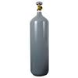
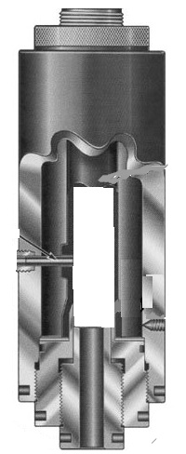
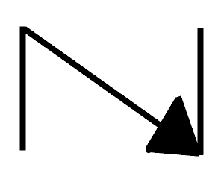
FOAM EXPERIMENTAL SET UP
TO EFFLUENT
OVEN 45 ⁰C
BPR
OUTLET
N₂
GAS
CONFINING PRESSURE
TRANSDUCERS
P4
MFC
CORE
2.46”
P3
N₂
GAS
1.7”
2.46”
CHECK VALVE
P2
Liquid Pump
CONFINING PRESSURE
P1
INLET

Slide 4
Lauryl Sultaine –AOS ₁₄₋₁₆ blends

Slide 5
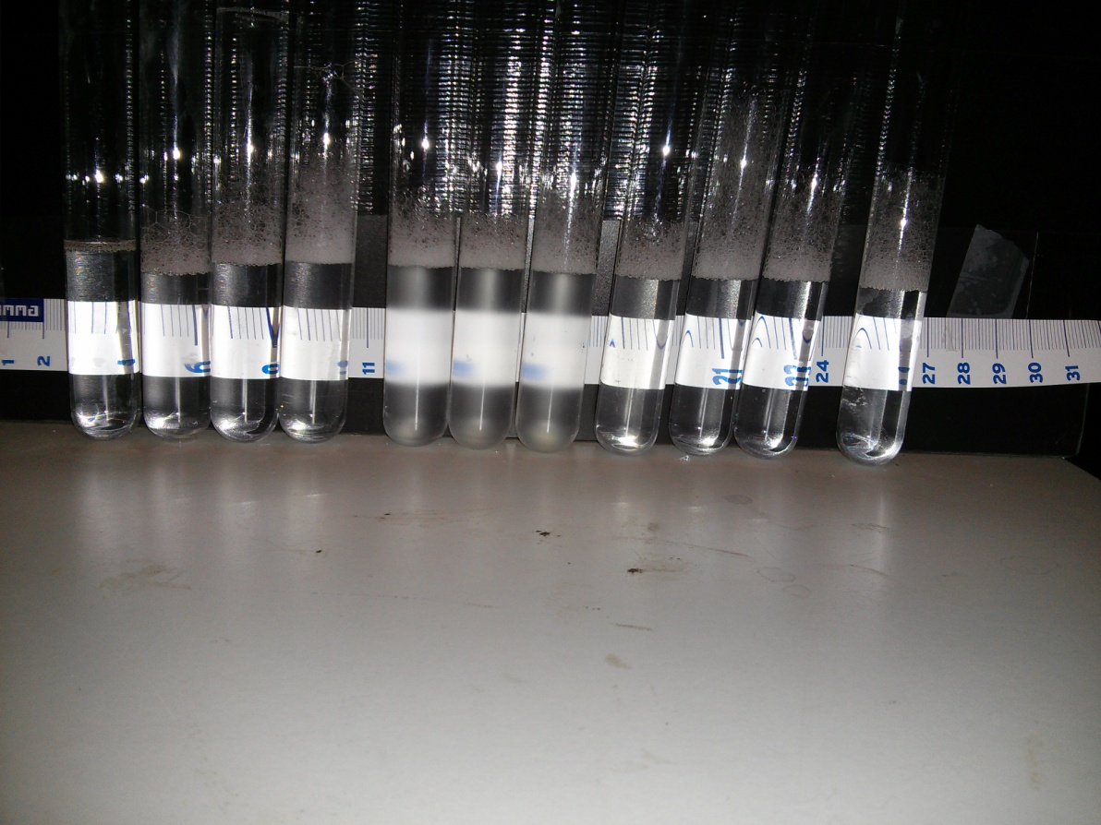
Aqueous stability test - Sultaine AOS blends at 45⁰C
(S) 1 0.9 0.8 0.7 0.6 0.5 0.4 0.3 0.2 0.1 0
(AOS) 0 0.1 0.2 0.3 0.4 0.5 0.6 0.7 0.8 0.9 1
Clear
Unclear
Clear

Slide 6
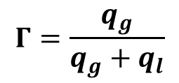
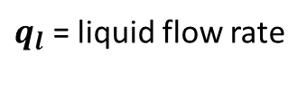
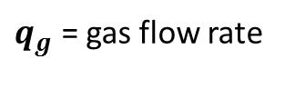
Foam Quality scan- 45 °C, ~ 2.5 Darcy,
~ 20 ft/day interstitial velocity
Overall
Internal tap
IN
OUT
N₂ foam
BPR ~ 25 bar=362psi
$q_{g}$ = gas flow rate
$$Γ=\frac{q_{g}}{q_{g}+q_{l}}$$
$q_{l}$ = liquid flow rate

Slide 7
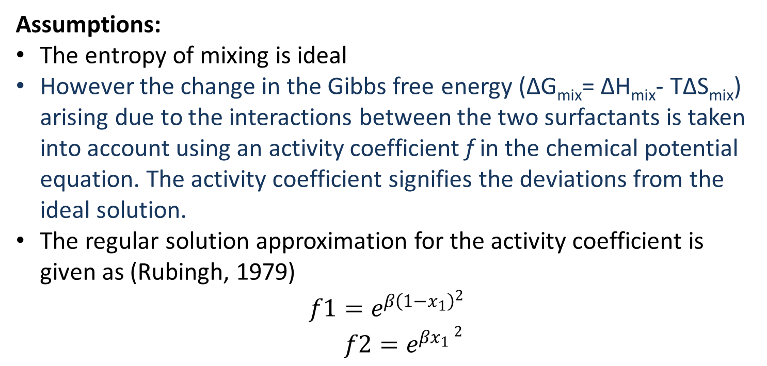
Regular solution theory
Assumptions:
The entropy of mixing is ideal
However the change in the Gibbs free energy (ΔG_{mix}= ΔH_{mix}- TΔS_{mix}) arising due to the interactions between the two surfactants is taken into account using an activity coefficient f in the chemical potential equation. The activity coefficient signifies the deviations from the ideal solution.
The regular solution approximation for the activity coefficient is given as (Rubingh, 1979)
$$f1=e^{β{\left(1−x_{1}\right)}^{2}}$$
$$f2=e^{β{x_{1} }^{2}}$$
Rosen, M. J. (1991). Synergism in mixtures containing zwitterionic surfactants. Langmuir, 885-888.
Rubingh, D. N. (1979). Mixed Micelle Solutions (Vol. 1). Springer New York.
Zhou, Q., & Rosen, M. (2003). Molecular Interactions of Surfactants in Mixed Monolayers at the Air/Aqueous Solution Interface and in Mixed Micelles in Aqueous Media: The Regular Solution Approach. Langmuir, 4555-4562.

Slide 8
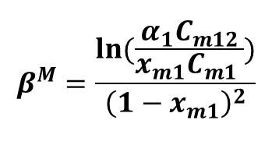
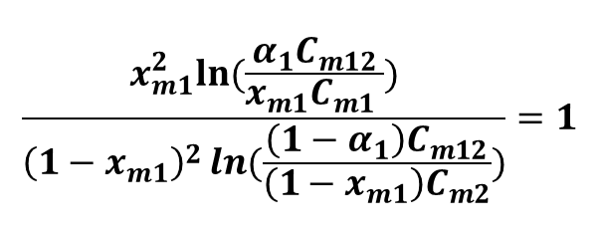
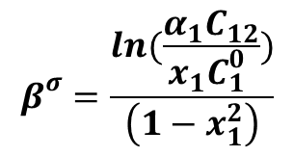
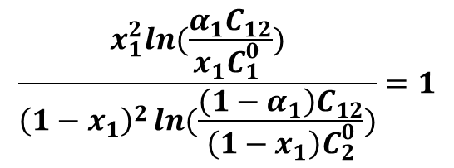
Calculation of β parameters- Regular solution theory
?
?
$$\frac{x_{m1}^{2}ln⁡(\frac{α_{1}C_{m12}}{x_{m1}C_{m1} })}{{\left(1−x_{m1}\right)}^{2}\ln{(\frac{\left(1−α_{1}\right)C_{m12}}{\left(1−x_{m1}\right)C_{m2}})}}=1$$
$$\frac{x_{1}^{2}ln(\frac{α_{1}C_{12}}{x_{1}C_{1}^{0} })}{{\left(1−x_{1}\right)}^{2}\ln{(\frac{\left(1−α_{1}\right)C_{12}}{\left(1−x_{1}\right)C_{2}^{0}})}}=1$$
α1- mole fraction of surfactant 1 in the prepared bulk solution (LB)
x_{m1} – the mole fraction of surfactant 1 (LB) in the mixed micelle
C_{m1}, C_{m2}- cmc of the individual surfactants LB and AOS respectively
C_{m12}- cmc of the surfactant mixture
γ – surface tension
X₁= mole fraction of surfactant 1 (LB in this case) in the total mixed monolayer
C₁₂, C₁⁰, C₂⁰ are the molar concentrations of LB: AOS mixture, LB, AOS respectively chosen to give a particular surface tension value
$$β^{σ}=\frac{ln(\frac{α_{1}C_{12}}{x_{1}C_{1}^{0} })}{\left(1−x_{1}^{2}\right)}$$
?
$$β^{M}=\frac{ln⁡(\frac{α_{1}C_{m12}}{x_{m1}C_{m1} })}{{\left(1−x_{m1}\right)}^{2}}$$
?

Slide 9
Surface tension measurements for Sultaine-AOS blends mad in sea water
Air-water interface, 20 °C
C⁰₁₂
Du-Nuoy Padday method used
C⁰₁
C⁰₂
Surfactant | CMC (wt%) | CMC (M) | Surface tension (mN/m)
LS | 0.017 | 0.000983 | 33.52
8LS+2AOS | 0.0073 | 0.00044 | 28.35
1LS+9AOS | 0.00404 | 0.000313 | 29.74
AOS | 0.00508 | 0.000407 | 28.76

Slide 10
Interfacial tension between octane and sultaine-AOS blends, 20°C

Slide 11
Characterization of synergism by β parameter for Sultaine AOS blends
Air-liquid interface
Surfactant | Bulk mole fraction α _{LS} | Interfacial mole fraction X_{1 LS} | β^{σ}
Sultaine
8 Sultaine + 2 AOS | 0.73 | 0.50 | -1.56
1 Sultaine+ 9 AOS | 0.072 | 0.18 | +0.24
AOS
Octane-liquid interface
Surfactant | α _{LS} | X_{1 LS} | β^{σ}
Sultaine
8 Sultaine + 2 AOS | 0.73 | 0.50 | -1.01
1 Sultaine+ 9 AOS | 0.072 | Cannot solve perhaps mole fraction of LS is too low.
AOS
Zhou, Q., & Rosen, M. (2003). Molecular Interactions of Surfactants in Mixed Monolayers at the Air/Aqueous Solution Interface and in Mixed Micelles in Aqueous Media: The Regular Solution Approach. Langmuir, 4555-4562

Slide 12
Foam Quality scan- 45 °C, ~ 2.5 Darcy,
~ 20 ft/day interstitial velocity
Overall
Internal tap
IN
OUT
N₂ foam
BPR ~ 25 bar=362psi

Slide 13
S:AOS Foam with crude oil, 45⁰ C, ~ 40% residual oil
Internal tap (foam no oil)
Overall
IN
OUT
Oil ~ 60 cP
IN
Foam presence of crude oil

Slide 14
S:AOS Foam with crude oil, 45⁰ C, ~ 40% residual oil
Internal tap (foam)
Overall
IN
OUT
IN
Foam presence of crude oil

Slide 15
Lauryl Betaine –AOS ₁₄₋₁₆ blends

Slide 16
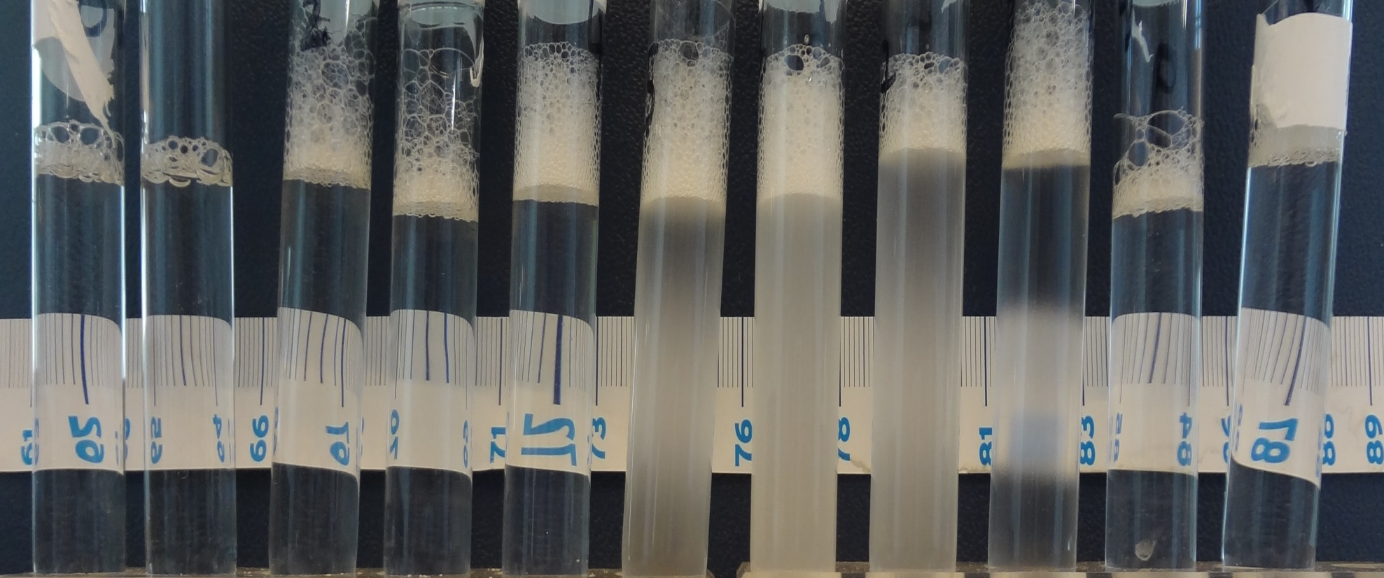
Blend Scan (45 ⁰C)
(LB) 1 0.9 0.8 0.7 0.6 0.5 0.4 0.3 0.2 0.1 0
(AOS) 0 0.1 0.2 0.3 0.4 0.5 0.6 0.7 0.8 0.9 1
Clear
Not Clear
Clear

Slide 17
Betaine- AOS foam quality scan- 45°C
Compared at shear rate 28.3 1/s
N₂ foam
BPR ~ 5 bar=72.5psi
Overall
Internal tap
IN
OUT
2.6 Darcy
2.5 Darcy
0.9 Darcy
1.2 Darcy

Slide 18
Surface tension measurements for Betaine-AOS blends made in sea water
Air-water interface, 20 °C
Surfactant | CMC (wt%) | CMC (M) | Surface tension (mN/m)
LB | 0.0136 | 0.00157 | 33.79
7LB+3AOS | 0.0057 | 0.00034 | 27.9
1LB+9AOS | 0.00415 | 0.000348 | 28.65
AOS | 0.00508 | 0.000407 | 28.76

Slide 19
Interfacial tension between octane and betaine-AOS blends- 20°C

Slide 20
Characterization of synergism by β parameter- Betaine AOS blends
Air-liquid interface
Surfactant | Bulk mole fraction α _{LB} | Interfacial mole fraction X_{1 LB} | β^{σ}
Betaine
7 Betaine +3AOS | 0.77 | 0.49 | -7.08
1 Betaine+ 9 AOS | 0.14 | 0.31 | -2.72
AOS
Octane-liquid interface
Surfactant | X_{1 LB} | β^{σ}
Betaine
7 Betaine +3AOS | 0.37 | -3.24
1 Betaine+ 9 AOS | 0.30 | -2.19
AOS

Slide 21
LB:AOS Foam with crude oil, ~ 30% residual oil
Internal tap (foam)
Overall
IN
Foam presence of crude oil
IN
OUT

Slide 22
LB:AOS Foam with crude oil , ~30% residual oil (contd.)
Internal tap (foam)
Overall
IN
Foam presence of crude oil
IN
OUT

Slide 23
Comparison of interfacial complex viscosity- Interfacial stress rheometer magnetic needle method
All surfactant solutions made in sea water

Slide 24
Observations and Conclusions
Absence of crude oil: In a blend of zwitterionic Lauryl betaine and Anionic AOS ₁₄₋₁₆ (AOS) , betaine does not boost the foam of the blends to any better value than pure AOS itself. The same goes for blends of Lauryl sultaine and AOS where sultaine does not boost the foam of blend to any better value than AOS.
Presence of crude oil : AOS foam performs well in the presence of crude oil that a blend is not required for the test conditions in this study.
None of the surfactants have measurable interfacial rheology.
Regular solution theory predicts there is more synergism in Betaine & AOS blends than in Sultaine & AOS blends. However this does not have correlation to foam strength for the test conditions. ( Rosen et.al , Journal of the American Oil Chemists’ Society, April 1988, Volume 65, Issue 4, pp 663-668)
Pure Lauryl Betaine and Pure Lauryl Sultaine surfactants are not good foamers in interests of EOR.

Slide 25
Acknowledgements
Foam Experimental set up
  Michiel Slob- TU Delft
  Dr. Ali Akbar Eftekhari- TU Delft
Interfacial Rheology
  Dr. Gerard Fuller’s lab – Stanford University
Surface/Interfacial tension measurements
  Hakim Hamouche- Kibron
Processes in Porous Media Consortium, Solvay, Shell Rijswijk.

Slide 26
Back up slides

Slide 27
Procedure to determine concentration to estimate β parameter at interfaces
Here example case of betaine AOS blends are shown

Slide 28
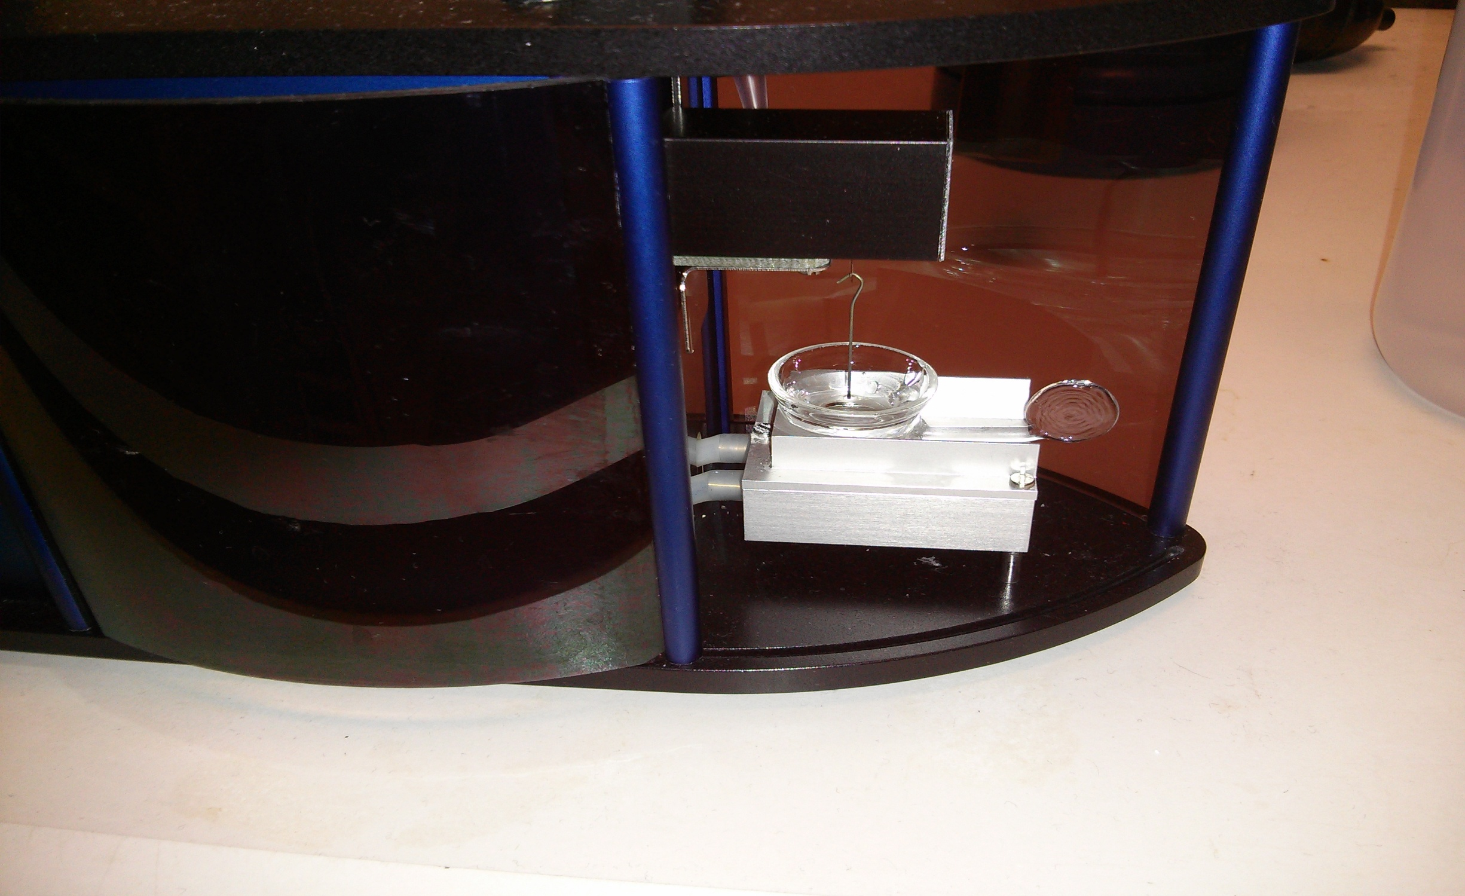
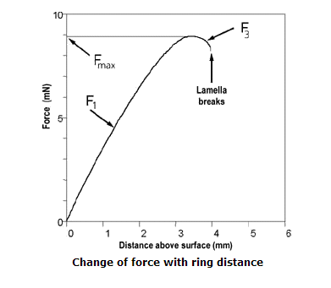
Du-Nuoy method- Kibron EZ-Pi Plus
F = 2 π r γ
Rate of pulling= 0.2 mm/s

Slide 29
Characterization of synergism by β parameter for Sultaine AOS blends
Air-liquid interface(linear fit)
Surfactant | Bulk mole fraction α _{LS} | Interfacial mole fraction X₁ | Micellar mole fraction X_{m} | β^{σ} | β^{M}
Sultaine
8 Sultaine + 2 AOS | 0.73 | 0.50 | 0.52 | -1.56 | -1.92
1 Sultaine+ 9 AOS | 0.072 | 0.18 | 0.19 | +0.24 | +0.29
AOS
Octane-liquid interface (polynomial fit)
Surfactant | α _{LS} | X₁ | X_{m} | β^{σ} | β^{M}
Sultaine
8 Sultaine + 2 AOS | 0.73 | 0.50 |  | -1.01
1 Sultaine+ 9 AOS | 0.072 | Cannot solve perhaps mole fraction of LS is too low.
AOS

Slide 30
Characterization of synergism by β parameter- Betaine AOS blends
Air-liquid interface
Surfactant | Bulk mole fraction α _{LS} | Interfacial mole fraction X₁ | Micellar mole fraction X_{m} | β^{σ} | Surfactant
Betaine
7 Betaine +3AOS | 0.77 | 0.49 | 0.48 | -7.08 | -2.84
1 Betaine+ 9 AOS | 0.14 | 0.31 | 0.26 | -2.72 | -1.40
AOS
Octane-liquid interface
Surfactant | X₁ | X_{m} | β^{σ} | β^{M}
Betaine
7 Betaine +3AOS | 0.37 |  | -3.24
1 Betaine+ 9 AOS | 0.30 | 0.27 | -2.19 | -0.77
AOS

Slide 31
Pressure History and Oil recovery LS:AOS 1:9

