Slide 1
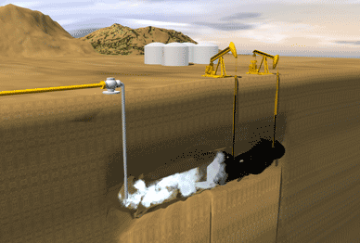
Effect of Gas Type and Composition on Foam Rheology in Porous Media for EOR
19th Consortium
Yongchao Zeng
Ali Akbar Eftekhari┴, Aarthi Muthuswamy†, Sebastien Vincent-Bonnieu‡,
Rouhi Farajzadeh‡┴*, Sibani L. Biswal†*, and George J. Hirasaki†*
†Rice University, 6100 Main St., MS-362, Department of Chemical and Biomolecular Engineering, Houston, TX, 77005 USA.
‡Shell Global Solutions International, 2288GS Rijswijk, the Netherlands
┴Delft University of Technology, Delft, 2628CN, the Netherlands.

Slide 2
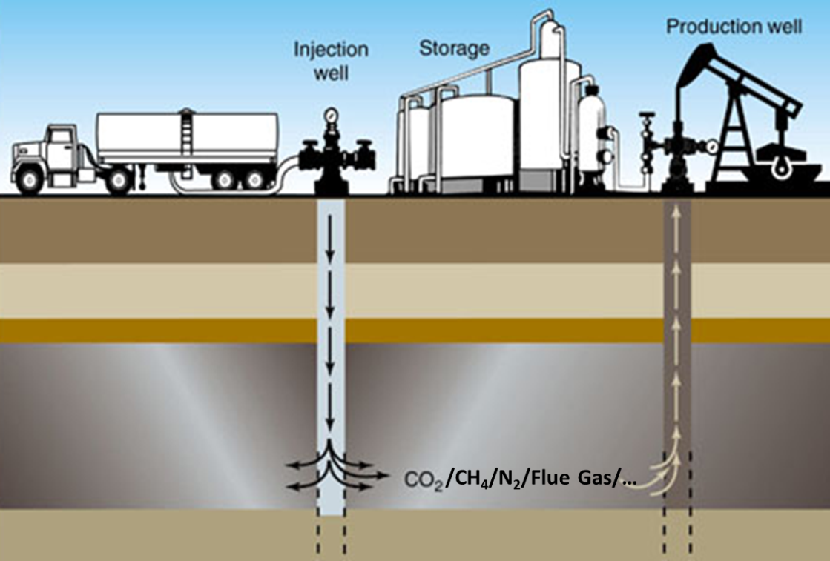
Gas Supply for Foam EOR
Gas Possibilities for Foam EOR
CO₂
N₂
CH₄/CO₂
Flue Gas
CH₄
Core Sample
Bentheimer Sandstone | Parameters
Diameter | 3.8 cm
Length | 17.0 cm
Porosity | 21.0 %
Pore Volume | 40.5 cm³
Permeability (DI water) | 2.3 Darcy

Slide 3
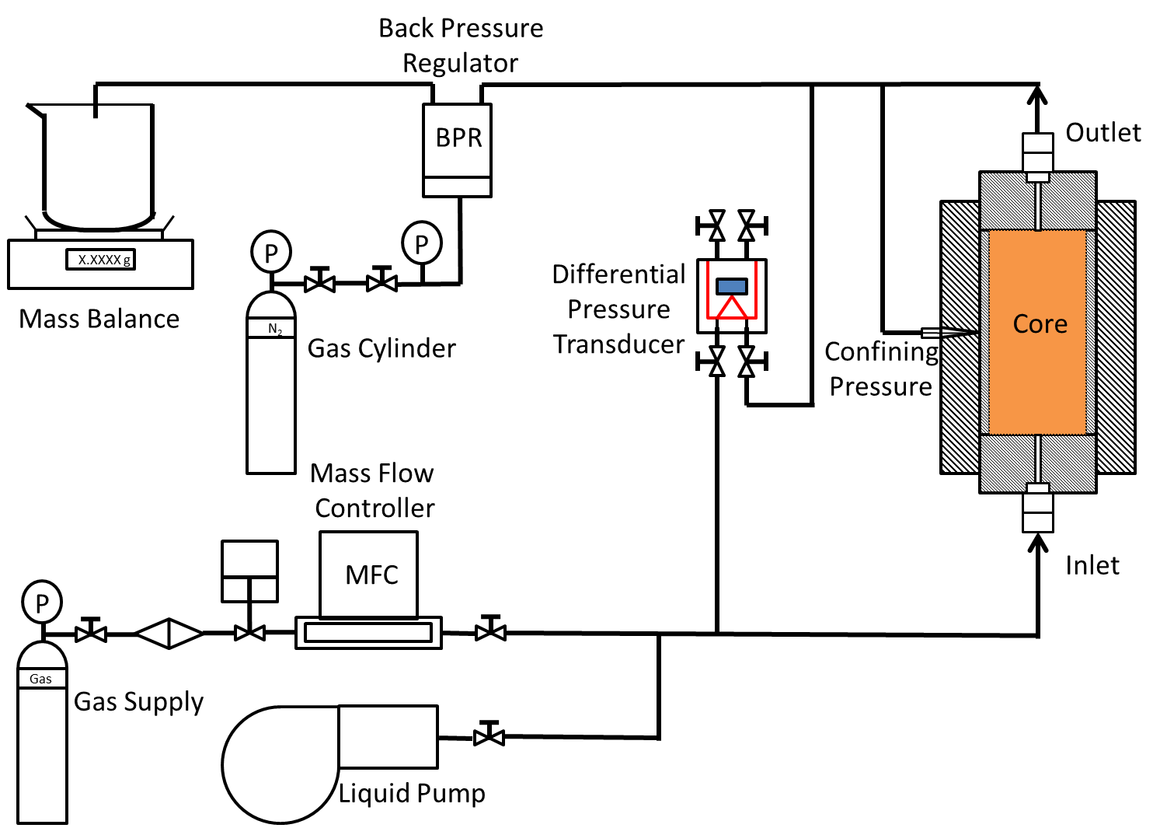
Experiment Setup Scheme

Slide 4
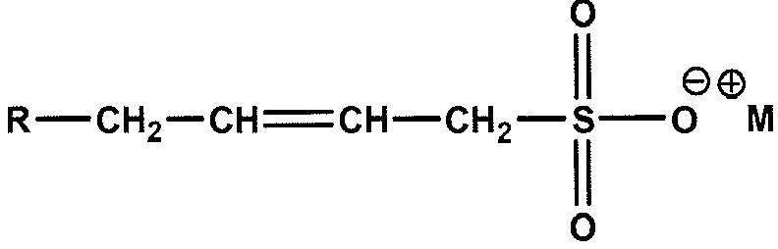
Materials and Conditions
Surfactant AOS C14-16: 1 wt%
  Successfully applied to pilot test in Snorre field in North Sea
Brine Composition:
  Baronia field sea water Salinity
Experiment Conditions
Total Interstitial Velocity | 20 ft/day
Temperature | ~20 ºC
Back Pressure | 21 bar

Slide 5
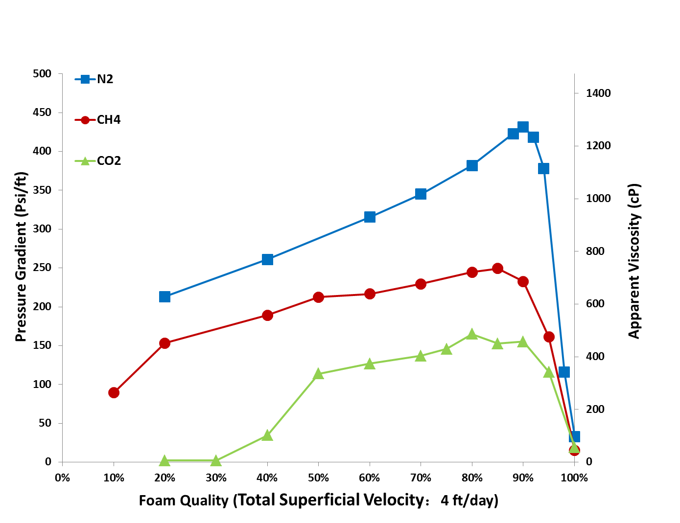
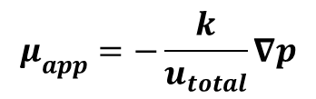
Foam Strength Comparison
Steady State Foam Strength for Pure Gases
$$μ_{app}=−\frac{k}{u_{total}}∇p$$
N₂ > CH₄ > CO₂

Slide 6
Three Hypotheses
Hypothesis I (Stability of Lamella)
Different types of gas will affect the stability of lamella by changing the disjoining pressure.
Hypothesis II (Gas Solubility)
Different types of gas have varied solubility in aqueous phase. For gas with high solubility, the actual foam quality is lower than the injected quality. Thus the foam apparent viscosity is different.
Hypothesis III (Diffusion Coarsening)
Different types of gas have varied permeability through the lamella thus changing the rate of mass transfer between small and large bubbles.

Slide 7
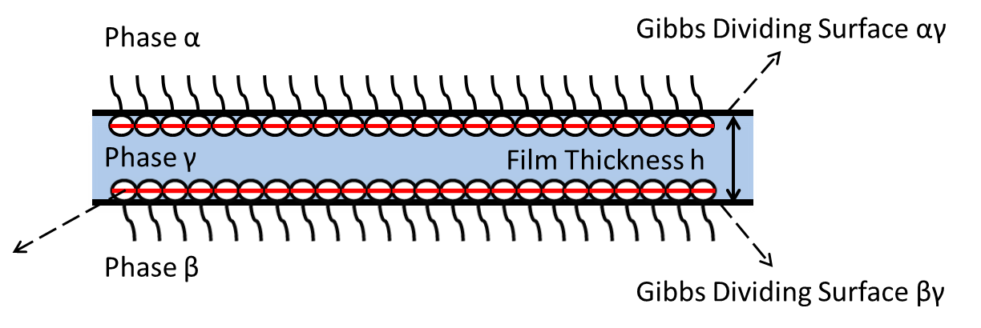
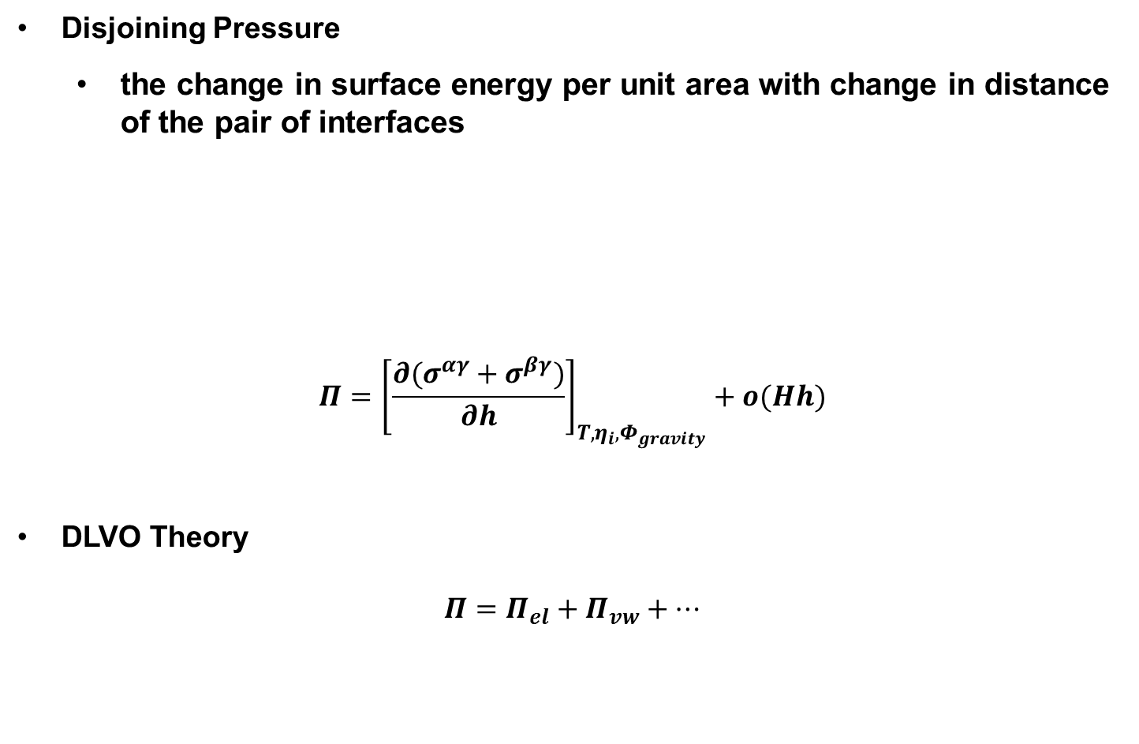
Hypothesis I
Hypothesis I: Stability of Lamella
Disjoining Pressure
  the change in surface energy per unit area with change in distance of the pair of interfaces
$$Π={\left[\frac{∂(σ^{αγ}+σ^{βγ})}{∂h}\right]}_{T,η_{i},Φ_{gravity}}+o(Hh)$$
DLVO Theory
$Π=Π_{el}+Π_{vw}+…$
Israelachvili, Jacob 1991 Intermolecular and Surface Forces. Second Edition. Academic Press.

Slide 8
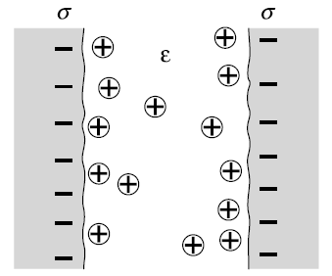
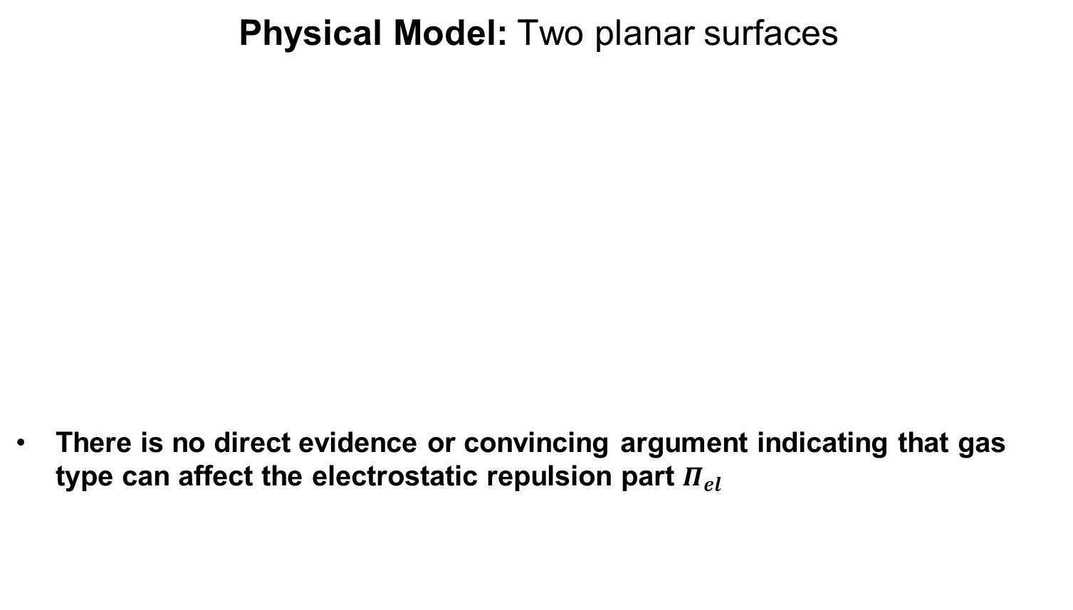
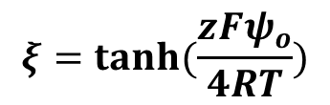

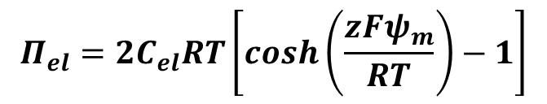
Hypothesis I
Electrostatic Repulsion Component
Physical Model: Two planar surfaces
There is no direct evidence or convincing argument indicating that gas type can affect the electrostatic repulsion part $Π_{el}$
$$Π_{el}=2C_{el}RT\left[\cosh\left(\frac{zFψ_{m}}{RT}\right)−1\right]$$
$$ψ_{m}=(8k_{B}Tξ/e)exp(−κh/2)$$
$$ξ=tanh⁡(\frac{zFψ_{o}}{4RT})$$
Israelachvili, Jacob 1991 Intermolecular and Surface Forces. Second Edition. Academic Press.

Slide 9
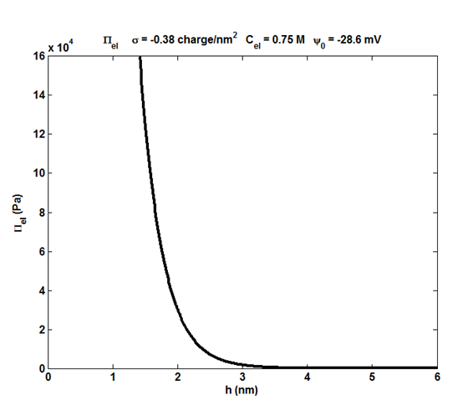
Hypothesis I
Electrostatic Repulsion Component
Physical Model: Two planar surfaces
Exerowa, D., T. Kolarov, and Khr. Khristov 1987 Direct Measurement of Disjoining Pressure in Black Foam Films. I. Films from an Ionic Surfactant. Colloids and Surfaces 22(2): 161–169.

Slide 10
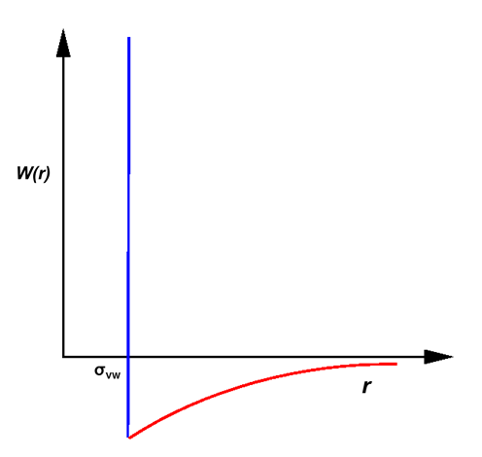
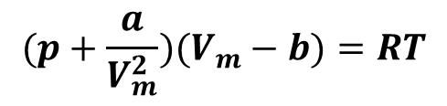
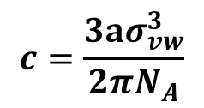
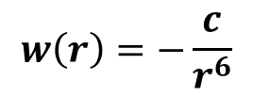
Hypothesis I
Van de Waals Component
Assumption: Van der Waals EOS applies to all types of gases
Van der Waals Parameters
$$(p+\frac{a}{V_{m}^{2}})(V_{m}−b)=RT$$
Gas Type | a /Pa.m⁶.mol⁻² | b / m³/mol | σ_{vw} / Å
N₂ | 0.141 | 3.91E-5 | 4.99
CH₄ | 0.228 | 4.28E-5 | 5.14
CO₂ | 0.364 | 4.27E-5 | 5.14
$$w\left(r\right)=−\frac{c}{r^{6}}$$
Van der Waals Pair Potential Coefficient
$$c=\frac{3aσ_{vw}^{3}}{2πN_{A}}$$
Gas Type | c / J.m⁶
N₂ | 2.3E-77
CH₄ | 4.1E-77
CO₂ | 6.5E-77
Israelachvili, Jacob 1991 Intermolecular and Surface Forces. Second Edition. Academic Press.
Zhu, Wentao 2008 Physical Chemistry. Tsinghua University Press

Slide 11
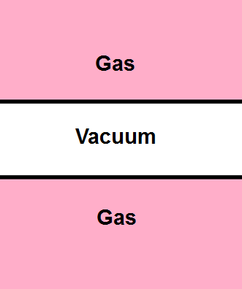

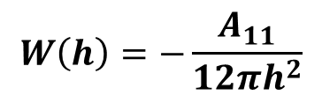
Hypothesis I
Van de Waals Interaction across Vacuum
Conventional Hamaker Constant
$$A_{11}=π^{2}cρ_{1}^{2}$$
$$W\left(h\right)=−\frac{A_{11}}{12πh^{2}}$$
Gas Type | A₁₁ ( J) 21 bar 20 ℃
N₂ | 3.8E-22
CH₄ | 7.9E-22
CO₂ | 20.3E-22
Israelachvili, Jacob 1991 Intermolecular and Surface Forces. Second Edition. Academic Press.

Slide 12
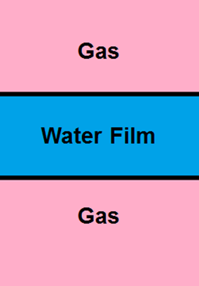
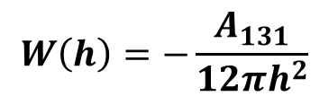
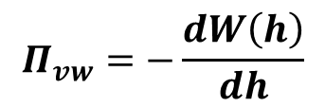
Hypothesis I
Van de Waals Interaction across Water Film
Assumption: Combining relation applies
$$A_{131}≈A_{11}+A_{33}−2A_{13}≈{(\sqrt{A_{11}}−\sqrt{A_{33}})}^{2}$$
Material | A₁₃₁ ( J ) 21 bar 20 ℃
N₂|Water|N₂ | 3.40E-20
CH₄|Water|CH₄ | 3.29E-20
CO₂|Water|CO₂ | 3.15E-20
$$W\left(h\right)=−\frac{A_{131}}{12πh^{2}}$$
$$Π_{vw}=−\frac{dW\left(h\right)}{dh}$$
Israelachvili, Jacob 1991 Intermolecular and Surface Forces. Second Edition. Academic Press.

Slide 13
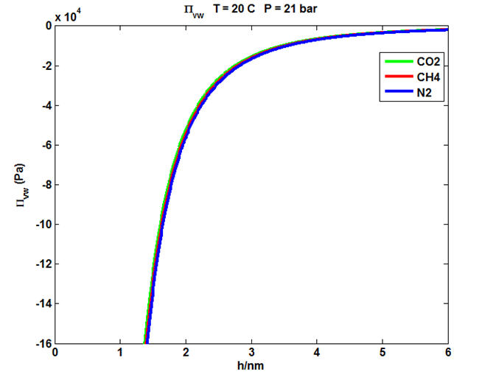
Hypothesis I
Van de Waals Component
Van der Waals Component
CO₂ > CH₄ > N₂

Slide 14
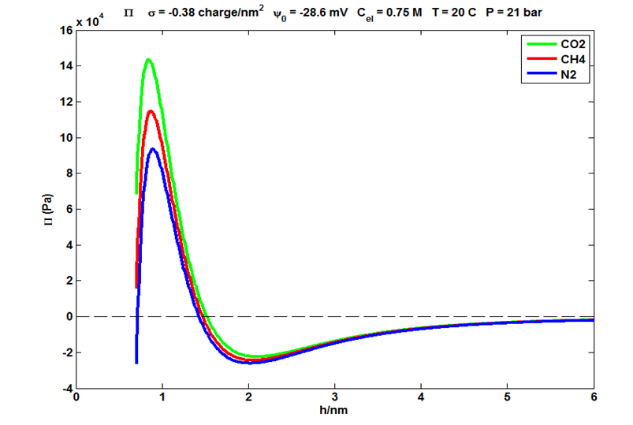
Hypothesis I
Disjoining Pressure Based on DLVO Theory
Disjoining pressure calculated from different Hamaker constants shows that CO₂ has the most stable foam whereas N₂ has the least stable foam, which is contrary to our experimental observation.
The van der Waals property of gas does not explain the different foam strength with respect to different gas type.

Slide 15
Hypothesis II
Hypothesis II: Gas Solubility
Gas Type | Mole Fraction Solubility X₁ (20 ℃, 1 bar)
N₂ | 1.2E-5
CH₄ | 2.6E-5
CO₂ | 61.5E-5
What if we compensate the dissolved gas in aqueous phase?
CO₂ foam
CO₂ foam with surfactant solution saturated with CO₂ at 21 bar (13.24 bar CO₂ was dissolved in 2L surfactant solution at 21 bar)
CO₂ foam with increased gas flow rate to compensate the dissolved CO₂ in surfactant solution (assuming local equilibrium; CO₂ solubility model provided by Zhenhao Duan)

Slide 16
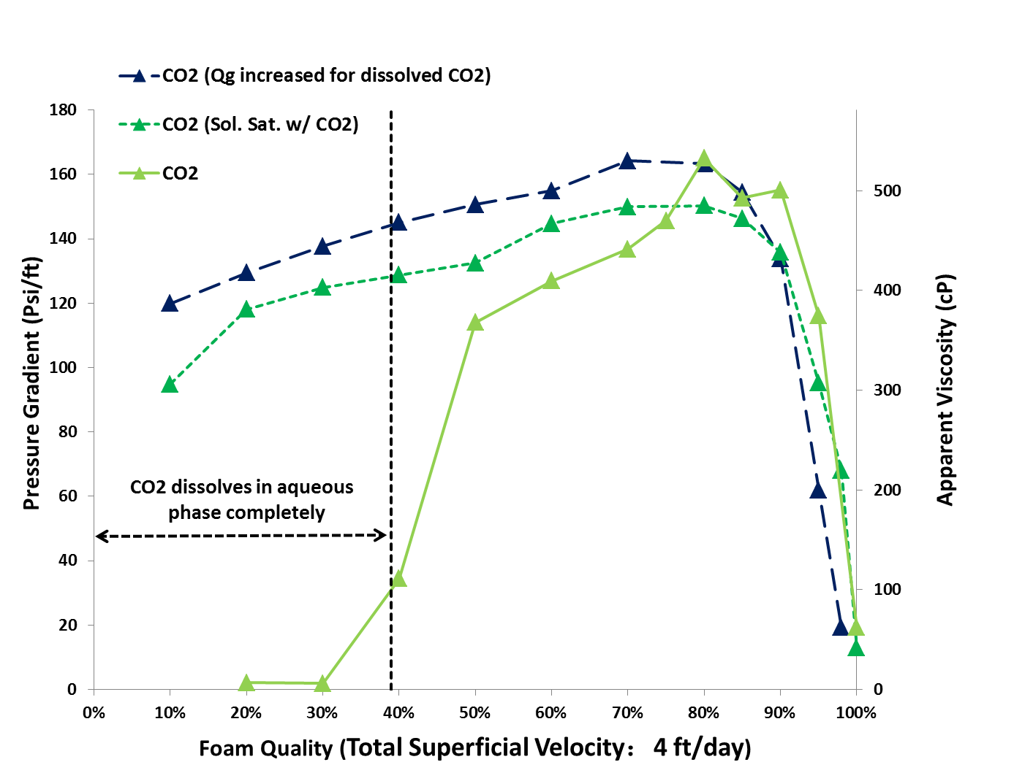
Hypothesis II
More gas is required to foam as the gas solubility in the aqueous solution is high. Because the surfactant solutions were not saturated, the gas dissolves in the solution, which will make the actual quality lower than the injected quality.
Gas solubility has a significant effect on foam strength in low quality region whereas the effect in high quality region is negligible.

Slide 17
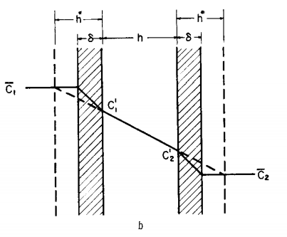
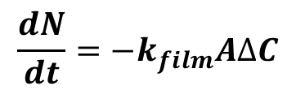
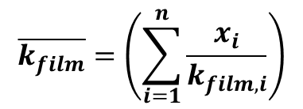
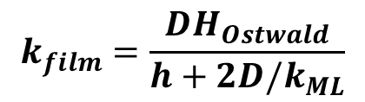
Hypothesis III
Hypothesis III: Diffusion Coarsening
Gas Diffusion across Thin Film
$$\frac{dN}{dt}=−k_{film}A∆C$$
$$k_{film}=\frac{DH_{Ostwald}}{h+2D/k_{ML}}$$
Gas Type | k_{film}* (m/s)
N₂ | 0.13
Flue Gas | 0.16
CH₄ | 0.30
(50% CH₄ & 50% CO₂) | 0.58
CO₂ | 7.85
$$\overline{k_{film}}=\left(\sum_{i=1}^{n}{\frac{x_{i}}{k_{film, i}}}\right)$$
Princen, H.M., and S.G. Mason 1965 The Permeability of Soap Films to Gases. Journal of Colloid Science 20(4): 353–375.
Farajzadeh, Rouhi 2014 Effect of Gas Type and Composition on Macroscopic Properties of Foam.

Slide 18
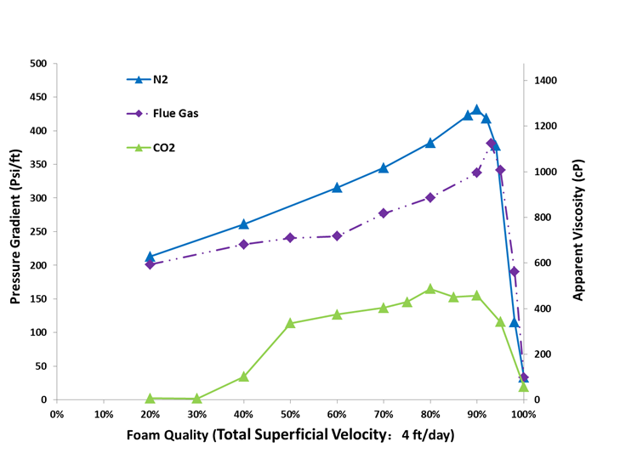
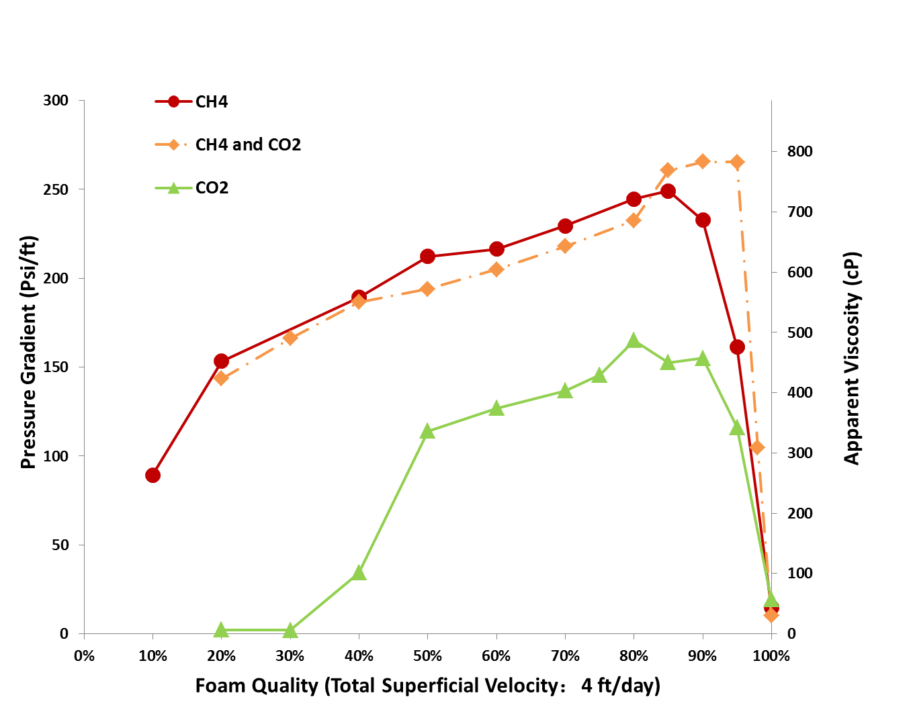
Hypothesis III
Effect of Gas Composition
The mixture of gases usually have approximately the same foam strength as the less soluble gas.
When adding a second component into the gas, the system increases one degree of freedom which will allow bubbles to coexist at different pressures. This is the reason for adding non-condensable gas in steam foams.

Slide 19
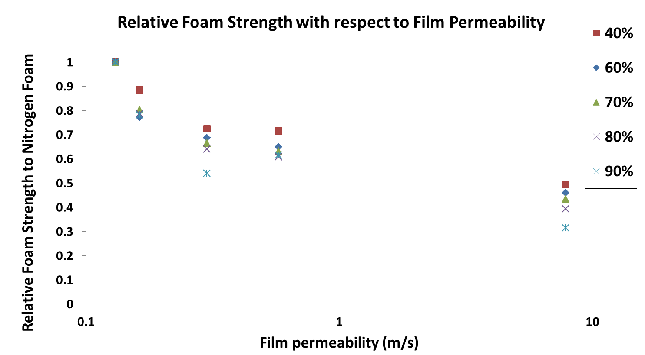
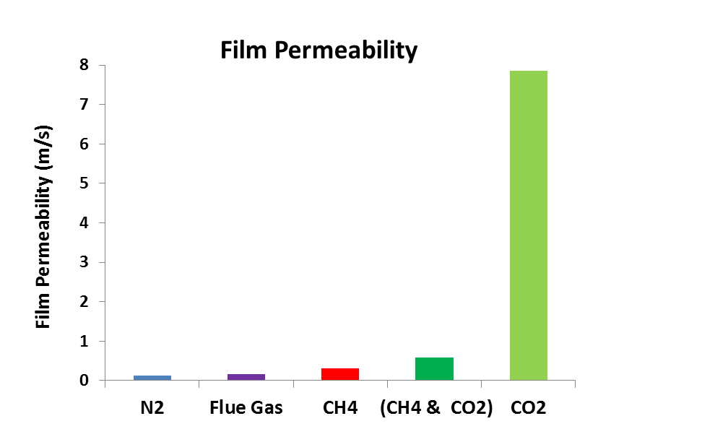
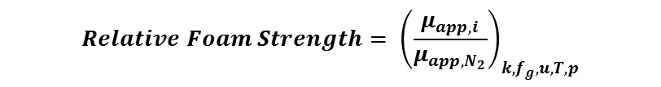
Hypothesis III
$$Relative Foam Strength= {\left(\frac{μ_{app, i}}{μ_{app, N_{2}}}\right)}_{k, f_{g},u,T,p}$$
Experimentally relative foam strength shows a significant dependence on permeability of the film. Foam strength decays with the increase in film permeability.
Different types of gas have varied film permeability. The difference in film permeability changes the rate of gas diffusion. Thus bubbles coarsen at different rate.

Slide 20
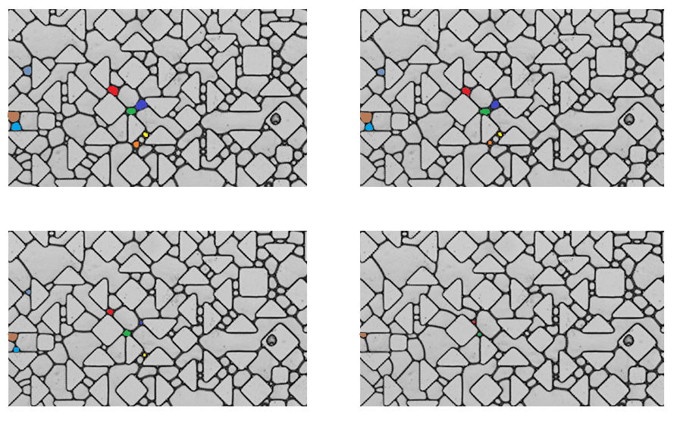
Hypothesis III
Controversial Gas Diffusion for Porous Media Foam
Direct Evidence: Foam Flow in Micro-model (By Charles Conn)
Time 1
Time 2
Time 3
Time 4
Diffusion-driven coarsening was observed to be the dominant foam destruction mechanism.

Slide 21
Conclusion
Under our experiment condition, the van der Waals property of different gases in the disjoining pressure does not account for the different foam strength in porous media.
Compensating dissolved CO₂ in aqueous phase will increase foam strength in low quality regime however having negligible effect in high quality regime.
The mixture of gases usually has approximately the same foam strength as the less soluble gas.
Different types of gas have varied permeability through lamella. Gas diffuses at different rate. Consequently the rate of foam coarsening is different. Thus different gas has different foam strength.

Slide 22



Acknowledgement
We acknowledge financial support from
Petroliam Nasional Berhad
(PETRONAS, Kuala Lumpur, Malaysia)
Shell Global Solutions International
(Rijswijk, the Netherlands).
Rice University Consortium for Processes in Porous Media (Houston, TX, USA)

Slide 23

Thank you

