Slide 1
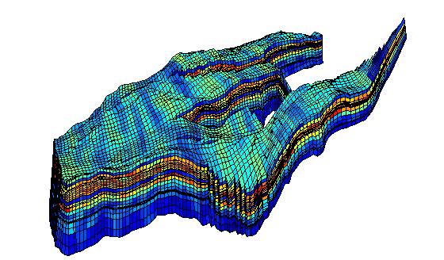
Innovative Algorithm to Estimate Scalable Parameters for Gas Mobility Control Simulation
19th Consortium
Yongchao Zeng
Aarthi Muthuswamy, Maura Puerto, Kun Ma┴, Ying (Annie) Wang, Sibani L. Biswal* and George J. Hirasaki*
┴ Current Affiliation: Total E&P Research and Technology USA, LLC.

Slide 2
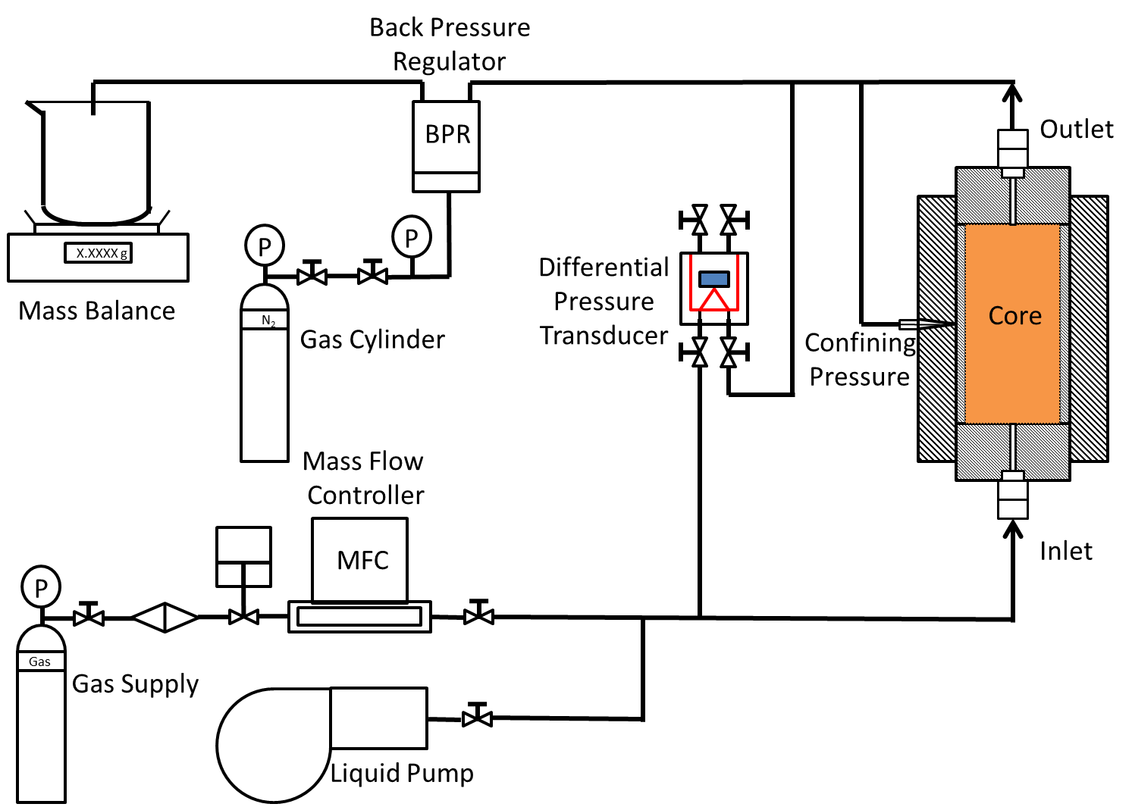
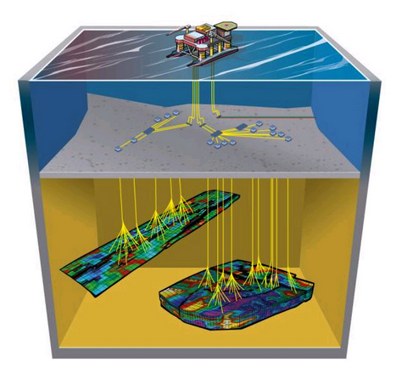

Background
Algorithms are needed to fit lab data to scalable foam models to assess recovery efficiency before applied to any fields
Challenges
  Multi-variable Estimation
  Sensitivity of Initial Values
  Issue of Non-uniqueness of Solution
  Poor Prediction for Varied Conditions
http://ta.twi.tudelft.nl/nw/users/vuik/numanal/wobbes_eng.html

Slide 3
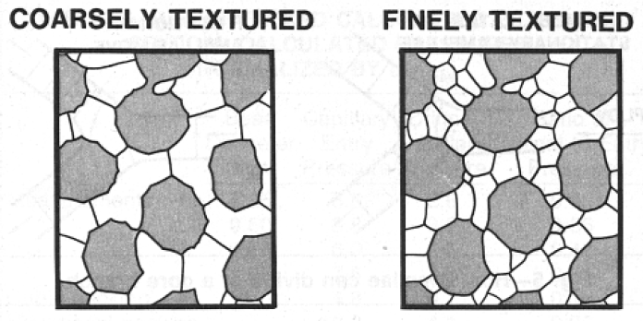



Foam Models
$$λ_{g}^{foam}=f(Foam Texture)$$
Population Balance Model (Texture-Explicit)
Local Equilibrium Model (Texture-Implicit)
$$\frac{∂(φ(n_{f}S_{f}+n_{t}S_{t}))}{∂t}+∇∙\left(n_{f}u_{f}\right)=φS_{g}(r_{generation}−r_{coalescence})$$
$$r_{generation}=r_{coalescence}$$
$$λ_{g}^{foam}=λ_{g}^{free gas}×f(Local Conditions)$$
Falls, AH, GJ Hirasaki, TW e al Patzek, et al. 1988 Development of a Mechanistic Foam Simulator: The Population Balance and Generation by Snap-Off. SPE Reservoir Engineering 3(03): 884–892.
Rossen, W.R. 2013 Numerical Challenges in Foam Simulation: A Review. In SPE: Society of Petroleum Engineers.

Slide 4

CMG-STARS Model
$$λ_{rg}^{f}=λ_{rg}^{nf}×FM$$
$$FM=\frac{1}{1+fmmob×F1×F2×F3×F4×F5×F6×F7×…}$$
Dependent Variables
Surfactant Concentration
Water Saturation
Oil Saturation
Oil Composition
Critical $N_{Ca}$
Critical 𝑵_𝑪𝒂
Salinity
Shear Thinning
Ma, Kun, Guangwei Ren, Khalid Mateen, Danielle Morel, and Philippe Cordelier 2014 Literature Review of Modeling Techniques for Foam Flow Through Porous Media. In SPE: Society of Petroleum Engineers.

Slide 5
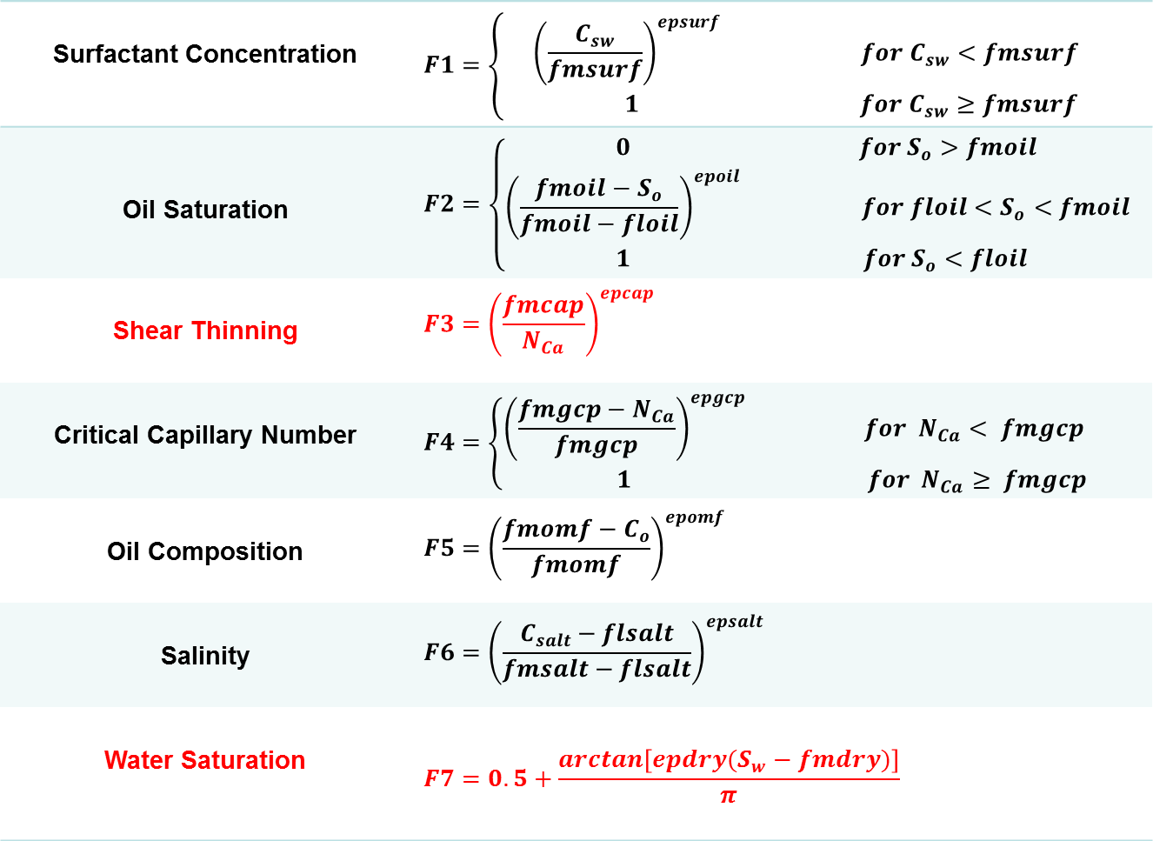
Dependent Functions
Surfactant Concentration | $$F1=\left\{ \begin{matrix}{\left(\frac{C_{sw}}{fmsurf}\right)}^{epsurf} for C_{sw}<fmsurf \\ 1 for C_{sw}≥fmsurf\end{matrix}\right.$$
Oil Saturation | $$F2=\left\{\begin{matrix}0 & for S_{o}>fmoil \\ {\left(\frac{fmoil−S_{o}}{fmoil−floil}\right)}^{epoil} & for floil<S_{o}<fmoil \\ 1 & for S_{o}<floil \end{matrix}\right.$$
Shear Thinning | $$F3={\left(\frac{fmcap}{N_{Ca}}\right)}^{epcap}$$
Critical Capillary Number | $$F4=\left\{\begin{matrix}{\left(\frac{fmgcp−N_{Ca}}{fmgcp}\right)}^{epgcp} & for N_{Ca}< fmgcp \\ 1 & for N_{Ca}≥ fmgcp\end{matrix}\right.$$
Oil Composition | $$F5={\left(\frac{fmomf−C_{o}}{fmomf}\right)}^{epomf}$$
Salinity | $$F6={\left(\frac{C_{salt}−flsalt}{fmsalt−flsalt}\right)}^{epsalt}$$
Water Saturation | $$F7=0.5+\frac{arctan\left[epdry(S_{w}−fmdry)\right]}{π}$$
Ma, Kun, Guangwei Ren, Khalid Mateen, Danielle Morel, and Philippe Cordelier 2014 Literature Review of Modeling Techniques for Foam Flow Through Porous Media. In SPE: Society of Petroleum Engineers.

Slide 6
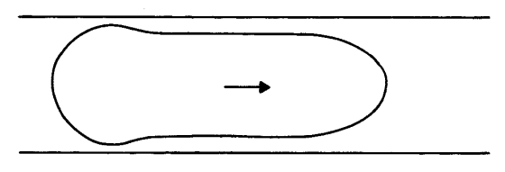
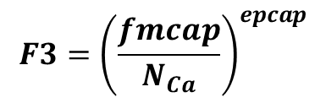
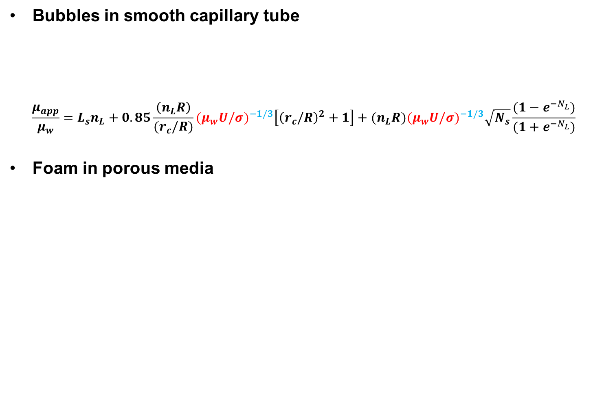
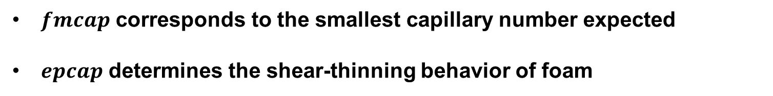

Shear Thinning Effect
Bubbles in smooth capillary tube
$$\frac{μ_{app}}{μ_{w}}=L_{s}n_{L}+0.85\frac{\left(n_{L}R\right)}{{(r}_{c}/R)}{(μ_{w}U/σ)}^{−1/3}\left[{\left(r_{c}/R\right)}^{2}+1\right]+(n_{L}R){(μ_{w}U/σ)}^{−1/3}\sqrt{N_{s}}\frac{(1−e^{−N_{L}^{}})}{(1+e^{−N_{L}^{}})}$$
Foam in porous media
$$N_{Ca}=\frac{μ_{w}u_{t}}{σ}$$
$$F3={\left(\frac{fmcap}{N_{Ca}}\right)}^{epcap}$$
$fmcap$ corresponds to the smallest capillary number expected
$epcap$ determines the shear-thinning behavior of foam

Slide 7
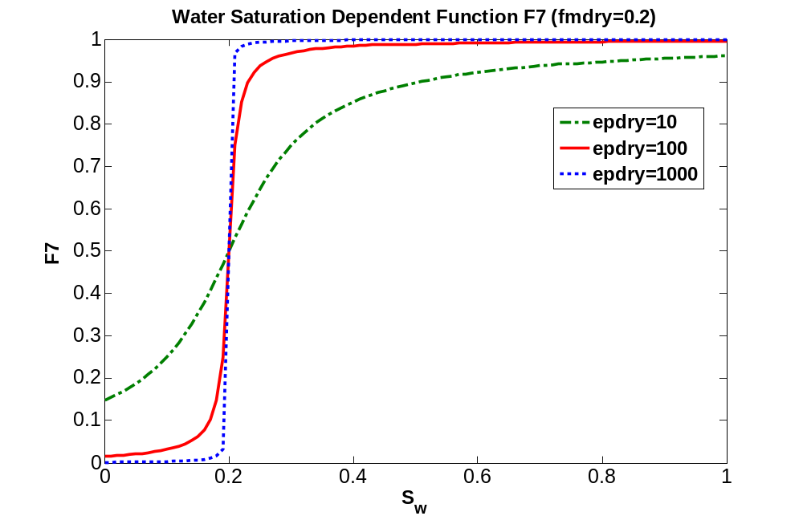
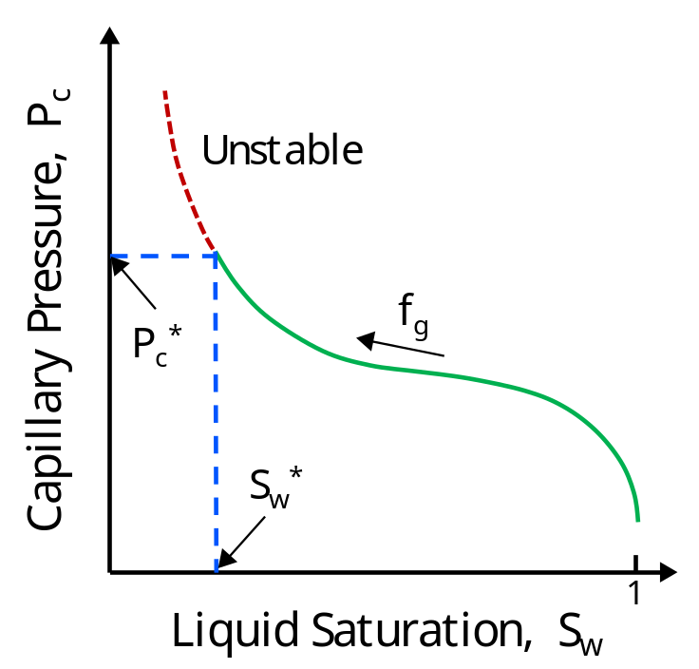
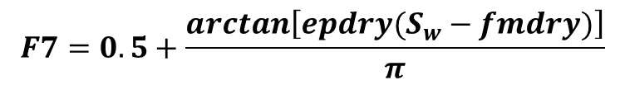
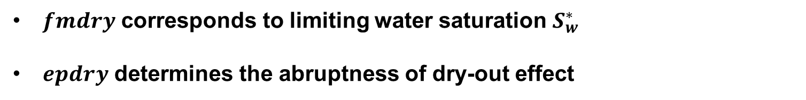
Dry-out Effect
$$F7=0.5+\frac{arctan\left[epdry(S_{w}−fmdry)\right]}{π}$$
$fmdry$ corresponds to limiting water saturation $S_{w}^{∗}$
$epdry$ determines the abruptness of dry-out effect
Farajzadeh, R.; Muruganathan, R. M.; Rossen, W. R.; Krastev, R. Adv. Colloid Interface Sci. 2011, 168 (1-2), 71–78.

Slide 8
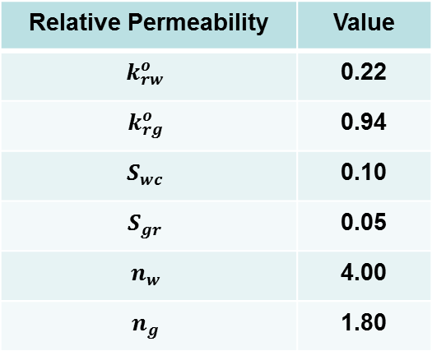
Sample System
System I | Description
Surfactant 1 | Lauryl Betaine (LB)
Surfactant 2 | Alpha Olefin Sulfonate 1416 (AOS)
Blend Ratio | LB/AOS 7/3
Concentration | 0.5 wt%
Salinity | Sea Water
Gas | Nitrogen
Temperature | Ambient
Back Pressure | 5 Bar
Core Sample | Bentheimer Sandstone
Diameter of core | 3.7 cm
Cross Section Area | 10.74 cm2
Length of Core | 16.8 cm
Absolute Permeability | 0.65 Darcy
Porosity | 0.22
Relative Permeability | Value
$$k_{rw}^{o}$$ | 0.22
$$k_{rg}^{o}$$ | 0.94
$$S_{wc}$$ | 0.10
$$S_{gr}$$ | 0.05
$$n_{w}$$ | 4.00
$$n_{g}$$ | 1.80

Slide 9
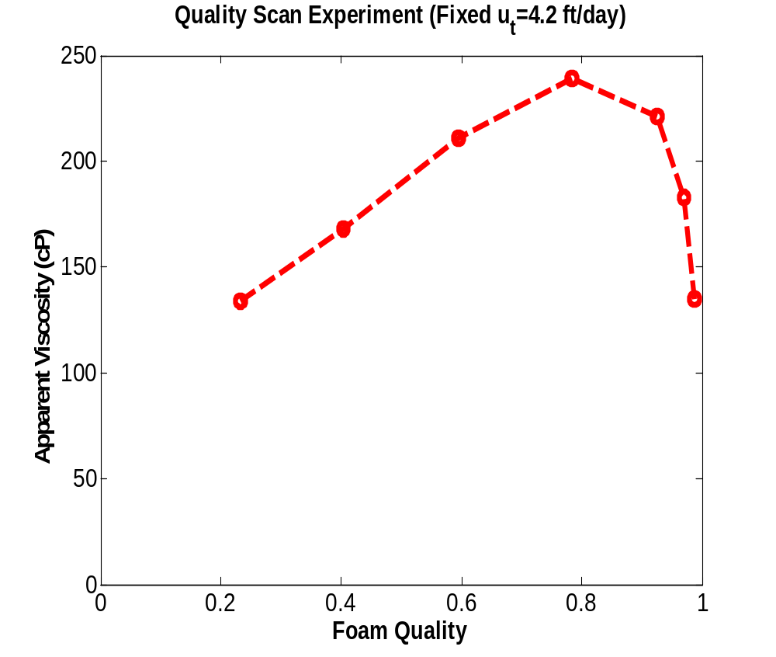
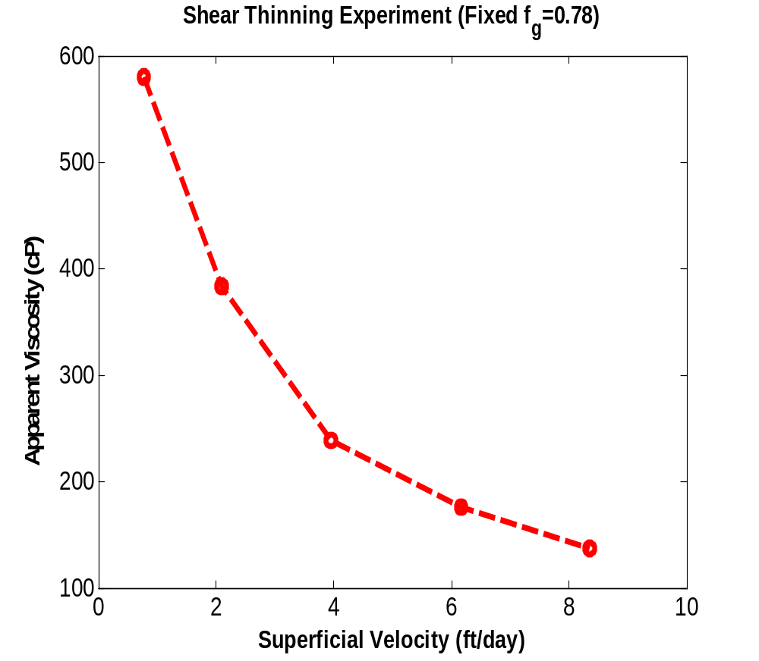


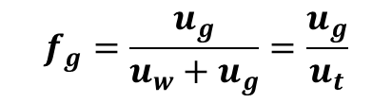
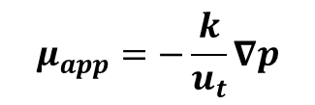
Sample System
$$f_{g}=\frac{u_{g}}{u_{w}+u_{g}}=\frac{u_{g}}{u_{t}}$$
Foam Quality: gas fractional flow
Apparent Viscosity: measure of foam strength
$$μ_{app}=−\frac{k}{u_{t}}∇p$$
$$\left({f_{g, imax}^{exp}, μ}_{app,imax}^{exp}\right)$$
$${f_{g, imax−1}^{exp}<f}_{g, transition}^{}<f_{g, imax+1}^{exp}$$

Slide 10
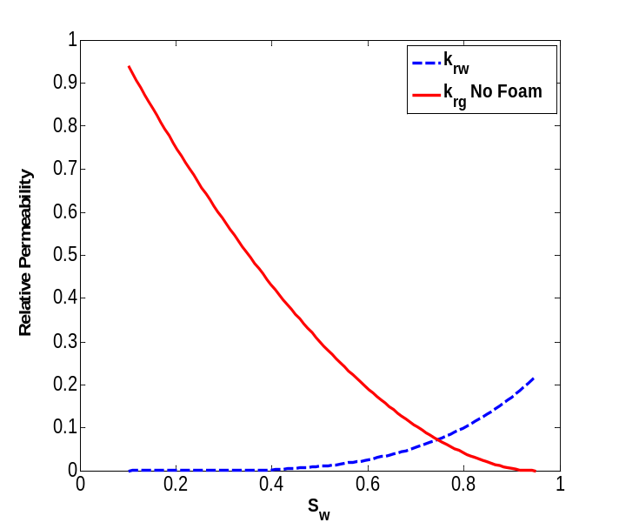
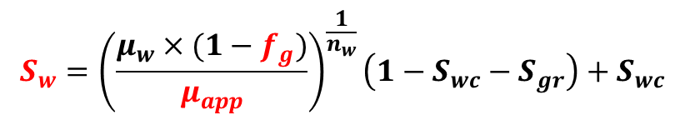
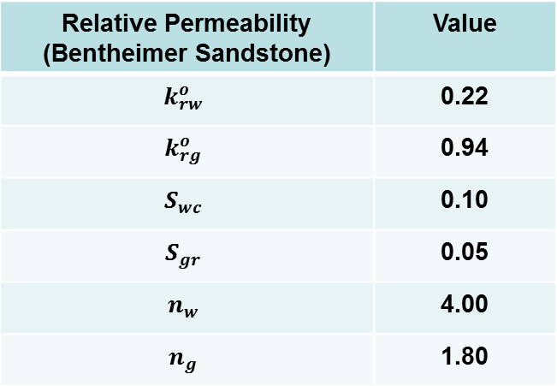
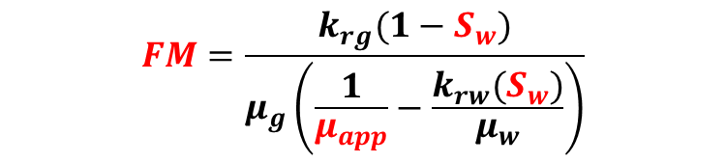
Relative Permeability
The proposed algorithm is developed based on the accuracy of the relative permeability data
Relative Permeability (Bentheimer Sandstone) | Value
$$k_{rw}^{o}$$ | 0.22
$$k_{rg}^{o}$$ | 0.94
$$S_{wc}$$ | 0.10
$$S_{gr}$$ | 0.05
$$n_{w}$$ | 4.00
$$n_{g}$$ | 1.80
$$S_{w}={\left(\frac{μ_{w}×(1−f_{g})}{μ_{app}}\right)}^{\frac{1}{n_{w}}}\left(1−S_{wc}−S_{gr}\right)+S_{wc}$$
$$FM=\frac{k_{rg}(1−S_{w})}{μ_{g}\left(\frac{1}{μ_{app}}−\frac{k_{rw}(S_{w})}{μ_{w}}\right)}$$

Slide 11
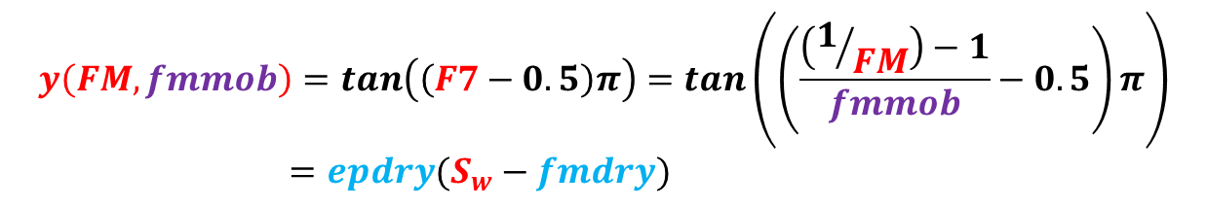
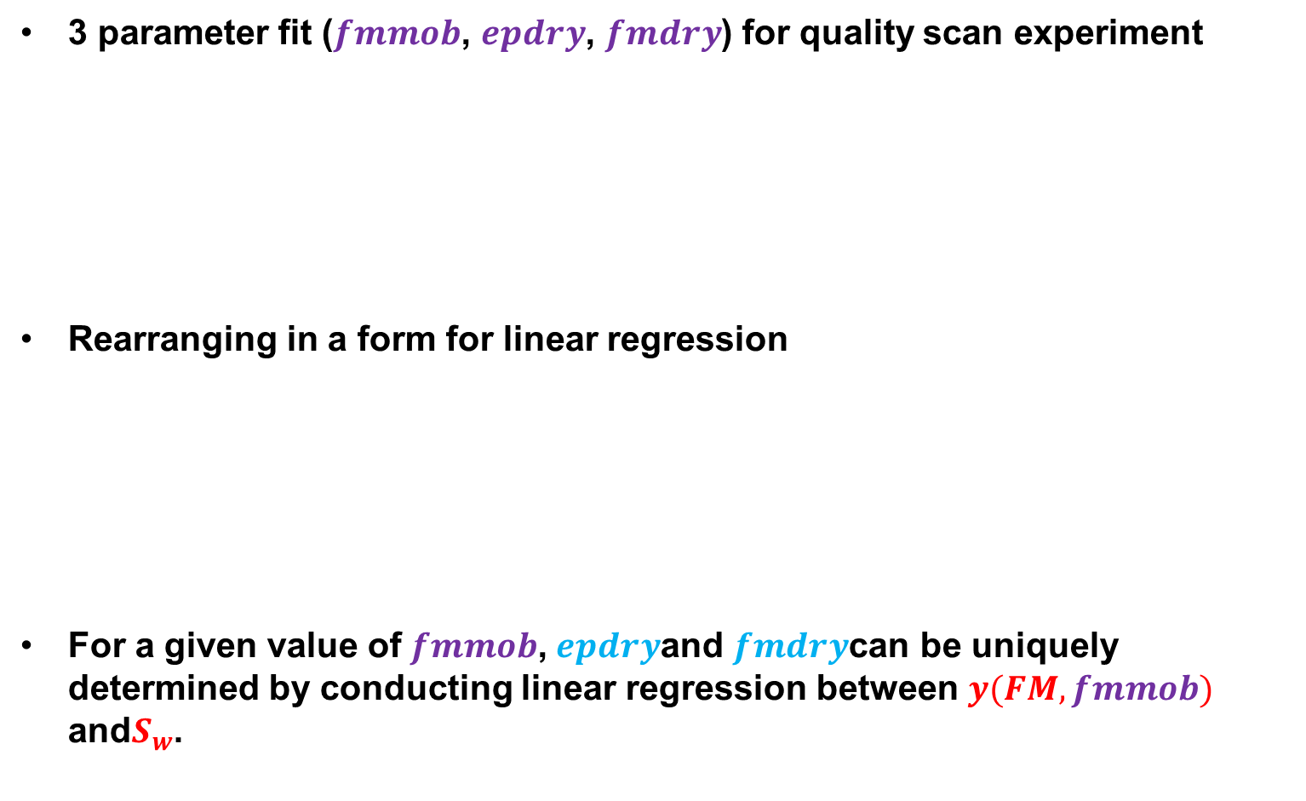

Quality Scan Data Fit
3 parameter fit ($fmmob$, $epdry$, $fmdry$) for quality scan experiment
Rearranging in a form for linear regression
For a given value of $fmmob$,$epdry$and $fmdry$can be uniquely determined by conducting linear regression between $y(FM,fmmob)$ and$S_{w}$.
$$FM=\frac{1}{1+fmmob×\{0.5+\frac{arctan\left[epdry\left(S_{w}−fmdry\right)\right]}{π}\}}$$
$$y\left(FM,fmmob\right)=tan\left(\left(F7−0.5\right)π\right)=tan\left(\left(\frac{\left(1/{FM}\right)−1}{fmmob}−0.5\right)π\right)$$
$=epdry(S_{w}−fmdry)$

Slide 12
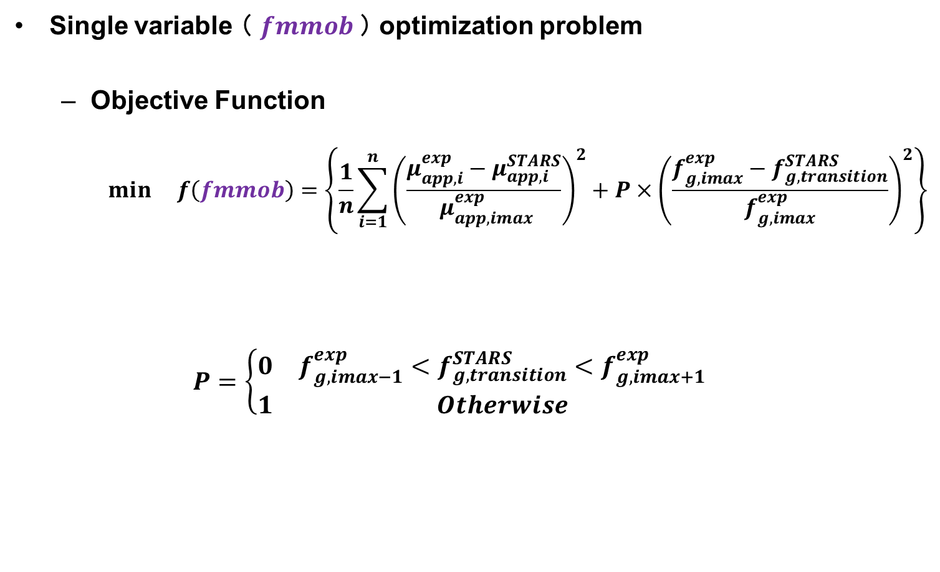
Quality Scan Data Fit
Single variable （ $fmmob$） optimization problem
  Objective Function
    $$min f\left(fmmob\right)=\left\{\frac{1}{n}\sum_{i=1}^{n}{{\left(\frac{μ_{app,i}^{exp}−μ_{app,i}^{STARS}}{ μ_{app,imax}^{exp}}\right)}^{2}}+P×{\left(\frac{f_{g, imax}^{exp}−f_{g, transition}^{STARS}}{f_{g, imax}^{exp}}\right)}^{2}\right\}$$
  $$P=\left\{\begin{matrix}0 & {f_{g, imax−1}^{exp}<f}_{g, transition}^{STARS}<f_{g, imax+1}^{exp} \\ 1 & Otherwise\end{matrix}\right.$$
Least square fitting
Penalty function

Slide 13
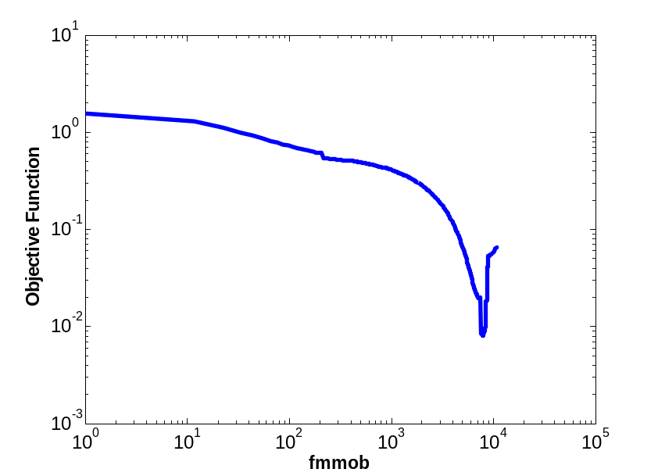
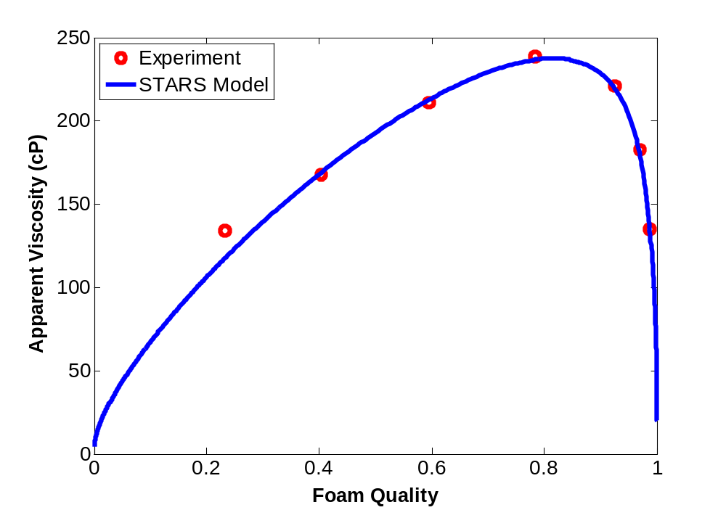
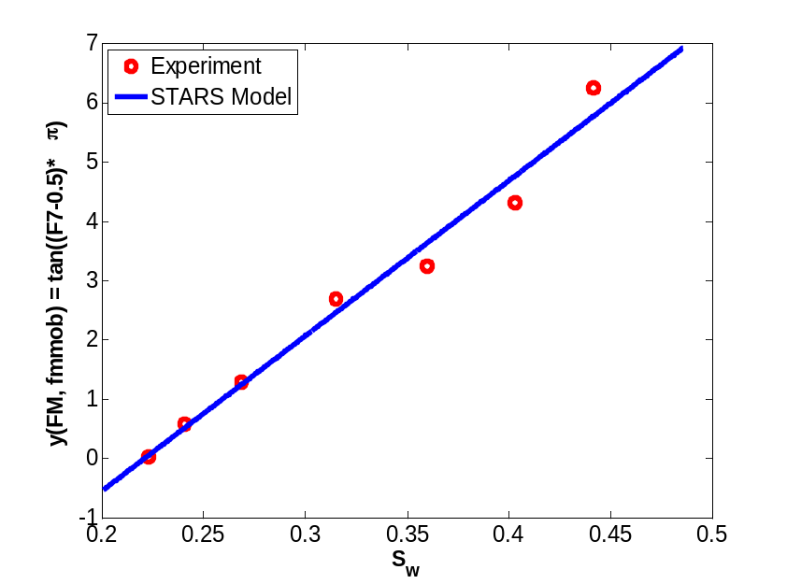
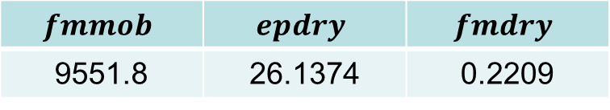
Quality Scan Data Fit
3 Parameter Optimization
$$fmmob$$ | $$epdry$$ | $$fmdry$$
9551.8 | 26.1374 | 0.2209

Slide 14

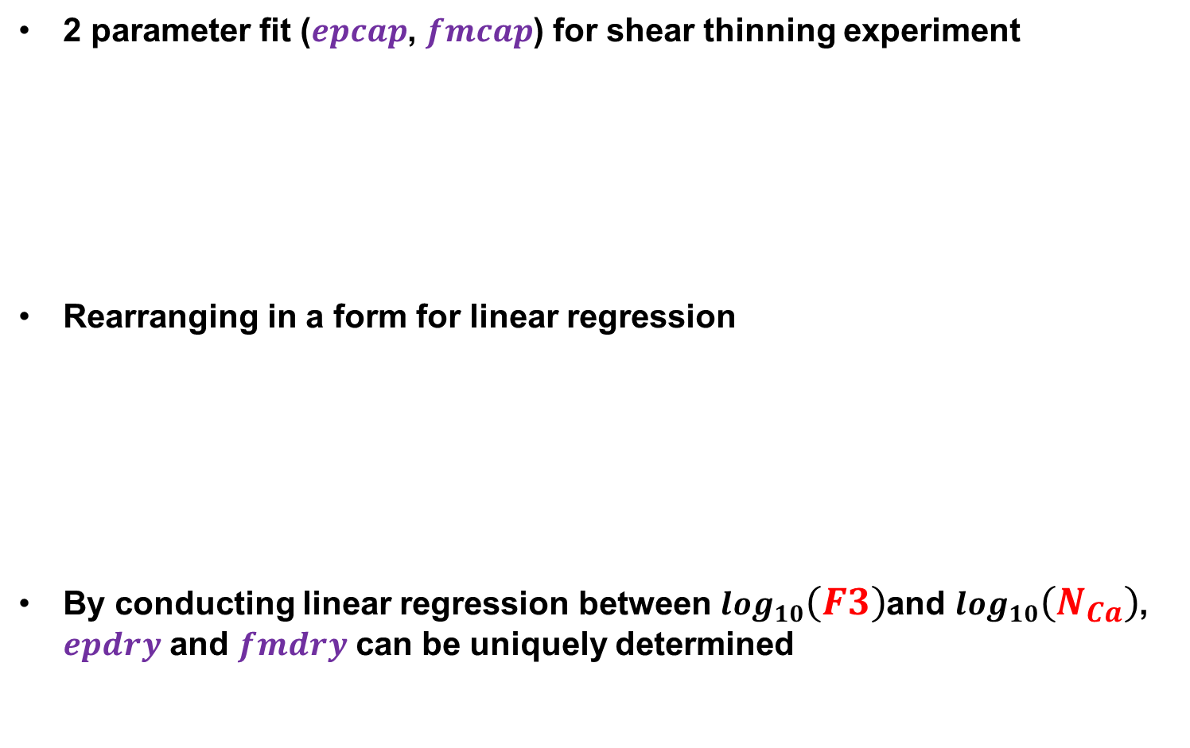
Shear Thinning Behavior Data Fit
2 parameter fit ($epcap$, $fmcap$) for shear thinning experiment
Rearranging in a form for linear regression
By conducting linear regression between $\log_{10}\left(F3\right)$and $\log_{10}\left(N_{Ca}\right)$, $epdry$ and $fmdry$ can be uniquely determined
$$FM=\frac{1}{1+fmmob×F7×{\left(\frac{fmcap}{N_{Ca}}\right)}^{epcap}}$$
$$\log_{10}\left(F3\right)=\log_{10}\left(\frac{\left(1/{FM}\right)−1}{fmmob×F7}\right)=−epcap×\left(\log_{10}\left(N_{Ca}\right)+\log_{10}\left(fmcap\right)\right)$$

Slide 15
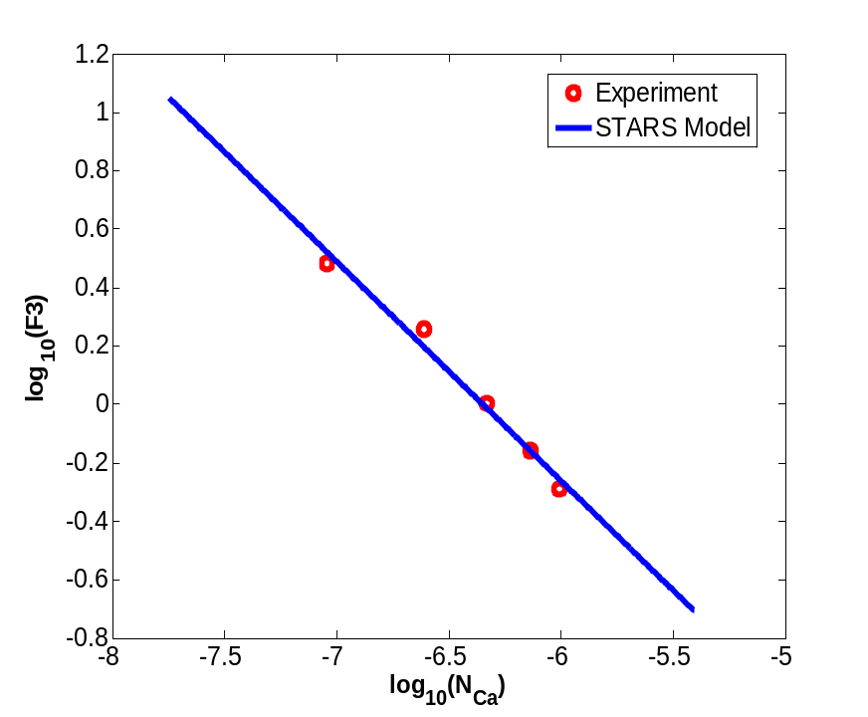
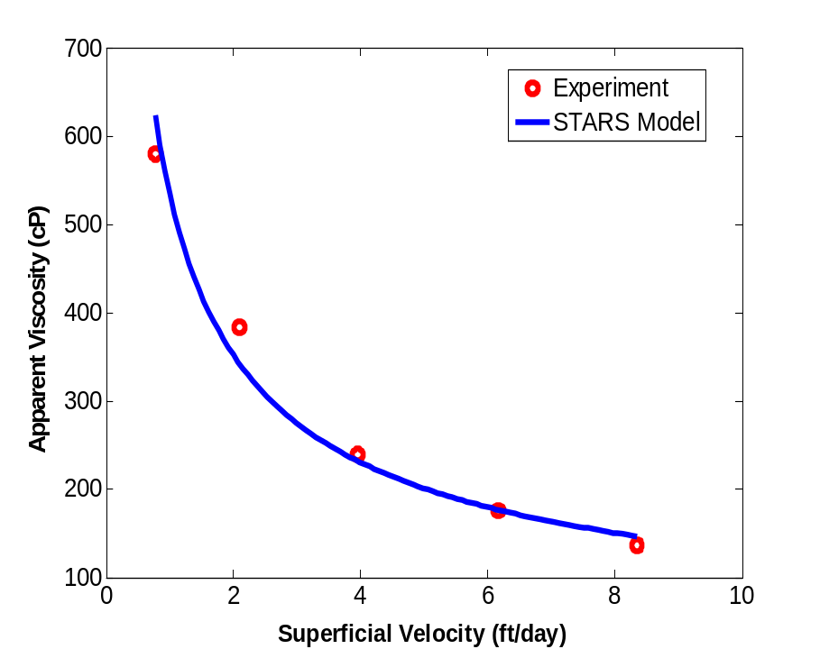
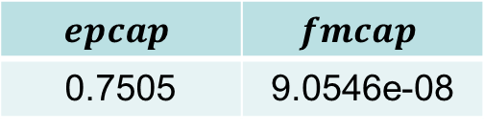
Shear Thinning Behavior Data Fit
2 Parameter Optimization
$$epcap$$ | $$fmcap$$
0.7505 | 9.0546e-08

Slide 16
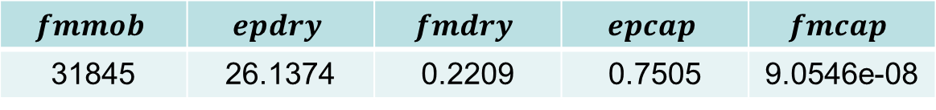
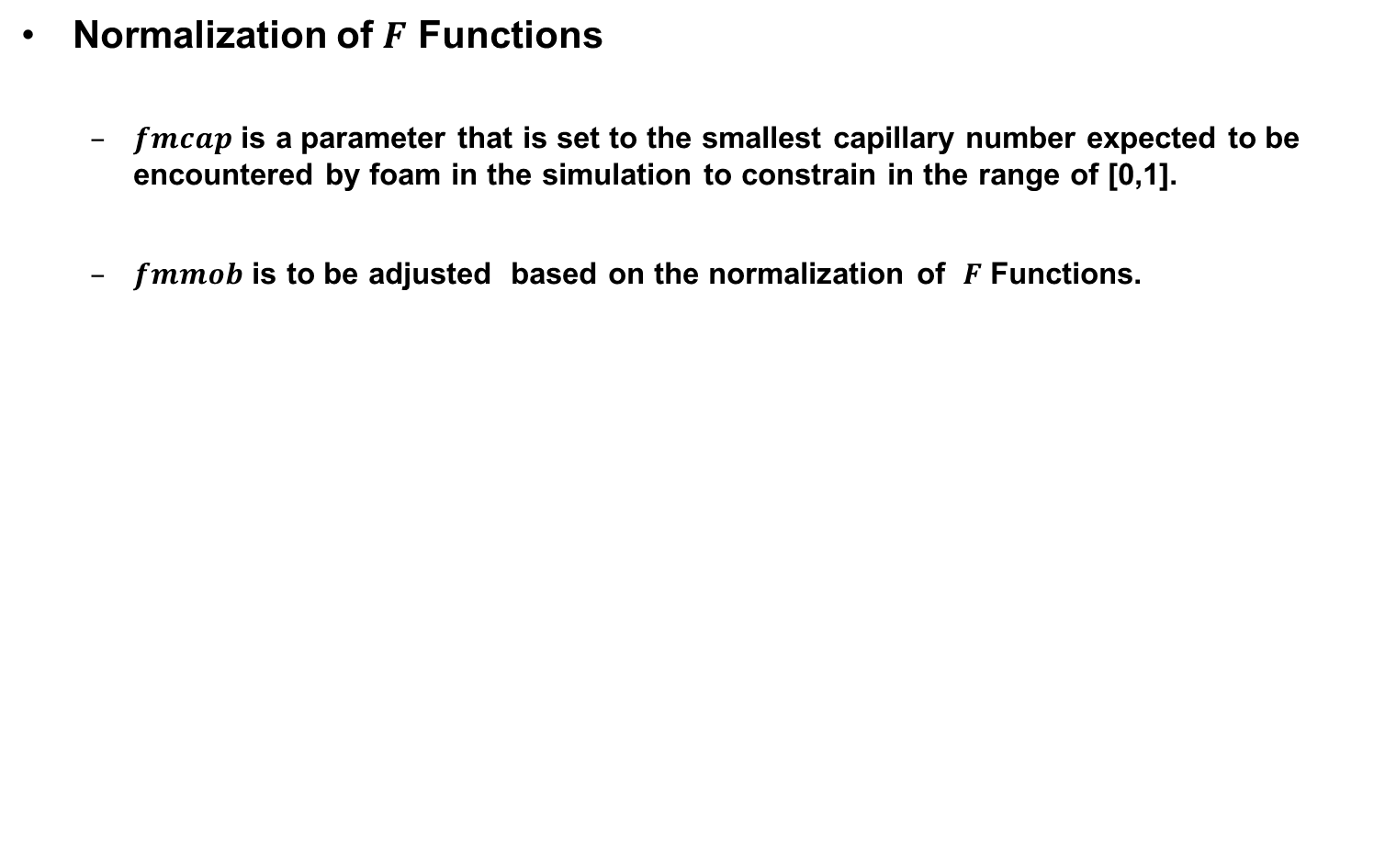
5 Parameter Estimation
Normalization of $F$ Functions
  $fmcap$ is a parameter that is set to the smallest capillary number expected to be encountered by foam in the simulation to constrain in the range of [0,1].
  $fmmob$ is to be adjusted based on the normalization of $F$ Functions.
$$fmmob$$ | $$epdry$$ | $$fmdry$$ | $$epcap$$ | $$fmcap$$
31845 | 26.1374 | 0.2209 | 0.7505 | 9.0546e-08

Slide 17
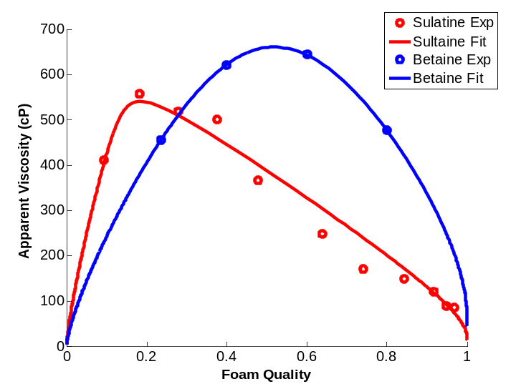
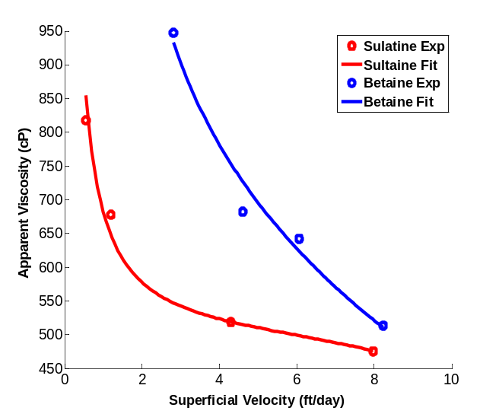
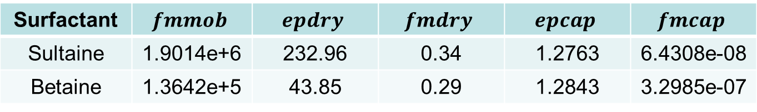
Other Systems
Different Surfactant (Zwitterionic)
System II | Description
Surfactant A | Sultaine
Surfactant B | Betaine
Concentration | 0.5 wt%
Salinity | Sea Water
Temperature | Ambient
Back Pressure | 5 Bar
Core Sample | Bentheimer
Absolute Permeability | 2.5 Darcy
Porosity | 0.22
Surfactant | $$fmmob$$ | $$epdry$$ | $$fmdry$$ | $$epcap$$ | $$fmcap$$
Sultaine | 1.9014e+6 | 232.96 | 0.34 | 1.2763 | 6.4308e-08
Betaine | 1.3642e+5 | 43.85 | 0.29 | 1.2843 | 3.2985e-07

Slide 18
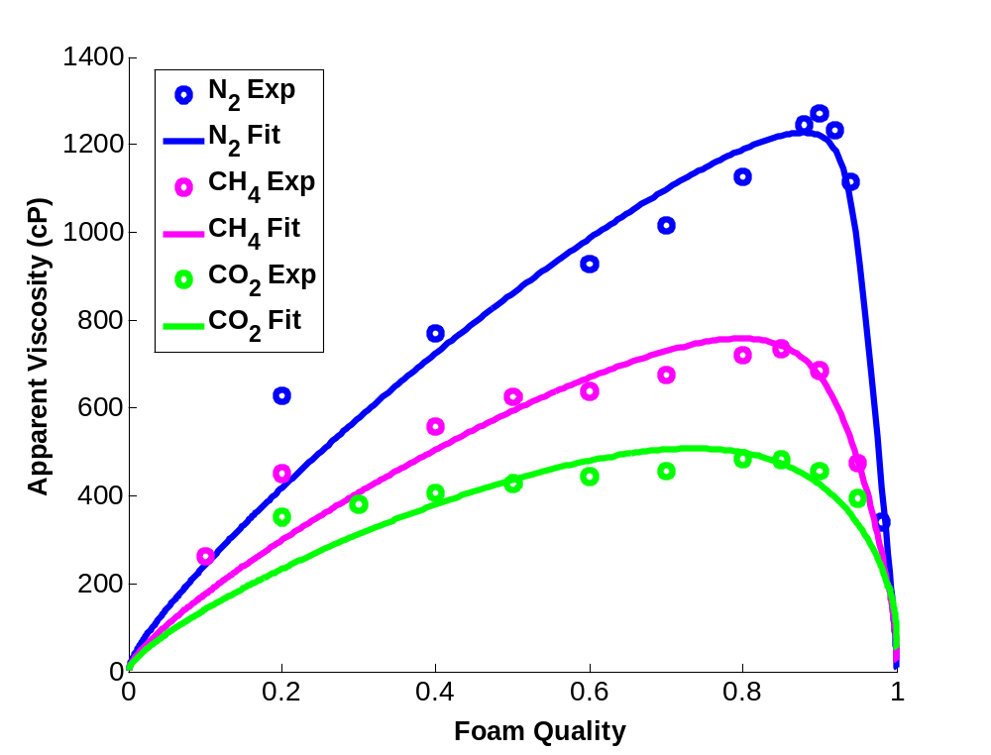
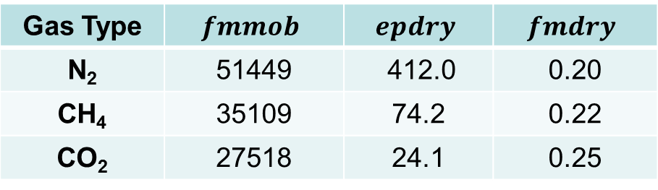
Other Systems
Different Types of Gases (N₂ , CH₄, CO₂)
System III | Description
Surfactant | AOS 1416
Concentration | 1.0 wt%
Salinity | Sea Water
Temperature | Ambient
Back Pressure | 20 Bar
Core Sample | Bentheimer
Absolute Permeability | 2.30 Darcy
Porosity | 0.21
Gas Type | $$fmmob$$ | $$epdry$$ | $$fmdry$$
N₂ | 51449 | 412.0 | 0.20
CH₄ | 35109 | 74.2 | 0.22
CO₂ | 27518 | 24.1 | 0.25

Slide 19
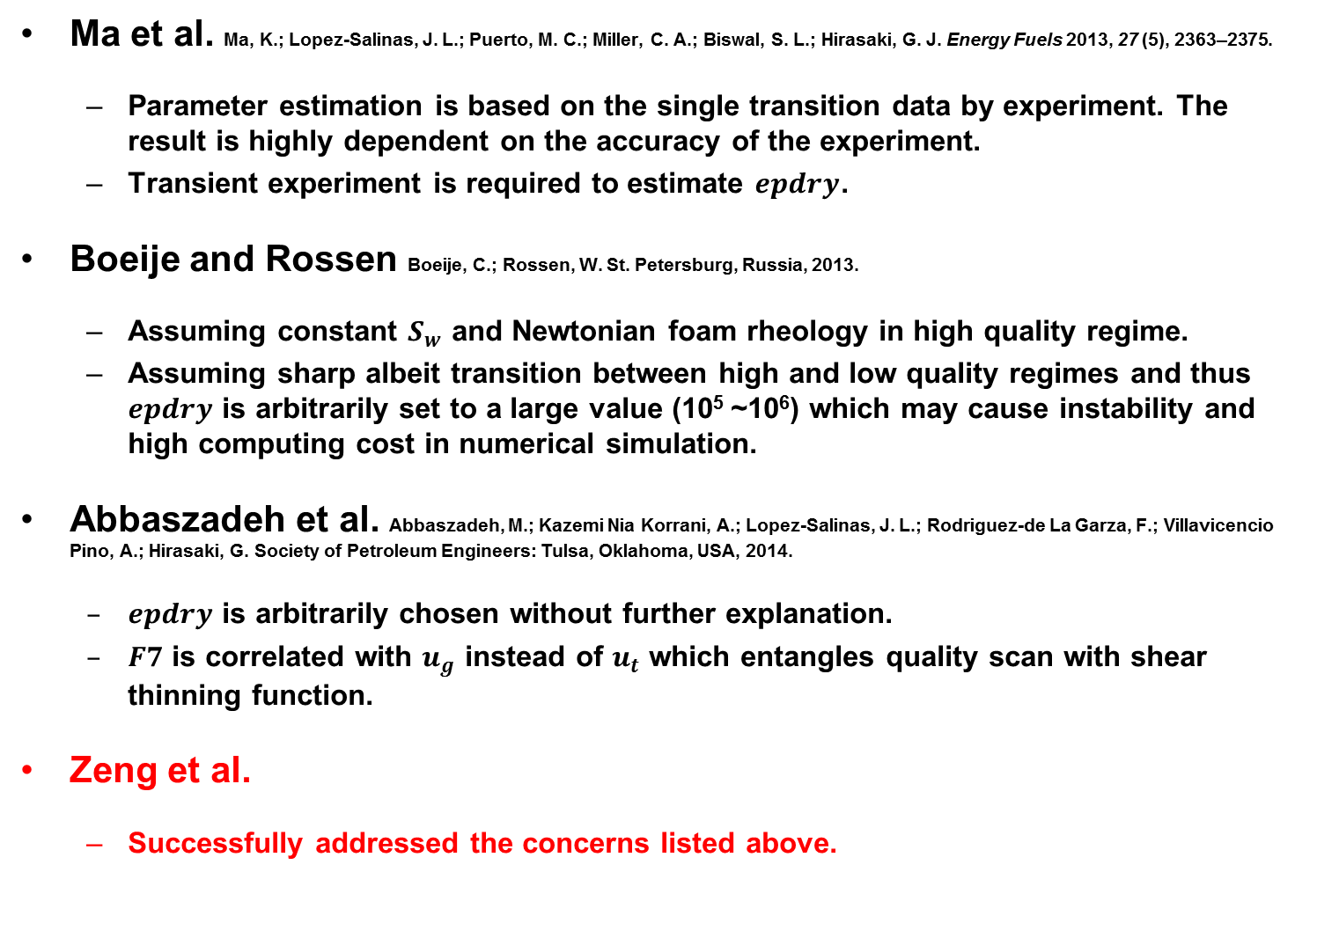
Algorithm Comparison
Ma et al. Ma, K.; Lopez-Salinas, J. L.; Puerto, M. C.; Miller, C. A.; Biswal, S. L.; Hirasaki, G. J. Energy Fuels 2013, 27 (5), 2363–2375.
  Parameter estimation is based on the single transition data by experiment. The result is highly dependent on the accuracy of the experiment.
  Transient experiment is required to estimate $epdry$.
Boeije and Rossen Boeije, C.; Rossen, W. St. Petersburg, Russia, 2013.
  Assuming constant $S_{w}$ and Newtonian foam rheology in high quality regime.
  Assuming sharp albeit transition between high and low quality regimes and thus $epdry$ is arbitrarily set to a large value (10⁵ ~10⁶) which may cause instability and high computing cost in numerical simulation.
Abbaszadeh et al. Abbaszadeh, M.; Kazemi Nia Korrani, A.; Lopez-Salinas, J. L.; Rodriguez-de La Garza, F.; Villavicencio Pino, A.; Hirasaki, G. Society of Petroleum Engineers: Tulsa, Oklahoma, USA, 2014.
  $epdry$ is arbitrarily chosen without further explanation.
  $F7$ is correlated with $u_{g}$ instead of $u_{t}$ which entangles quality scan with shear thinning function.
Zeng et al.
  Successfully addressed the concerns listed above.

Slide 20
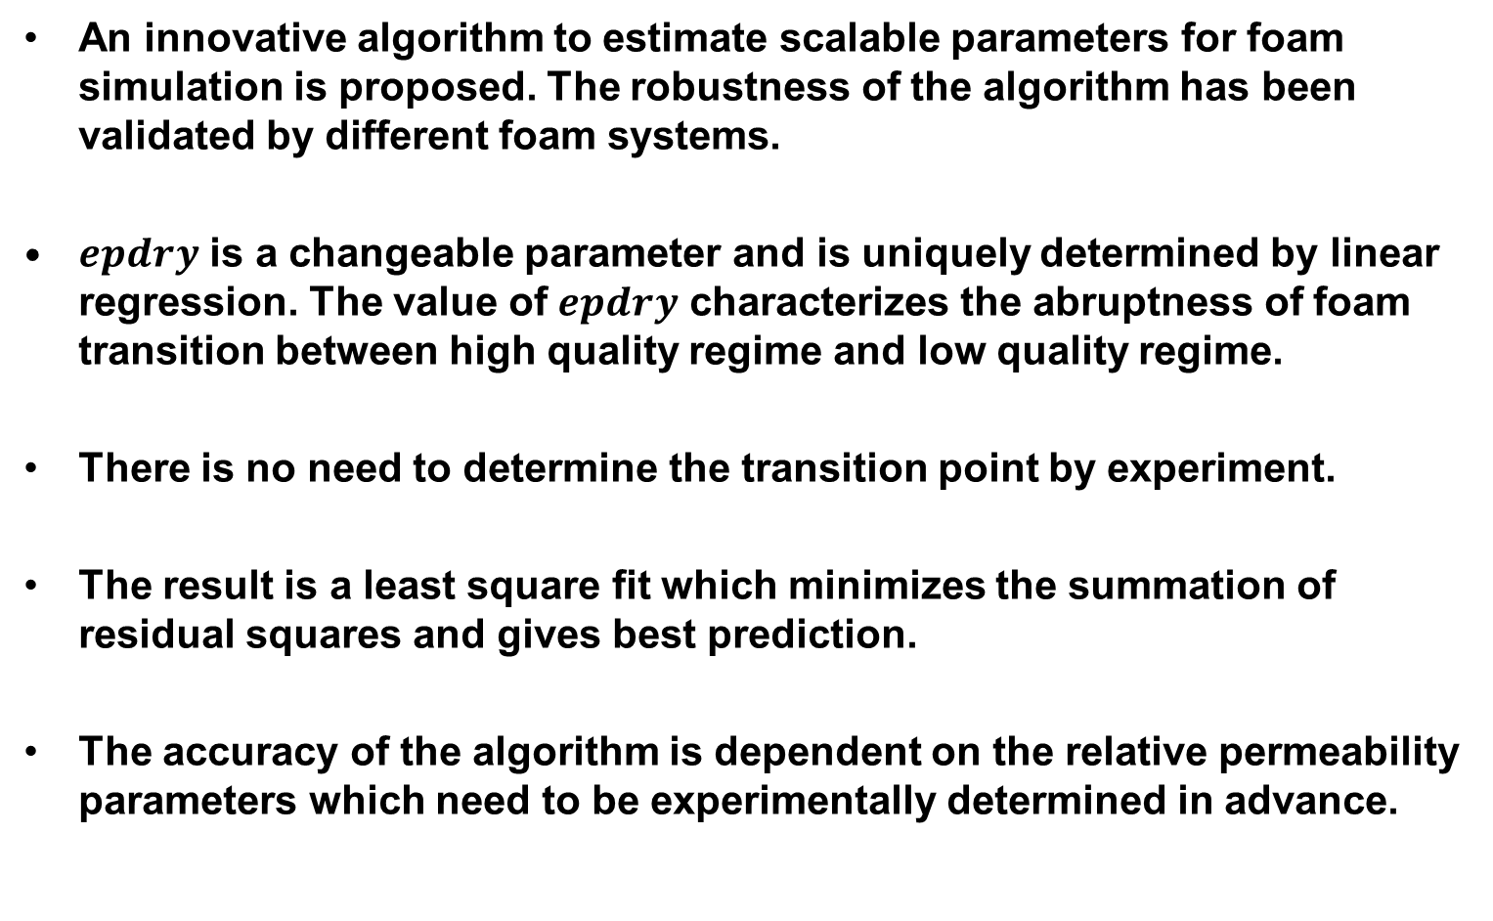
Conclusion
An innovative algorithm to estimate scalable parameters for foam simulation is proposed. The robustness of the algorithm has been validated by different foam systems.
$epdry$ is a changeable parameter and is uniquely determined by linear regression. The value of $epdry$ characterizes the abruptness of foam transition between high quality regime and low quality regime.
There is no need to determine the transition point by experiment.
The result is a least square fit which minimizes the summation of residual squares and gives best prediction.
The accuracy of the algorithm is dependent on the relative permeability parameters which need to be experimentally determined in advance.

Slide 21



Acknowledgement
We acknowledge financial support from
Petroliam Nasional Berhad
(PETRONAS, Kuala Lumpur, Malaysia)
Shell Global Solutions International
(Rijswijk, the Netherlands).
Rice University Consortium for Processes in Porous Media (Houston, TX, USA)

Slide 22

Thank you

