Slide 1
Sodium Ions for Optimal Salinity of ASP
Presentation for the Rice University Consortium for Processes in Porous Media
19th Annual Meeting
Lei Ding
Maura C. Puerto
Clarence A. Miller
George J. Hirasaki
2015-04-22
Notes:
My presentation is…The incentive for…evaluate surfactant system, optimal salinity for sodium chloride and sodium carbonate is different. Then I want to FIND the relationship between different salts, because in the lab, most of the time, we are using sodium salts for the preliminary study or evaluation. Here, no divalent ions, which we may cares more, was not studied here.
the objective is to show that sodium activity is the best way of correlating optimal conditions for anionic surfactants in brines where Na is the only counterion

Slide 2
Contents
Single Sodium Salt/Single Surfactant/Alcohol/ Model Oil System
Sodium Salts Mixture/Surfactant Mixture/ Alcohol/ Model Oil System
Sodium Activity as a function of Soap/Surfactant Ratio (Alkali/Oleic Acid/Surfactant/Alcohol/ Model Oil)

Slide 3
Contents
Single Sodium Salt/Single Surfactant/Alcohol/ Model Oil System
Sodium Salts Mixture/Surfactant Mixture/ Alcohol/ Model Oil System
Sodium Activity as a function of Soap/Surfactant Ratio (Alkali/Oleic Acid/Surfactant/Alcohol/ Model Oil)

Slide 4
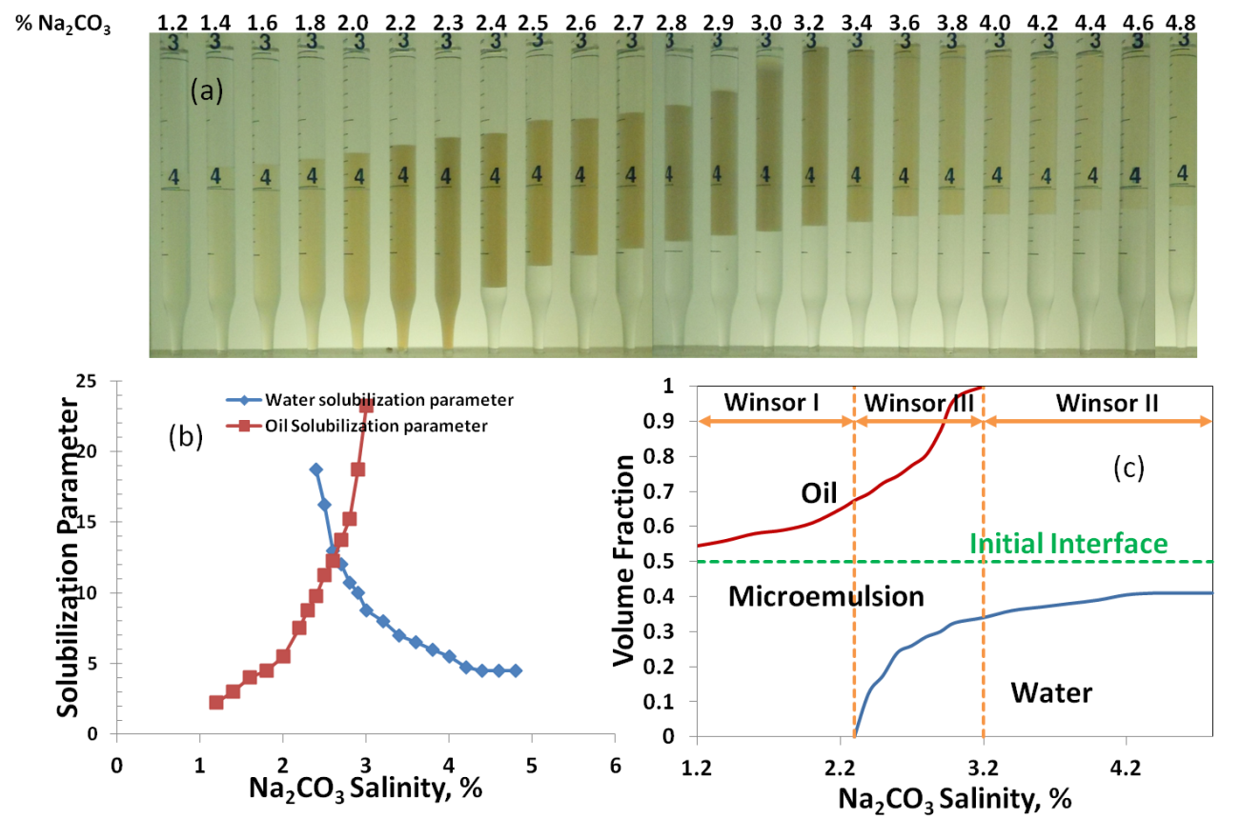
Optimal Salinity of Single Anionic Surfactants
In Aqueous Phase
2% Dodecyl Benzene Sulfonate (OA) /2% 2-Butanol (OA)/Toluene/Na₂CO₃ systems @RT
Notes:
Influence of brine type, surfactant type, oil, cosurfactant, temperature
Dioctyl sulfosuccinate sodium salt

Slide 5
Optimal Salinity of Single Anionic Surfactants
Surfactant/Alcohol (Overall Concentration) | Electrolytes Type | Molarity (M) | Ionic Strength (M) | Weight Percent (%) | Sodium Equivalence (M)
2% Dodecyl Benzene Sulfonate/ 2% 2-Butanol/ Toluene @RT | NaCl | 0.410 | 0.410 | 2.40 | 0.410
 | NaOH | 0.405 | 0.405 | 1.62 | 0.405
 | Na₂CO₃ | 0.245 | 0.870 | 2.60 | 0.490

Slide 6
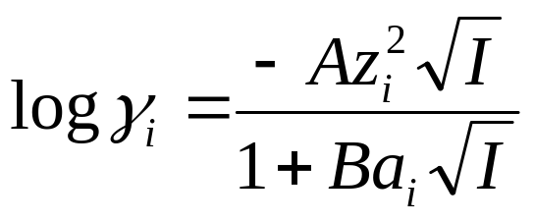
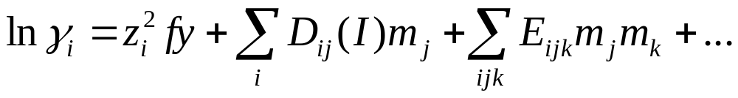
Activity Coefficient Models
Activity Coefficient (Phreeqc® Software):
Extended Debye–Hückel Equation:
Pitzer Equation:
Notes:
z is charge; i, m(j) is the molality of major electrolyte ion j; ∈(i,j,I) describes interaction of ion and electrolyte ion
f^{y} describes interaction between same or opposite sign, terms to do this are called binary virial coefficients
ion-size parameter

Slide 7
Optimal Salinity of Single Anionic Surfactants
Surfactant/Alcohol (Overall Concentration) | Electrolytes Type | Molarity (M) | Ionic Strength (M) | Weight Percent (%) | Sodium Equivalence (M) | Sodium Activity (M) | V_{o}/V_{s} V_{w}/V_{s}
2% Dodecyl Benzene Sulfonate/ 2% 2-Butanol/ Toluene @RT | NaCl | 0.410 | 0.410 | 2.40 | 0.410 | 0.29 | 12.8
 | NaOH | 0.405 | 0.405 | 1.62 | 0.405 | 0.29 | 12.5
 | Na₂CO₃ | 0.245 | 0.870 | 2.60 | 0.490 | 0.29 | 12.7
Notes:
Influence of brine type, surfactant type, oil, cosurfactant, temperature
Dioctyl sulfosuccinate sodium salt

Slide 8
Optimal Salinity of Single Anionic Surfactants
Surfactant/Alcohol (Overall Concentration) | Electrolytes Type | Molarity (M) | Ionic Strength (M) | Weight Percent (%) | Sodium Equivalence (M) | Sodium Activity (M) | V_{o}/V_{s} V_{w}/V_{s}
2% Dodecyl Benzene Sulfonate/ 2% 2-Butanol/ Toluene @RT | NaCl | 0.410 | 0.410 | 2.40 | 0.410 | 0.29 | 12.8
 | NaOH | 0.405 | 0.405 | 1.62 | 0.405 | 0.29 | 12.5
 | Na₂CO₃ | 0.245 | 0.870 | 2.60 | 0.490 | 0.29 | 12.7
2.7% IOS₁₅₋₁₈/2.7% 2-Butanol/Octane @RT | NaCl | 1.37 | 1.37 | 8 | 1.37 | 1 | 4.6
 | NaOH | 1.54 | 1.54 | 6.2 | 1.54 | 1.01 | 4.8
 | Na₂CO₃ | 1.14 | 3.42 | 12.1 | 2.28 | 1.02 | 4.8
Notes:
Influence of brine type, surfactant type, oil, cosurfactant, temperature
Dioctyl sulfosuccinate sodium salt

Slide 9
Contents
Single Sodium Salt/Single Surfactant/Alcohol/ Model Oil System
Sodium Salts Mixture/Surfactant Mixture/ Alcohol/ Model Oil System
Sodium Activity as a function of Soap/Surfactant Ratio (Alkali/Oleic Acid/Surfactant/Alcohol/ Model Oil)
Notes:
Most time, we need to use mixtures of surfactant and mixtures of salts for ASP

Slide 10
Optimal Salinity of Single Anionic Surfactants
Surfactant/Alcohol (Overall Concentration) | Electrolytes Type | Molarity (M) | Ionic Strength (M) | Weight Percent (%) | Sodium Equivalence (M) | Sodium Activity (M) | V_{o}/V_{s} V_{w}/V_{s}
2.7% IOS₁₅₋₁₈/2.7% 2-Butanol/Octane | NaCl | 1.37 | 1.37 | 8 | 1.37 | 1 | 4.6
 | NaOH | 1.54 | 1.54 | 6.2 | 1.54 | 1.01 | 4.8
 | Na₂CO₃ | 1.14 | 3.42 | 12.1 | 2.28 | 1.02 | 4.8
 | NaCl+NaOH | 1.44 | 1.44 | 8.0 | 1.44 | 1.01 | 4.5
 | NaCl+Na₂CO₃ | 1.29 | 2.08 | 9.4 | 1.68 | 1.02 | 4.6
 | Na₂CO₃+NaOH | 1.28 | 2.64 | 9.6 | 1.96 | 1.00 | 4.6
2% SDS/2% 1-Butanol/Heptane | NaCl | No Classical Phase Behavior Obtained
 | NaOH | 2.03 | 2.03 | 8.0 | 2.03 | 1.36 | 10.5
 | Na₂CO₃ | 1.58 | 4.74 | 16.7 | 3.16 | 1.35 | 10.3
 | NaCl+NaOH | 2.03 | 2.03 | 8.9 | 2.03 | 1.38 | 10.5
 | NaCl+Na₂CO₃ | 1.65 | 4.06 | 15.4 | 1.85 | 1.38 | 10.2
Influence of Brine Mixtures on Optimal Salinity
Notes:
Influence of brine type, surfactant type, oil, cosurfactant, temperature
Dioctyl sulfosuccinate sodium salt

Slide 11
Mixtures of Anionic Surfactants, Mixtures of Sodium Salts
Surfactant/Alcohol (Overall Concentration) | Electrolytes Type | Molarity (M) | Ionic Strength (M) | Weight Percent (%) | Sodium Equivalence (M) | Sodium Activity (M)
3% S₁₃D+3% IOS₁₅₋₁₈+ Octane@130F | NaCl | 0.28 | 0.28 | 1.64 | 0.28 | 0.21
 | NaOH | 0.28 | 0.28 | 1.12 | 0.28 | 0.20
 | Na₂CO₃ | 0.18 | 0.54 | 1.91 | 0.36 | 0.22
 | Na₂SO₄ | 0.19 | 0.57 | 2.70 | 0.38 | 0.23
 | NaCl+NaOH | 0.25 | 0.25 | 1.28 | 0.25 | 0.18
 | NaCl+Na₂CO₃ | 0.2 | 0.42 | 1.69 | 0.31 | 0.20
Influence of Brine Mixtures on Optimal Salinity
Notes:
Influence of brine type, surfactant type, oil, cosurfactant, temperature
Dioctyl sulfosuccinate sodium salt

Slide 12
Contents
Single Sodium Salt/Single Surfactant/Alcohol/ Model Oil System
Sodium Salts Mixture/Surfactant Mixture/ Alcohol/ Model Oil System
Sodium Activity as a function of Soap/Surfactant Ratio (Alkali/Oleic Acid/Surfactant/Alcohol/ Model Oil)

Slide 13

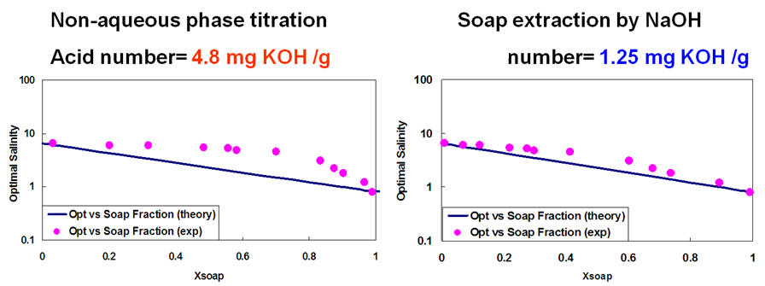

Background
Mixing Rule for mixtures of anionic surfactants
Liu, S. (2010). Alkaline/Surfactant/Polymer Processes: Wide Range of Conditions for Good Recovery. SPEJ, SPE-113936-PA, 282-293.
Notes:
Compositional simulator, ASP
Nonlinear
Oil solubilization ratio-linear mixing rule

Slide 14
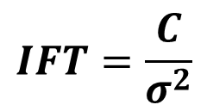
Optimal salinity of Oleic Acid
Comparison Between Different Alkalis
Concentration (%) | TAN (mg/g oil) | 2-Butanol, % | Alkali Type | Alkali Molarity (M) | Ionic Strength (M) | Weight Percent % | Sodium Equivalence (M) | Sodium Activity (M) | Solubilization Parameter
2.25 | 8.94 | 6.8 | NaOH | 1.175 | 1.175 | 4.7 | 1.175 | 0.766 | 5.2
 |  |  | Na₂CO₃ | 0.783 | 2.349 | 8.3 | 1.566 | 0.747 | 6.3
3.00 | 11.9 | 9.0 | NaOH | 1.025 | 1.025 | 4.1 | 1.025 | 0.67 | 5.2
 |  |  | Na₂CO₃ | 0.67 | 2.01 | 7.1 | 1.34 | 0.66 | 6.2
3.75 | 14.9 | 11.2 | NaOH | 0.90 | 0.90 | 3.6 | 0.90 | 0.592 | 5.3
 |  |  | Na₂CO₃ | 0.557 | 1.671 | 6.0 | 1.114 | 0.569 | 6.3
Sodium Activity at optimal depends on alcohol concentration!
Chun Huh Model:
$$IFT=\frac{C}{σ^{2}}$$
Notes:
1H1-21

Slide 15
Optimal Salinity (Na₂CO₃) of Oleic Acid
Oleic Acid Concentration (%) | TAN (mg/g oil) | Optimal Molarity (M/L) | Sodium Activity (M/L)
2.0 | 7.94 | 0.89 | 0.82
2.67 | 10.61 | 0.88 | 0.82
4 | 15.89 | 0.87 | 0.81
5.3 | 21.05 | 0.89 | 0.82
6% 2-Butanol
Notes:
1H1-21

Slide 16
Y% Oleic Acid+ X% SDS+7.5% 2-Butanol/Octane
Notes:
1H1-2, DISREGARDS THE FIRST ONE, OR DECREASE THE AMOUNT OF SODIUM CARBONATE1

Slide 17
Conclusions
1) When a mixture of sodium salts is used, the sodium activity at optimal conditions is invariant;
2) Solubilization parameter at optimal was independent of anions for sulfate and sulfonate surfactants;
3) Solubilization parameter at optimal for oleic acid depends on alkali types; a higher solubilization parameter is obtained when Na₂CO₃ is used than that of NaOH;
4) A good correlation is obtained when the total sodium activity is used in the log mean mixing rule for optimal salinity.
Notes:
counterion concentration increases, compressing the electrical double layer and depressing the electrostatic repulsion between the polar heads of surfactant

Slide 18
Acknowledgement
This work was financially supported by Rice University Consortium for Processes in Porous Media
Thank you!
Questions?

Slide 19
Backup

Slide 20
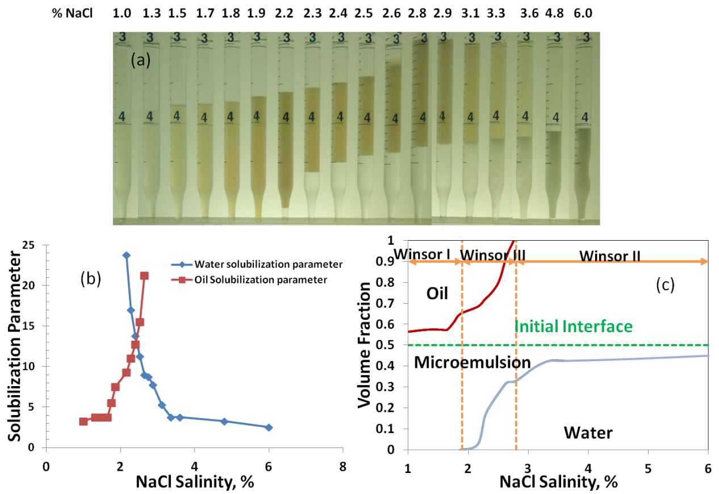
Optimal Salinity of Single Anionic Surfactants
2% Dodecyl Benzene Sulfonate/2% 2-Butanol/Toluene/NaCl systems
Notes:
Influence of brine type, surfactant type, oil, cosurfactant, temperature
Dioctyl sulfosuccinate sodium salt

Slide 21
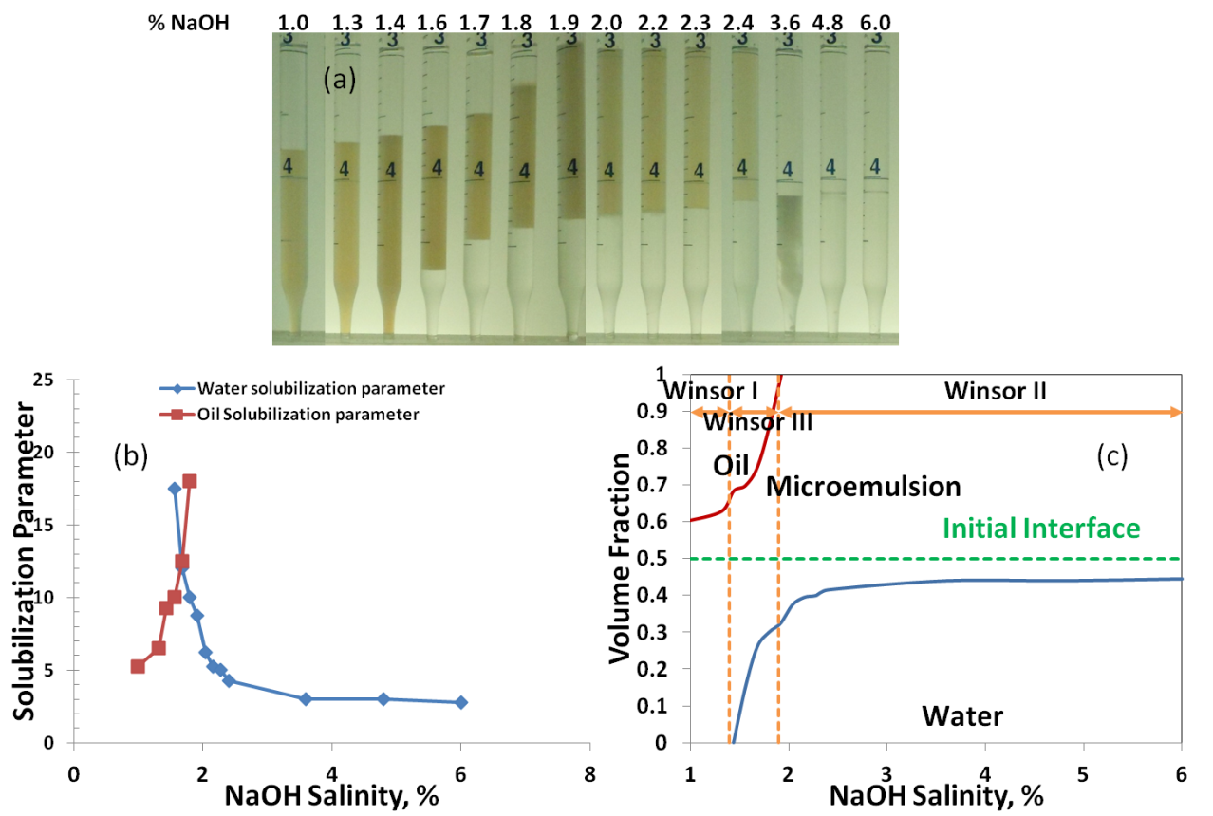
Optimal Salinity of Single Anionic Surfactants
2% Dodecyl Benzene Sulfonate/2% 2-Butanol/Toluene/NaOH systems
Notes:
Influence of brine type, surfactant type, oil, cosurfactant, temperature
Dioctyl sulfosuccinate sodium salt

Slide 22
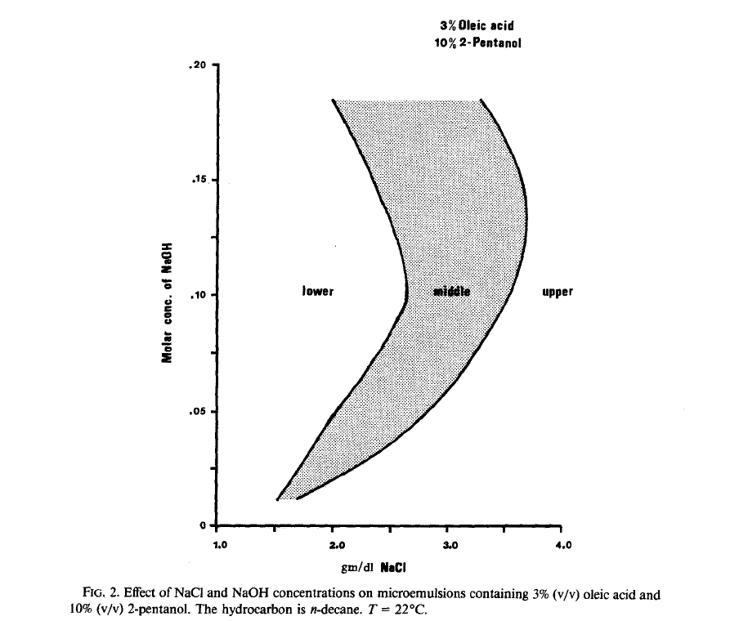
pH Dependent Phase Behavior
Qutubuddin S., Miller C.A., Journal of Colloid and Interface Science, 1984
Notes:
Degree of ionization, hydrophilic, Ph INCREASE

Slide 23
Optimal Salinity of Single Anionic Surfactants
Surfactant/Alcohol (Overall Concentration) | Electrolytes Type | Molarity (M) | Ionic Strength (M) | Weight Percent (%) | Sodium Equivalence (M) | Sodium Activity (M) | V_{o}/V_{s} V_{w}/V_{s}
2.7% IOS₁₅₋₁₈/2.7% 2-Butanol/Octane | NaCl | 1.37 | 1.37 | 8 | 1.37 | 1 | 4.6
 | NaOH | 1.54 | 1.54 | 6.2 | 1.54 | 1.01 | 4.8
 | Na₂CO₃ | 1.14 | 3.42 | 12.1 | 2.28 | 1.02 | 4.8
2.7% IOS₁₅₋₁₈/2.7% 2-pentanol/Octane | NaCl | 0.89 | 0.89 | 5.2 | 0.89 | 0.63 | 7.1
 | NaOH | 0.975 | 0.975 | 4.2 | 0.975 | 0.64 | 7.3
 | Na₂CO₃ | 1.32 | 3.96 | 7.0 | 2.64 | 0.65 | 7.4
2.7% IOS₁₅₋₁₈/2.7% 1-Hexanol/Octane | NaCl | 0.14 | 0.14 | 0.80 | 0.14 | 0.11 | >18.2
 | NaOH | 0.16 | 0.16 | 0.65 | 0.16 | 0.11 | >18.2
 | Na₂CO₃ | 0.19 | 0.57 | 1.00 | 0.38 | 0.12 | >18.2
Influence of Alcohol on Optimal Salinity
Notes:
Influence of brine type, surfactant type, oil, cosurfactant, temperature
Dioctyl sulfosuccinate sodium salt

Slide 24
Optimal Salinity of Single Anionic Surfactants
Surfactant/Alcohol (Overall Concentration) | Electrolytes Type | Molarity (M) | Ionic Strength (M) | Weight Percent (%) | Sodium Equivalence (M) | Sodium Activity (M) | V_{o}/V_{s} V_{w}/V_{s}
2% Dodecyl Benzene Sulfonate/2% 2-Butanol/Toluene@ Room Temperature | NaCl | 0.410 | 0.410 | 2.40 | 0.410 | 0.29 | 12.8
 | NaOH | 0.405 | 0.405 | 1.62 | 0.405 | 0.29 | 12.5
 | Na₂CO₃ | 0.245 | 0.870 | 2.60 | 0.490 | 0.29 | 12.7
2.7% IOS₁₅₋₁₈/2.7% 2-Butanol/Octane @ Room Temperature | NaCl | 1.37 | 1.37 | 8 | 1.37 | 1 | 4.6
 | NaOH | 1.54 | 1.54 | 6.2 | 1.54 | 1.01 | 4.8
 | Na₂CO₃ | 1.14 | 3.42 | 12.1 | 2.28 | 1.02 | 4.8
2.7% IOS₁₅₋₁₈/2.7% 2-pentanol/Octane @ Room Temperature | NaCl | 0.89 | 0.89 | 5.2 | 0.89 | 0.63 | 7.1
 | NaOH | 0.975 | 0.975 | 4.2 | 0.975 | 0.64 | 7.3
 | Na₂CO₃ | 1.32 | 3.96 | 7.0 | 2.64 | 0.65 | 7.4
Influence of Temperature on Optimal Salinity
Notes:
Influence of brine type, surfactant type, oil, cosurfactant, temperature
Dioctyl sulfosuccinate sodium salt

Slide 25
Optimal Salinity of Single Anionic Surfactants
Surfactant/Alcohol (Overall Concentration) | Electrolytes Type | Molarity (M) | Ionic Strength (M) | Weight Percent (%) | Sodium Equivalence (M) | Sodium Activity (M) | V_{o}/V_{s} V_{w}/V_{s}
2% Dodecyl Benzene Sulfonate/2% 2-Butanol/Toluene @54°C | NaCl | 0.421 | 0.421 | 2.46 | 0.421 | 0.297 | 12.5
 | NaOH | 0.436 | 0.436 | 1.74 | 0.436 | 0.296 | 12.5
 | Na₂CO₃ | 0.278 | 0.834 | 2.95 | 0.556 | 0.318 | 12.3
2.7% IOS₁₅₋₁₈/2.7% 2-Butanol/Octane @54°C | NaCl | 1.44 | 1.44 | 8.4 | 1.44 | 1.04 | 5.5
 | NaOH | 1.595 | 1.595 | 6.4 | 1.595 | 1.03 | 5.5
 | Na₂CO₃ | 1.14 | 3.42 | 12.1 | 2.28 | 1.03 | 5.4
2.7% IOS₁₅₋₁₈/2.7% 2-Pentanol/Octane @54°C | NaCl | 0.99 | 0.99 | 5.8 | 0.99 | 0.70 | 7.6
 | NaOH | 1.06 | 1.06 | 4.25 | 1.06 | 0.69 | 7.2
 | Na₂CO₃ | 0.736 | 2.208 | 7.6 | 1.472 | 0.71 | 7.8
Influence of Temperature on Optimal Salinity
Notes:
Influence of brine type, surfactant type, oil, cosurfactant, temperature
Dioctyl sulfosuccinate sodium salt

Slide 26
Optimal Salinity of Single Anionic Surfactants
Surfactant/Alcohol (Overall Concentration) | Electrolytes Type | Molarity (M) | Ionic Strength (M) | Weight Percent (%) | Sodium Equivalence (M) | Sodium Activity (M) | V_{o}/V_{s} V_{w}/V_{s}
2% Dodecyl Benzene Sulfonate/2% 2-Butanol/Toluene | NaCl | 0.410 | 0.410 | 2.40 | 0.410 | 0.29 | 12.8
 | NaOH | 0.405 | 0.405 | 1.62 | 0.405 | 0.29 | 12.5
 | Na₂CO₃ | 0.245 | 0.870 | 2.60 | 0.490 | 0.29 | 12.7
3% Dodecyl Benzene Sulfonate/3% 2-Butanol/Toluene | NaCl | 0.294 | 0.294 | 1.72 | 0.294 | 0.21 | 10.8
 | NaOH | 0.270 | 0.270 | 1.08 | 0.270 | 0.20 | 10.5
 | Na₂CO₃ | 0.215 | 0.345 | 2.28 | 0.430 | 0.22 | 10.5
Influence of Surfactant/Alcohol Concentration on Optimal Salinity
Notes:
Influence of brine type, surfactant type, oil, cosurfactant, temperature
Dioctyl sulfosuccinate sodium salt

Slide 27
Optimal Salinity of Single Anionic Surfactants
Surfactant/Alcohol (Overall Concentration) | Electrolytes Type | Molarity (M) | Ionic Strength (M) | Weight Percent (%) | Sodium Equivalence (M) | Sodium Activity (M) | V_{o}/V_{s} V_{w}/V_{s}
2.7% IOS₁₅₋₁₈/2.7% 2-Butanol/Octane | NaCl | 1.37 | 1.37 | 8 | 1.37 | 1 | 4.6
 | NaOH | 1.54 | 1.54 | 6.2 | 1.54 | 1.01 | 4.8
 | Na₂CO₃ | 1.14 | 3.42 | 12.1 | 2.28 | 1.02 | 4.8
2% SDS/2% 1-Butanol/Heptane | NaCl | No Classical Phase Behavior Obtained
 | NaOH | 2.03 | 2.03 | 8.0 | 2.03 | 1.36 | 10.5
 | Na₂CO₃ | 1.58 | 4.74 | 16.7 | 3.16 | 1.35 | 10.3
2.7% IOS₁₅₋₁₈/2.7% 2-Butanol/Octane | NaCl+NaOH | 1.44 | 1.44 | 8.0 | 1.44 | 1.01 | 4.5
 | NaCl+Na₂CO₃ | 1.29 | 2.08 | 9.4 | 1.68 | 1.02 | 4.6
 | Na₂CO₃+NaOH | 1.28 | 2.64 | 9.6 | 1.96 | 1.00 | 4.6
2% SDS/2% 1-Butanol/Heptane | NaCl+NaOH | 2.03 | 2.03 | 8.9 | 2.03 | 1.38 | 10.5
 | NaCl+Na₂CO₃ | 1.65 | 4.06 | 15.4 | 1.85 | 1.38 | 10.2
Influence of Brine Mixtures on Optimal Salinity
Notes:
Influence of brine type, surfactant type, oil, cosurfactant, temperature
Dioctyl sulfosuccinate sodium salt

Slide 28
Optimal Salinity of Single Anionic Surfactants
Surfactant/Alcohol (Overall Concentration) | Electrolytes Type | Molarity (M) | Ionic Strength (M) | Weight Percent (%) | Sodium Equivalence (M) | Sodium Activity (M) | V_{o}/V_{s} V_{w}/V_{s}
3% Dodecyl Benzene Sulfonate/3% 2-Butanol/Octane | NaCl | 1.03 | 1.03 | 6.0 | 1.03 | 0.73 | 4.5
 | NaOH | 1.10 | 1.10 | 4.4 | 1.10 | 0.72 | 4.7
 | Na₂CO₃ | 0.79 | 2.37 | 8.4 | 1.58 | 0.74 | 4.5
3% Dodecyl Benzene Sulfonate/3% 2-Butanol/Toluene | NaCl | 0.294 | 0.294 | 1.72 | 0.294 | 0.21 | 10.8
 | NaOH | 0.270 | 0.270 | 1.08 | 0.270 | 0.20 | 10.5
 | Na₂CO₃ | 0.215 | 0.345 | 2.28 | 0.430 | 0.22 | 10.5
2.8% AOT/Dodecane | No Classical Phase Behavior Obtained
1.35% IOS₁₅₋₁₈/1.35% 2-Butanol/Octane | No Classical Phase Behavior Obtained
Influence of Oil Type on Optimal Salinity
Notes:
Influence of brine type, surfactant type, oil, cosurfactant, temperature
Dioctyl sulfosuccinate sodium salt

Slide 29
Optimal Salinity of Single Anionic Surfactants
Surfactant/Alcohol (Overall Concentration) | Electrolytes Type | Molarity (M) | Ionic Strength (M) | Weight Percent (%) | Sodium Equivalence (M) | Sodium Activity (M) | V_{o}/V_{s} V_{w}/V_{s}
2% Dodecyl Benzene Sulfonate/2% 2-Butanol/Toluene | NaCl | 0.410 | 0.410 | 2.40 | 0.410 | 0.29 | 12.8
 | NaOH | 0.405 | 0.405 | 1.62 | 0.405 | 0.29 | 12.5
 | Na₂CO₃ | 0.245 | 0.870 | 2.60 | 0.490 | 0.29 | 12.7
2.7% IOS₁₅₋₁₈/2.7% 2-Butanol/Octane | NaCl | 1.37 | 1.37 | 8 | 1.37 | 1 | 4.6
 | NaOH | 1.54 | 1.54 | 6.2 | 1.54 | 1.01 | 4.8
 | Na₂CO₃ | 1.14 | 3.42 | 12.1 | 2.28 | 1.02 | 4.8
Notes:
Influence of brine type, surfactant type, oil, cosurfactant, temperature
Dioctyl sulfosuccinate sodium salt

Slide 30
X% Oleic Acid+ 6% 2-Butanol/Decane
Procedure:
1) Salinity Scan (X% Na₂CO₃)
Stock concentrated brine, DIW, stock surfactant solution, Decane
2) 2.0% oleic acid + 6% 2-Butanol (overall)
2.67% oleic acid + 6% 2-Butanol (overall)
4.0% oleic acid + 6% 2-Butanol (overall)
5.3% oleic acid + 6% 2-Butanol (overall)
3) Sodium Activity at Optimal calculated by Phreeqc software
Notes:
Influence of brine type, surfactant type, oil, cosurfactant, temperature
Dioctyl sulfosuccinate sodium salt

Slide 31
2.25% Oleic Acid+ X% IOS+6.75% 2-Butanol/Octane
Procedure:
1) Prepare 20% IOS in DI Water
2) Salinity Scan (4% Na₂CO₃ + NaCl)
Stock concentrated brine, DIW, stock surfactant solution, Octane
3) 2.25% oleic acid + 6.75% 2-Butanol (overall)
2.25% oleic acid + 6.75% 2-Butanol (overall) +0.5% IOS (overall)
2.25% oleic acid + 6.75 % 2-Butanol (overall) +1.0% IOS (overall)
2.25% oleic acid + 6.75 % 2-Butanol (overall) +2.0% IOS (overall)
2.25% oleic acid + 6.75 % 2-Butanol (overall) +3.0% IOS (overall)
2.25% oleic acid + 6.75 % 2-Butanol (overall) +4.0% IOS (overall)
1.68 % IOS+ 6.75 % 2-Butanol (overall)
5) Sodium Activity at Optimal calculated by Phreeqc software
6) Optimal salinity as a function of IOS₁₅₋₁₈ molar fraction
IOS₁₅₋₁₈ molarity: 333 (IOS_{16.5})
Notes:
Influence of brine type, surfactant type, oil, cosurfactant, temperature
Dioctyl sulfosuccinate sodium salt

Slide 32
X% DBS+ Y% 2-Butanol/Toluene
System | Optimal Activity, Na⁺,M
2%DBS+3%2-Butanol | 0.22
3%DBS+3%2-Butanol | 0.21
2%DBS+2%2-Butanol | 0.29
1.3%DBS+2%2-Butanol | 0.28
Notes:
1H1-21

Slide 33
Y% Oleic Acid+ X% SDS+2-Butanol/Octane
Supplement Data Points:
1) 2.5% oleic acid + 7.5% 2-Butanol (overall) +2.0% SDS (overall)
2.5% oleic acid + 7.5% 2-Butanol (overall) +2.5% SDS (overall)
2) Prepare 33% Oleic Acid+67% 2-Butanol
3.8% oleic acid + 7.5% 2-Butanol (overall) +1.5% SDS (overall)
3.8% oleic acid + 7.5% 2-Butanol (overall) +1.0% SDS (overall)
3) SDS/2-Butanol added separately (solubility)
2.5% SDS+7.5% 2-Butanol (overall)
1.5% SDS+7.5% 2-Butanol (overall)
3) 1.0% Oleic acid in Octane (0.5% overall)
0.725% SDS+7.5% 2-Butanol (overall); 1.16% SDS+7.5% 2-Butanol (overall); 2.4% SDS+7.5% 2-Butanol (overall)
*In order to demonstrate Na activity at opt. conditions depends on Xsoap but not on total surfactant concentration, a point that overlap point from the experiments with fixed oleic acid and variable SDS was conducted. i.e., a couple of examples of points with the same surfactant fraction of soap (Xsoap on your plots) but with different overall surfactant concentrations.
3.8% Oleic Acid+1.5% SDS; 2.5% Oleic Acid+ 1% SDS
Notes:
Influence of brine type, surfactant type, oil, cosurfactant, temperature, solubility of SDS, 25%+75% not, separately, the error is too much, oleic acid in octane,
Dioctyl sulfosuccinate sodium salt

Slide 34
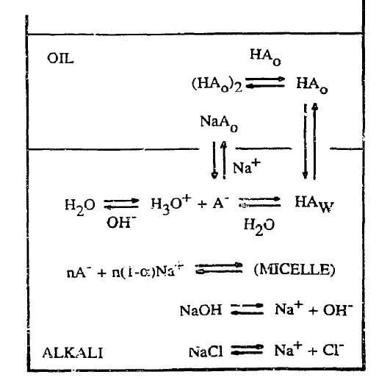
Optimal Salinity of Oleic Acid
Notes:
Oleic acid: insoluble in water
The Relations between Surface pH, Ion Concentrations and Interfacial Tension Author(s): James Frederic Danielli Source: Proceedings of the Royal Society of London. Series B, Biological Sciences, Vol. 122, No. 827 (Apr. 1, 1937), pp. 155-174
A CHEMICAL THEORY FOR LINEAR ALKALINE FLOODING

Slide 35

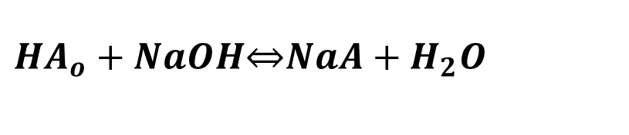
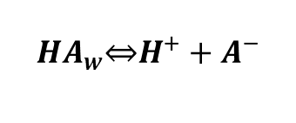

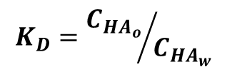

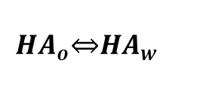
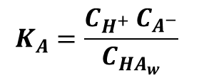

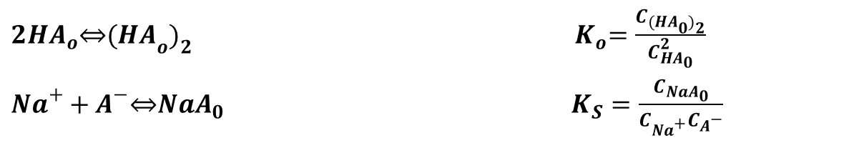
Optimal Salinity of Oleic Acid
${HA}_{o}+NaOH\overset{⇔}{ }NaA+H_{2}O$
$$K_{A}=\frac{C_{H^{+} }C_{A^{−}}}{C_{{HA}_{w}}}$$
$${HA}_{w}\underset{⇔}{ }H^{+}+A^{−}$$
$${HA}_{o}\underset{⇔}{ }{HA}_{w}$$
$$K_{D}={C_{{HA}_{o}}}/{C_{{HA}_{w}}}$$
$$H_{2}O=H^{+}+{OH}^{−}$$
$$K_{w}=C_{H^{+}} C_{{OH}^{−}}$$
$$C_{{Na}^{+}}+C_{H^{+}}=C_{A^{−}}+C_{{OH}^{−}}$$
$$K=K_{D}K_{W}/K_{A}$$
${2HA}_{o}\underset{⇔}{ }{(HA}_{o})_{2}$ ${ K}_{o}=\frac{C_{{(HA}_{0})_{2}}}{C_{{HA}_{0}}^{2}}$
${Na}^{+}+A^{−}\overset{⇔}{ }NaA_{0}$ $K_{S}=\frac{C_{{NaA}_{0}}}{C_{{Na}^{+}}C_{A^{−}}}$
Notes:
Oleic acid: insoluble in water
The Relations between Surface pH, Ion Concentrations and Interfacial Tension Author(s): James Frederic Danielli Source: Proceedings of the Royal Society of London. Series B, Biological Sciences, Vol. 122, No. 827 (Apr. 1, 1937), pp. 155-174
A CHEMICAL THEORY FOR LINEAR ALKALINE FLOODING

Slide 36
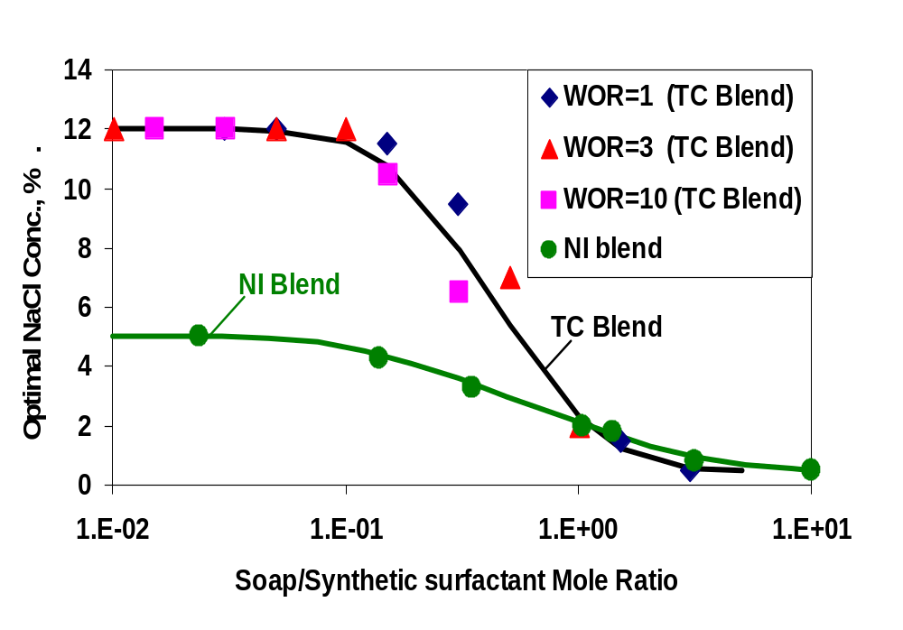
Background
1% Na₂CO₃
Liu, S. (2008). Favorable Attributes of Alkaline-Surfactant-Polymer Flooding. SPEJ, SPE-99744-PA,, 5-16.
Notes:
TC blend is 1:1 (wt) blend of TDA-4PO (iso-tridecyl 4 propoxylate sulfate from Stepan) and CS-330 (dodecyl 3 ethoxylated sulfate from Stepan)
Compositional simulator, ASP
Nonlinear
Oil solubilization ratio-linear mixing rule

Slide 37
2.25% Oleic Acid+ X% IOS₁₅₋₁₈+6.75% 2-Butanol/Octane
Brine: 4% Na₂CO₃ + NaCl
Notes:
1H1-21

Slide 38
2.25% Oleic Acid+ X% IOS₁₅₋₁₈+6.75% 2-Butanol/Octane
Brine: 4% Na₂CO₃ + NaCl
Notes:
1H1-21

Slide 39
Y% Oleic Acid+ X% SDS+7.5% 2-Butanol/Octane
Brine: 2% Na₂CO₃ + NaCl
Notes:
1H1-2, DISREGARDS THE FIRST ONE, OR DECREASE THE AMOUNT OF SODIUM CARBONATE1

Slide 40
Y% Oleic Acid+ X% SDS+2-Butanol/Octane
Brine: 6% Na₂CO₃ + NaCl
3.8% Oleic Acid+1.5% SDS; 2.5% Oleic Acid+ 1% SDS
Notes:
1H1-2, DISREGARDS THE FIRST ONE, OR DECREASE THE AMOUNT OF SODIUM CARBONATE1

