Slide 1
Molecular Dynamics Simulation on Synergism between
Lauryl Betaine and AOS
Le Wang

Slide 2
Content
Introduction
  Foam Booster
  Molecular Dynamics Simulation
Results
  Interfacial tension
  Area per molecule
  Ordering of molecules
Conclusions

Slide 3
Foam Booster
Foam boosters
  Foam are thermodynamically unstable
  Adding surfactant → kinetically stable
  → unstable when oil present
  Surfactants with foam booster → stable with oil
Betaine can act as foam booster

Slide 4
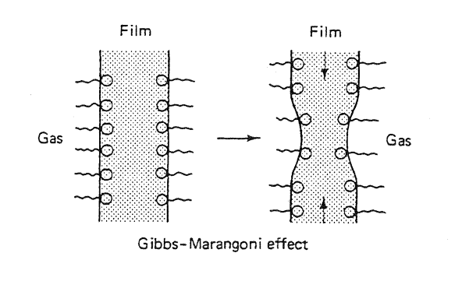
Foam Stability
Surface tension needs to be
large enough
For water/oil interface with AOS/LB mixture,
interfacial tension is small.
Question: What makes the pseudoemulsion film stable?
Possible mechanism:
electrostatic repulsion between surfactant monolayers
interface is rigid with high shear viscosity→film is slow to drain
Notes:
Gibbs-Marangoni effect may not contribute much to stabilize the film. That may be the reason why oil acts as antifoams.

Slide 5
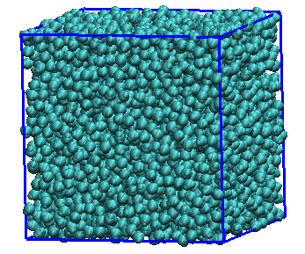
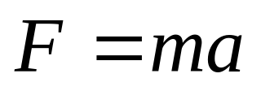
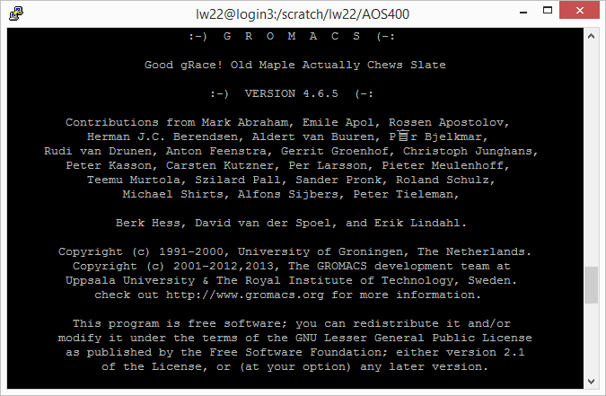
Molecular Dynamics
Simulation Box
Main Equation
GROMACS

Slide 6
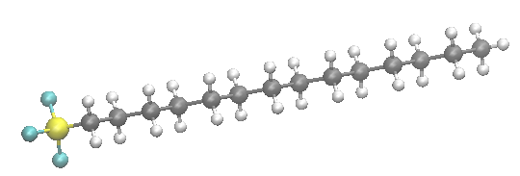
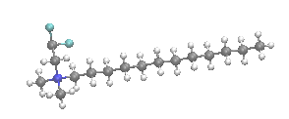

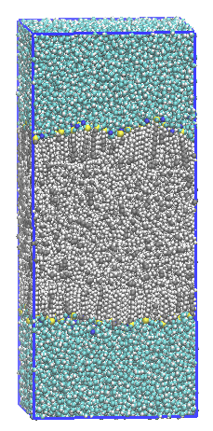
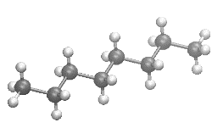
Simulation Details
Molecules in the System
  AOS14
  Lauryl Betaine
  Water
  Octane
Simulation box
Water
Surfactants
z
Oil
Surfactants
Water

Slide 7

Interfacial Tension
Interfacial Tension:
Interfacial tension of octane/water/surfactant system
In good agreement with experiments.

Slide 8
Area Per Molecule
None ideal mixing behavior→
Favorable Interaction Between LB and AOS14

Slide 9
Radial Distribution
Notes:
Nice Layered Structure with high AOS ratio.
Strong peak indicate strong attractive interaction between AOS and LB.

Slide 10

Surfactant Ordering
1 if normal to the interface
-1/2 if parallel to the interface

Slide 11
Head Orientation
Simulation box
Water
Surfactants
z
Oil
Surfactants
LB head orientation
Water

Slide 12
Octane Density
z

Slide 13
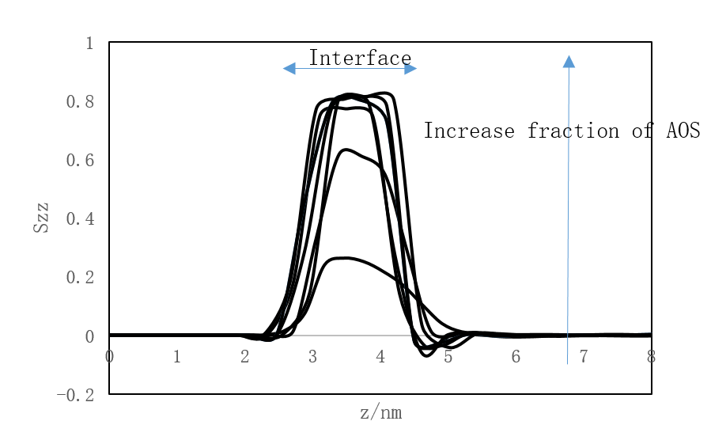
Octane Orientation
z

Slide 14
Conclusions
Small area per molecule can be obtained by surfactant mixture due to the favorable interaction between LB and AOS
Mixed surfactants and AOS prefer to be normal to the interface
The octane molecules in the interfacial region are highly directional and normal to the interface

Slide 15
Conclusions
Highly Structured Interfacial region→
Low area per molecule→
High surface shear viscosity→
Slow rate of drainage→
Foam is stable
Notes:
It is proposed that the molecular interaction which causes the reduction in the average area per molecule in the mixed monolayer also causes the maximum in surface shear viscosity, the minimum in the rate of drainage, and the maximum in foam stability.
A correlation of foam stability with surface shear viscosity and area per molecule in mixed surfactant systems D. O. Shah, N. F. Djabbarah, and D. T. Wasan 1977

Slide 16
Thank you!

